Slide 1
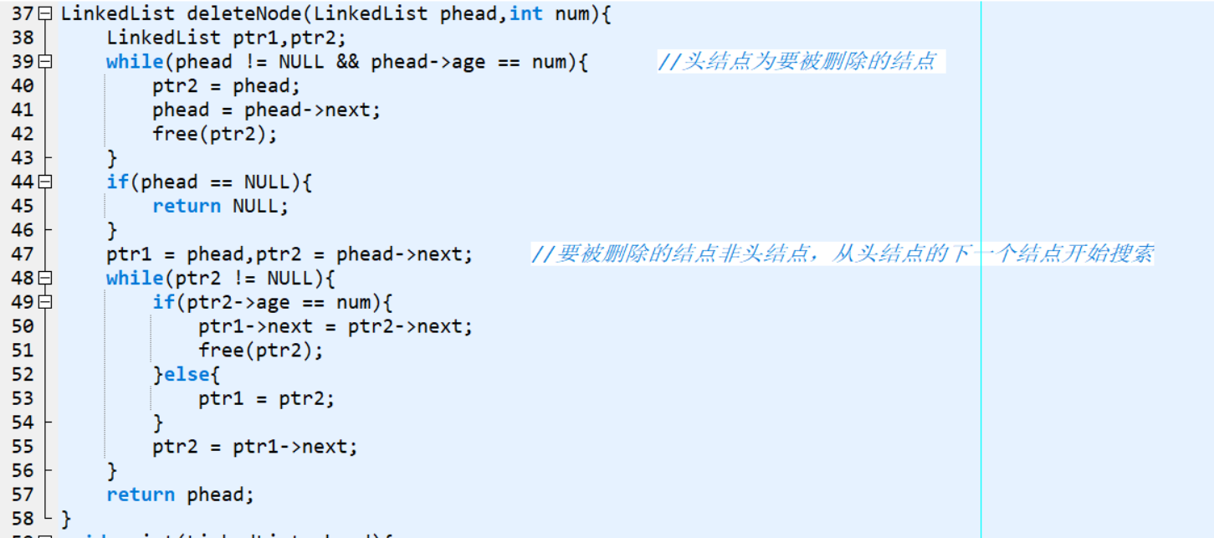
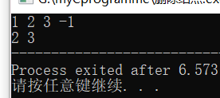
链表的删除（自己的理解）
Notes:
#include<stdio.h>
#include<stdlib.h>
typedef struct _node{
int age;
struct _node *next;
}Node;
typedef Node *LinkedList;
LinkedList createLinkedList();
LinkedList deleteNode(LinkedList phead,int num);
void print(LinkedList phead);
int main(void){
LinkedList head = (LinkedList)malloc(sizeof(Node));
head = createLinkedList();
head = deleteNode(head,1);
print(head);
}
LinkedList createLinkedList(){
LinkedList head = NULL,end;
int number;
end = head;
scanf("%d",&number);
while(number != -1){
LinkedList p = (LinkedList)malloc(sizeof(Node));
p->age = number;
p->next = NULL;
if(!head){
head = p;
}else{
end->next = p;
}
end = p;
scanf("%d",&number);
}
return head;
}
LinkedList deleteNode(LinkedList phead,int num){
LinkedList ptr1,ptr2;
while(phead != NULL && phead->age == num){ //头结点为要被删除的结点
ptr2 = phead;
phead = phead->next;
free(ptr2);
}
if(phead == NULL){
return NULL;
}
ptr1 = phead,ptr2 = phead->next; //要被删除的结点非头结点，从头结点的下一个结点开始搜索
while(ptr2 != NULL){
if(ptr2->age == num){
ptr1->next = ptr2->next;
free(ptr2);
}else{
ptr1 = ptr2;
}
ptr2 = ptr1->next;
}
return phead;
}
void print(LinkedList phead){
LinkedList cursor = (LinkedList)malloc(sizeof(Node));
cursor = phead;
while(cursor){
printf("%d ",cursor->age);
cursor = cursor->next;
}
}

Slide 2
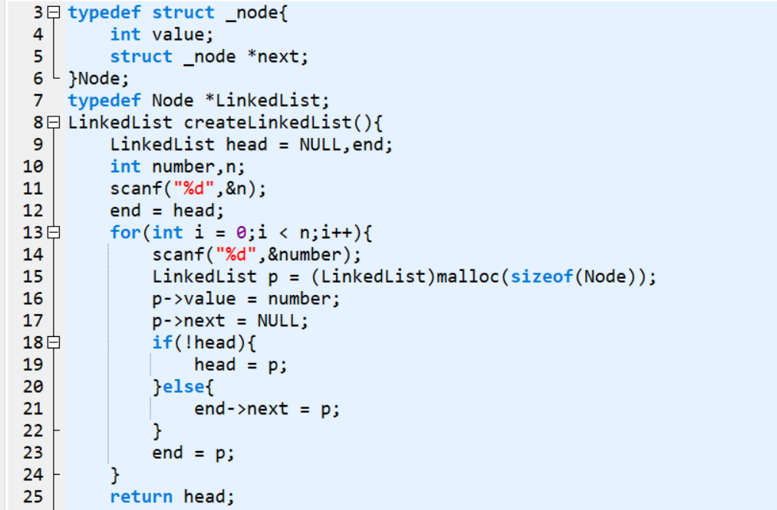
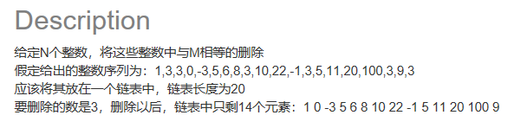
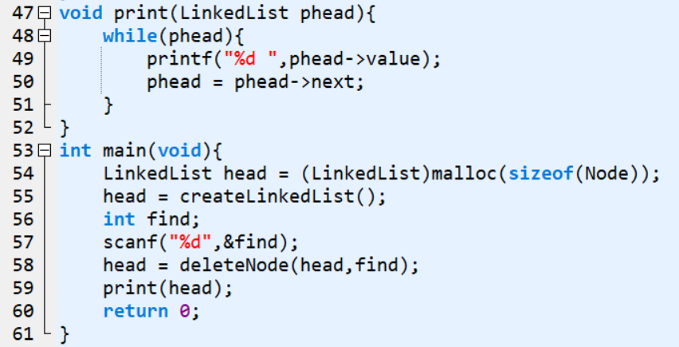
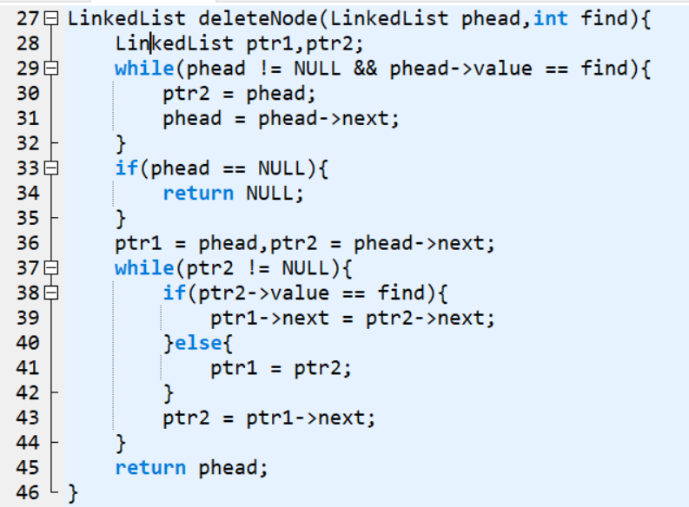
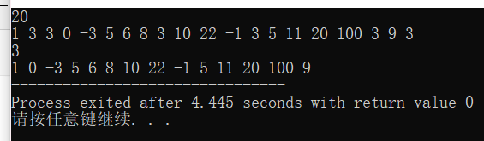
删除数组元素（链表实现）
运行结果：

