Slide 1
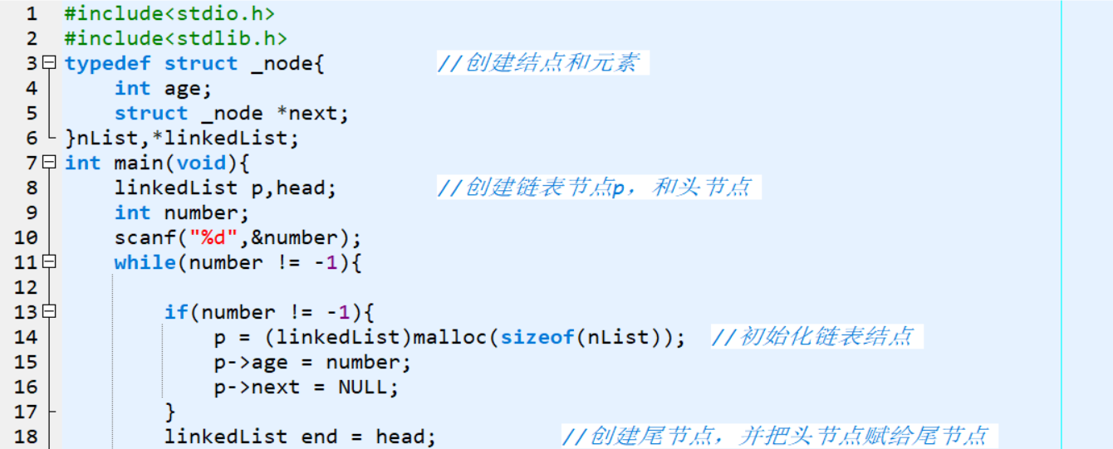
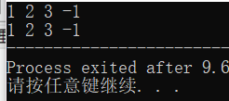
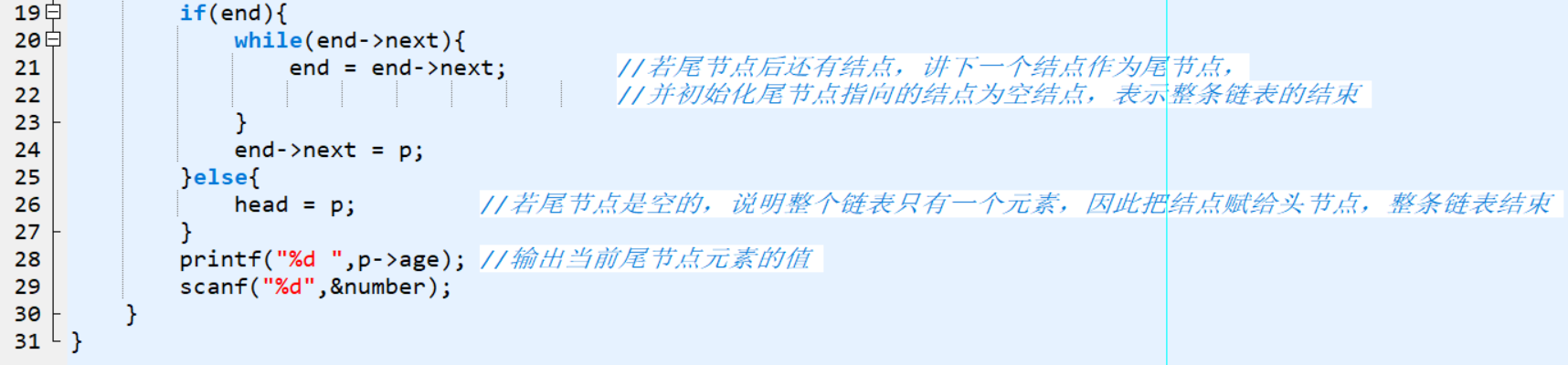
链表的创建(函数）
慕课（浙大）
运行结果：
Notes:
#include<stdio.h>
#include<stdlib.h>
typedef struct _node{
int value;
struct _node *next;
}NList,*LinkedList;
typedef struct _Node{
LinkedList head;
LinkedList end;
}List;
void add(List *list,int number);
void print(List *plist);
int main(void){
List list;
int number;
list.head = NULL;
do{
scanf("%d",&number);
add(&list,number);
}while(number != -1);
print(&list);
}
void add(List *list,int number){
LinkedList p = (LinkedList)malloc(sizeof(NList));
p->value = number;
p->next = NULL;
LinkedList end = list->head;
if(end){
while(end->next){
end = end->next;
}
end->next = p;
}else{
list->head = p;
}
}
void print(List *plist){
LinkedList p;
for(p = plist->head;p;p = p->next){
printf("%d ",p->value);
}
}

Slide 2
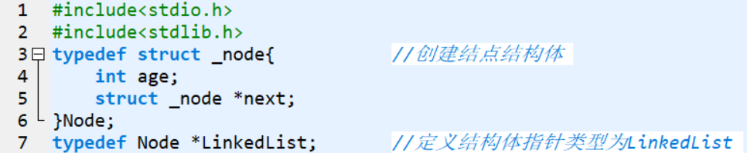
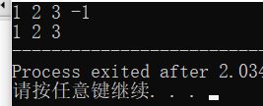
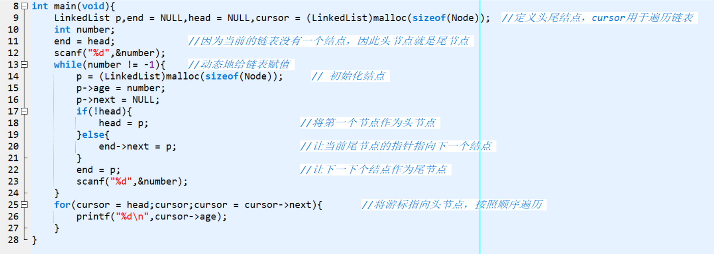
链表的创建（自己的理解）
运行结果：
Notes:
#include<stdio.h>
#include<stdlib.h>
typedef struct _node{ //创建结点结构体
int age;
struct _node *next;
}Node;
typedef Node *LinkedList; //定义结构体指针类型为LinkedList
int main(void){
LinkedList p,end = NULL,head = NULL,cursor = (LinkedList)malloc(sizeof(Node)); //定义头尾结点，cursor用于遍历链表
int number;
end = head; //因为当前的链表没有一个结点，因此头节点就是尾节点
scanf("%d",&number);
while(number != -1){ //动态地给链表赋值
p = (LinkedList)malloc(sizeof(Node)); // 初始化结点
p->age = number;
p->next = NULL;
if(!head){
head = p; //将第一个节点作为头节点
}else{
end->next = p; //让当前尾节点的指针指向下一个结点
}
end = p; //让下一下个结点作为尾节点
scanf("%d",&number);
}
for(cursor = head;cursor;cursor = cursor->next){ //将游标指向头节点，按照顺序遍历
printf("%d\n",cursor->age);
}
}

Slide 3
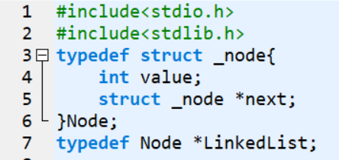
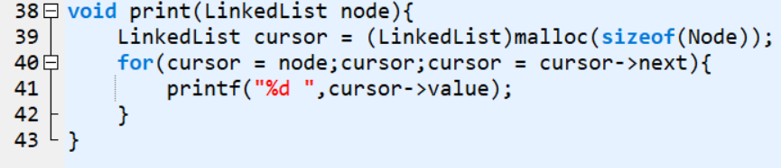
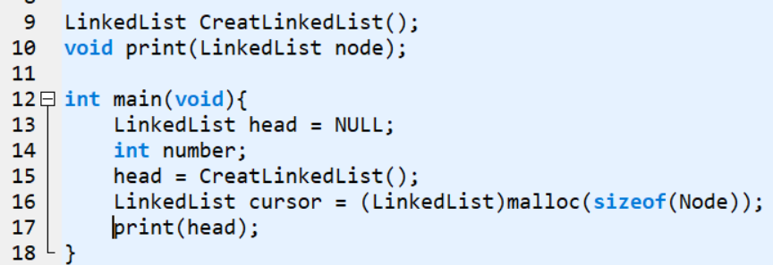
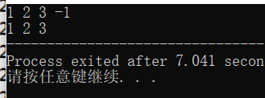
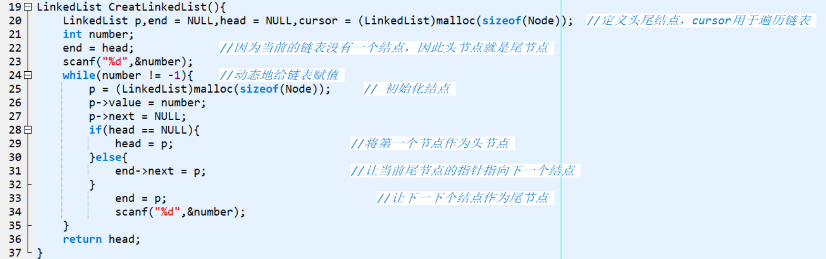
将链表的创建封装成函数（自己的理解）
运行结果：
Notes:
#include<stdio.h>
#include<stdlib.h>
typedef struct _node{
int value;
struct _node *next;
}Node;
typedef Node *LinkedList;
LinkedList CreatLinkedList();
void print(LinkedList node);
int main(void){
LinkedList head = NULL;
int number;
head = CreatLinkedList();
LinkedList cursor = (LinkedList)malloc(sizeof(Node));
print(head);
}
LinkedList CreatLinkedList(){
LinkedList p,end = NULL,head = NULL,cursor = (LinkedList)malloc(sizeof(Node)); //定义头尾结点，cursor用于遍历链表
int number;
end = head; //因为当前的链表没有一个结点，因此头节点就是尾节点
scanf("%d",&number);
while(number != -1){ //动态地给链表赋值
p = (LinkedList)malloc(sizeof(Node)); // 初始化结点
p->value = number;
p->next = NULL;
if(head == NULL){
head = p; //将第一个节点作为头节点
}else{
end->next = p; //让当前尾节点的指针指向下一个结点
}
end = p; //让下一下个结点作为尾节点
scanf("%d",&number);
}
return head;
}
void print(LinkedList node){
LinkedList cursor = (LinkedList)malloc(sizeof(Node));
for(cursor = node;cursor;cursor = cursor->next){
printf("%d ",cursor->value);
}
}

Slide 4
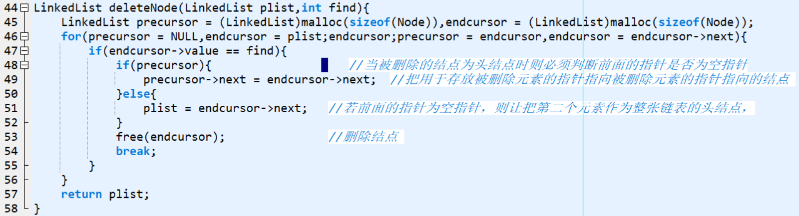
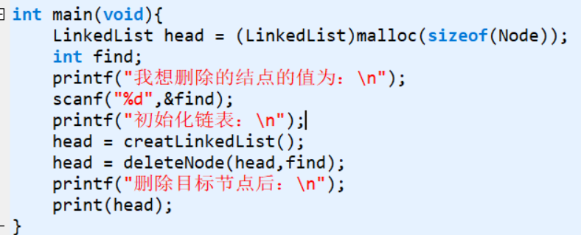
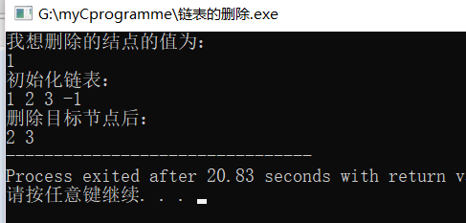
删除链表结点(浙大慕课）
Notes:
#include<stdio.h>
#include<stdlib.h>
typedef struct _node{
int value;
struct _node *next;
}Node;
typedef Node *LinkedList;
LinkedList creatLinkedList();
void print(LinkedList plist);
LinkedList deleteNode(LinkedList plist,int find);
int main(void){
LinkedList head = (LinkedList)malloc(sizeof(Node));
int find;
printf("我想删除的结点的值为：\n");
scanf("%d",&find);
printf("初始化链表：\n");
head = creatLinkedList();
head = deleteNode(head,find);
printf("删除目标节点后：\n");
print(head);
}
LinkedList creatLinkedList(){
LinkedList p,head = NULL,end;
int number;
scanf("%d",&number);
end = head;
while(number != -1){
p = (LinkedList)malloc(sizeof(Node));
p->value = number;
p->next = NULL;
if(!head){
head = p;
}else{
end->next = p;
}
end = p;
scanf("%d",&number);
}
return head;
}
void print(LinkedList plist){
LinkedList cursor = (LinkedList)malloc(sizeof(Node));
for(cursor = plist;cursor;cursor = cursor->next){
printf("%d ",cursor->value);
}
}
LinkedList deleteNode(LinkedList plist,int find){
LinkedList precursor = (LinkedList)malloc(sizeof(Node)),endcursor = (LinkedList)malloc(sizeof(Node));
for(precursor = NULL,endcursor = plist;endcursor;precursor = endcursor,endcursor = endcursor->next){
if(endcursor->value == find){
if(precursor){ //当被删除的结点为头结点时则必须判断前面的指针是否为空指针
precursor->next = endcursor->next; //把用于存放被删除元素的指针指向被删除元素的指针指向的结点
}else{
plist = endcursor->next; //若前面的指针为空指针，则让把第二个元素作为整张链表的头结点，
}
free(endcursor); //删除结点
break;
}
}
return plist;
}

