Slide 1
IBM BOB 2.0 HACKATHON
DevPilot
An AI developer-workflow copilot spanning all 5 example workflows —
onboarding, review, testing, release, and modernization — cross-checked and proven on a real GitHub repo.
Built with IBM Bob 2.0 — Agent Mode · 6 Parallel Subagents · Document Understanding · watsonx.ai (pluggable)

Slide 2
THE PROBLEM
Five workflows every team runs. Still manual, still disconnected.
1
Onboarding
A new engineer reads unfamiliar code with no map of the architecture — days lost before the first real commit.
2
Code review
Reviewers re-derive the same risk checklist by eye on every diff — SQL injection, unhandled nulls, secrets.
3
Testing
Coverage gaps go unnoticed until they cause an incident, not before one ships.
4
Release readiness
Sign-off is a manual checklist, and dependency or deployment steps are easy to skip under deadline pressure.
5
Legacy modernization
Tech debt (oversized functions, missing type hints, brittle pinning) piles up with no systematic way to triage it.
DevPilot — IBM Bob 2.0 Hackathon
2

Slide 3
THE SOLUTION
One orchestrator. Six subagents, in parallel. One report.
DevPilot Orchestrator
Agent mode — plans work, dispatches subagents
Onboarding
Code Review
Testing
Release Readiness
Modernization
Auto-Fix
Architecture map + tasks
Severity-ranked findings
Coverage gap + gen. tests
GO / NO-GO + notes
Tech-debt opportunities
Safe fixes + local commit
Consolidated report — 5 role-scoped views + confirmed-vs-flagged findings
Modernization and Auto-Fix are new this iteration. Each subagent runs in its own thread; DevPilot measures the parallel wall-clock time against a sequential-equivalent run rather than asserting the speedup.
DevPilot — IBM Bob 2.0 Hackathon
3

Slide 4
PROOF #1, NOT A PITCH
Run against a real, deployable project — with real bugs
SEEDED ISSUES — CAUGHT BY
TaskFlow API
SQL built with an f-string
Code review
FastAPI + SQLite task-management service
Dockerfile — builds and deploys as-is
Partial test suite (2 of 10 endpoints)
A pending feature-branch diff to review
2 endpoints skip a null-check
Code review
Only 20% endpoint coverage
Testing
PyYAML pinned to a flagged version
Release readiness
6 of 6 modules undocumented
Onboarding
DevPilot — IBM Bob 2.0 Hackathon
4

Slide 5
PROOF #2 -- GENERALITY, NOT A DEMO TRICK
Cloned live from GitHub. Different framework. Cold run.
miguelgrinberg / microblog
35
routes detected
A real, unmodified, popular Flask tutorial app -- fetched with `--repo-url`, never seen or tuned for by DevPilot beforehand.
Flask, not FastAPI -- proves the scanners aren't framework-hardcoded
24 modules, 35 routes auto-detected across blueprints
Tests are unittest against models, not an HTTP client
0 security findings on a mature, well-reviewed codebase
12.8%
functions referenced in tests (honest fallback metric)
0
false-positive security findings
2
real modernization findings
The testing subagent noticed the test suite doesn't drive routes over HTTP and reported the honest fallback metric instead of a misleading "0% covered."
DevPilot — IBM Bob 2.0 Hackathon
5

Slide 6
WHAT DEVPILOT FOUND -- TASKFLOW API
Real findings, verified two independent ways
20.0%
1 HIGH / 2 MED
NO-GO
2 of 3
endpoint test coverage — 8 pytest stubs auto-generated
code-review findings, severity-ranked
release recommendation, with cited reasons
flagged findings promoted to CONFIRMED by execution
The proof point
The code-review subagent statically flagged two endpoints for returning a database row without checking whether it was None. The testing subagent's auto-generated stub tests were then actually run against the live app — and two of them failed with the exact TypeError the review subagent predicted, before any human opened the file. DevPilot promotes exactly these findings from "flagged" to "CONFIRMED" in the report -- and left the third (the SQL-injection finding, with no matching test) correctly labeled "flagged," not confirmed, since only one method caught it.
DevPilot — IBM Bob 2.0 Hackathon
6

Slide 7
FROM FINDING TO FIX
Auto-fix commits locally. A human confirms before it ever leaves the machine.
Auto-fix subagent -- what it actually did
Ask DevPilot -- grounded in the report, not invented
Parameterized the SQL query (f-string -> bound param)
Added the missing null-check + 404 to both endpoints
Bumped PyYAML to a version without the load advisory
Re-ran the real test suite: 10/10 passed
Committed to a local branch -- never pushed automatically
Q: What should I fix first?
A: Start with tasks.py:get_task -- confirmed by two independent subagents.
Q: Is it safe to release?
A: NO-GO. PyYAML's unsafe-load advisory is unresolved.
Q: Where should a new engineer start?
A: Add a docstring to app/database.py -- top starter task.
Pushing + opening a PR is a separate script: requires --confirm and the user's own GitHub token, every time. Never automatic.
Falls back to this deterministic, templated logic when watsonx.ai isn't configured; calls a real watsonx.ai REST client (built and tested against the fallback path) once credits land.
DevPilot — IBM Bob 2.0 Hackathon
7

Slide 8
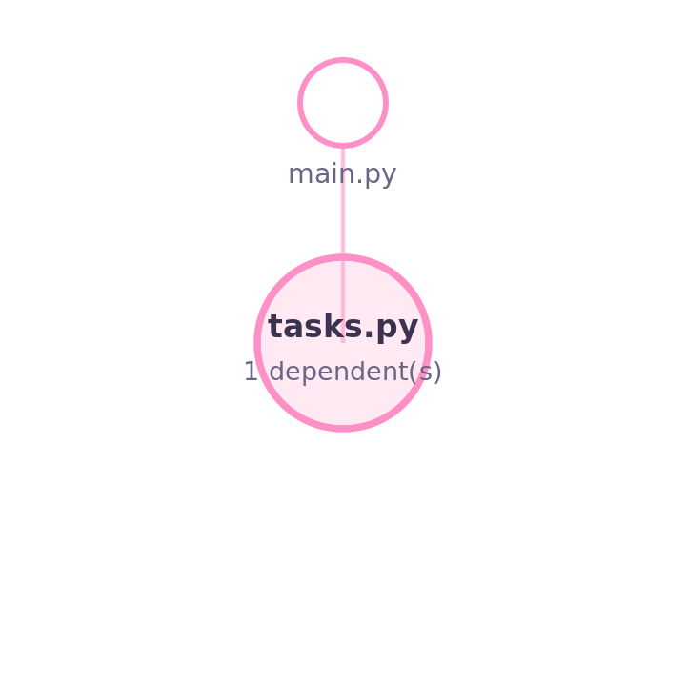
NEW THIS VERSION -- FROM THE MERGED HACKATHON-1.0 CONCEPTS
If it breaks, who else feels it -- and how?
Blast Radius
Pre-Mortem Intelligence
A request arrives with a crafted value instead of ordinary input.
The query executes with that value spliced directly into SQL instead of bound as a parameter.
The database returns rows the caller was never meant to see -- or a second statement executes outright.
By the time anyone notices, the data has already been read, altered, or exfiltrated.
Prevention: fix it now (see Auto-Fix) -- there's no monitoring workaround for a bug that's already in the code path. Narrative can be phrased by watsonx.ai; falls back to this same template text otherwise.
Real reverse-dependency search, not a simulation: tasks.py's SQL-injection finding has 1 confirmed dependent (main.py) in this exact repo.
DevPilot — IBM Bob 2.0 Hackathon
8

Slide 9

NEW THIS VERSION
A number for leadership. A memory for the codebase.
Executive Intelligence
Engineering Historian
54/100
health score (Critical)
NO-GO
release recommendation
Run 1: 36/100 -> Run 2: 54/100 (+18, improving)
4.9h
estimated hours saved
Recurring across every run so far:
3
standout risks (risk portfolio)
sql-injection -- seen in 2 of 2 runs
unchecked-lookup -- seen in 2 of 2 runs
Deliberately does NOT invent MTTR / MTBF / cost-of-downtime -- those need real production incident telemetry a static-analysis tool doesn't have. Everything above traces to this run's own findings.
A small local JSON log per project (no database) -- this is what turns "a finding" into "an architectural weakness we keep re-introducing."
DevPilot — IBM Bob 2.0 Hackathon
9

Slide 10
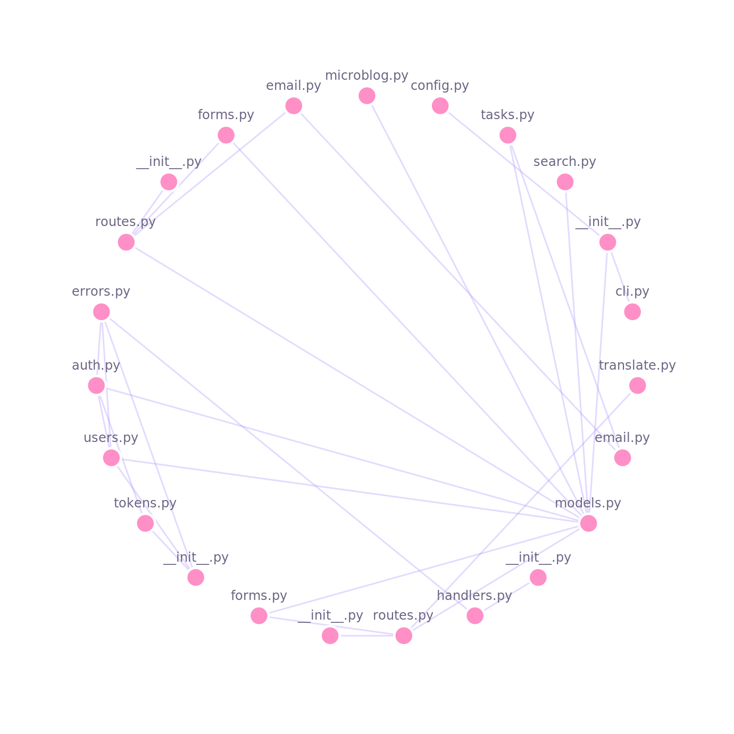
NEW THIS VERSION
The whole map, a demo tab, and a friendlier coat of paint
Dependency Map -- microblog, live clone
Demo Video tab
Drop a demo_video.mp4 next to webui.py and it plays natively in its own tab, with real seek/scrub support -- a friendly placeholder shows instead if there isn't one.
Cinematic touches
Panels fade in on tab switch
The health gauge counts up on load
A pulsing LIVE badge marks the agent log mid-run
A modern, cute look
Baby pink, light green, light purple, and lemon-yellow accents; pill-shaped tabs; rounded cards -- replacing the original dark-navy theme, across both the web UI and the static report.
DevPilot — IBM Bob 2.0 Hackathon
10

Slide 11
WHY THESE FEATURES EXIST
Two hackathon builds, merged honestly
This version deliberately pulls in the strongest concepts from an earlier IBM Bob hackathon project (Nexus -- a predictive-reliability platform), adapted to run on data DevPilot actually has, instead of data it doesn't.
Nexus concept (hackathon 1.0) | DevPilot's adaptation (this build)
Blast-radius simulation | Real reverse-dependency graph search over this repo's own imports
Pre-mortem failure scenarios | Timeline built from this run's own severity + blast-radius data
Executive intelligence (MTTR/MTBF) | Health score + risk portfolio -- honest that MTTR/MTBF need real incident telemetry we don't have
Engineering historian / pattern library | Local per-project run history: score trend + recurring-rule detection
GitHub dependency graph | Full repo-wide import graph, rendered as a chord diagram
Cinematic demo mode | Fade-in panels, count-up gauge, pulsing live badge, dedicated demo-video tab
Incident-DNA vector matching (ChromaDB) | Not ported -- needs real historical incident data; faking it would mean inventing numbers
DevPilot — IBM Bob 2.0 Hackathon
11

Slide 12
BUSINESS VALUE
From reactive and manual to automatic and pre-merge
Workflow step | Manual effort today | With DevPilot
Onboarding | 0.5–1 day reading code unguided | Architecture map + starter tasks in seconds
Code review | Re-derive risk checklist by eye, per PR | Severity-ranked, confirmed-vs-flagged findings
Test coverage | Discovered reactively, often post-incident | Coverage gap + generated tests pre-merge
Release sign-off | Manual checklist, easy to skip a step | Automated GO/NO-GO with cited reasons
Modernization | Ad-hoc, rarely prioritized | Concrete, file-level triage list
6.7h estimated saved on TaskFlow API · 17.1h on microblog -- illustrative, clearly-labeled estimates, not an audited metric. Every finding also lands in a role-scoped view: New Developer, Reviewer, Tester, Release Manager.
DevPilot — IBM Bob 2.0 Hackathon
12

Slide 13
WHY THIS IS AN IBM BOB 2.0 PROJECT
Every core capability, put to work on a real pipeline
Agent mode
The orchestrator plans and dispatches work to six specialist subagents instead of running one monolithic script.
Parallel tasks & subagents
All six execute concurrently and are cross-checked against each other, not just concatenated into one report.
Document understanding
The onboarding agent reads source at the AST level for an accurate module map; the release agent reads the changelog to draft notes.
Full-workflow coverage
All 5 example use cases from the brief, end-to-end, not one autocomplete-style suggestion -- proven on a real GitHub repo, not just a demo.
DevPilot — IBM Bob 2.0 Hackathon
13

Slide 14
WHAT'S NEXT
From hackathon prototype to a CI-grade pipeline
1
2
3
4
Confirm the PR
Go live on watsonx.ai
Live advisories
Trend tracking
push_and_pr.py is built -- user confirms + supplies their own GitHub token, then it opens.
Client is built and tested against its fallback path; flip on once IBM Cloud Lite credits land.
Replace the illustrative dependency table with a real CVE/SBOM feed.
Persist reports so teams see coverage, confirmed-findings, and hours-saved trends over time.
DevPilot — IBM Bob 2.0 Hackathon
14

Slide 15
Five manual workflows.
One parallel, self-verifying, cross-checked pipeline.
Proven on a seeded demo AND a real, unmodified GitHub repo — built end-to-end with IBM Bob 2.0

