Slide 1
Rancho Programming Language
Developed by Team 13
Harsh Kavdikar
Raghavan Sreenivasa
Prakhar Sambhar
Mayank Kataruka

Slide 2
Language features
Datatype | num, boolean, string
Boolean operator | and, or, not
Relational operator | <, >, <=, >=, ==, !=
Arithmetic operator | +, -, /, *, (, )
Assignment operator | =
Conditional operator | if else, ternary
Looping Construct | traditional for and while loop, for in range(x,y)
Printing | print()

Slide 3
Language features
Data structure – Stack, Queue and List
String Concatenation operation
Variable Scope Checking
Type Checking during Parsing
Functions

Slide 4

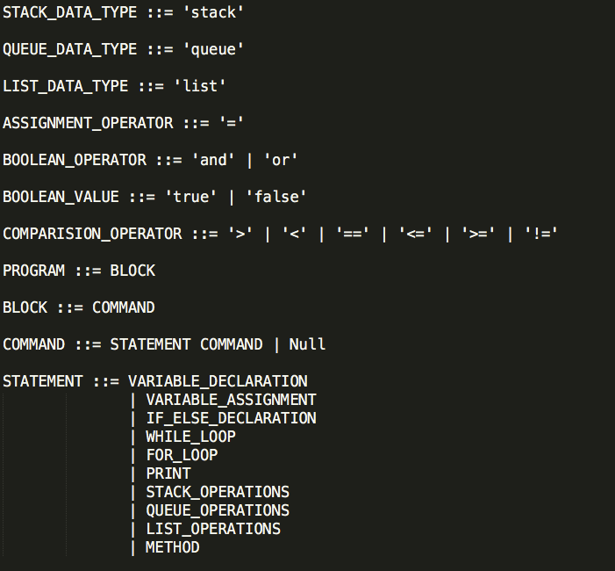
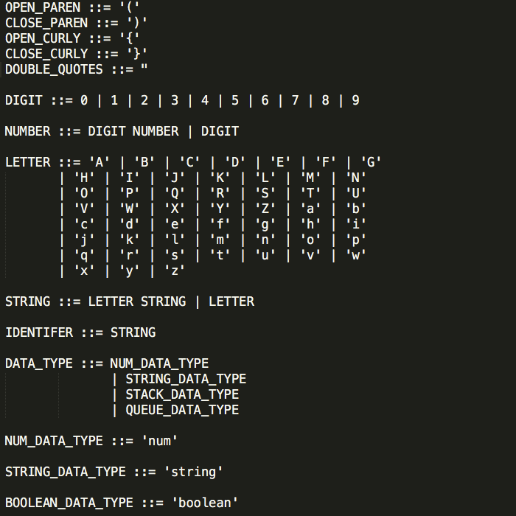
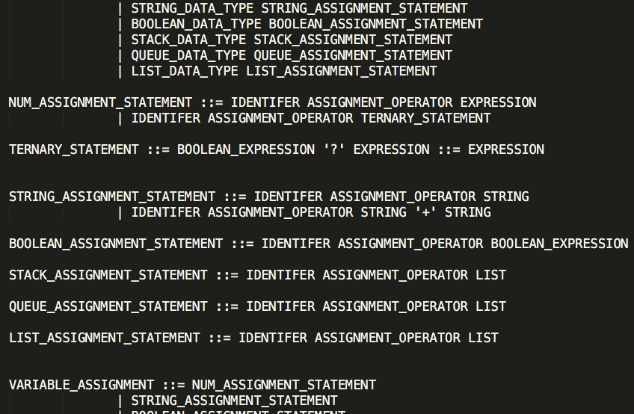
Grammar

Slide 5
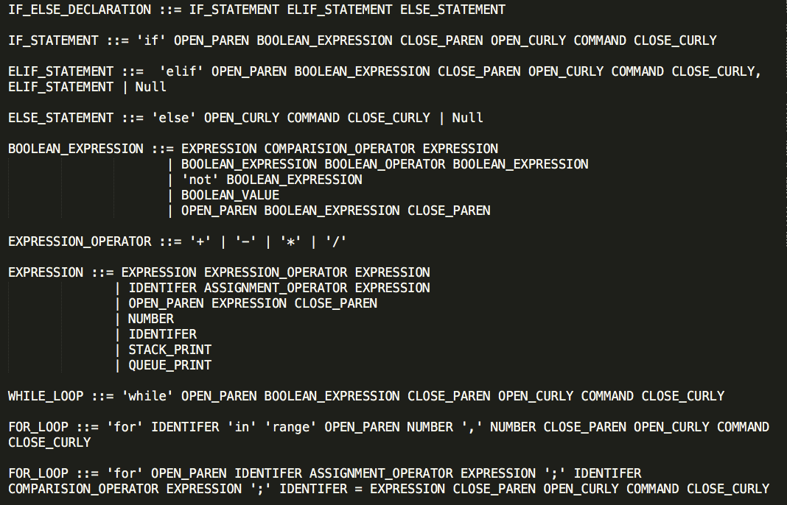
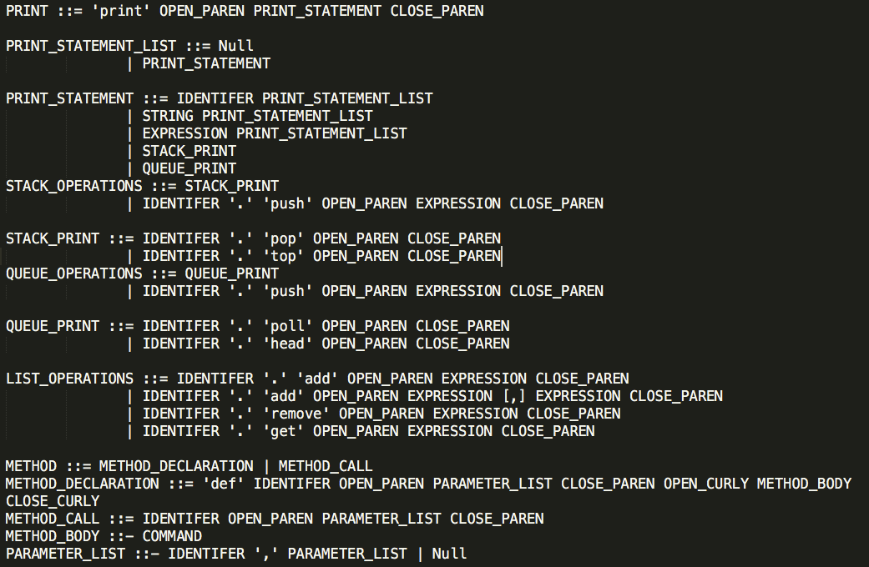
Grammar

Slide 6
Compiler design process
Input file
Lexer
Tokens Generated
Parser
Parse tree / AST Generated
Output
Semantics

Slide 7
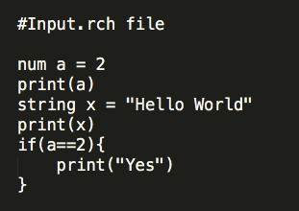
LEXER
Lexer reads the characters from source program and groups them into lexemes (sequence of characters that “go together”). Each lexeme corresponds to a token.
Lexer Input
Lexer Output
[num,a,=,2,print,'(',a,')',string,x,=,"Hello World",print,'(',x,')',if,'(',a,==,2,')','{',print,'(',"Yes",')','}']

Slide 8
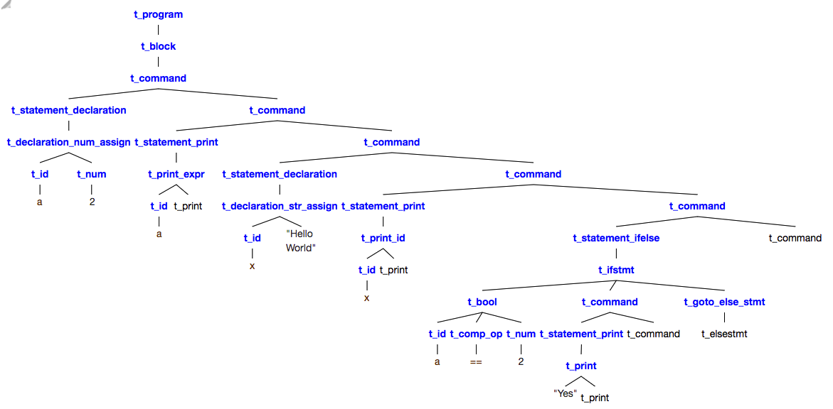
Parser
It takes all the tokens one by one and constructs the parse tree
Symbol Table Data Structure and its Uses in Parser
Parser Output
Symbol Table
Identifier | Type
x | num
y | stack
add | method

Slide 9
Semantics
Giving meaning to the parse tree
Symbol table Data Structure
[(Identifier, Value, Type)]
O/P – Execution of I/P file
Identifier | Value | Type
x | 5 | num
A | [10,20] | stack
add | ((t_formal_parameter(t_id(x), t_formal_parameter(t_id(y), t_formal_parameter())),t_body(t_command(t_statement_print(t_print_expr(t_add(t_id(x), t_id(y)), t_print())), t_command())))) | method

Slide 10
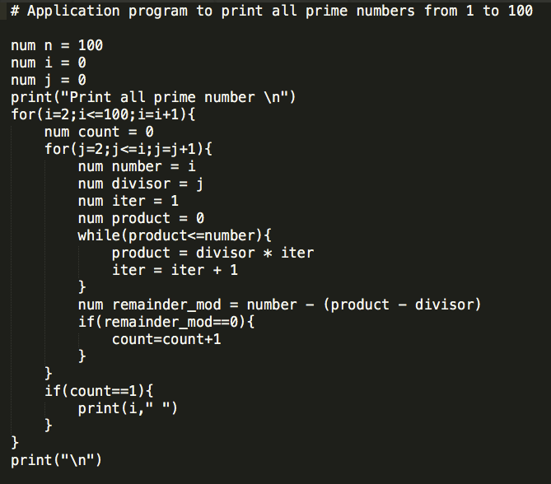
Main.py
Running your main program
python main.py <inputfile.rch>
Snapshot of the demonstration of the language

Slide 11
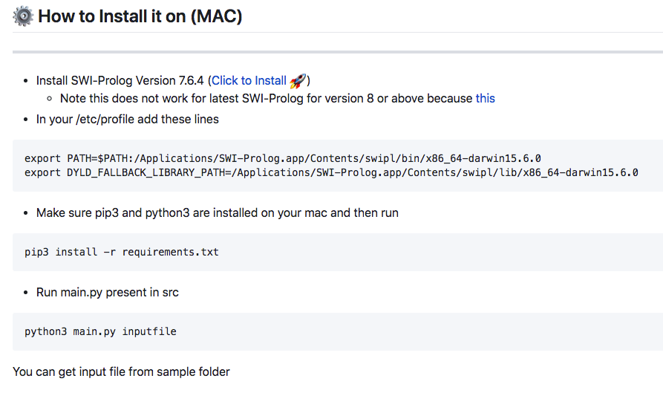
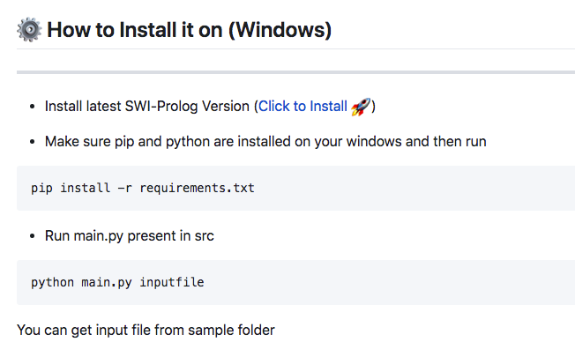
Installation Demonstration

Slide 12
Future Scope
Advanced Data Structure
User Defined Data types
Import Multiple files and functions
Recursion
Multi-threading

Slide 13
Sample Code Demonstration

