Slide 1

CREDIT RISK PREDICTION
M A C H I N E L E A R N I N G L A B - F I N A L E X A M I N A T I O N
G R O U P 0 9
241BCADA01
241BCADA27
241BCADA38
241BCADA41
241BCADA49
241BCADA65

Slide 2
PROBLEM STATEMENT & OBJECTIVE
U N D E R S T A N D I N G T H E T A S K
PROBLEM STATEMENT
MAIN OBJECTIVES
Develop an ML-based Credit Risk Prediction System.
INPUT & OUTPUT
I N P U T
Credit risk assessment is an important task in retail banking.
Applicant credit and personal information
Predict Good or Bad Credit Risk of applicants.
O U T P U T
Credit_Risk → Good / Bad
The project aims to predict whether a credit applicant has Good or Bad credit risk.
Preprocess and analyze credit data effectively.
TARGET VARIABLE
Incorrect classification can lead to financial losses for the bank.
Compare ML models using classification metrics.
Credit_Risk
C R E D I T R I S K P R E D I C T I O N
02

Slide 3
DATASET & DATA UNDERSTANDING
UCI Statlog (German Credit Data)
D A T A S O U R C E
1,000
RECORDS
20
INPUT FEATURES
2
CLASSES
Good / Bad
TARGET · CREDIT_RISK
IMPORTANT FEATURES
DATA TYPES
Numerical Age, Credit Amount, Duration, Installment Rate… Categorical Checking Status, Credit History, Purpose, Housing, Job…
Credit Amount
Duration (Months)
Credit History
Checking Status
DATASET LIMITATIONS
Relatively small dataset (1,000 records)
Historical credit data
Mix of categorical and numerical variables
Extreme values present in some numerical features
Savings Status
Employment Since
Age
Housing
Hofmann, H. (1994), UCI Machine Learning Repository — Statlog (German Credit Data).
03

Slide 4
DATA PREPARATION & EDA
P R E P R O C E S S I N G P I P E L I N E
DATA CLEANING
OUTLIER DETECTION · IQR METHOD
Credit Amount
✓
✓
Dataset schema validated
Invalid values checked
72
70
23
Missing values checked
Duplicate records checked
Duration
Age
Not auto-removed — may represent valid applicants.
PREPROCESSING
FEATURE PREPARATION
One-Hot Encoding → categorical features
20 → 61
input features → processed features
StandardScaler → numerical features
80:20 stratified train-test split
Fitted only on training data (no leakage)
train.csv
800 × 62
test.csv
200 × 62
C R E D I T R I S K P R E D I C T I O N
04

Slide 5
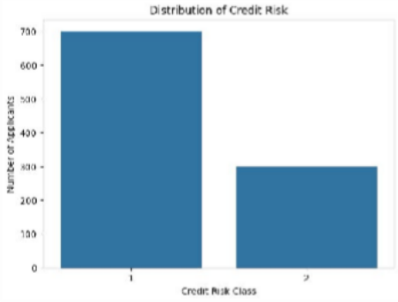
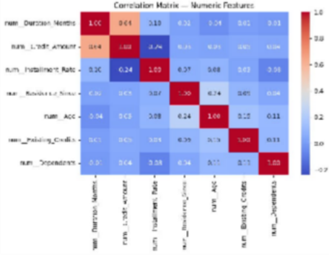
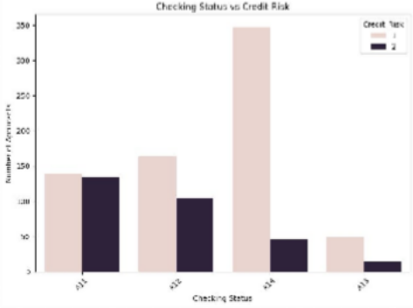
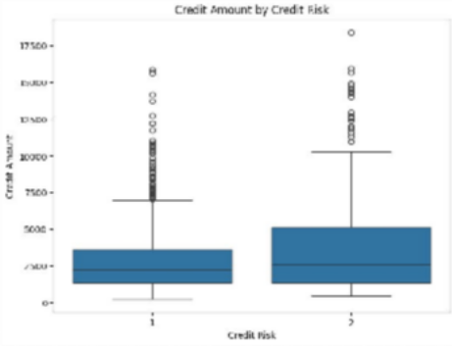
EXPLORATORY DATA ANALYSIS
E X P L O R A T O R Y A N A L Y S I S
CREDIT RISK DISTRIBUTION
CORRELATION HEATMAP
CHECKING STATUS VS CREDIT RISK
CREDIT AMOUNT BY CREDIT RISK
C R E D I T R I S K P R E D I C T I O N
05

Slide 6
MACHINE LEARNING APPROACH
M O D E L L I N G
ALGORITHMS TRIED
Logistic Regression
Decision Tree
Random Forest
Gradient Boosting
WHY THESE MODELS?
Selected to compare different classification approaches for predicting Credit Risk.
TRAIN-TEST SPLIT / VALIDATION
Used the processed training and testing datasets.
Applied 5-Fold Stratified Cross-Validation for model validation.
HYPERPARAMETER TUNING
GridSearchCV was used to tune the Gradient Boosting model.
FINAL SELECTED MODEL
Gradient Boosting Classifier
The model achieved 74.50% accuracy after tuning.
Saved as final_gradient_boosting_model.pkl.
C R E D I T R I S K P R E D I C T I O N
06

Slide 7
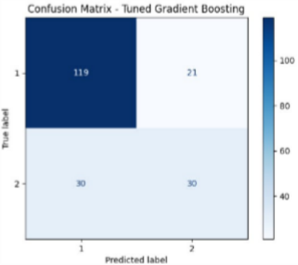
MODEL EVALUATION
R E S U L T S
MODEL COMPARISON PERFORMANCE
 | Model | Accuracy | Precision | Recall | F1-score
 | Logistic Regression | 78.00% | 74.12% | 70.95% | 72.10%
 | Decision Tree | 63.00% | 55.59% | 55.48% | 55.52%
 | Random Forest | 74.00% | 68.84% | 63.81% | 64.86%
 | Gradient Boosting | 79.00% | 75.33% | 72.62% | 73.67%
CONFUSION MATRIX · TUNED GB
WHERE THE MODEL PERFORMS WELL
Good balance between Precision and Recall, reflected by the 68.20% F1-score.
Recall improved from 56.67% to 67.50% after tuning.
WHERE IT PERFORMS POORLY
30 of 60 class-1 cases were misclassified as class 0.
Overall accuracy after tuning is 74.50%.
C R E D I T R I S K P R E D I C T I O N
07

Slide 8




LIVE DEMO
M O D E L E X E C U T I O N P I P E L I N E
8.
1 SAMPLE INPUT
10 applicants × 20 features
2 INPUT VALIDATION
Exact order match: True Missing columns: [] Extra columns: []
3 PREPROCESSING
2026-09-28 13:18:03,980 - INFO - Preprocessing started.
2026-09-28 13:18:04,987 - INFO - Preprocessing completed successfully.
Raw input shape: (10, 20)
Transformed output shape: (10, 61) Transformed data type:
Saved successfully: data/processed/sample_applicants_data.csv
Shape: (10, 20)
4
PREDICTION
5
FINAL RESULTS
2026-09-28 13:18:03,980 - INFO - Prediction completed successfully. 2026-09-28 13:18:03,982 - INFO - Inference latency: 18.628 ms
Predicted classes:
:: | Predicted_Class | Probability_Class_1 | Probability_Class_2 | Prediction_Confidence
1 | 1 | 0.984427 | 0.015573 | 0.984427
2 | 2 | 0.168370 | 0.831630 | 0.831630
3 | 1 | 0.923147 | 0.076853 | 0.923147
4 | 1 | 0.751106 | 0.248894 | 0.751106
5 | 1 | 0.857885 | 0.142115 | 0.857885
6 | 2 | 0.359173 | 0.640827 | 0.640827
7 | 1 | 0.984427 | 0.015573 | 0.984427
8 | 2 | 0.168370 | 0.831630 | 0.831630
9 | 1 | 0.923147 | 0.076853 | 0.923147
10 | 1 | 0.751106 | 0.248894 | 0.751106
[1 2 1 1 1 2 1 1 1 2]
Probability matrix shape: (10, 2)
First applicant probability values: [0.98442688 0.01557312]
LOGGING
Prediction completed successfully.
Inference latency logged for the full pipeline.
INFERENCE LATENCY
18.628 ms
(~0.019 sec for 10 applicants)

Slide 9
THANK YOU

