Slide 1
Designing HPC and Big Data Middleware for Exascale Systems: Opportunities and Challenges
Keynote Talk at ISCS (2015)
by
Dhabaleswar K. (DK) Panda
The Ohio State University
E-mail: panda@cse.ohio-state.edu
http://www.cse.ohio-state.edu/~panda

Slide 2
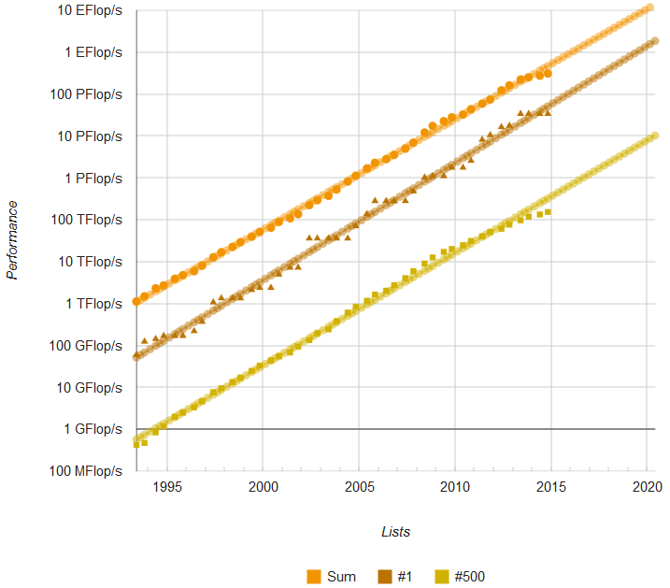
High-End Computing (HEC): ExaFlop & ExaByte
100-200 PFlops in 2016-2018
40K EBytes in 2020 ?
10K-20K EBytes in 2016-2018
1 EFlops in 2020-2024?
ExaFlop & HPC
ExaByte & BigData

Slide 3
Trends for Commodity Computing Clusters in the Top 500 List (http://www.top500.org)
85%

Slide 4
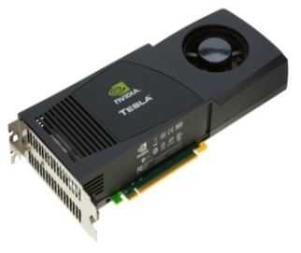
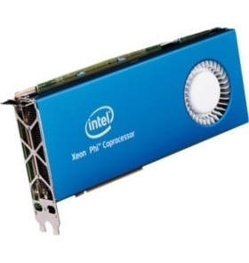
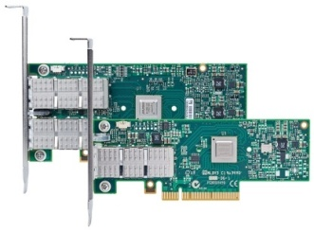
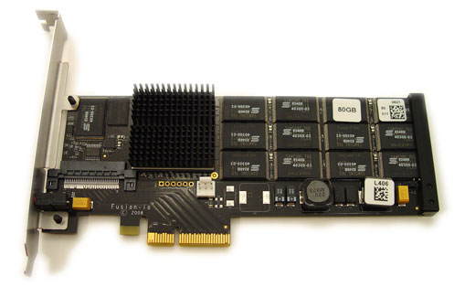
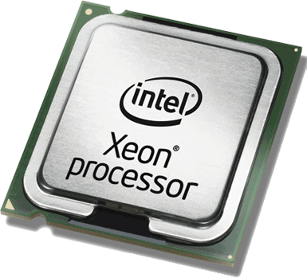
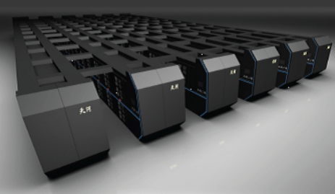

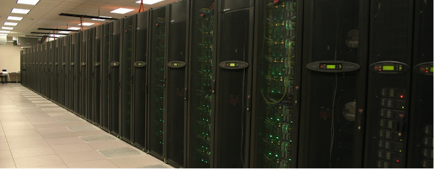
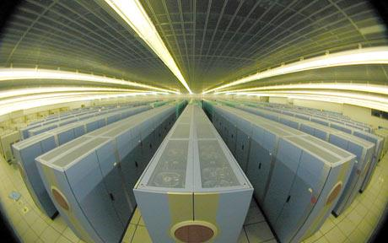
Drivers of Modern HPC Cluster Architectures
High Performance Interconnects - InfiniBand
<1usec latency, 100Gbps Bandwidth>
Accelerators / Coprocessors
high compute density, high performance/watt
>1 TFlop DP on a chip
Multi-core Processors
SSD, NVMe-SSD, NVRAM
Multi-core/many-core technologies
Remote Direct Memory Access (RDMA)-enabled networking (InfiniBand and RoCE)
Solid State Drives (SSDs), Non-Volatile Random-Access Memory (NVRAM), NVMe-SSD
Accelerators (NVIDIA GPGPUs and Intel Xeon Phi)
Tianhe – 2
Titan
Stampede
Tianhe – 1A

Slide 5
Large-scale InfiniBand Installations
235 IB Clusters (47%) in the Nov’ 2015 Top500 list (http://www.top500.org)
Installations in the Top 50 (21 systems):
462,462 cores (Stampede) at TACC (10th) | 76,032 cores (Tsubame 2.5) at Japan/GSIC (25th)
185,344 cores (Pleiades) at NASA/Ames (13th) | 194,616 cores (Cascade) at PNNL (27th)
72,800 cores Cray CS-Storm in US (15th) | 76,032 cores (Makman-2) at Saudi Aramco (32nd)
72,800 cores Cray CS-Storm in US (16th) | 110,400 cores (Pangea) in France (33rd)
265,440 cores SGI ICE at Tulip Trading Australia (17th) | 37,120 cores (Lomonosov-2) at Russia/MSU (35th)
124,200 cores (Topaz) SGI ICE at ERDC DSRC in US (18th) | 57,600 cores (SwiftLucy) in US (37th)
72,000 cores (HPC2) in Italy (19th) | 55,728 cores (Prometheus) at Poland/Cyfronet (38th)
152,692 cores (Thunder) at AFRL/USA (21st ) | 50,544 cores (Occigen) at France/GENCI-CINES (43rd)
147,456 cores (SuperMUC) in Germany (22nd) | 76,896 cores (Salomon) SGI ICE in Czech Republic (47th)
86,016 cores (SuperMUC Phase 2) in Germany (24th) | and many more!

Slide 6
Towards Exascale System (Today and Target)
Systems | 2015 Tianhe-2 | 2020-2024 | Difference Today & Exascale
System peak | 55 PFlop/s | 1 EFlop/s | ~20x
Power | 18 MW (3 Gflops/W) | ~20 MW (50 Gflops/W) | O(1) ~15x
System memory | 1.4 PB (1.024PB CPU + 0.384PB CoP) | 32 – 64 PB | ~50X
Node performance | 3.43TF/s (0.4 CPU + 3 CoP) | 1.2 or 15 TF | O(1)
Node concurrency | 24 core CPU + 171 cores CoP | O(1k) or O(10k) | ~5x - ~50x
Total node interconnect BW | 6.36 GB/s | 200 – 400 GB/s | ~40x -~60x
System size (nodes) | 16,000 | O(100,000) or O(1M) | ~6x - ~60x
Total concurrency | 3.12M 12.48M threads (4 /core) | O(billion) for latency hiding | ~100x
MTTI | Few/day | Many/day | O(?)
Courtesy: Prof. Jack Dongarra

Slide 7
Two Major Categories of Applications
Scientific Computing
Message Passing Interface (MPI), including MPI + OpenMP, is the Dominant Programming Model
Many discussions towards Partitioned Global Address Space (PGAS)
UPC, OpenSHMEM, CAF, etc.
Hybrid Programming: MPI + PGAS (OpenSHMEM, UPC)
Big Data/Enterprise/Commercial Computing
Focuses on large data and data analysis
Hadoop (HDFS, HBase, MapReduce)
Spark is emerging for in-memory computing
Memcached is also used for Web 2.0

Slide 8
Parallel Programming Models Overview
P1
P2
P3
P1
P2
P3
P1
P2
P3
Shared Memory
Memory
Memory
Memory
Logical shared memory
Memory
Memory
Memory
Shared Memory Model
SHMEM, DSM
Distributed Memory Model
MPI (Message Passing Interface)
Partitioned Global Address Space (PGAS)
Global Arrays, UPC, Chapel, X10, CAF, …
Programming models provide abstract machine models
Models can be mapped on different types of systems
e.g. Distributed Shared Memory (DSM), MPI within a node, etc.
PGAS models and Hybrid MPI+PGAS models are gradually receiving importance

Slide 9
Partitioned Global Address Space (PGAS) Models
Key features
Simple shared memory abstractions
Light weight one-sided communication
Easier to express irregular communication
Different approaches to PGAS
Languages
Unified Parallel C (UPC)
Co-Array Fortran (CAF)
X10
Chapel
Libraries
OpenSHMEM
Global Arrays

Slide 10
Hybrid (MPI+PGAS) Programming
Application sub-kernels can be re-written in MPI/PGAS based on communication characteristics
Benefits:
Best of Distributed Computing Model
Best of Shared Memory Computing Model
Exascale Roadmap*:
“Hybrid Programming is a practical way to program exascale systems”
HPC Application
Kernel 1
MPI
Kernel 2
PGAS
Kernel 2
MPI
Kernel 3
MPI
Kernel N
MPI
Kernel N PGAS
* The International Exascale Software Roadmap, Dongarra, J., Beckman, P. et al., Volume 25, Number 1, 2011, International Journal of High Performance Computer Applications, ISSN 1094-3420

Slide 11
Designing Communication Libraries for Multi-Petaflop and Exaflop Systems: Challenges
Application Kernels/Applications
Co-Design Opportunities and Challenges across Various Layers
Performance
Scalability
Fault-Resilience
Middleware
Programming Models
MPI, PGAS (UPC, Global Arrays, OpenSHMEM), CUDA, OpenMP, OpenACC, Cilk, Hadoop (MapReduce), Spark (RDD, DAG), etc.
Communication Library or Runtime for Programming Models
Point-to-point Communication
Collective Communication
Energy-
Awareness
Synchronization and Locks
I/O and
File Systems
Fault
Tolerance
Networking Technologies
(InfiniBand, 40/100GigE,
Aries, and OmniPath)
Multi/Many-core
Architectures
Accelerators
(NVIDIA and MIC)

Slide 12
Broad Challenges in Designing Communication Libraries for (MPI+X) at Exascale
Scalability for million to billion processors
Support for highly-efficient inter-node and intra-node communication (both two-sided and one-sided)
Scalable Collective communication
Offload
Non-blocking
Topology-aware
Balancing intra-node and inter-node communication for next generation multi-core (128-1024 cores/node)
Multiple end-points per node
Support for efficient multi-threading
Integrated Support for GPGPUs and Accelerators
Fault-tolerance/resiliency
QoS support for communication and I/O
Support for Hybrid MPI+PGAS programming (MPI + OpenMP, MPI + UPC, MPI + OpenSHMEM, CAF, …)
Virtualization
Energy-Awareness

Slide 13
Additional Challenges for Designing Exascale Software Libraries
Extreme Low Memory Footprint
Memory per core continues to decrease
D-L-A Framework
Discover
Overall network topology (fat-tree, 3D, …), Network topology for processes for a given job
Node architecture, Health of network and node
Learn
Impact on performance and scalability
Potential for failure
Adapt
Internal protocols and algorithms
Process mapping
Fault-tolerance solutions
Low overhead techniques while delivering performance, scalability and fault-tolerance

Slide 14
Overview of the MVAPICH2 Project
High Performance open-source MPI Library for InfiniBand, 10-40Gig/iWARP, and RDMA over Converged Enhanced Ethernet (RoCE)
MVAPICH (MPI-1), MVAPICH2 (MPI-2.2 and MPI-3.0), Available since 2002
MVAPICH2-X (MPI + PGAS), Available since 2011
Support for GPGPUs (MVAPICH2-GDR) and MIC (MVAPICH2-MIC), Available since 2014
Support for Virtualization (MVAPICH2-Virt), Available since 2015
Support for Energy-Awareness (MVAPICH2-EA), Available since 2015
Used by more than 2,500 organizations in 76 countries
More than 317,000 (> 0.3 million) downloads from the OSU site directly
Empowering many TOP500 clusters (Nov ‘15 ranking)
10th ranked 519,640-core cluster (Stampede) at TACC
13th ranked 185,344-core cluster (Pleiades) at NASA
25th ranked 76,032-core cluster (Tsubame 2.5) at Tokyo Institute of Technology and many others
Available with software stacks of many vendors and Linux Distros (RedHat and SuSE)
http://mvapich.cse.ohio-state.edu
Empowering Top500 systems for over a decade
System-X from Virginia Tech (3rd in Nov 2003, 2,200 processors, 12.25 TFlops) ->
Stampede at TACC (10th in Nov’15, 519,640 cores, 5.168 Plops)

Slide 15
Overview of A Few Challenges being Addressed by the MVAPICH2 Project for Exascale
Scalability for million to billion processors
Support for highly-efficient inter-node and intra-node communication (both two-sided and one-sided RMA)
Extremely minimal memory footprint
Collective communication
Offload and Non-blocking
Integrated Support for GPGPUs
Integrated Support for MICs
Unified Runtime for Hybrid MPI+PGAS programming (MPI + OpenSHMEM, MPI + UPC, CAF, …)
Virtualization
Energy-Awareness

Slide 16
One-way Latency: MPI over IB with MVAPICH2
TrueScale-QDR - 2.8 GHz Deca-core (IvyBridge) Intel PCI Gen3 with IB switch
ConnectX-3-FDR - 2.8 GHz Deca-core (IvyBridge) Intel PCI Gen3 with IB switch
ConnectIB-Dual FDR - 2.8 GHz Deca-core (IvyBridge) Intel PCI Gen3 with IB switch
ConnectX-4-EDR - 2.8 GHz Deca-core (Haswell) Intel PCI Gen3 Back-to-back

Slide 17
Bandwidth: MPI over IB with MVAPICH2
TrueScale-QDR - 2.8 GHz Deca-core (IvyBridge) Intel PCI Gen3 with IB switch
ConnectX-3-FDR - 2.8 GHz Deca-core (IvyBridge) Intel PCI Gen3 with IB switch
ConnectIB-Dual FDR - 2.8 GHz Deca-core (IvyBridge) Intel PCI Gen3 with IB switch
ConnectX-4-EDR - 2.8 GHz Deca-core (Haswell) Intel PCI Gen3 Back-to-back

Slide 18
MVAPICH2 Two-Sided Intra-Node Performance (Shared memory and Kernel-based Zero-copy Support (LiMIC and CMA))
Latest MVAPICH2 2.2b
Intel Ivy-bridge
0.45 us
0.18 us
14,250 MB/s
13,749 MB/s

Slide 19
Minimizing Memory Footprint by DC Transport
Node 0
Constant connection cost (One QP for any peer)
Full Feature Set (RDMA, Atomics etc)
Separate objects for send (DC Initiator) and receive (DC Target)
DC Target identified by “DCT Number”
Messages routed with (DCT Number, LID)
Requires same “DC Key” to enable communication
Available since MVAPICH2-X 2.2a
P0
P1
Node 3
IB
Network
Node 1
P6
P2
P7
P3
Node 2
P4
P5
H. Subramoni, K. Hamidouche, A. Venkatesh, S. Chakraborty and D. K. Panda, Designing MPI Library with Dynamic Connected Transport (DCT) of InfiniBand : Early Experiences. IEEE International Supercomputing Conference (ISC ’14).

Slide 20
Overview of A Few Challenges being Addressed by the MVAPICH2 Project for Exascale
Scalability for million to billion processors
Support for highly-efficient inter-node and intra-node communication (both two-sided and one-sided RMA)
Extremely minimum memory footprint
Collective communication
Offload and Non-blocking
Integrated Support for GPGPUs
Unified Runtime for Hybrid MPI+PGAS programming (MPI + OpenSHMEM, MPI + UPC, CAF, …)
Virtualization
Energy-Awareness

Slide 21
Co-Design with MPI-3 Non-Blocking Collectives and Collective Offload Co-Direct Hardware (Available since MVAPICH2-X 2.2a)
17%
4.5%
Modified P3DFFT with Offload-Alltoall does up to 17% better than default version (128 Processes)
Modified HPL with Offload-Bcast does up to 4.5% better than default version (512 Processes)
K. Kandalla, et. al.. High-Performance and Scalable Non-Blocking All-to-All with Collective Offload on InfiniBand Clusters: A Study with Parallel 3D FFT, ISC 2011
21.8%
K. Kandalla, et. al, Designing Non-blocking Broadcast with Collective Offload on InfiniBand Clusters: A Case Study with HPL, HotI 2011
K. Kandalla, et. al., Designing Non-blocking Allreduce with Collective Offload on InfiniBand Clusters: A Case Study with Conjugate Gradient Solvers, IPDPS ’12
Modified Pre-Conjugate Gradient Solver with Offload-Allreduce does up to 21.8% better than default version
Can Network-Offload based Non-Blocking Neighborhood MPI Collectives Improve Communication Overheads of Irregular Graph Algorithms? K. Kandalla, A. Buluc, H. Subramoni, K. Tomko, J. Vienne, L. Oliker, and D. K. Panda, IWPAPS’ 12

Slide 22
Overview of A Few Challenges being Addressed by the MVAPICH2 Project for Exascale
Scalability for million to billion processors
Support for highly-efficient inter-node and intra-node communication (both two-sided and one-sided RMA)
Extremely minimum memory footprint
Collective communication
Offload and Non-blocking
Integrated Support for GPGPUs
Integrated Support for MICs
Unified Runtime for Hybrid MPI+PGAS programming (MPI + OpenSHMEM, MPI + UPC, CAF, …)
Virtualization
Energy-Awareness

Slide 23


MPI + CUDA - Naive
Data movement in applications with standard MPI and CUDA interfaces
CPU
At Sender:
cudaMemcpy(s_hostbuf, s_devbuf, . . .);
MPI_Send(s_hostbuf, size, . . .);
At Receiver:
MPI_Recv(r_hostbuf, size, . . .);
cudaMemcpy(r_devbuf, r_hostbuf, . . .);
PCIe
GPU
NIC
Switch
High Productivity and Low Performance

Slide 24
MPI + CUDA - Advanced
Pipelining at user level with non-blocking MPI and CUDA interfaces
At Sender:
for (j = 0; j < pipeline_len; j++)
cudaMemcpyAsync(s_hostbuf + j * blk, s_devbuf + j * blksz, …);
for (j = 0; j < pipeline_len; j++) {
while (result != cudaSucess) {
result = cudaStreamQuery(…);
if(j > 0) MPI_Test(…);
}
MPI_Isend(s_hostbuf + j * block_sz, blksz . . .);
}
MPI_Waitall();
<<Similar at receiver>>
CPU
PCIe
GPU
NIC
Switch
Low Productivity and High Performance

Slide 25
GPU-Aware MPI Library: MVAPICH2-GPU
Standard MPI interfaces used for unified data movement
Takes advantage of Unified Virtual Addressing (>= CUDA 4.0)
Overlaps data movement from GPU with RDMA transfers
At Sender:
At Receiver:
MPI_Recv(r_devbuf, size, …);
MPI_Send(s_devbuf, size, …);
inside
MVAPICH2
High Performance and High Productivity

Slide 26
GPU-Direct RDMA (GDR) with CUDA
SNB E5-2670 /
IVB E5-2680V2
OFED with support for GPUDirect RDMA is developed by NVIDIA and Mellanox
OSU has a design of MVAPICH2 using
GPUDirect RDMA
Hybrid design using GPU-Direct RDMA
GPUDirect RDMA and Host-based pipelining
Alleviates P2P bandwidth bottlenecks on SandyBridge and IvyBridge
Support for communication using multi-rail
Support for Mellanox Connect-IB and ConnectX VPI adapters
Support for RoCE with Mellanox ConnectX VPI adapters
CPU
System
Memory
GPU
IB Adapter
Chipset
GPU
Memory
SNB E5-2670
P2P write: 5.2 GB/s
P2P read: < 1.0 GB/s
IVB E5-2680V2
P2P write: 6.4 GB/s
P2P read: 3.5 GB/s

Slide 27
Performance of MVAPICH2-GPU with GPU-Direct RDMA (GDR)
10X
3.7X
11x
2.18 usec
2X
MVAPICH2-GDR-2.2a
Intel Ivy Bridge (E5-2680 v2) node - 20 cores
NVIDIA Tesla K40c GPU
Mellanox Connect-IB Dual-FDR HCA
CUDA 7
Mellanox OFED 2.4 with GPU-Direct-RDMA
2x
11x
LENS (Oct '15)
27

Slide 28
Application-Level Evaluation (HOOMD-blue)
Platform: Wilkes (Intel Ivy Bridge + NVIDIA Tesla K20c + Mellanox Connect-IB)
HoomdBlue Version 1.0.5
GDRCOPY enabled: MV2_USE_CUDA=1 MV2_IBA_HCA=mlx5_0 MV2_IBA_EAGER_THRESHOLD=32768 MV2_VBUF_TOTAL_SIZE=32768 MV2_USE_GPUDIRECT_LOOPBACK_LIMIT=32768 MV2_USE_GPUDIRECT_GDRCOPY=1 MV2_USE_GPUDIRECT_GDRCOPY_LIMIT=16384
LENS (Oct '15)
28

Slide 29
CUDA-Aware Non-Blocking Collectives
Platform: Wilkes: Intel Ivy Bridge
NVIDIA Tesla K20c + Mellanox Connect-IB
MVAPICH2-GDR 2.2a
A. Venkatesh, K. Hamidouche, H. Subramoni, and D. K. Panda, “Offloaded GPU Collectives using CORE-Direct and CUDA Capabilities on IB Clusters”, HIPC, 2015

Slide 30
Overview of A Few Challenges being Addressed by the MVAPICH2 Project for Exascale
Scalability for million to billion processors
Support for highly-efficient inter-node and intra-node communication (both two-sided and one-sided RMA)
Extremely minimum memory footprint
Collective communication
Offload and Non-blocking
Integrated Support for GPGPUs
Integrated Support for MICs
Unified Runtime for Hybrid MPI+PGAS programming (MPI + OpenSHMEM, MPI + UPC, CAF, …)
Virtualization
Energy-Awareness

Slide 31

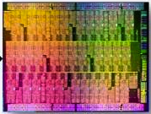
MPI Applications on MIC Clusters
Flexibility in launching MPI jobs on clusters with Xeon Phi
Xeon
Xeon Phi
Multi-core Centric
Host-only
MPI Program
Offload
(/reverse Offload)
MPI Program
Offloaded Computation
Symmetric
MPI Program
MPI Program
Coprocessor-only
MPI Program
Many-core Centric

Slide 32
MVAPICH2-MIC 2.0 Design for Clusters with IB and MIC
Offload Mode
Intranode Communication
Coprocessor-only and Symmetric Mode
Internode Communication
Coprocessors-only and Symmetric Mode
Multi-MIC Node Configurations
Running on three major systems
Stampede, Blueridge (Virginia Tech) and Beacon (UTK)

Slide 33

MIC-Remote-MIC P2P Communication with Proxy-based Communication
Intra-socket P2P
Latency (Large Messages)
Bandwidth
5236
Better
Better
Inter-socket P2P
Latency (Large Messages)
Bandwidth
Better
5594
Better

Slide 34
Optimized MPI Collectives for MIC Clusters (Allgather & Alltoall)
58%
76%
55%
A. Venkatesh, S. Potluri, R. Rajachandrasekar, M. Luo, K. Hamidouche and D. K. Panda - High Performance Alltoall and Allgather designs for InﬁniBand MIC Clusters; IPDPS’14, May 2014

Slide 35
Overview of A Few Challenges being Addressed by the MVAPICH2 Project for Exascale
Scalability for million to billion processors
Support for highly-efficient inter-node and intra-node communication (both two-sided and one-sided RMA)
Extremely minimum memory footprint
Collective communication
Offload and Non-blocking
Integrated Support for GPGPUs
Integrated Support for MICs
Unified Runtime for Hybrid MPI+PGAS programming (MPI + OpenSHMEM, MPI + UPC, CAF, …)
Virtualization
Energy-Awareness

Slide 36
MVAPICH2-X for Advanced MPI and Hybrid MPI + PGAS Applications
MPI, OpenSHMEM, UPC, CAF or Hybrid (MPI + PGAS) Applications
OpenSHMEM Calls
CAF Calls
UPC Calls
MPI Calls
Unified MVAPICH2-X Runtime
InfiniBand, RoCE, iWARP
Unified communication runtime for MPI, UPC, OpenSHMEM, CAF available with MVAPICH2-X 1.9 (2012) onwards!
http://mvapich.cse.ohio-state.edu
Feature Highlights
Supports MPI(+OpenMP), OpenSHMEM, UPC, CAF, MPI(+OpenMP) + OpenSHMEM, MPI(+OpenMP) + UPC + CAF
MPI-3 compliant, OpenSHMEM v1.0 standard compliant, UPC v1.2 standard compliant (with initial support for UPC 1.3), CAF 2008 standard (OpenUH)
Scalable Inter-node and intra-node communication – point-to-point and collectives

Slide 37
Application Level Performance with Graph500 and Sort
Graph500 Execution Time
Sort Execution Time
13X
51%
7.6X
Performance of Hybrid (MPI+ OpenSHMEM) Graph500 Design
8,192 processes
- 2.4X improvement over MPI-CSR
- 7.6X improvement over MPI-Simple
16,384 processes
- 1.5X improvement over MPI-CSR
- 13X improvement over MPI-Simple
Performance of Hybrid (MPI+OpenSHMEM) Sort Application
4,096 processes, 4 TB Input Size
- MPI – 2408 sec; 0.16 TB/min
- Hybrid – 1172 sec; 0.36 TB/min
- 51% improvement over MPI-design
J. Jose, S. Potluri, H. Subramoni, X. Lu, K. Hamidouche, K. W. Schulz, H. Sundar, D. K. Panda, Designing Scalable Out-of-core Sorting with Hybrid MPI+PGAS Programming Models, PGAS ‘14, Oct. 2014.
J. Jose, S. Potluri, K. Tomko and D. K. Panda, Designing Scalable Graph500 Benchmark with Hybrid MPI+OpenSHMEM Programming Models, International Supercomputing Conference (ISC’13), June 2013.

Slide 38
Overview of A Few Challenges being Addressed by the MVAPICH2 Project for Exascale
Scalability for million to billion processors
Support for highly-efficient inter-node and intra-node communication (both two-sided and one-sided RMA)
Extremely minimum memory footprint
Collective communication
Offload and Non-blocking
Integrated Support for GPGPUs
Integrated Support for MICs
Unified Runtime for Hybrid MPI+PGAS programming (MPI + OpenSHMEM, MPI + UPC, CAF, …)
Virtualization
Energy-Awareness

Slide 39
Can HPC and Virtualization be Combined?
Virtualization has many benefits
Fault-tolerance
Job migration
Compaction
Have not been very popular in HPC due to overhead associated with Virtualization
New SR-IOV (Single Root – IO Virtualization) support available with Mellanox InfiniBand adapters changes the field
Enhanced MVAPICH2 support for SR-IOV
MVAPICH2-Virt 2.1 (with and without OpenStack) is publicly available
J. Zhang, X. Lu, J. Jose, R. Shi and D. K. Panda, Can Inter-VM Shmem Benefit MPI Applications on SR-IOV based Virtualized InfiniBand Clusters? EuroPar'14
J. Zhang, X. Lu, J. Jose, M. Li, R. Shi and D.K. Panda, High Performance MPI Libray over SR-IOV enabled InfiniBand Clusters, HiPC’14
J. Zhang, X .Lu, M. Arnold and D. K. Panda, MVAPICH2 Over OpenStack with SR-IOV: an Efficient Approach to build HPC Clouds, CCGrid’15

Slide 40
Application-Level Performance (8 VM * 8 Core/VM)
NAS
Graph500
Compared to Native, 1-9% overhead for NAS
Compared to Native, 4-9% overhead for Graph500

Slide 41


NSF Chameleon Cloud: A Powerful and Flexible Experimental Instrument
Large-scale instrument
Targeting Big Data, Big Compute, Big Instrument research
~650 nodes (~14,500 cores), 5 PB disk over two sites, 2 sites connected with 100G network
Reconfigurable instrument
Bare metal reconfiguration, operated as single instrument, graduated approach for ease-of-use
Connected instrument
Workload and Trace Archive
Partnerships with production clouds: CERN, OSDC, Rackspace, Google, and others
Partnerships with users
Complementary instrument
Complementing GENI, Grid’5000, and other testbeds
Sustainable instrument
Industry connections
http://www.chameleoncloud.org/

Slide 42
Overview of A Few Challenges being Addressed by the MVAPICH2 Project for Exascale
Scalability for million to billion processors
Support for highly-efficient inter-node and intra-node communication (both two-sided and one-sided RMA)
Extremely minimum memory footprint
Collective communication
Offload and Non-blocking
Integrated Support for GPGPUs
Integrated Support for MICs
Unified Runtime for Hybrid MPI+PGAS programming (MPI + OpenSHMEM, MPI + UPC, CAF, …)
Virtualization
Energy-Awareness

Slide 43
Energy-Aware MVAPICH2 & OSU Energy Management Tool (OEMT)
MVAPICH2-EA 2.1 (Energy-Aware)
A white-box approach
New Energy-Efficient communication protocols for pt-pt and collective operations
Intelligently apply the appropriate Energy saving techniques
Application oblivious energy saving
OEMT
A library utility to measure energy consumption for MPI applications
Works with all MPI runtimes
PRELOAD option for precompiled applications
Does not require ROOT permission:
A safe kernel module to read only a subset of MSRs

Slide 44
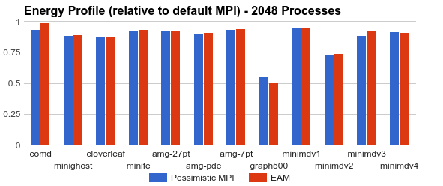
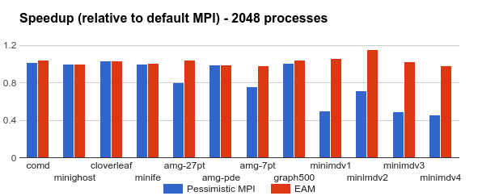
MVAPICH2-EA: Application Oblivious Energy-Aware-MPI (EAM)
An energy efficient runtime that provides energy savings without application knowledge
Uses automatically and transparently the best energy lever
Provides guarantees on maximum degradation with 5-41% savings at <= 5% degradation
Pessimistic MPI applies energy reduction lever to each MPI call
1
A Case for Application-Oblivious Energy-Efficient MPI Runtime A. Venkatesh, A. Vishnu, K. Hamidouche, N. Tallent, D. K. Panda, D. Kerbyson, and A. Hoise, Supercomputing ‘15, Nov 2015 [Best Student Paper Finalist]

Slide 45
MVAPICH2 – Plans for Exascale
Performance and Memory scalability toward 1M cores
Hybrid programming (MPI + OpenSHMEM, MPI + UPC, MPI + CAF …)
Support for task-based parallelism (UPC++)
Enhanced Optimization for GPU Support and Accelerators
Taking advantage of advanced features
User Mode Memory Registration (UMR)
On-demand Paging
Enhanced Inter-node and Intra-node communication schemes for upcoming OmniPath and Knights Landing architectures
Extended RMA support (as in MPI 3.0)
Extended topology-aware collectives
Energy-aware point-to-point (one-sided and two-sided) and collectives
Extended Support for MPI Tools Interface (as in MPI 3.0)
Extended Checkpoint-Restart and migration support with SCR

Slide 46
Two Major Categories of Applications
Scientific Computing
Message Passing Interface (MPI), including MPI + OpenMP, is the Dominant Programming Model
Many discussions towards Partitioned Global Address Space (PGAS)
UPC, OpenSHMEM, CAF, etc.
Hybrid Programming: MPI + PGAS (OpenSHMEM, UPC)
Big Data/Enterprise/Commercial Computing
Focuses on large data and data analysis
Hadoop (HDFS, HBase, MapReduce)
Spark is emerging for in-memory computing
Memcached is also used for Web 2.0

Slide 47

How Can HPC Clusters with High-Performance Interconnect and Storage Architectures Benefit Big Data Applications?
Can the bottlenecks be alleviated with new designs by taking advantage of HPC technologies?
Can RDMA-enabled high-performance interconnects benefit Big Data processing?
Can HPC Clusters with high-performance storage systems (e.g. SSD, parallel file systems) benefit Big Data applications?
How much performance benefits can be achieved through enhanced designs?
How to design benchmarks for evaluating the performance of Big Data middleware on HPC clusters?
What are the major bottlenecks in current Big Data processing middleware (e.g. Hadoop, Spark, and Memcached)?
Bring HPC and Big Data processing into a “convergent trajectory”!

Slide 48
Designing Communication and I/O Libraries for Big Data Systems: Challenges
Applications
Benchmarks
Big Data Middleware
(HDFS, MapReduce, HBase, Spark and Memcached)
Upper level Changes?
Programming Models
(Sockets)
Other Protocols?
Communication and I/O Library
Point-to-Point
Communication
Threaded Models
and Synchronization
Virtualization
I/O and File Systems
QoS
Fault-Tolerance
Networking Technologies
(InfiniBand, 1/10/40/100 GigE and Intelligent NICs)
Commodity Computing System Architectures
(Multi- and Many-core architectures and accelerators)
Storage Technologies
(HDD, SSD, and NVMe-SSD)
Notes:
OmniPath can be added into the figure!

Slide 49
Design Overview of HDFS with RDMA
Applications
Design Features
RDMA-based HDFS write
RDMA-based HDFS replication
Parallel replication support
On-demand connection setup
InfiniBand/RoCE support
HDFS
Others
Write
Java Socket Interface
Java Native Interface (JNI)
OSU Design
Verbs
1/10/40/100 GigE, IPoIB Network
RDMA Capable Networks
(IB, iWARP, RoCE ..)
Enables high performance RDMA communication, while supporting traditional socket interface
JNI Layer bridges Java based HDFS with communication library written in native code
N. S. Islam, M. W. Rahman, J. Jose, R. Rajachandrasekar, H. Wang, H. Subramoni, C. Murthy and D. K. Panda , High Performance RDMA-Based Design of HDFS over InfiniBand , Supercomputing (SC), Nov 2012
N. Islam, X. Lu, W. Rahman, and D. K. Panda, SOR-HDFS: A SEDA-based Approach to Maximize Overlapping in RDMA-Enhanced HDFS, HPDC '14, June 2014

Slide 50
Evaluations using Enhanced DFSIO of Intel HiBench on TACC-Stampede
Increased by 64%
Reduced by 37%
Cluster with 64 DataNodes, single HDD per node
64% improvement in throughput over IPoIB (FDR) for 256GB file size
37% improvement in latency over IPoIB (FDR) for 256GB file size

Slide 51
Enhanced HDFS with In-Memory and Heterogeneous Storage
Design Features
Three modes
Default (HHH)
In-Memory (HHH-M)
Lustre-Integrated (HHH-L)
Policies to efficiently utilize the heterogeneous storage devices
RAM, SSD, HDD, Lustre
Eviction/Promotion based on data usage pattern
Hybrid Replication
Lustre-Integrated mode:
Lustre-based fault-tolerance
Applications
Triple-H
Data Placement Policies
Hybrid Replication
Eviction/Promotion
Heterogeneous Storage
RAM Disk
SSD
HDD
Lustre
N. Islam, X. Lu, M. W. Rahman, D. Shankar, and D. K. Panda, Triple-H: A Hybrid Approach to Accelerate HDFS on HPC Clusters with Heterogeneous Storage Architecture, CCGrid ’15, May 2015
Notes:
So far, by default it’s hybrid replication, two in ram, one in ssd/disk

Slide 52
Performance Improvement on TACC Stampede (HHH)
Increased by 2x
Reduced by 3x
Increased by 7x
TestDFSIO
RandomWriter
For 160GB TestDFSIO in 32 nodes
Write Throughput: 7x improvement over IPoIB (FDR)
Read Throughput: 2x improvement over IPoIB (FDR)
For 120GB RandomWriter in 32 nodes
3x improvement over IPoIB (QDR)
Notes:
Write, hybrid replication, 2 replicas in ram and 1 in disk for osu-ib; rdma communication for write and replication; so 7x
Read, mostly read data from ram, since 2 replicas in memory; no replication overhead; ipoib for read if not local; so 2x
Default Hadoop version: 2.5.0; no policy support; all data written into/read from disk.
OSU-ib: greedy policy

Slide 53
Evaluation with PUMA and CloudBurst (HHH-L/HHH)
Reduced by 17%
HDFS-IPoIB (FDR) | OSU-IB (FDR)
60.24 s | 48.3 s
Reduced by 29.5%
PUMA
CloudBurst
PUMA on OSU RI
SequenceCount with HHH-L: 17% benefit over Lustre, 8% over HDFS
Grep with HHH: 29.5% benefit over Lustre, 13.2% over HDFS
CloudBurst on TACC Stampede
With HHH: 19% improvement over HDFS

Slide 54
Evaluation with Spark on SDSC Gordon (HHH)
Reduced by 2.4x
Reduced by 25.2%
TeraGen
TeraSort
For 200GB TeraGen on 32 nodes
Spark-TeraGen: HHH has 2.4x improvement over Tachyon; 2.3x over HDFS-IPoIB (QDR)
Spark-TeraSort: HHH has 25.2% improvement over Tachyon; 17% over HDFS-IPoIB (QDR)
N. Islam, M. W. Rahman, X. Lu, D. Shankar, and D. K. Panda, Performance Characterization and Acceleration of In-Memory File Systems for Hadoop and Spark Applications on HPC Clusters, IEEE BigData ’15, October 2015
Notes:
Tachyon-Cache mode
Write-Through-Cache doesn’t work well for TeraSort

Slide 55
Design Overview of MapReduce with RDMA
Applications
Design Features
RDMA-based shuffle
Prefetching and caching map output
Efficient Shuffle Algorithms
In-memory merge
On-demand Shuffle Adjustment
Advanced overlapping
map, shuffle, and merge
shuffle, merge, and reduce
On-demand connection setup
InfiniBand/RoCE support
MapReduce
Job
Tracker
Task
Tracker
Map
Reduce
Java Socket Interface
Java Native Interface (JNI)
OSU Design
Verbs
1/10/40/100 GigE, IPoIB Network
RDMA Capable Networks
(IB, iWARP, RoCE ..)
Enables high performance RDMA communication, while supporting traditional socket interface
JNI Layer bridges Java based MapReduce with communication library written in native code

Slide 56
Performance Evaluation of Sort and TeraSort
Sort in OSU Cluster
TeraSort in TACC Stampede
For 240GB Sort in 64 nodes (512 cores)
40% improvement over IPoIB (QDR) with HDD used for HDFS
For 320GB TeraSort in 64 nodes (1K cores)
38% improvement over IPoIB (FDR) with HDD used for HDFS

Slide 57
Design Overview of Shuffle Strategies for MapReduce over Lustre
Design Features
Two shuffle approaches
Lustre read based shuffle
RDMA based shuffle
Hybrid shuffle algorithm to take benefit from both shuffle approaches
Dynamically adapts to the better shuffle approach for each shuffle request based on profiling values for each Lustre read operation
In-memory merge and overlapping of different phases are kept similar to RDMA-enhanced MapReduce design
Map 1
Map 2
Map 3
Intermediate Data Directory
Lustre
Lustre Read / RDMA
Reduce 1
Reduce 2
In-memory merge/sort
reduce
In-memory merge/sort
reduce
M. W. Rahman, X. Lu, N. S. Islam, R. Rajachandrasekar, and D. K. Panda, High Performance Design of YARN MapReduce on Modern HPC Clusters with Lustre and RDMA, IPDPS, May 2015

Slide 58
Performance Improvement of MapReduce over Lustre on TACC-Stampede
Local disk is used as the intermediate data directory
Reduced by 44%
Reduced by 48%
For 500GB Sort in 64 nodes
44% improvement over IPoIB (FDR)
For 640GB Sort in 128 nodes
48% improvement over IPoIB (FDR)
M. W. Rahman, X. Lu, N. S. Islam, R. Rajachandrasekar, and D. K. Panda, MapReduce over Lustre: Can RDMA-based Approach Benefit?, Euro-Par, August 2014.

Slide 59
Case Study - Performance Improvement of MapReduce over Lustre on SDSC-Gordon
Lustre is used as the intermediate data directory
Reduced by 34%
Reduced by 25%
For 80GB Sort in 8 nodes
34% improvement over IPoIB (QDR)
For 120GB TeraSort in 16 nodes
25% improvement over IPoIB (QDR)

Slide 60
Design Overview of Spark with RDMA
Design Features
RDMA based shuffle
SEDA-based plugins
Dynamic connection management and sharing
Non-blocking and out-of-order data transfer
Off-JVM-heap buffer management
InfiniBand/RoCE support
Enables high performance RDMA communication, while supporting traditional socket interface
JNI Layer bridges Scala based Spark with communication library written in native code
X. Lu, M. W. Rahman, N. Islam, D. Shankar, and D. K. Panda, Accelerating Spark with RDMA for Big Data Processing: Early Experiences, Int'l Symposium on High Performance Interconnects (HotI'14), August 2014
Notes:
High performance and Ecosystem compatibility

Slide 61
Performance Evaluation on TACC Stampede - SortByTest
58%
16 Worker Nodes, SortByTest Shuffle Time
16 Worker Nodes, SortByTest Total Time
Intel SandyBridge + FDR, 16 Worker Nodes, 256 Cores, (256M 256R)
RDMA-based design for Spark 1.4.0
RDMA vs. IPoIB with 256 concurrent tasks, single disk per node and RamDisk. For SortByKey Test:
Shuffle time reduced by up to 77% over IPoIB (56Gbps)
Total time reduced by up to 58% over IPoIB (56Gbps)

Slide 62


The High-Performance Big Data (HiBD) Project
RDMA for Apache Hadoop 2.x (RDMA-Hadoop-2.x)
Plugins for Apache and HDP Hadoop distributions
RDMA for Apache Hadoop 1.x (RDMA-Hadoop)
RDMA for Memcached (RDMA-Memcached)
OSU HiBD-Benchmarks (OHB)
HDFS and Memcached Micro-benchmarks
http://hibd.cse.ohio-state.edu
Users Base: 135 organizations from 20 countries
More than 13,400 downloads from the project site
RDMA for Apache HBase, Spark and CDH (upcoming)
Network Based Computing
Laboratory

Slide 63
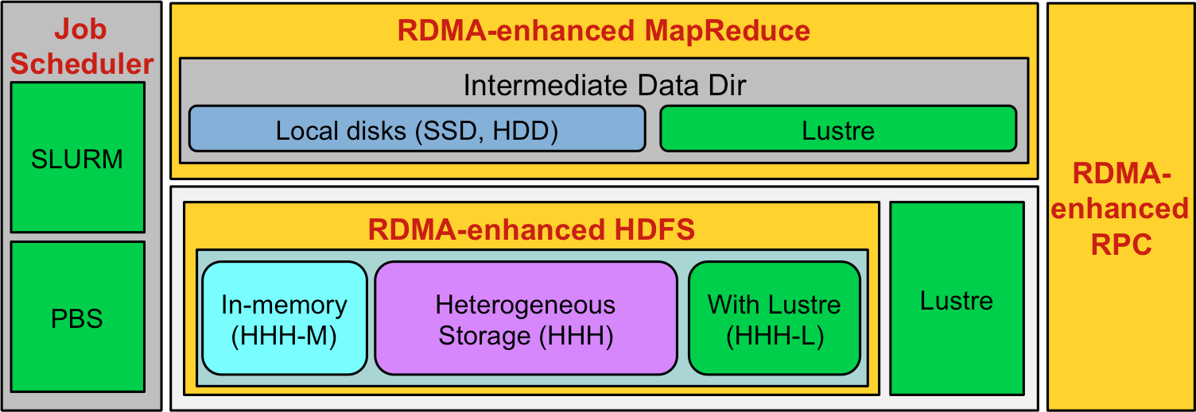
Different Modes of RDMA for Apache Hadoop 2.x
HHH: Heterogeneous storage devices with hybrid replication schemes are supported in this mode of operation to have better fault-tolerance as well as performance. This mode is enabled by default in the package.
HHH-M: A high-performance in-memory based setup has been introduced in this package that can be utilized to perform all I/O operations in-memory and obtain as much performance benefit as possible.
HHH-L: With parallel file systems integrated, HHH-L mode can take advantage of the Lustre available in the cluster.
MapReduce over Lustre, with/without local disks: Besides, HDFS based solutions, this package also provides support to run MapReduce jobs on top of Lustre alone. Here, two different modes are introduced: with local disks and without local disks.
Running with Slurm and PBS: Supports deploying RDMA for Apache Hadoop 2.x with Slurm and PBS in different running modes (HHH, HHH-M, HHH-L, and MapReduce over Lustre).

Slide 64
Future Plans of OSU High Performance Big Data (HiBD) Project
Upcoming Releases of RDMA-enhanced Packages will support
Spark
HBase
Upcoming Releases of OSU HiBD Micro-Benchmarks (OHB) will support
MapReduce
RPC
Advanced designs with upper-level changes and optimizations
E.g. Memcached-HDFS

Slide 65
Looking into the Future ….
Exascale systems will be constrained by
Power
Memory per core
Data movement cost
Faults
Programming Models and Runtimes for HPC and BigData need to be designed for
Scalability
Performance
Fault-resilience
Energy-awareness
Programmability
Productivity
Highlighted some of the issues and challenges
Need continuous innovation on all these fronts

Slide 66















Funding Acknowledgments
Funding Support by
Equipment Support by

Slide 67
Personnel Acknowledgments
Current Students
A. Augustine (M.S.)
A. Awan (Ph.D.)
S. Chakraborthy (Ph.D.)
C.-H. Chu (Ph.D.)
N. Islam (Ph.D.)
M. Li (Ph.D.)
Current Research Scientists Current Senior Research Associate
H. Subramoni
X. Lu
K. Kulkarni (M.S.)
M. Rahman (Ph.D.)
D. Shankar (Ph.D.)
A. Venkatesh (Ph.D.)
J. Zhang (Ph.D.)
- K. Hamidouche
Current Post-Doc
J. Lin
D. Banerjee
Current Programmer
J. Perkins
Current Research Specialist
M. Arnold
Past Students
P. Balaji (Ph.D.)
S. Bhagvat (M.S.)
A. Bhat (M.S.)
D. Buntinas (Ph.D.)
L. Chai (Ph.D.)
B. Chandrasekharan (M.S.)
N. Dandapanthula (M.S.)
V. Dhanraj (M.S.)
T. Gangadharappa (M.S.)
K. Gopalakrishnan (M.S.)
W. Huang (Ph.D.)
W. Jiang (M.S.)
J. Jose (Ph.D.)
S. Kini (M.S.)
M. Koop (Ph.D.)
R. Kumar (M.S.)
S. Krishnamoorthy (M.S.)
K. Kandalla (Ph.D.)
P. Lai (M.S.)
J. Liu (Ph.D.)
M. Luo (Ph.D.)
A. Mamidala (Ph.D.)
G. Marsh (M.S.)
V. Meshram (M.S.)
A. Moody (M.S.)
S. Naravula (Ph.D.)
R. Noronha (Ph.D.)
X. Ouyang (Ph.D.)
S. Pai (M.S.)
S. Potluri (Ph.D.)
R. Rajachandrasekar (Ph.D.)
G. Santhanaraman (Ph.D.)
A. Singh (Ph.D.)
J. Sridhar (M.S.)
S. Sur (Ph.D.)
H. Subramoni (Ph.D.)
K. Vaidyanathan (Ph.D.)
A. Vishnu (Ph.D.)
J. Wu (Ph.D.)
W. Yu (Ph.D.)
Past Post-Docs
H. Wang
X. Besseron
H.-W. Jin
M. Luo
E. Mancini
S. Marcarelli
J. Vienne
Past Research Scientist
S. Sur
Past Programmers
D. Bureddy

Slide 68
International Workshop on High-Performance Big Data Computing (HPBDC)
HPBDC 2015 was held with Int’l Conference on Distributed Computing Systems (ICDCS ‘15), Columbus, Ohio, USA, Monday, June 29th, 2015
Two Keynote Talks: Dan Stanzione (TACC) and Zhiwei Xu (ICT/CAS)
Two Invited Talks: Jianfeng Zhan (ICT/CAS), Raghunath Nambiar (Cisco)
Panel: Jianfeng Zhan (ICT/CAS)
Four Research Papers
http://web.cse.ohio-state.edu/~luxi/hpbdc2015
HPBDC 2016 will be held in conjunction with IPDPS ’16
http://web.cse.ohio-state.edu/~luxi/hpbdc2016
Submission: January 2016

Slide 69
Multiple Positions Available in My Group
Looking for Bright and Enthusiastic Personnel to join as
Visiting Scientists
Post-Doctoral Researchers
PhD Students
MPI Programmer/Software Engineer
Hadoop/Big Data Programmer/Software Engineer
If interested, please contact me at this conference and/or send an e-mail to panda@cse.ohio-state.edu

Slide 70

Thank You!
panda@cse.ohio-state.edu
Network Based Computing
Laboratory
Network-Based Computing Laboratory
http://nowlab.cse.ohio-state.edu/
The MVAPICH2 Project
http://mvapich.cse.ohio-state.edu/
The High-Performance Big Data Project
http://hibd.cse.ohio-state.edu/

