Slide 1

Dynamic Terraform Configuration for Cloud using Generative AI
India
September 2023
Presenter- Suvankar Chakraborty Chief Systems Engineer EPAM SYSTEMS

Slide 2

Your Guided Tour Through the Revolution of DevOps Automation with Generative AI:-
Introduction
"Automating Infrastructure Code with AI"
2. How It Works
"Turning Words Into Code: The Magic Behind the Scenes"
3. Phases of Execution
"From Simple to Sophisticated: Phasing It Right!"
4. Effort & Next Steps
"Clock's Ticking: Time & Tactics for Deployment Success"
5. Market Outlook
"Measuring the Mammoth: The Skyrocketing Scale of Generative AI in the DevOps Arena"
6. Q&A

Slide 3
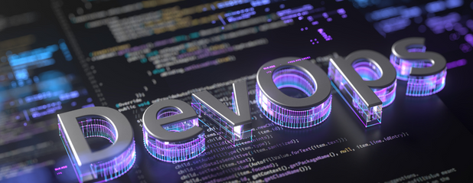
Automating Infrastructure Code with AI
objectives
Unlock the Future of Infrastructure Automation! Imagine provisioning complex Oracle Cloud setups not with endless lines of code, but with simple, spoken sentences! Welcome to the revolutionary blend of Dynamic Terraform Configuration for OCI and Generative AI. We're about to turn your DevOps world upside-down!

Slide 4
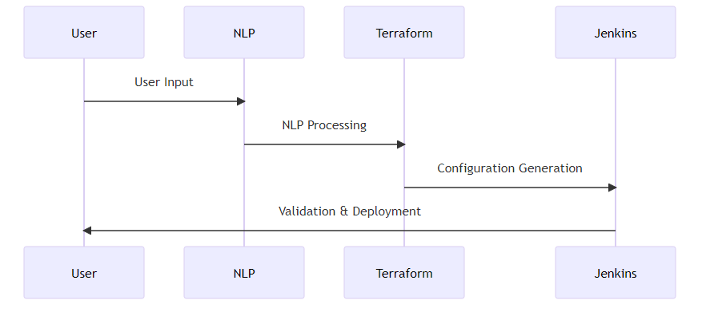
Turning Words Into Code: The Magic Behind the Scenes
HOW IT Works
1> User Input: Team members provide a natural language input like "I need a VCN in OCI with three subnets.“ 2> NLP Processing: This input is analyzed by an AI model trained in DevOps terminology.
3> Configuration Generation: The model then generates a ready-to-use Terraform script.
4> Validation & Deployment: This script can be validated and deployed, automating resource provisioning in OCI. We can use Jenkins pipelines for the same

Slide 5
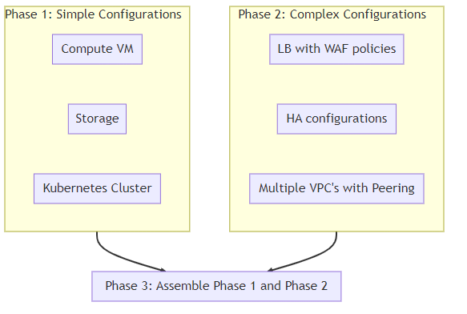
From Simple to Sophisticated: Phasing It Right!
Execution :-
This will be executed in three phases
Phase 1:- Simple configurations (Compute VM/ Storage/ Kuberenetes Cluster)
Phase 2:- Complex Configurations (LB with WAF policies/ HA configurations / Multiple VPC's with Peering)
Phase 3 :- Assemble Phase 1 and Phase 2 to deliver end to end configuration for the project

Slide 6
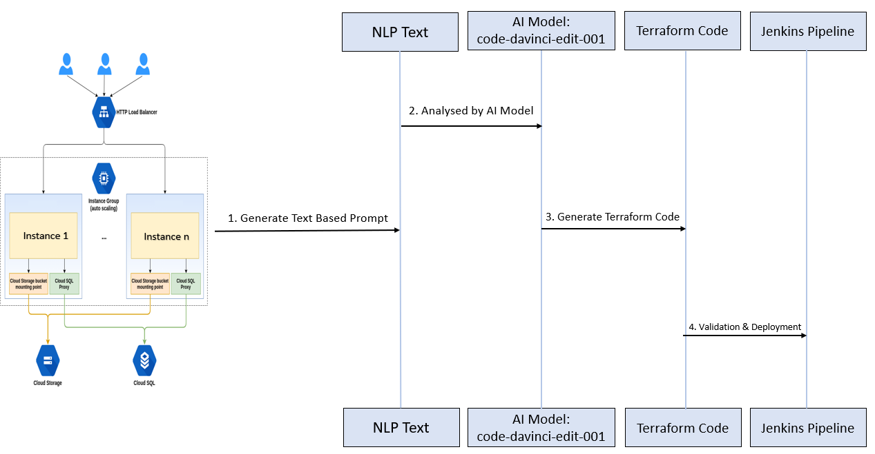
AI-Powered CloudOps: From Blueprint to Deployment

Slide 7

Clock's Ticking: Time & Tactics for Deployment Success
EFFORTS :-
Embarking on a 160-Hour Journey to Automation: Buckle Up! Please note, this is a rough roadmap—the road might get bumpy, and detours are likely.

Slide 8
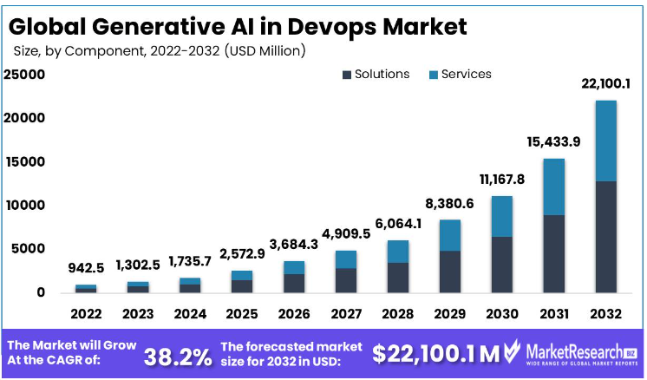
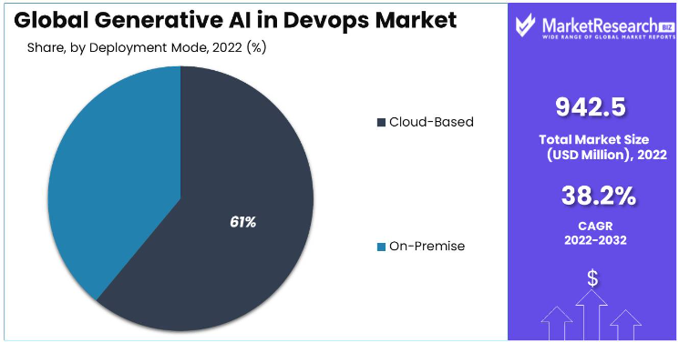
Measuring the Mammoth: The Skyrocketing Scale of Generative AI in the DevOps Arena
EFFORTS :-
Untapped Goldmine: Generative AI in DevOps is the Frontier of Limitless Business Opportunities and Exponential Growth.

Slide 9
Q
Q&A?

Slide 10

Thank you

