Slide 1
Deepfake Tweet Author Detection System
Jeremy Yang, Ruoyao Yin, Shengjie Zhang, Yujie Song

Slide 2

Introduction
Social media affects public opinions
Neural text generative models (TGMs) can generate deceptive texts
Transmission of deepfakes weakens public trust
Deepfake social media text detection systems
Human-written tweets vs. AI-generated tweets
Which AI? RNN, GPT-2 or others?
“Deepfakes”: deceptive texts generated by neural models
Notes:
Social media platforms (i.e. Twitter) can manipulate and affect public opinions through fake news
Neural text generative models (TGMs) can automatically generate deceptive texts that are indistinguishable from human-written texts
Transmission of deepfakes weakens public trust
Develop deepfake social media text detection systems helps tackle the problem
Human-written tweets vs. AI-generated tweets
Which AI? RNN, GPT-2 or others?

Slide 3
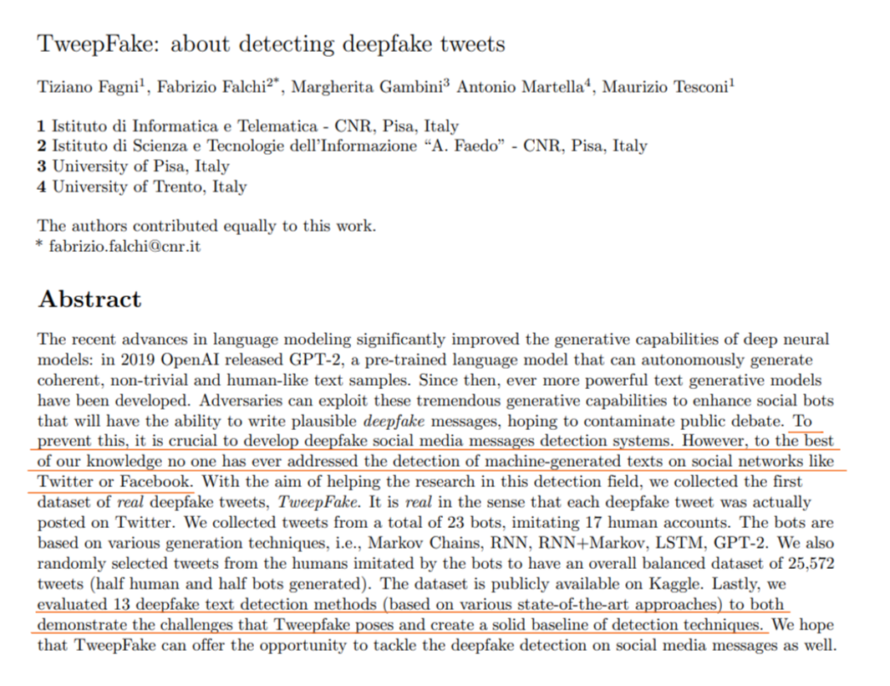
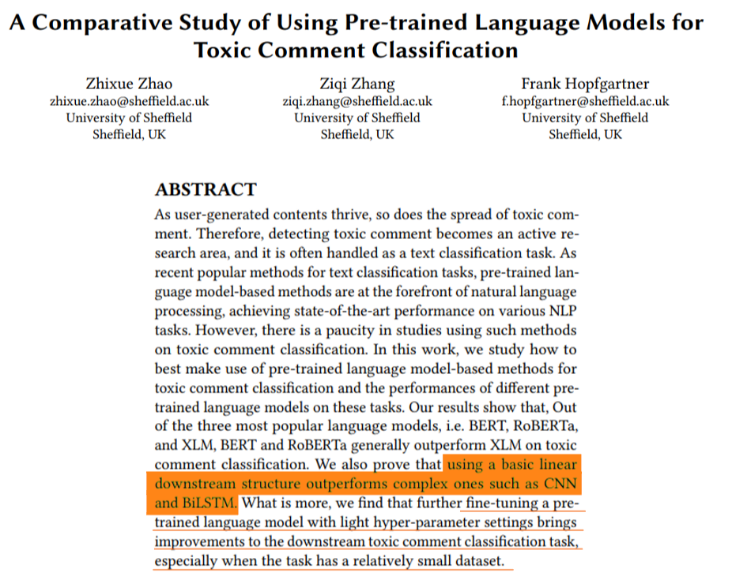
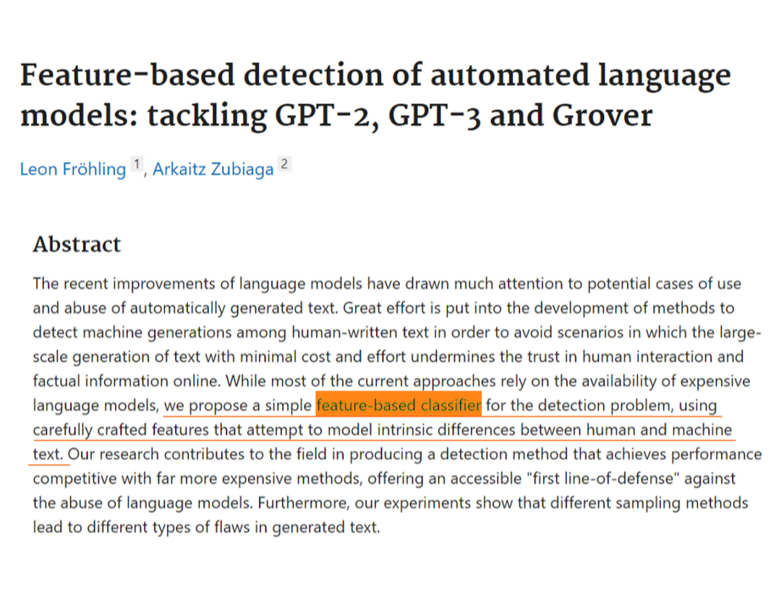
Previous work

Slide 4
Data: TweepFake dataset
Balanced data
Imbalanced data
Split | bot Tweets | human Tweets | total
Training | 10354 | 10358 | 20712
Validation | 1152 | 1150 | 2302
Test | 1280 | 1278 | 2558
Human tweets | 10358
RNN | 3325
GPT2 | 3109
Others | 3920

Slide 5
Methods
BERT + CNN
Parallel BERT + LSTM
BERT + Feature engineering
Evaluation: macro f1 score

Slide 6
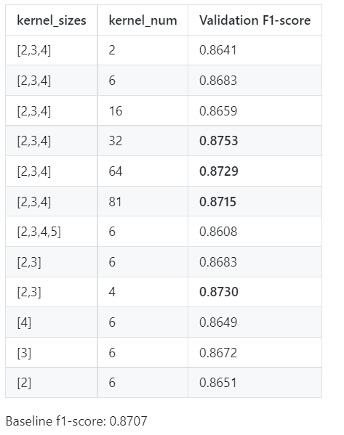
Result 1: BERT + CNN
Complex prediction layer harms model performance*
Input → BERT (last_hidden_state) → CNN → output
Complex CNN can actually improve model performance
Capture extra information from output of BERT
Zhao, Z., Zhang, Z. and Hopfgartner, F. orcid.org/0000-0003-0380-6088 (2021) A comparative study of using
pre-trained language models for toxic comment classification. https://doi.org/10.1145/3442442.3452313

Slide 7
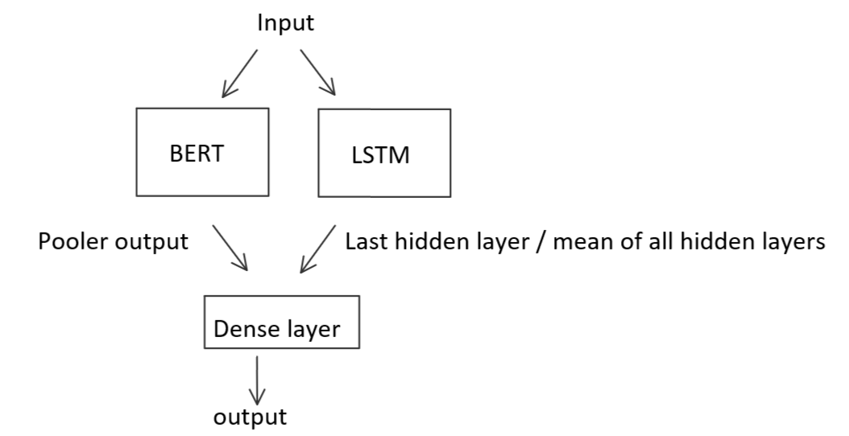
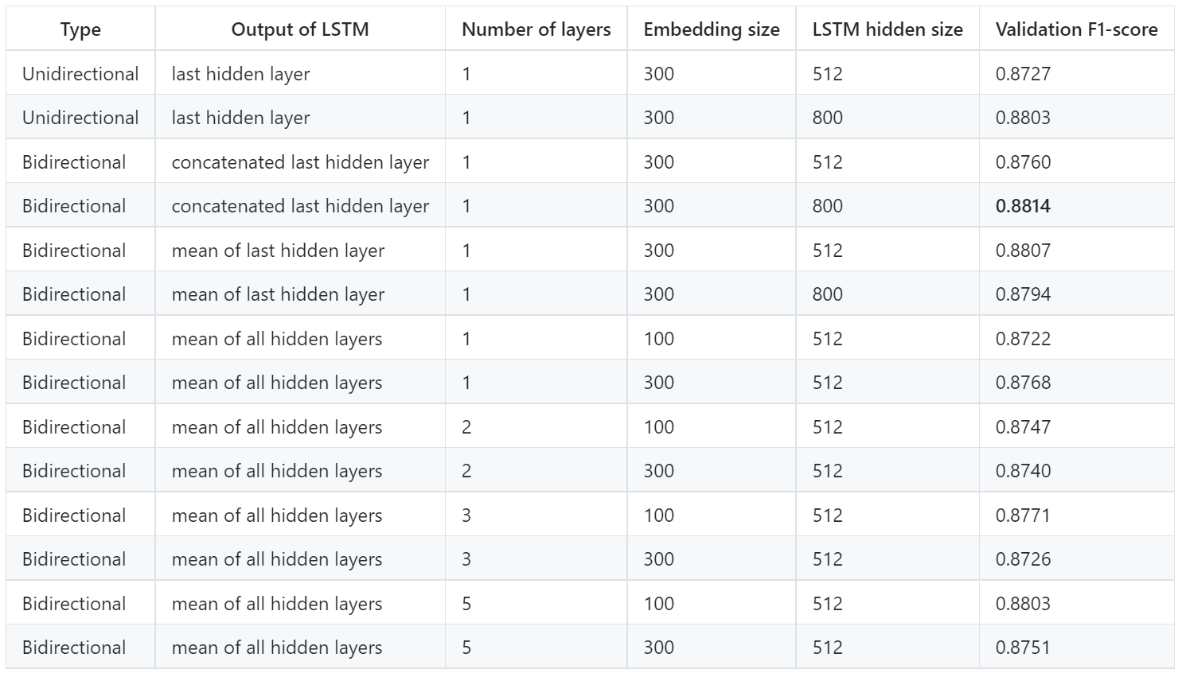

Result 2: Parallel BERT + LSTM
Structure
Results
LSTM does improve the performance but not much.
The best result here is 0.8814

Slide 8
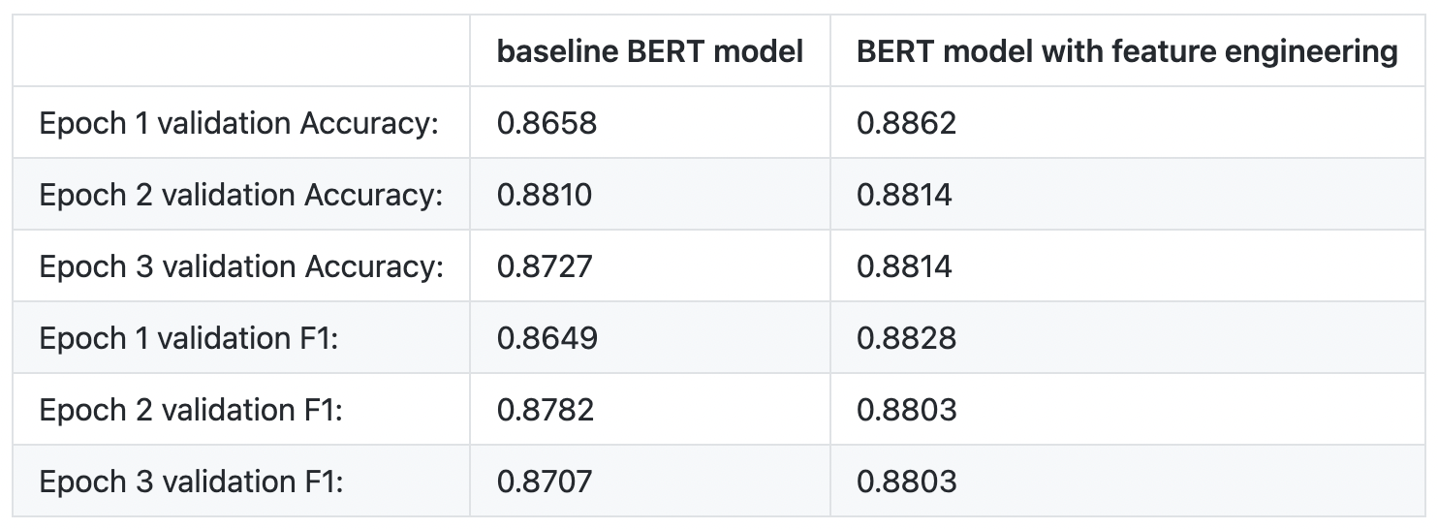
Result 3: BERT + Feature Engineering
Linguistic features like diversity helps differentiate human generated text from machine generated text*
Combine BERT embeddings with syntactic diversity, lexical diversity, and their joint measure
Clear improvements on the baseline model without feature engineering
Fröhling, L., & Zubiaga, A. (2021). Feature-based detection of automated language models: tackling GPT-2, GPT-3 and Grover. PeerJ Computer Science, 7, e443.
Chicago

Slide 9
Conclusion & Future work
Unlike some previous works suggest, adding model complexity on a BERT-Linear classification model does improve model performance
A richer representation as well as a more complex classification architecture can both help us identify which model generated a certain tweet
Further investigations can focus on an analysis of a combined model, as well as how the model performs on the specific machine generated text classes.

