Slide 1



Slide 2


Slide 3


Slide 4
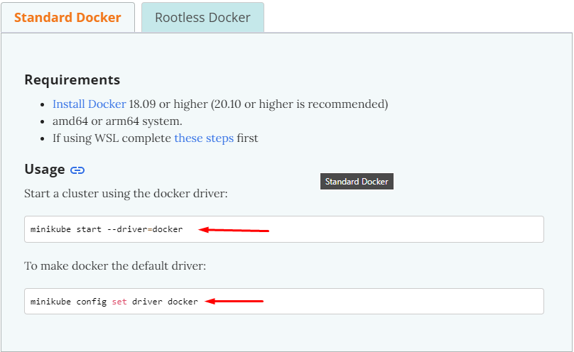
https://minikube.sigs.k8s.io/docs/drivers/docker/

Slide 5


Slide 6
Move to demo

