Slide 1
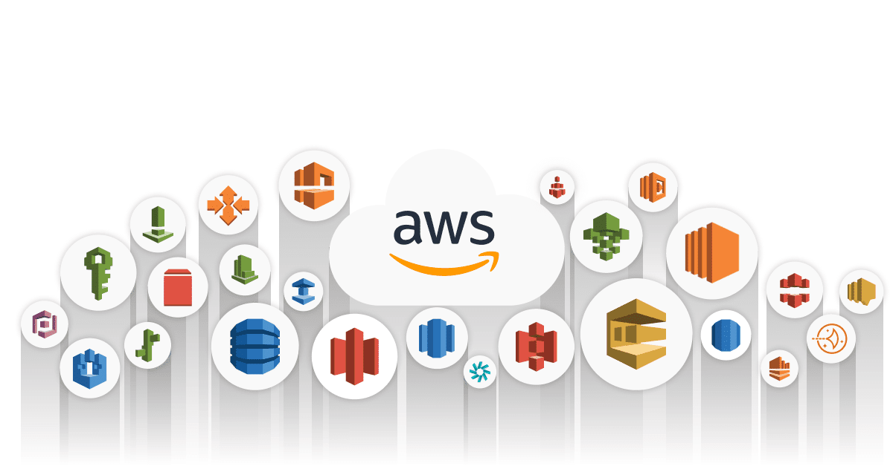

Slide 2
Introduction to Cloud Computing
Amazon Web Services – Cloud Computing
What is Cloud Computing?
Cloud computing is an internet-based computing service in which large groups of remote servers are networked to allow centralized data storage, and online access to computer services or resources.
Using cloud computing, organizations can use shared computing and storage resources rather than building, operating, and improving infrastructure on their own.
Cloud computing is a model that enables the following features.
• Users can provision and release resources on-demand.
• Resources can be scaled up or down automatically, depending on the load.
• Resources are accessible over a network with proper security.
• Cloud service providers can enable a pay-as-you-go model.

Slide 3
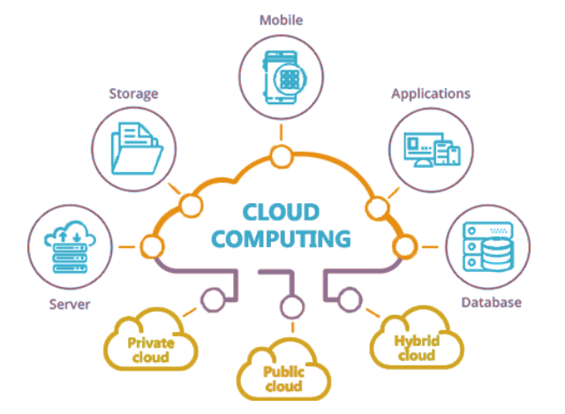

Slide 4
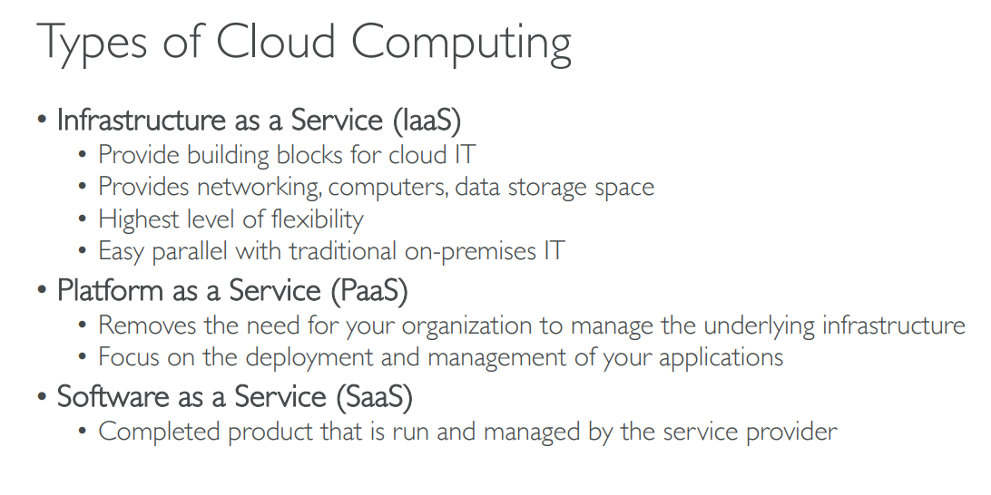

Slide 5
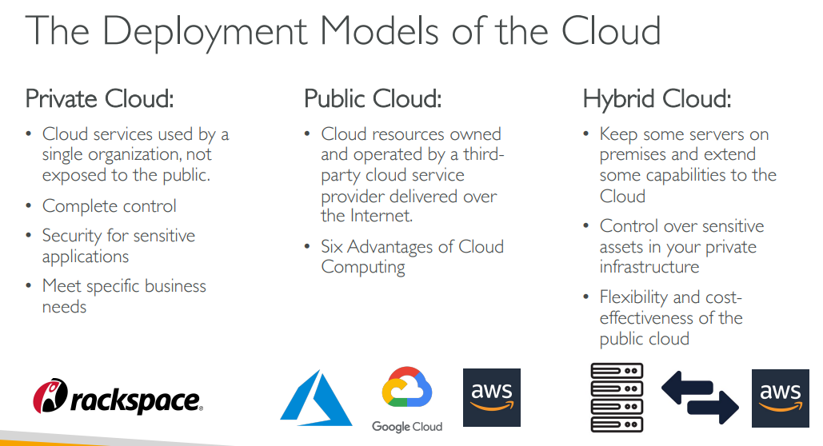

Slide 6
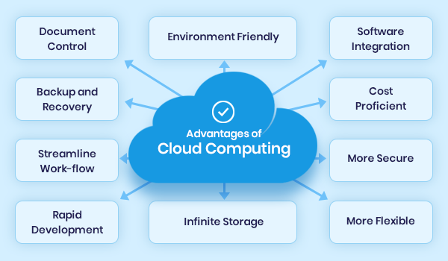

Slide 7
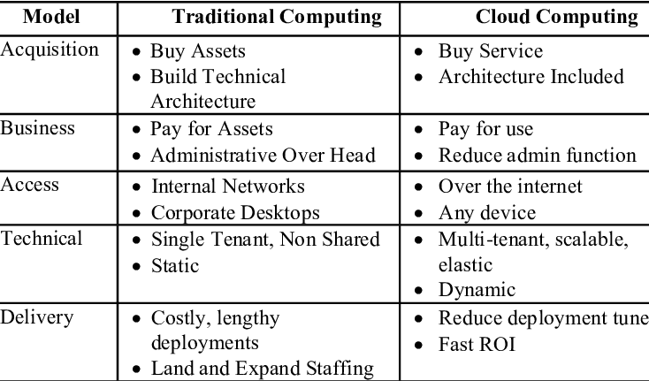
Traditional computing vs. Cloud computing

Slide 8

AWS - Amazon Web Services
Definition of AWS
Amazon Web Services(AWS) is a cloud service from Amazon, which provides services in the form of building blocks, these building blocks can be used to create and deploy any type of application in the cloud.

Slide 9
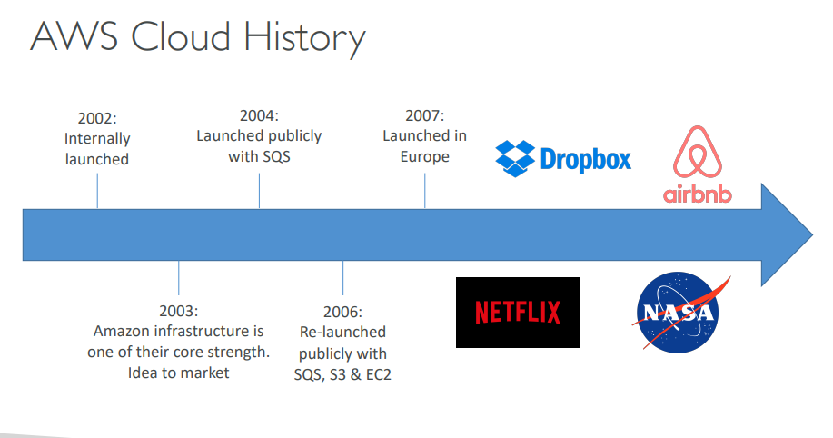

Slide 10
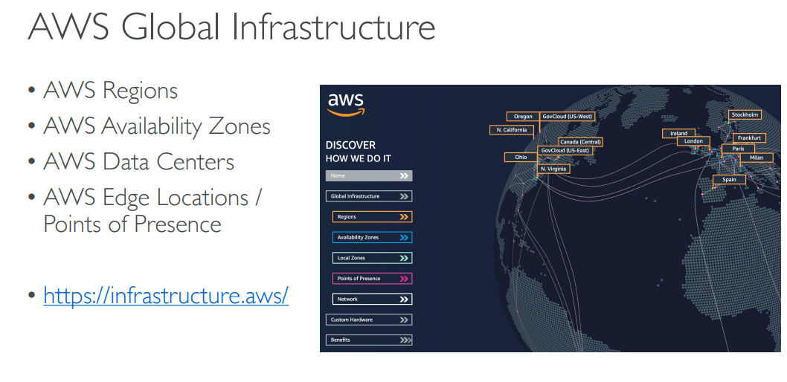

Slide 11
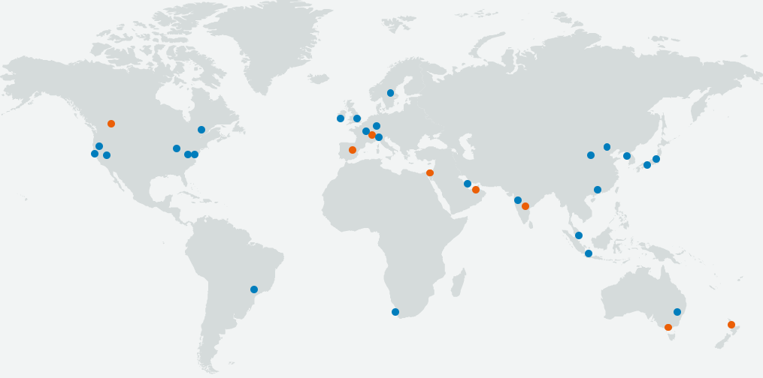
Global Network of AWS Regions

Slide 12
Services offered by the AWS
AWS offers us a wide variety of services depending on our business needs. Some of the most frequently used services by the IT industry are as follows.
1. Compute Services → Amazon EC2, AWS Lambda Functions, Amazon Lightsail, etc.
2. Storage Services → Amazon S3, Amazon EBS, Amazon EFS, Amazon S3 Glacier, etc.
3. Databases → Amazon Aurora, Aurora DynamoDB, Amazon RDS, Amazon Redshift, etc.
4. Security
5. Networking Services

Slide 13
AWS Software Development Toolkit (SDK)
The AWS Cloud Development Kit (AWS CDK) is an open-source software development framework to define your cloud application resources using familiar programming languages.
AWS CDK uses the familiarity and expressive power of programming languages for modeling your applications.
It provides high-level components called constructs that preconfigure cloud resources with proven defaults,
Benefits of SDK
Easier cloud onboarding
CDK allows you to use your existing skills and tools, applying them to the task of building cloud infrastructure..
Faster development process
AWS CDK gives you the expressive power of programming languages for defining infrastructure.

Slide 14

This Photo by Unknown Author is licensed under CC BY-NC

