Slide 1
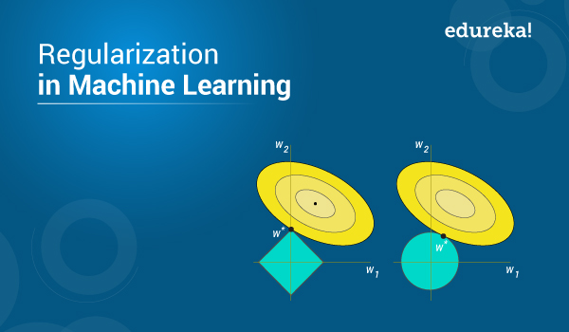
What is L1 and L2
Regularization

Slide 2
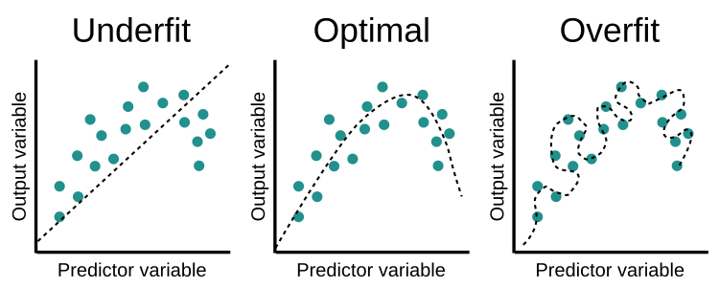
Regularization is a technique used to reduce the errors by fitting the function appropriately on the given training set and avoid overfitting.

Slide 3
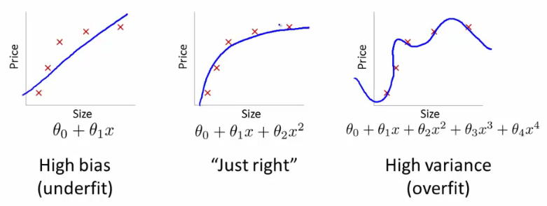

Slide 4
















Y = 0.9 + 1.2 * X1 + 20 * X2 + 39 * X3
Y = 0.9 + 0.7 * X1 + 2 * X2 + 5.5 * X3
What if coefficient = 10000 or 244646 ,
Model will become complex and computation power.
That’s why we reduce regression coefficients.

Slide 5
Regularization = Loss + Penalty

Slide 6
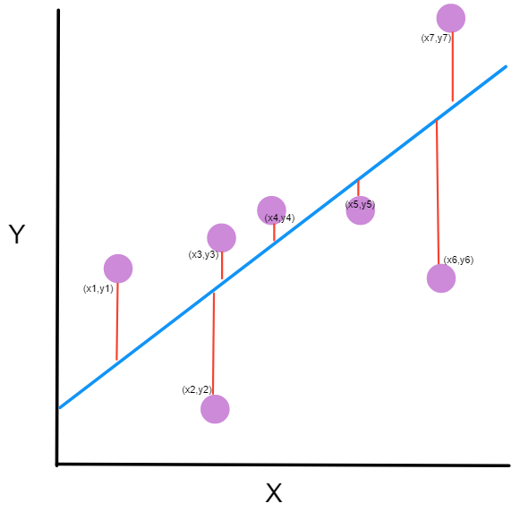
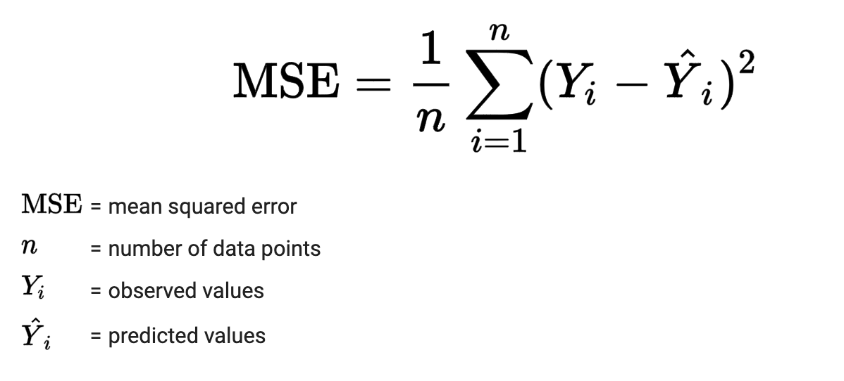

Slide 7
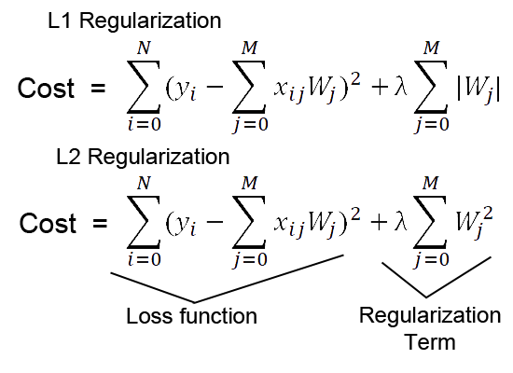

Slide 8
There are three main regularization techniques, namely:
Ridge Regression (L2 Norm)
Lasso (L1 Norm)
Dropout

Slide 9
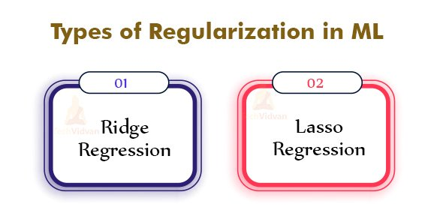

Slide 10
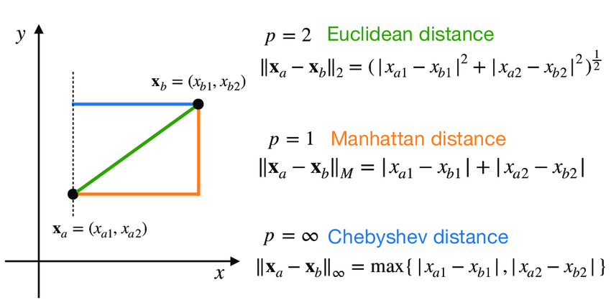

Slide 11
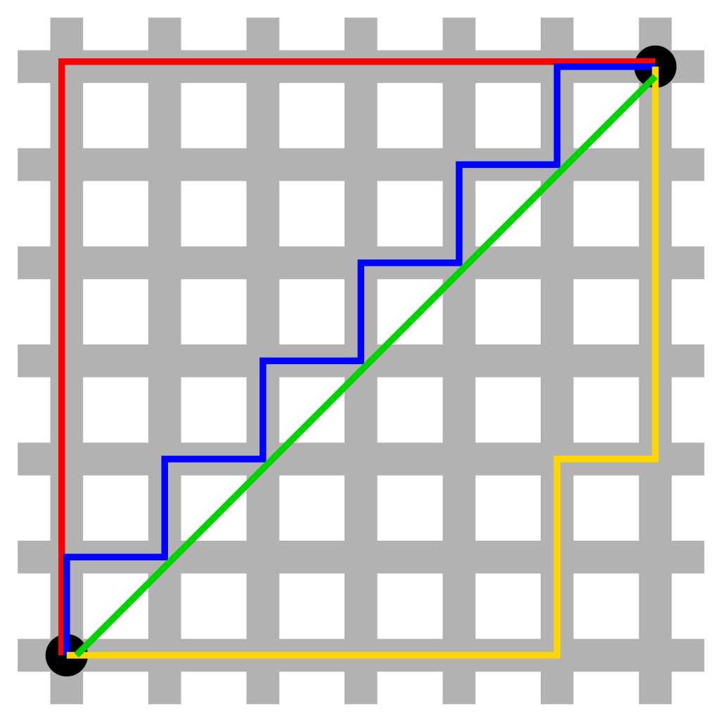

Slide 12
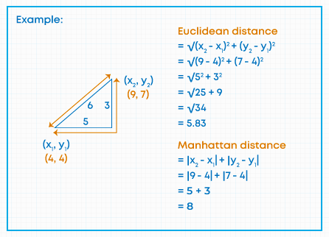

Slide 13
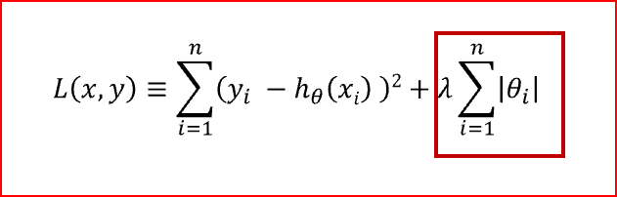
L1-Regularization (Lasso)

Slide 14
Lasso Regg = Loss + Penalty (alpha * ||w||)
where , ||w|| = (w1)**2 + (w1)**2 + (w1)**2 + ….+ (w1)**2
alpha =constant= 0.01,0.02,0.2,0.5,1,2……..etc.

Slide 15
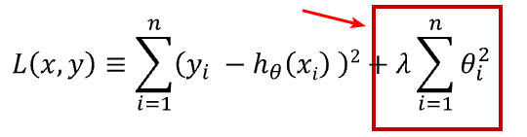
L2-Regularization (Ridge)

Slide 16
Ridge Regg = Loss + Penalty (alpha * ||w||**2)
where , ||w|| = (w1)**2 + (w1)**2 + (w1)**2 + ….+ (w1)**2
alpha =constant= 0.01,0.02,0.2,0.5,1,2……..etc.

