Slide 1
What is “ Url “ ?

Slide 2
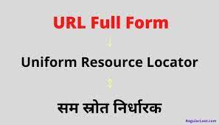

Slide 3
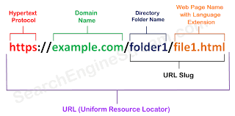

Slide 4

What is http and https ?

Slide 5
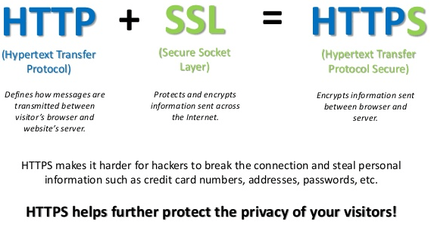

Slide 6
Thanks for watching

