Slide 1


Slide 2


Slide 3

Apache -Bike ???

Slide 4


Slide 5


Slide 6
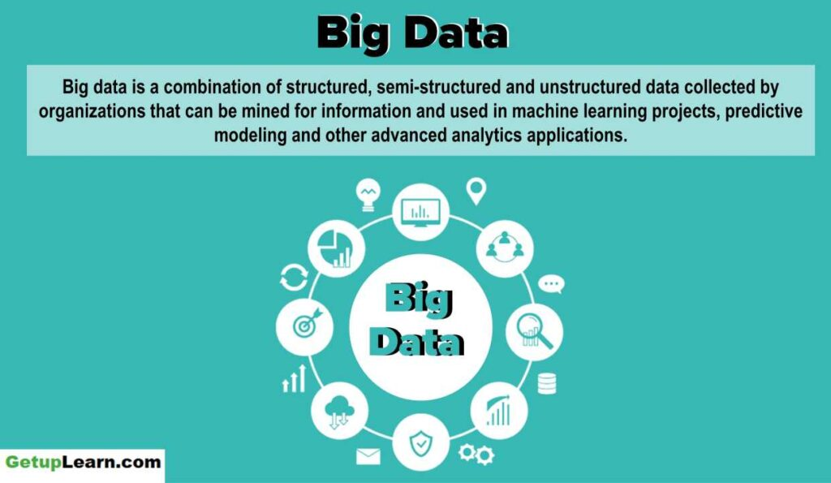

Slide 7


Slide 8
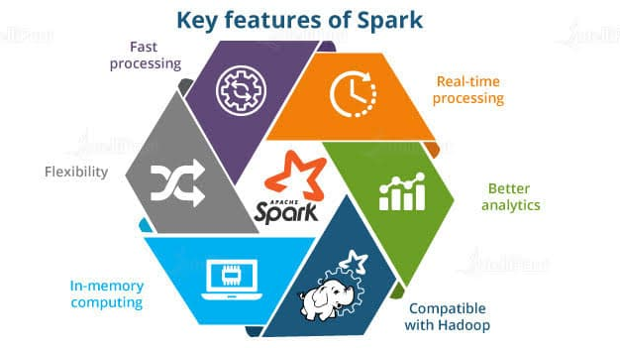

Slide 9
Database Knowledge
Code language
Statistics
Data Manipulation
Pre-Requisites

Slide 10
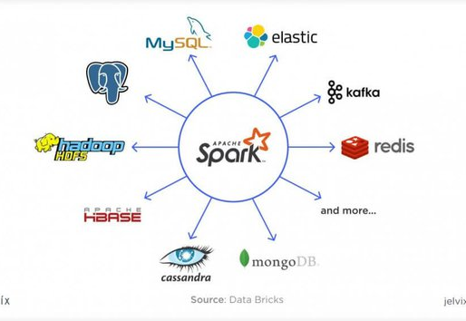
Storage Support ?

Slide 11
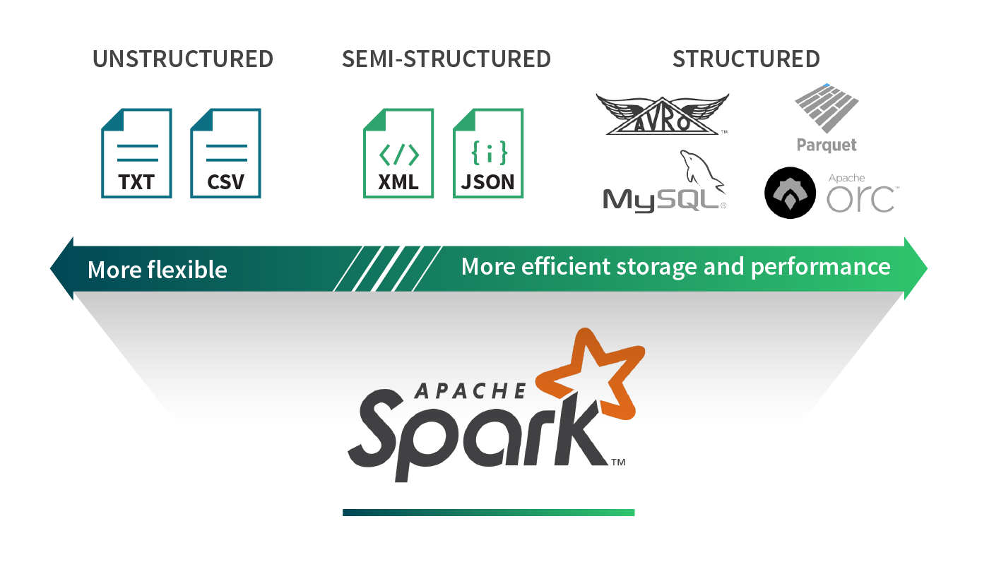
Files Support ?

Slide 12
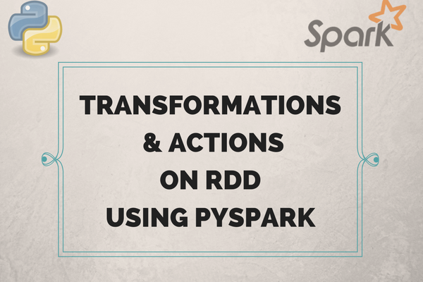

Slide 13


Slide 14
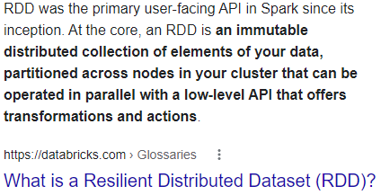


Slide 15
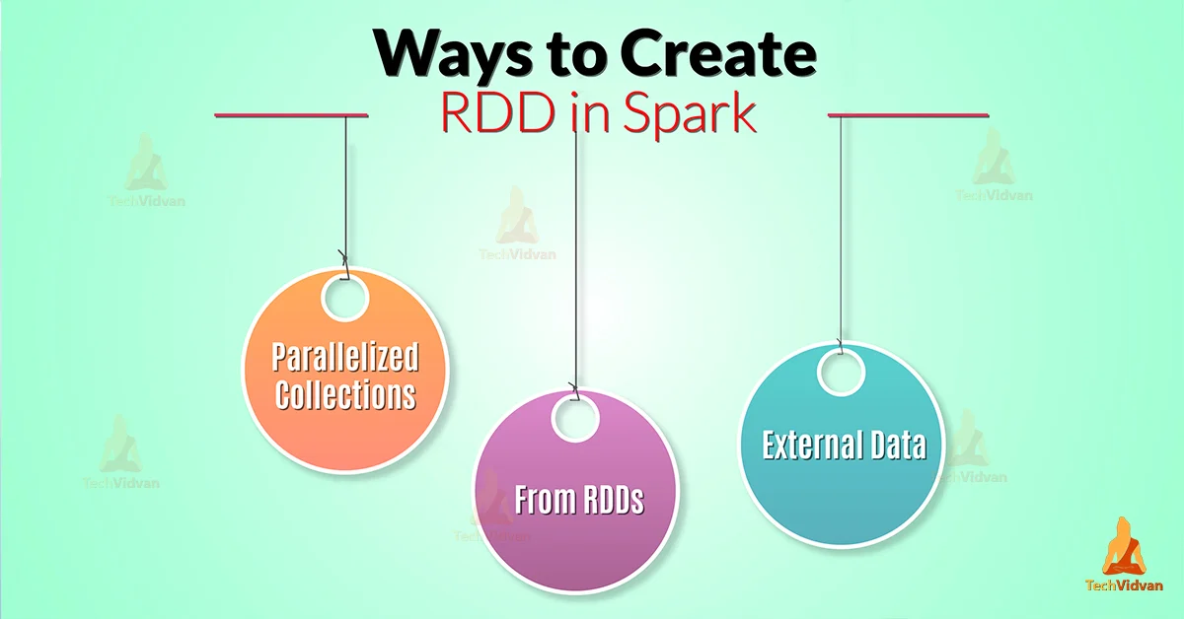

Slide 16
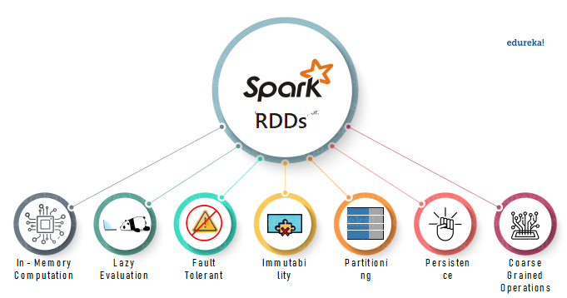

Slide 17
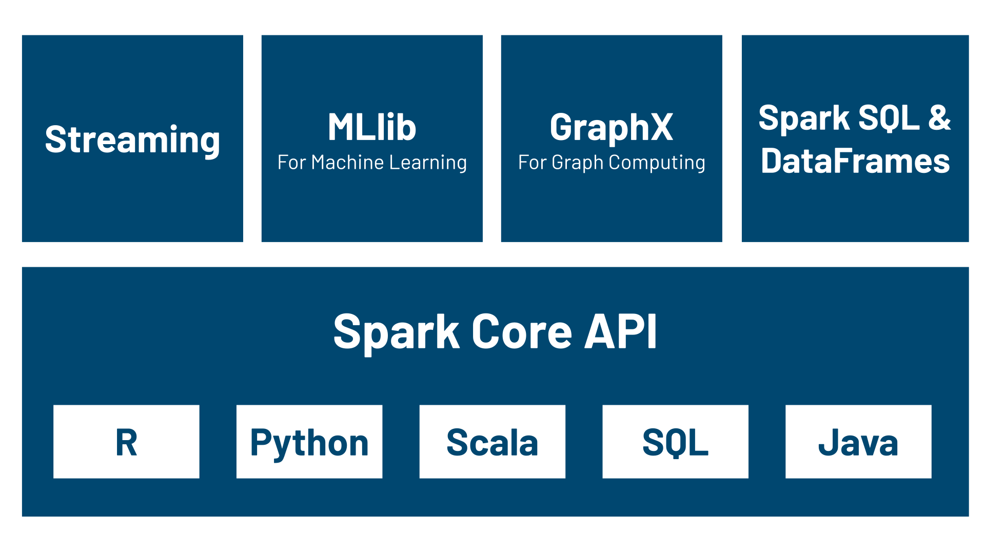

Slide 18


Slide 19
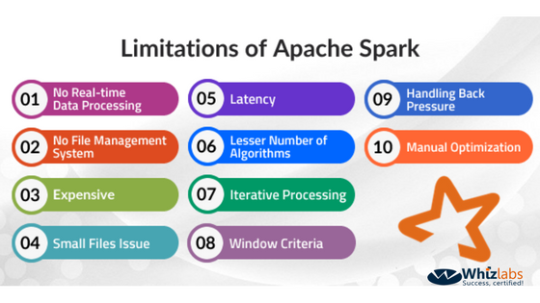

Slide 20


Slide 21
Thanks for Watching.............

