Slide 1


Slide 2

What is Amazon Redshift ?
Amazon Redshift is a fast and petabyte-scale, SQL based data warehouse service used to analyze data easily.

Slide 3
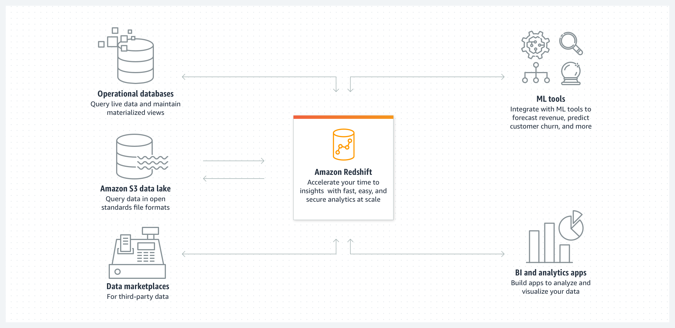
How it works

Slide 4
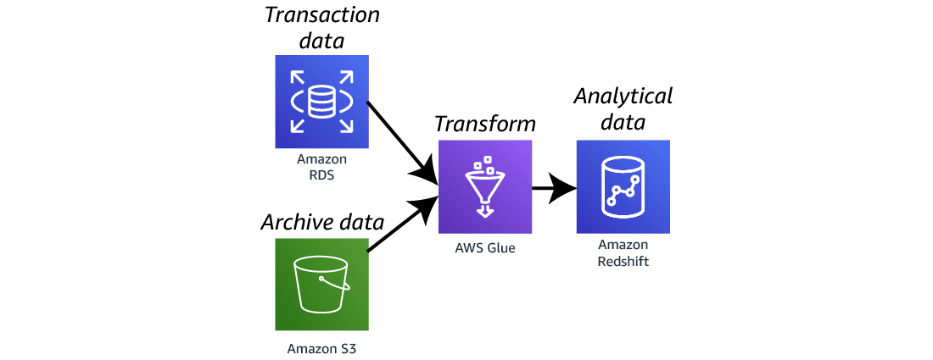
Rich data platform architecture

Slide 5
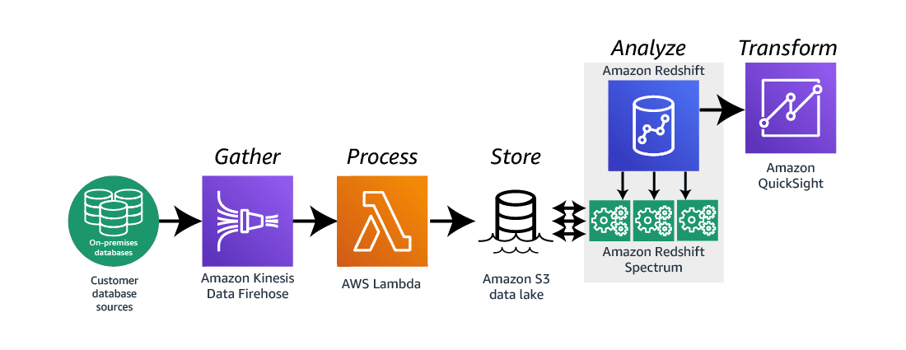
Event-driven data analysis architecture

Slide 6
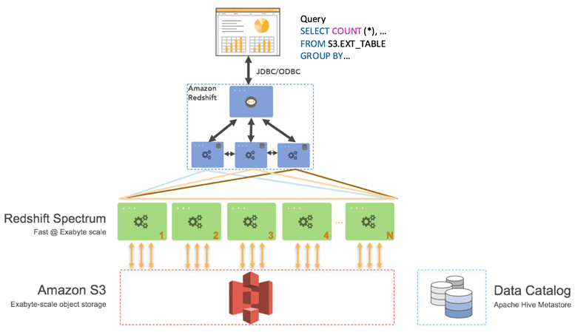
Technical Overview
Endpoints
Leader Node
Cluster
Compute Node
(CPU, Memory, Attached Disk storage)
Slices
(Done assign portion of Job)

Slide 7




Big Data
Dark Data
Analyze
Redshift
Job Done

Slide 8


Data Analyze

Slide 9
Let’s move to Hands on

