Slide 1


Slide 2


Slide 3


Slide 4
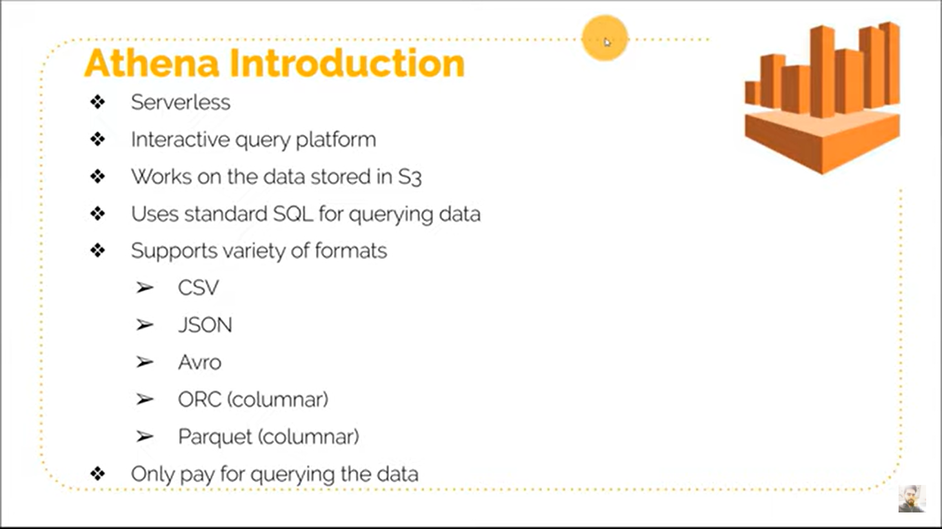

Slide 5
Why AWS Athena Popular?
Used by data Analyst to query large S3 dataset
No need of Server or Hadoop Cluster

