Slide 1
Subinterpreters
Stanislav Nikitin
MIPT, 2025

Slide 2
Definition
A subinterpreter is an independent Python execution context within a single CPython process. Each subinterpreter has its own state, including modules, imports, global variables, and its own GIL (Global Interpreter Lock). They share the same address space, so isolation is logical rather than physical and is not intended for security boundary.
Goal: enable true parallelism without the overhead of creating separate processes, while maintaining context isolation.

Slide 3
Development history
1997 - the first subinterpreters in CPython. Subinterpreters appeared almost at the same time as early versions of CPython as an internal mechanism. Initially, they were not intended for parallelism, but for isolating execution environments.
Sep. 2017 - PEP 554 proposed the idea of a public stdlib API for subinterpreters with message-passing communication, laying the groundwork for later isolation and per-interpreter GIL developments.

Slide 4
Development history
Feb. 2022 - PEP 683 introduced immortal objects in CPython, making selected objects truly immutable by fixing their reference count, thereby reducing refcount overhead and enabling safer and more scalable designs such as per-interpreter GILs.
Mar. 2022 - PEP 684 introduced a per-interpreter GIL by isolating CPython runtime state, enabling true multi-core parallelism between subinterpreters while preventing unsafe sharing of global state.
Apr. 2022 - PEP 687 significantly advanced stdlib module isolation by eliminating shared global state and enabling safe multi-interpreter execution.

Slide 5
Development history
Nov. 2023 - PEP 734 introduced a public standard-library API (interpreters) for creating, managing, and running multiple isolated subinterpreters with message-based communication.
Jun. 2025 - concurrent.interpreters (Python 3.14) provides a high-level standard-library API for creating and managing isolated subinterpreters and, when combined with threads, enables true multi-core parallelism via per-interpreter GILs.

Slide 6
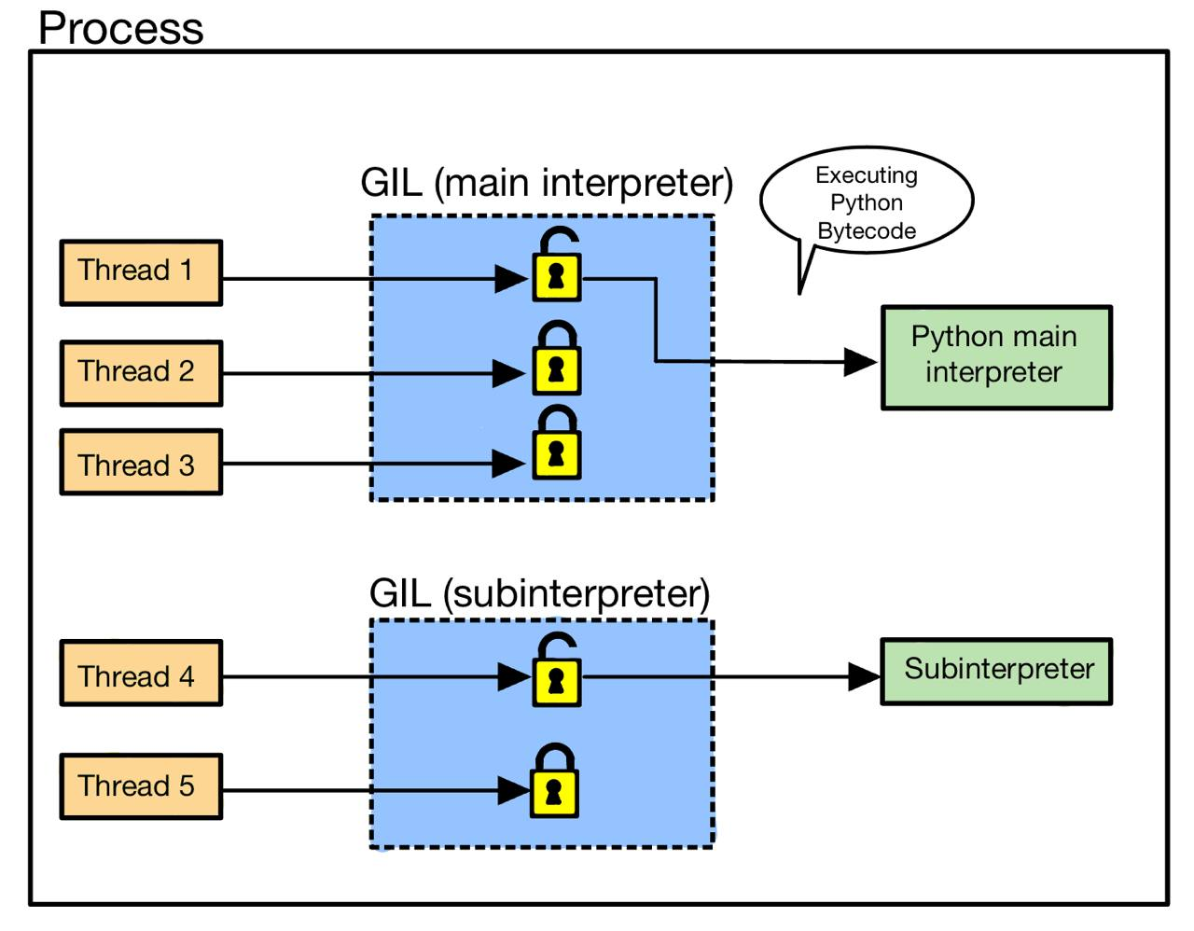
How parallelism works

Slide 7
How to run code on a subinterpreter
from concurrent import interpreters
interp = interpreters.create()
interp.exec("print('Hello, world!')")
interp.close()
from concurrent import interpreters
def func(arg1: int, arg2: int) -> int:
res = arg1 + arg2
return res
interp = interpreters.create()
a, b = 1, 2
c = interp.call(func, a, b)
print(c)
interp.close()
Interpreter.exec() executes the given source code in the interpreter (in the current OS thread), using its __main__ module. It doesn’t return anything. The code running in the current OS thread (a different interpreter) is effectively paused until Interpreter.exec() finishes.
Interpreter.call() runs the callable object in the interpreter (in the current OS thread). Return the result of calling running the given function. If the callable raises an exception then it gets propagated as an ExecutionFailed exception, in the same way as Interpreter.exec().

Slide 8
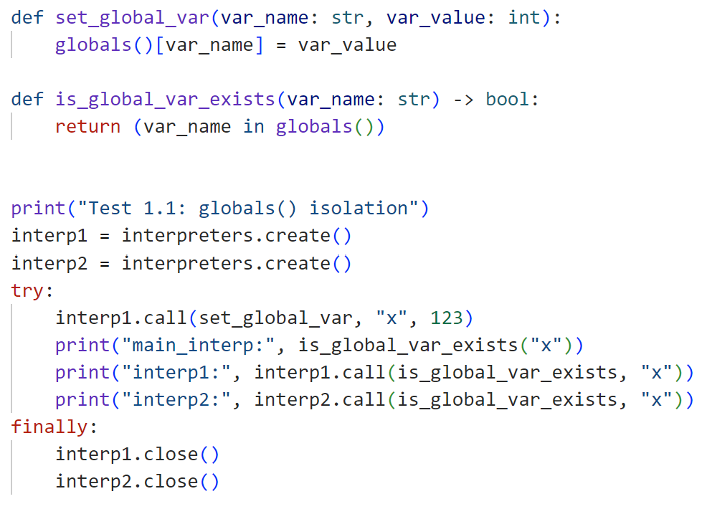
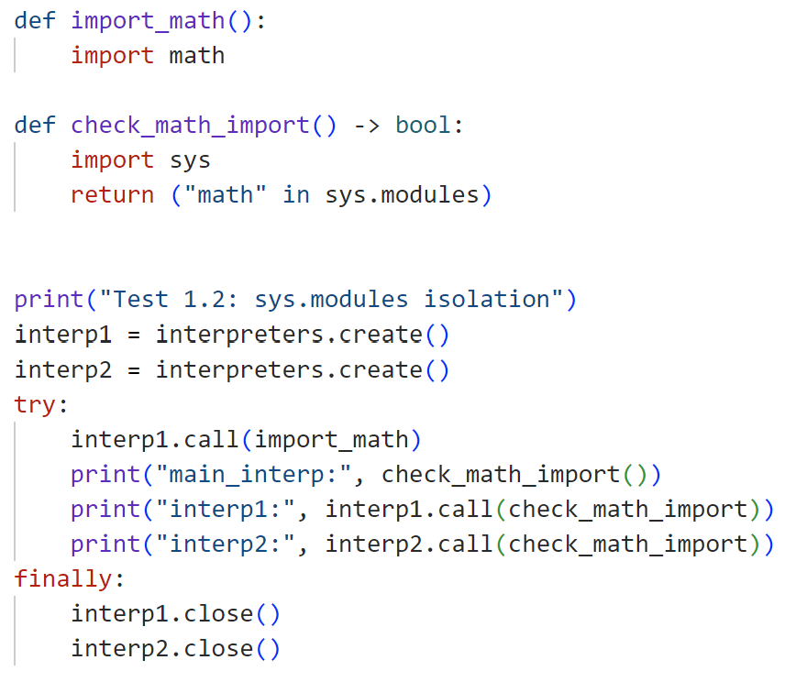
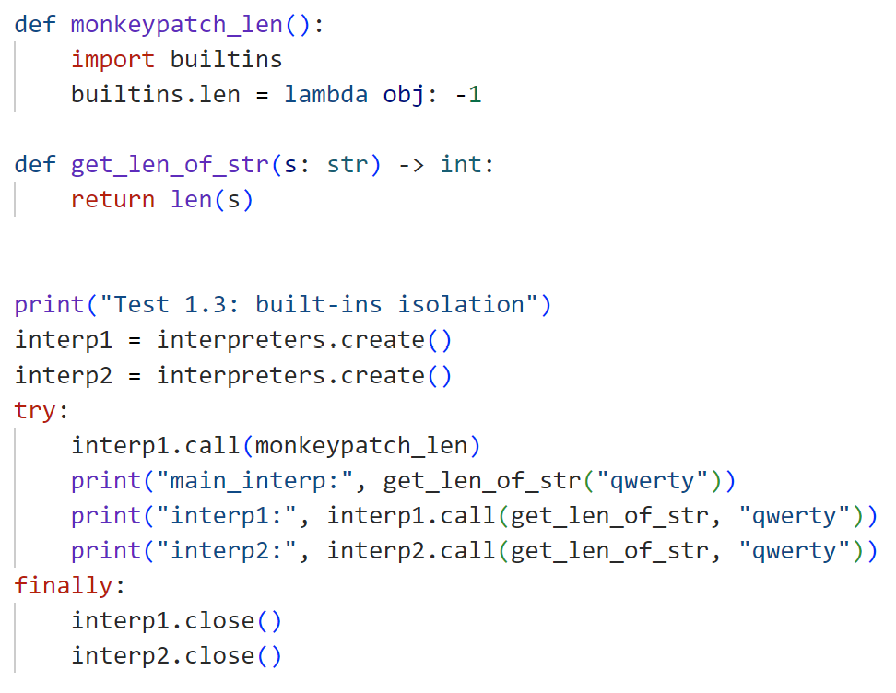
Subinterpreters states isolation check
Test 1.1: globals() isolation
main_interp: False
interp1: True
interp2: False
Test 1.2: sys.modules isolation
main_interp: False
interp1: True
interp2: False
Test 1.3: built-ins isolation
main_interp: 6
interp1: -1
interp2: 6

Slide 9
How to run code on a subinterpreter in a new thread
from concurrent import interpreters
def func(arg1: int, arg2: int) -> None:
res = arg1 + arg2
print(res)
interp = interpreters.create()
a, b = 1, 2
new_thread = interp.call_in_thread(func, a, b)
new_thread.join()
interp.close()
Interpreter.call_in_thread() is roughly equivalent to:
def task():
interp.call(func)
t = threading.Thread(target=task)
t.start()
Interpreter.call_in_thread() runs the given function in the interpreter (in a new thread). Function return values are discarded.

Slide 10
Data transfer between interpreters
concurrent.interpreters.Queue is a wrapper around a low-level, cross-interpreter queue, which implements the queue.Queue interface. The underlying queue can only be created through create_queue().
Most objects are transferred by copy (via pickle).
Only a small, explicitly supported set can be shared safely (for example, memoryview, Queue).
Immutable built-ins are either directly shared or copied efficiently. For example:
None
bool (True and False)
bytes
str
int
float
tuple (of similarly supported objects)

Slide 11
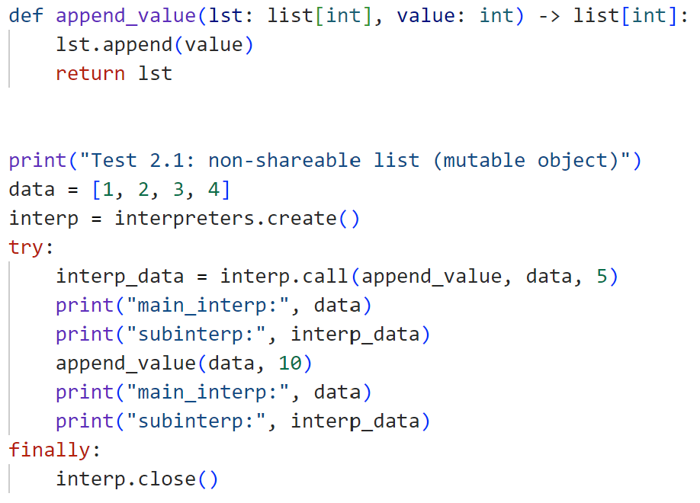
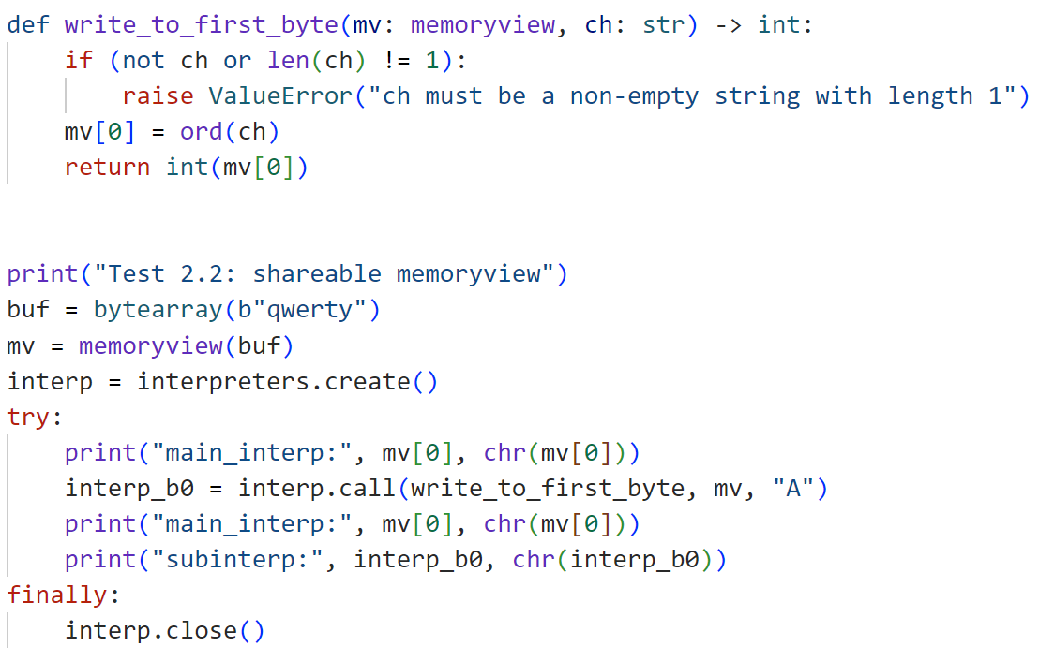
Shareable and non-shareable objects in subinterpreters
Test 2.1: non-shareable list (mutable object)
main_interp: [1, 2, 3, 4]
subinterp: [1, 2, 3, 4, 5]
main_interp: [1, 2, 3, 4, 10]
subinterp: [1, 2, 3, 4, 5]
Test 2.2: shareable memoryview
main_interp: 113 q
main_interp: 65 A
subinterp: 65 A

Slide 12
Alternatives for parallelism
Subinterpreters
One process, multiple interpreters
Separate GIL per interpreter
Isolate Python objects by design
noGIL
One process, single interpreter
True shared-memory threading
No GIL; atomics and explicit locking
Multiprocessing
Multiple OS processes
Full memory isolation
Serialization required
vs
vs

Slide 13
Start-Stop Time Test
Subinterpreters:
def bench_subinterp() -> None:
interp = interpreters.create()
t = interp.call_in_thread(empty_func)
t.join()
interp.close()
Threading with GIL and noGIL:
def bench_thread() -> None:
t = threading.Thread(target=empty_func)
t.start()
t.join()
Multiprocessing:
def bench_mp() -> None:
ctx = mp.get_context("spawn")
p = ctx.Process(target=empty_func)
p.start()
p.join()
vs
vs
This test checks the time it takes for the program to create a new subinterpreter/thread/process, execute an empty function on it, and then delete it.
def empty_func():
pass

Slide 14
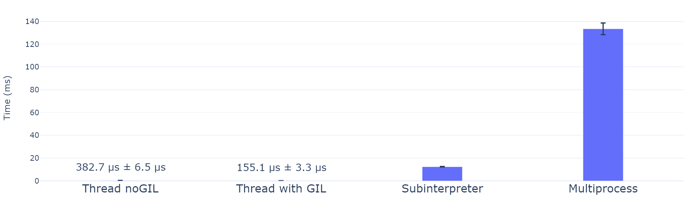
Start-Stop Time: Results
Runs on AMD Ryzen 7 7840HS (Python 3.14.2)

Slide 15
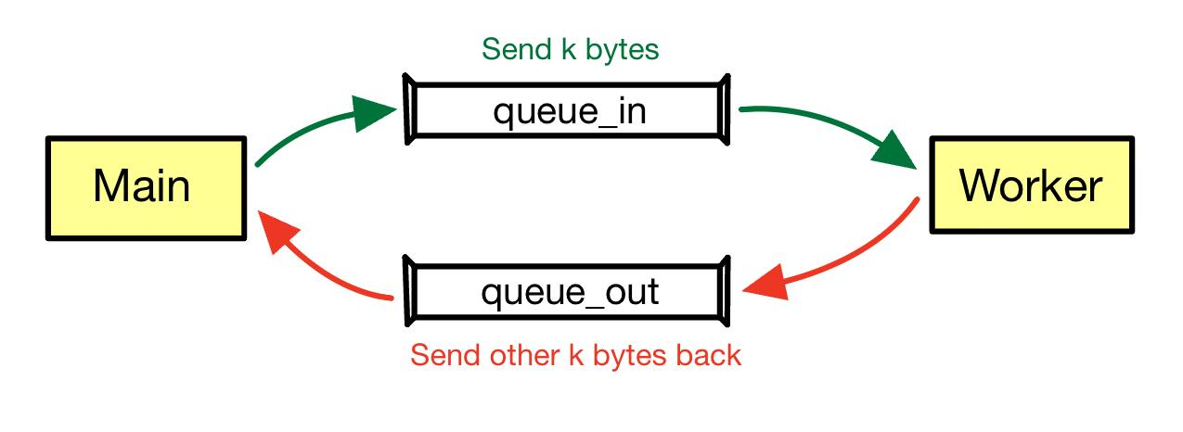
Inter-Worker Time (Ping-Pong test)
In this test, only one additional Worker thread/process is created, after which the time is measured for the Main thread/process to send a non-zero message of size k bytes to the Worker via queue_in and receive another non-zero message of size k bytes from the Worker via queue_out.

Slide 16
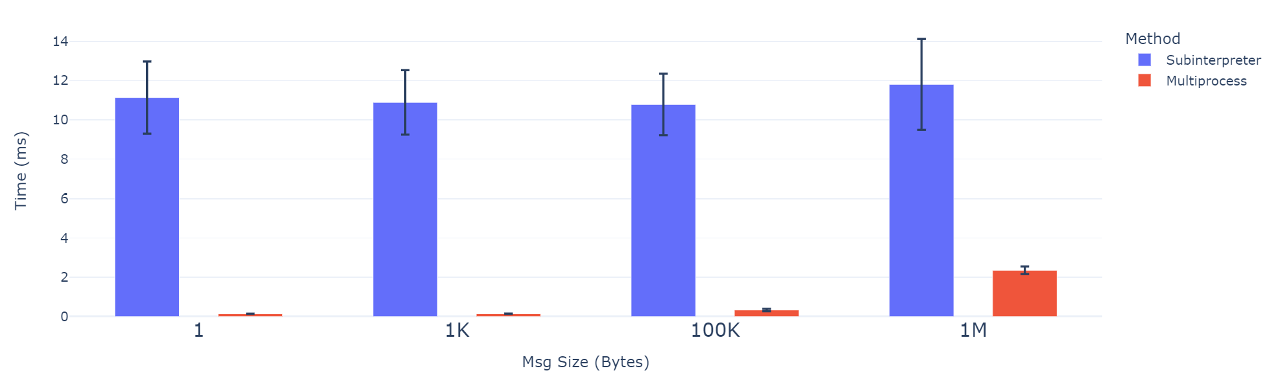
Inter-Worker Time (Ping-Pong test): Results
Runs on AMD Ryzen 7 7840HS (Python 3.14.2)

Slide 17
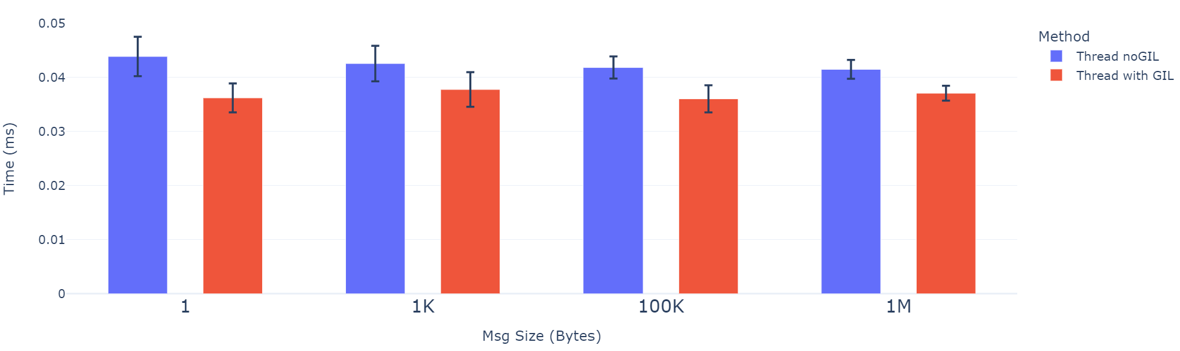
Inter-Worker Time (Ping-Pong test): Results
Runs on AMD Ryzen 7 7840HS (Python 3.14.2)

Slide 18
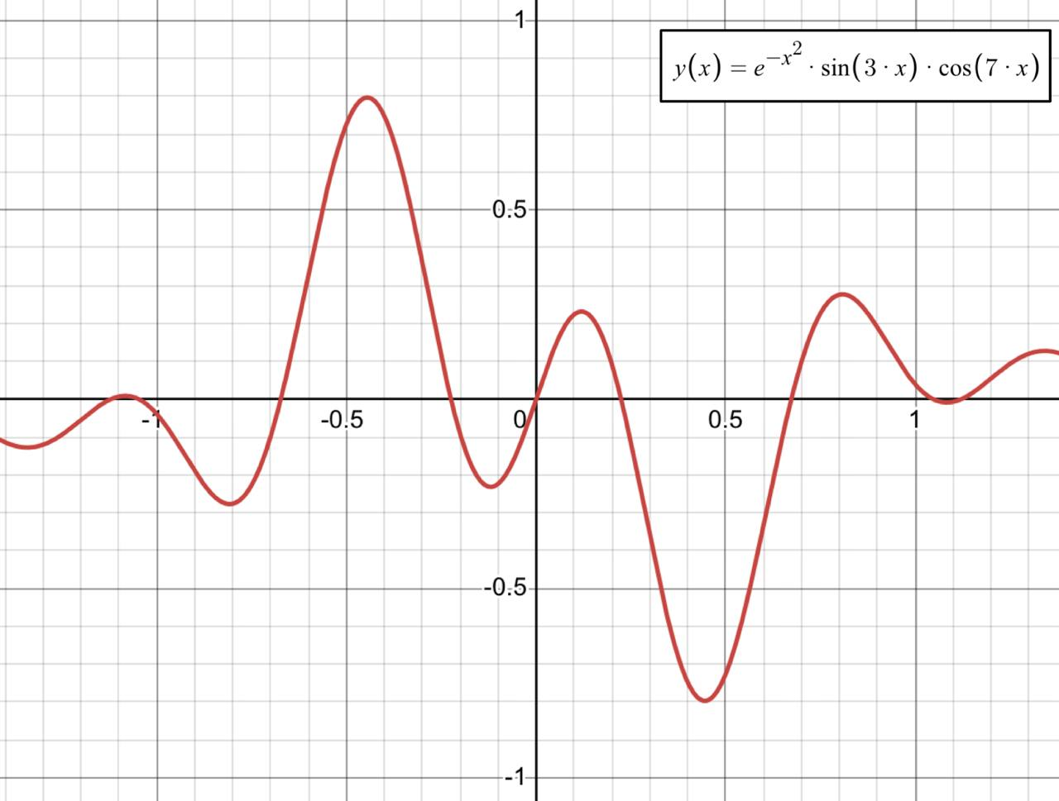
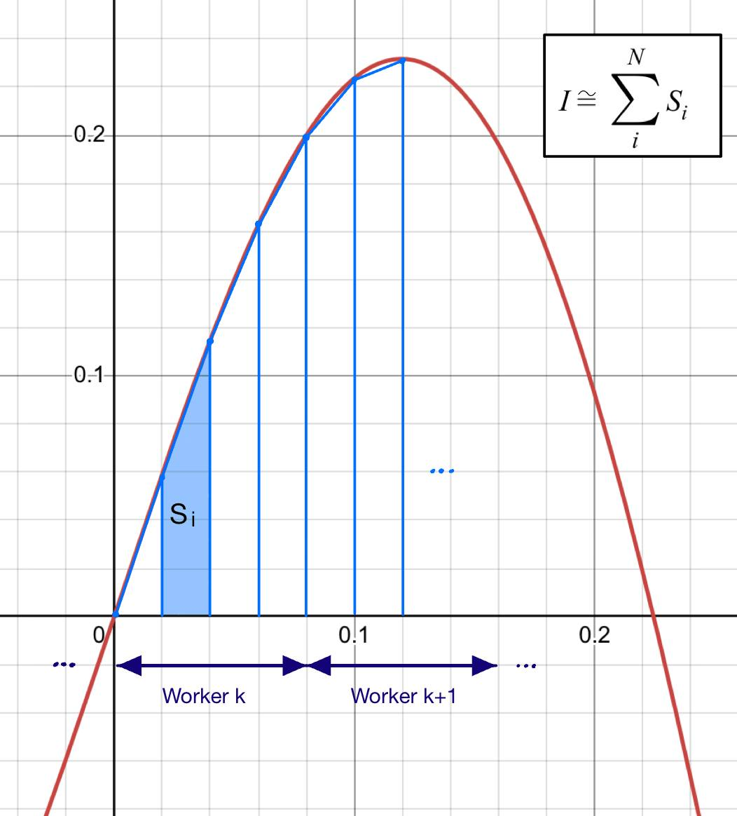
Full program work test: Calculation of a definite integral
This test checks the running time of a program that calculates a definite integral using the trapezoidal rule. The calculations are divided between several threads/processes (from 1 to 16 workers). The integral is defined on the interval [-1.0; 1.0]. The number of divisions is N = 2000000.

Slide 19
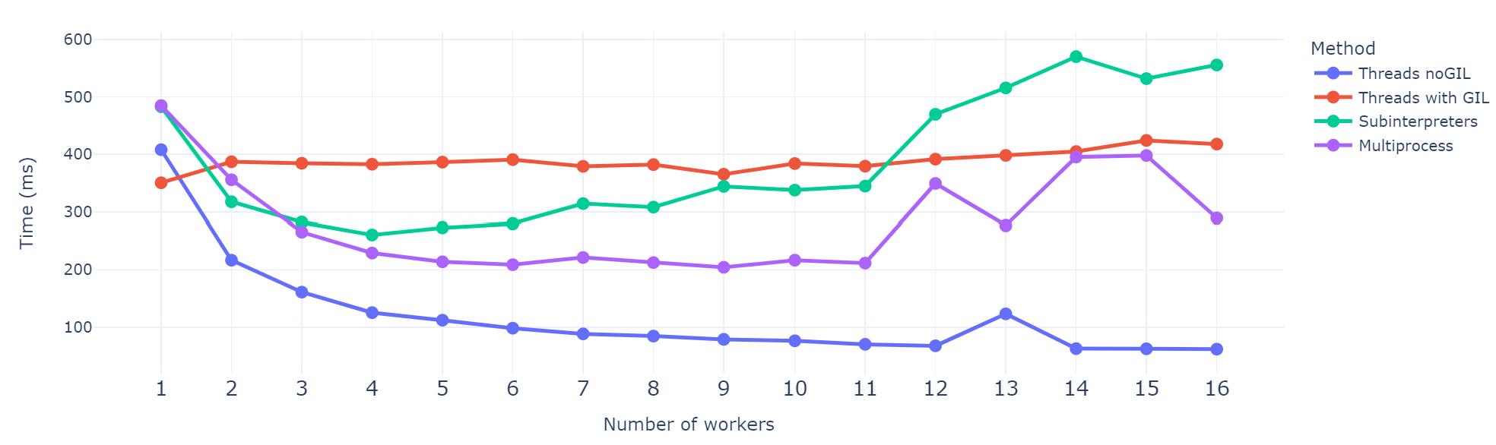
Full program work test: Results
Runs on AMD Ryzen 7 7840HS (Python 3.14.2)

Slide 20
Found benchmarks
CPU-bound:
IO-bound:
def worker_cpu(arg: tuple[int, int]):
start, end = arg
fact = 1
for i in range(start, end + 1):
fact *= i
import httpx
def worker_io(arg: tuple[int, int]):
start, end = arg
with httpx.Client() as client:
for i in range(start, end + 1):
client.get(f'http://jsonplaceholder.typicode.com/posts/{i}')

Slide 21
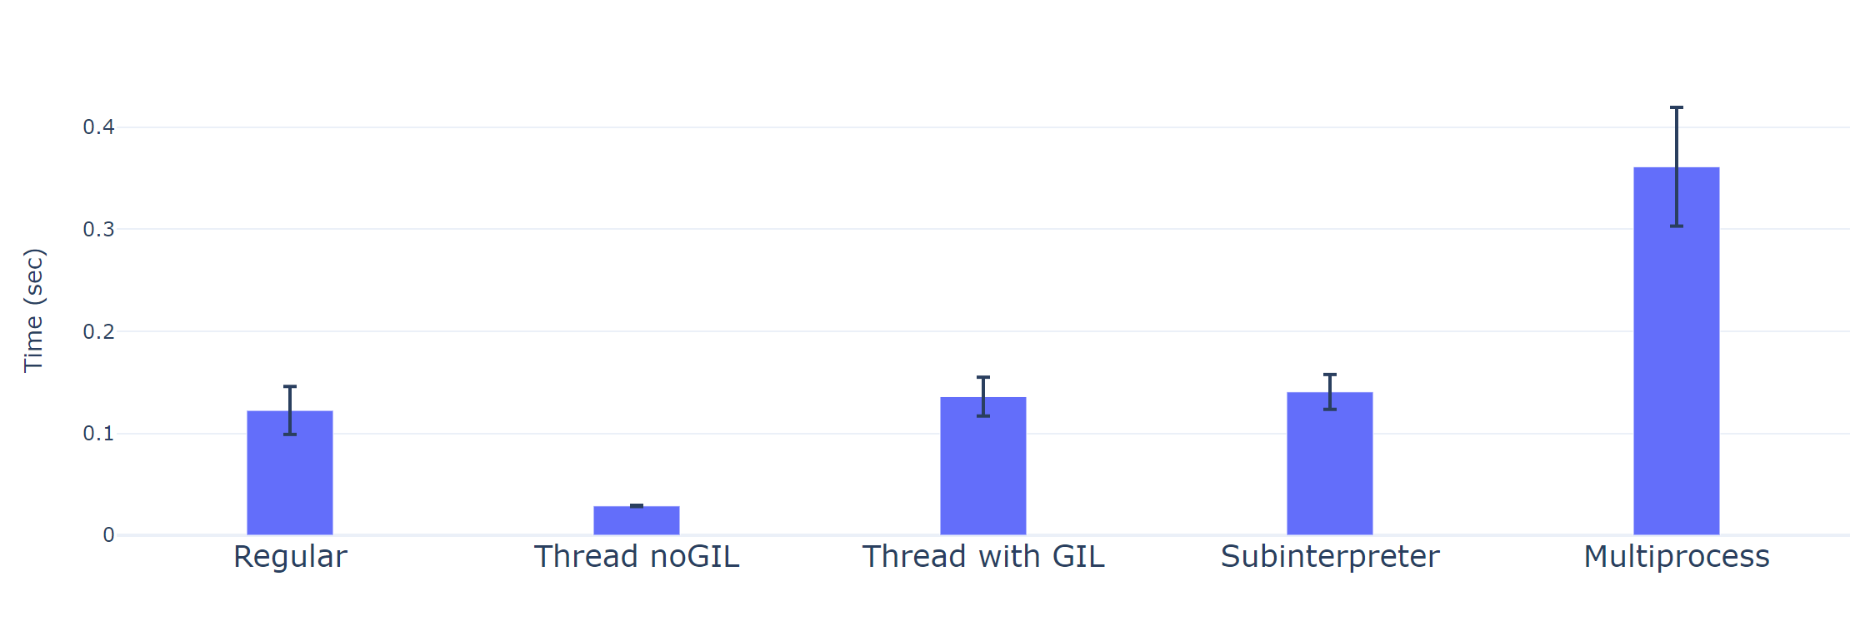
CPU-bound test: Results
Runs on AMD Ryzen 7 7840HS (Python 3.14.2)

Slide 22
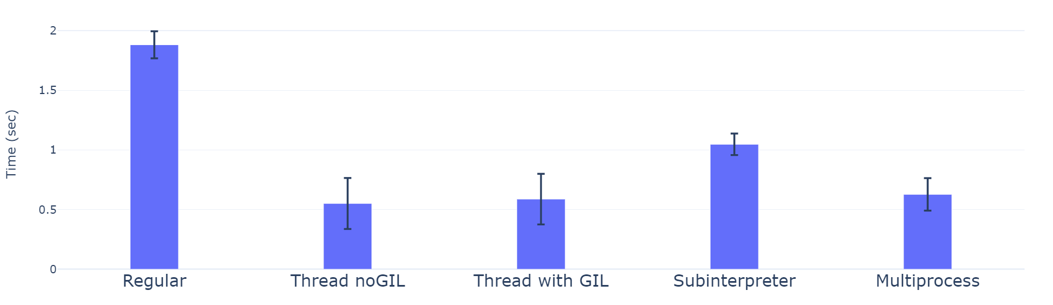
IO-bound test: Results
Runs on AMD Ryzen 7 7840HS (Python 3.14.2)

Slide 23
Results
Advantages:
Creating a subinterpreter and running code on a new thread is an order of magnitude faster than creating a new process
Allows isolating Python execution environments inside one process, simplifying lifecycle management compared to process-based isolation in multiprocessing
Disadvantages:
multiprocessing.Queue faster than concurrent.interpreters.Queue
In CPU-bound and IO-bound tests, subinterpreters don’t give a significant advantage in comparison with other parallelism methods

Slide 24
References
PEP 554: https://peps.python.org/pep-0554/
PEP 683: https://peps.python.org/pep-0683/
PEP 684: https://peps.python.org/pep-0684/
PEP 687: https://peps.python.org/pep-0687/
PEP 734: https://peps.python.org/pep-0734/
Docs: https://docs.python.org/3/library/concurrent.interpreters.html#module-concurrent.interpreters
Article: https://habr.com/ru/companies/timeweb/articles/922314/
Interview with Eric Snow: https://youtu.be/VBiaNNpLzWA?si=yLqYuN3pbb5TpHGe
Found benchmarks: https://gist.github.com/sobolevn/149a461c629f6e03aef3a772c7422b2e
Tests source code: https://github.com/SSStas/mipt-python-course/tree/main/subinterpreters_project

Slide 25
Thank you for your attention

