Slide 1

HistoriCal
Historical educational application

Slide 2
Table of contents
01
02
03
04
Team
The Task
Implementation
Technologies

Slide 3
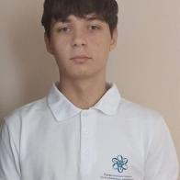
The team
Simeon Stefanov 10B
Full-Stack developer

Slide 4
The Task
The task is to make easy to use console application with educational purpose.

Slide 5
Implementation
01
02
03
04
Chose what technologies to use
Discussed the idea
Started to work on the project
Finished the project

Slide 6


Technologies
C++
Visual Studio 2022

Slide 7
Thank you for the attention
Let’s jump into the project!

