Slide 1
CS 426 (Fall 2010)
Public Key Encryption and Digital Signatures
Fall 2010/Lecture 31

Slide 2
Review of Secret Key (Symmetric) Cryptography
Confidentiality
  stream ciphers (uses PRNG)
  block ciphers with encryption modes
Integrity
  Cryptographic hash functions
  Message authentication code (keyed hash functions)
Limitation: sender and receiver must share the same key
  Needs secure channel for key distribution
  Impossible for two parties having no prior relationship
  Needs many keys for n parties to communicate
Fall 2010/Lecture 31

Slide 3
Public Key Encryption Overview
Each party has a PAIR (K, K⁻¹) of keys:
  K is the public key, and used for encryption
  K⁻¹ is the private key, and used for decryption
  Satisfies D_{K}-1[E_{K}[M]] = M
Knowing the public-key K, it is computationally infeasible to compute the private key K⁻¹
  How to check (K,K⁻¹) is a pair?
  Offers only computational security. PK Encryption impossible when P=NP, as deriving K⁻¹ from K is in NP.
The public-key K may be made publicly available, e.g., in a publicly available directory
  Many can encrypt, only one can decrypt
Public-key systems aka asymmetric crypto systems
Fall 2010/Lecture 31

Slide 4
Public Key Cryptography Early History
The concept is proposed in Diffie and Hellman (1976) “New Directions in Cryptography”
  public-key encryption schemes
  public key distribution systems
    Diffie-Hellman key agreement protocol
  digital signature
Public-key encryption was proposed in 1970 by James Ellis
  in a classified paper made public in 1997 by the British Governmental Communications Headquarters
Concept of digital signature is still originally due to Diffie & Hellman
Fall 2010/Lecture 31

Slide 5
Public Key Encryption Algorithms
Almost all public-key encryption algorithms use either number theory and modular arithmetic, or elliptic curves
RSA
  based on the hardness of factoring large numbers
El Gamal
  Based on the hardness of solving discrete logarithm
  Basic idea: public key g^{x}, private key x, to encrypt: [g^{y}, g^{xy} M].
Fall 2010/Lecture 31

Slide 6
RSA Algorithm
Invented in 1978 by Ron Rivest, Adi Shamir and Leonard Adleman
  Published as R L Rivest, A Shamir, L Adleman, "On Digital Signatures and Public Key Cryptosystems", Communications of the ACM, vol 21 no 2, pp120-126, Feb 1978
Security relies on the difficulty of factoring large composite numbers
Essentially the same algorithm was discovered in 1973 by Clifford Cocks, who works for the British intelligence
Fall 2010/Lecture 31

Slide 7
RSA Public Key Crypto System
Key generation:
1. Select 2 large prime numbers of about the same size, p and q
  Typically each p, q has between 512 and 2048 bits
2. Compute n = pq, and Φ(n) = (q-1)(p-1)
3. Select e, 1<e< Φ(n), s.t. gcd(e, Φ(n)) = 1
  Typically e=3 or e=65537
4. Compute d, 1< d< Φ(n) s.t. ed ≡ 1 mod Φ(n)
  Knowing Φ(n), d easy to compute.
Public key: (e, n)
Private key: d
Fall 2010/Lecture 31

Slide 8
RSA Description (cont.)
Encryption
Given a message M, 0 < M < n M ∈ Z_{n}− {0}
use public key (e, n)
compute C = Me mod n C ∈ Z_{n}− {0}
Decryption
Given a ciphertext C, use private key (d)
Compute C^{d} mod n = (Me mod n)^{d} mod n = M^{ed} mod n = M
Fall 2010/Lecture 31

Slide 9
C = Me mod (n=pq)
Plaintext: M
Ciphertext: C
C^{d} mod n
From n, difficult to figure out p,q
From (n,e), difficult to figure d.
From (n,e) and C, difficult to figure out M s.t. C = Me
Fall 2010/Lecture 31

Slide 10
RSA Example
p = 11, q = 7, n = 77, Φ(n) = 60
d = 13, e = 37 (ed = 481; ed mod 60 = 1)
Let M = 15. Then C ≡ Me mod n
  C ≡ 15³⁷ (mod 77) = 71
M ≡ C^{d} mod n
  M ≡ 71¹³ (mod 77) = 15
Fall 2010/Lecture 31

Slide 11
RSA Example 2
Parameters:
  p = 3, q = 5, q= pq = 15
  Φ(n) = ?
Let e = 3, what is d?
Given M=2, what is C?
How to decrypt?
Fall 2010/Lecture 31

Slide 12
RSA Security
Security depends on the difficulty of factoring n
  Factor n => Φ(n) => compute d from (e, Φ(n))
The length of n=pq reflects the strength
  700-bit n factored in 2007
  768 bit factored in 2009
1024 bit for minimal level of security today
  likely to be breakable in near future
Minimal 2048 bits recommended for current usage
NIST suggests 15360-bit RSA keys are equivalent in strength to 256-bit
RSA speed is quadratic in key length
Fall 2010/Lecture 31

Slide 13
Real World Usage of Public Key Encryption
Often used to encrypt a symmetric key
  To encrypt a message M under a public key (n,e), generate a new AES key K, compute [RSA(n,e,K), AES(K,M)]
Plain RSA does not satisfy IND requirement.
  How to break it?
One often needs padding, e.g., Optimal Asymmetric Encryption Padding (OAEP)
  Roughly, to encrypt M, chooses random r, encode M as M’ = [X = M ⊕ H₁(r) , Y= r ⊕ H₂(X) ] where H₁ and H₂ are cryptographic hash functions, then encrypt it as (M’) ^{e} mod n
  Note that given M’=[X,Y], r = Y ⊕ H₂(X), and M = X ⊕ H₁(r)
Fall 2010/Lecture 31

Slide 14
Digital Signatures: The Problem
Consider the real-life example where a person pays by credit card and signs a bill; the seller verifies that the signature on the bill is the same with the signature on the card
Contracts, they are valid if they are signed.
Signatures provide non-repudiation.
  ensuring that a party in a dispute cannot repudiate, or refute the validity of a statement or contract.
Can we have a similar service in the electronic world?
  Does Message Authentication Code provide non-repudiation? Why?
Fall 2010/Lecture 31

Slide 15
Digital Signatures
MAC: One party generates MAC, one party verifies integrity.
Digital signatures: One party generates signature, many parties can verify.
Digital Signature: a data string which associates a message with some originating entity.
Digital Signature Scheme:
  a signing algorithm: takes a message and a (private) signing key, outputs a signature
  a verification algorithm: takes a (public) key verification key, a message, and a signature
Provides:
  Authentication, Data integrity, Non-Repudiation
Fall 2010/Lecture 31

Slide 16
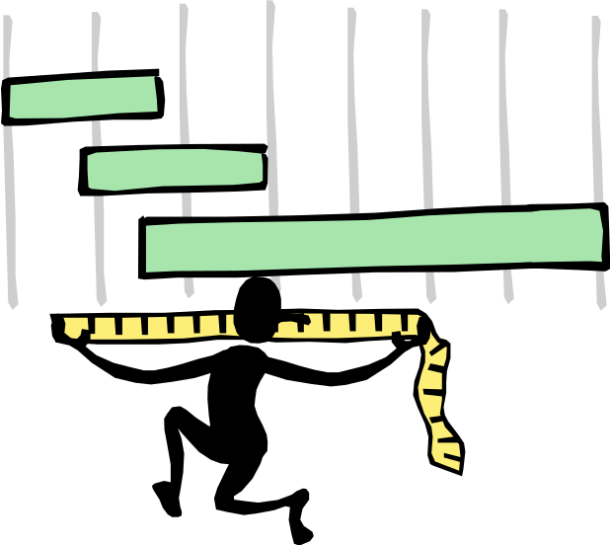
Digital Signatures and Hash
Very often digital signatures are used with hash functions, hash of a message is signed, instead of the message.
Hash function must be:
  Pre-image resistant
  Weak collision resistant
  Strong collision resistant
Fall 2010/Lecture 31

Slide 17
RSA Signatures
Key generation (as in RSA encryption):
Select 2 large prime numbers of about the
same size, p and q
Compute n = pq, and Φ = (q - 1)(p - 1)
Select a random integer e, 1 < e < Φ, s.t.
gcd(e, Φ) = 1
Compute d, 1 < d < Φ s.t. ed ≡ 1 mod Φ
Public key: (e, n) used for verification
Secret key: d, used for generation
Fall 2010/Lecture 31

Slide 18
RSA Signatures (cont.)
Signing message M
Verify 0 < M < n
Compute S = M^{d} mod n
Verifying signature S
Use public key (e, n)
Compute S^{e} mod n = (M^{d} mod n)^{e} mod n = M
Note: in practice, a hash of the message is signed
and not the message itself.
Fall 2010/Lecture 31

Slide 19
The Big Picture
Secrecy / Confidentiality | Stream ciphers Block ciphers + encryption modes | Public key encryption: RSA, El Gamal, etc.
Authenticity / Integrity | Message Authentication Code | Digital Signatures: RSA, DSA, etc.
Secret Key
Setting
Public Key
Setting
Fall 2010/Lecture 31

Slide 20

Readings for This Lecture
Differ & Hellman:
  New Directions in Cryptography
Fall 2010/Lecture 31

Slide 21

Coming Attractions …
Key management and certificates
Fall 2010/Lecture 31

