Slide 1
The Arduino seminar: Part I

Slide 2

Hello!
I am Shen Zheyu, 沈哲宇
Email: arsdragonfly@sjtu.edu.cn
Github: https://github.com/arsdragonfly

Slide 3
Prologue
All course material are available here:
https://github.com/SSTIA/arduino-seminar
Raise your hand if you have any questions.
The slides are copyrighted; do not redistribute!

Slide 4
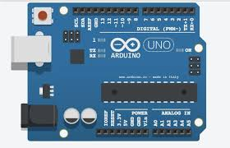
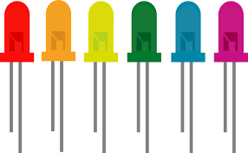
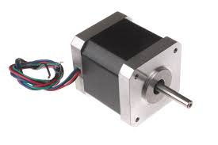
What is Arduino?
A micro computer able to control various hardware;
Vibrant community; easy-to-use

Slide 5
Before we start...
Download & install the Arduino IDE from here:
www.arduino.cc

Slide 6
Blinking an LED
1
That's how you get started with Arduino

Slide 7
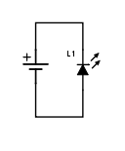
The most basic circuit

Slide 8
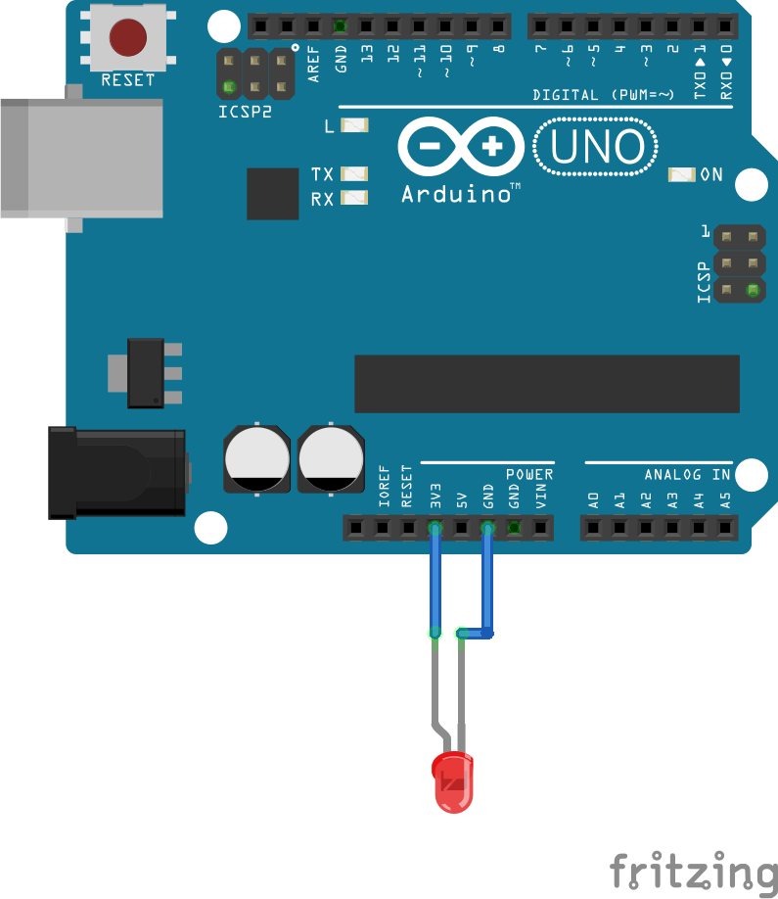
The most basic circuit

Slide 9
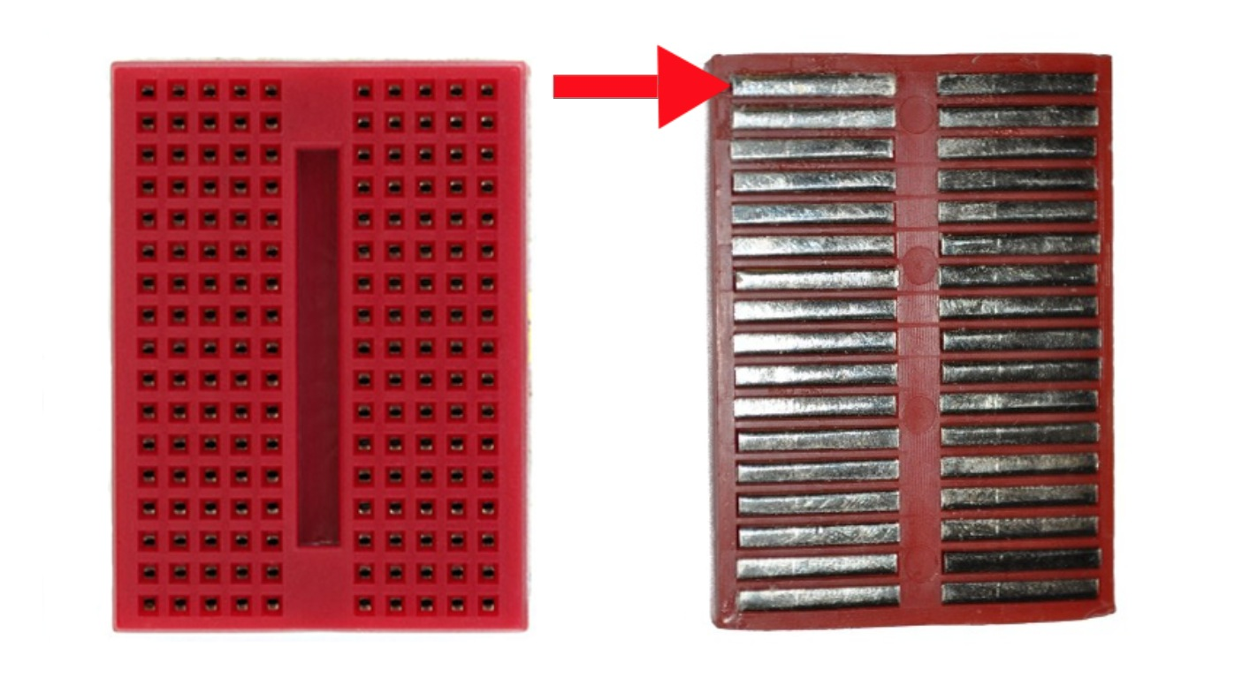
Breadboard

Slide 10
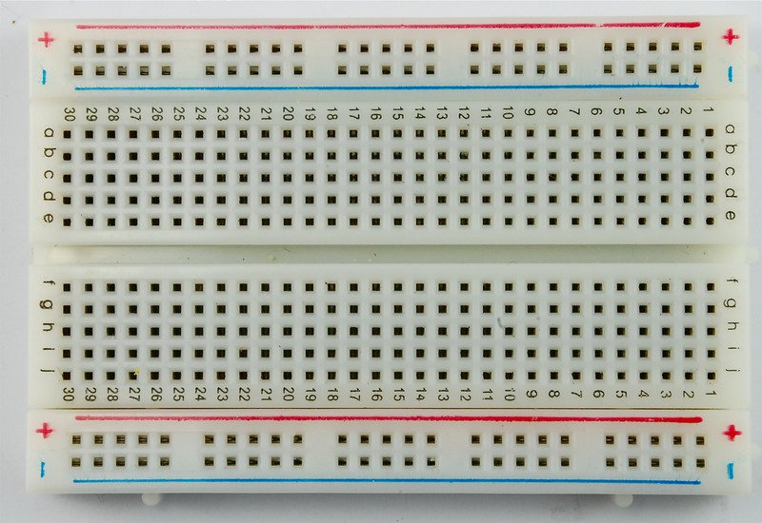
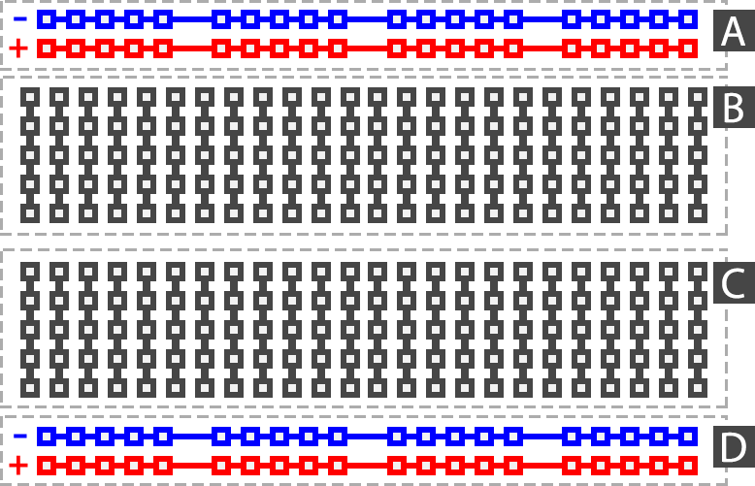
Breadboard

Slide 11
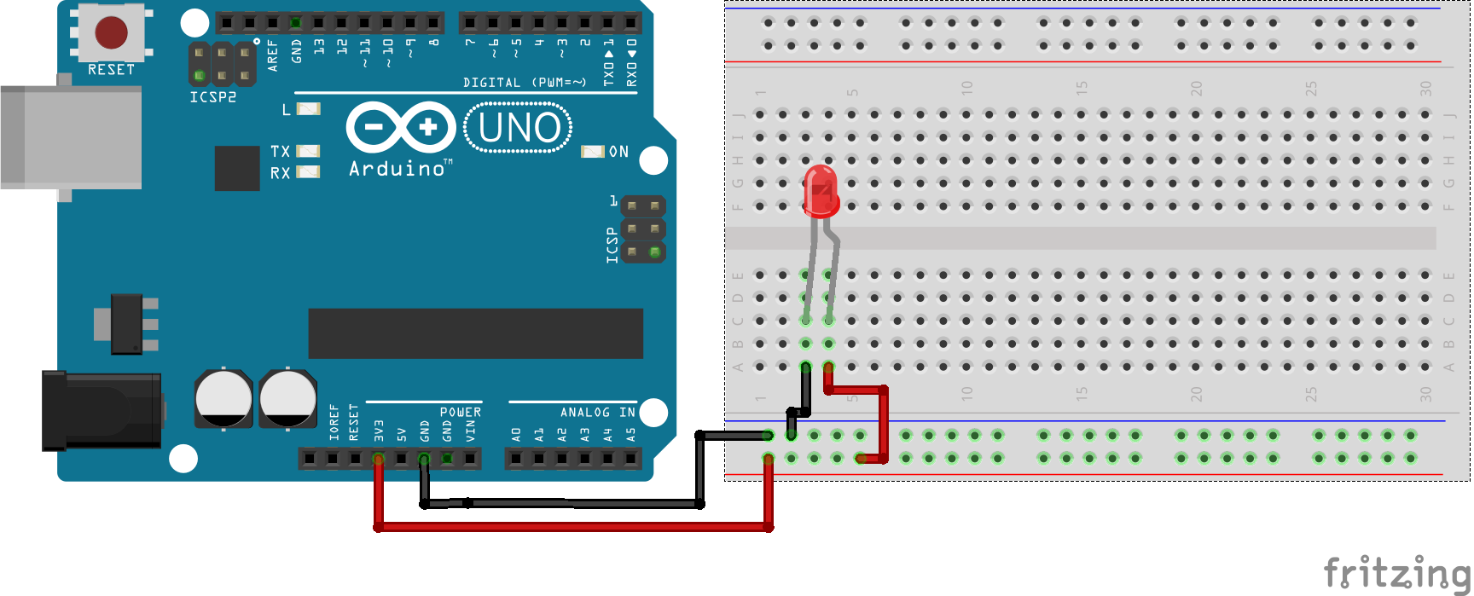
Same circuit using the breadboard

Slide 12
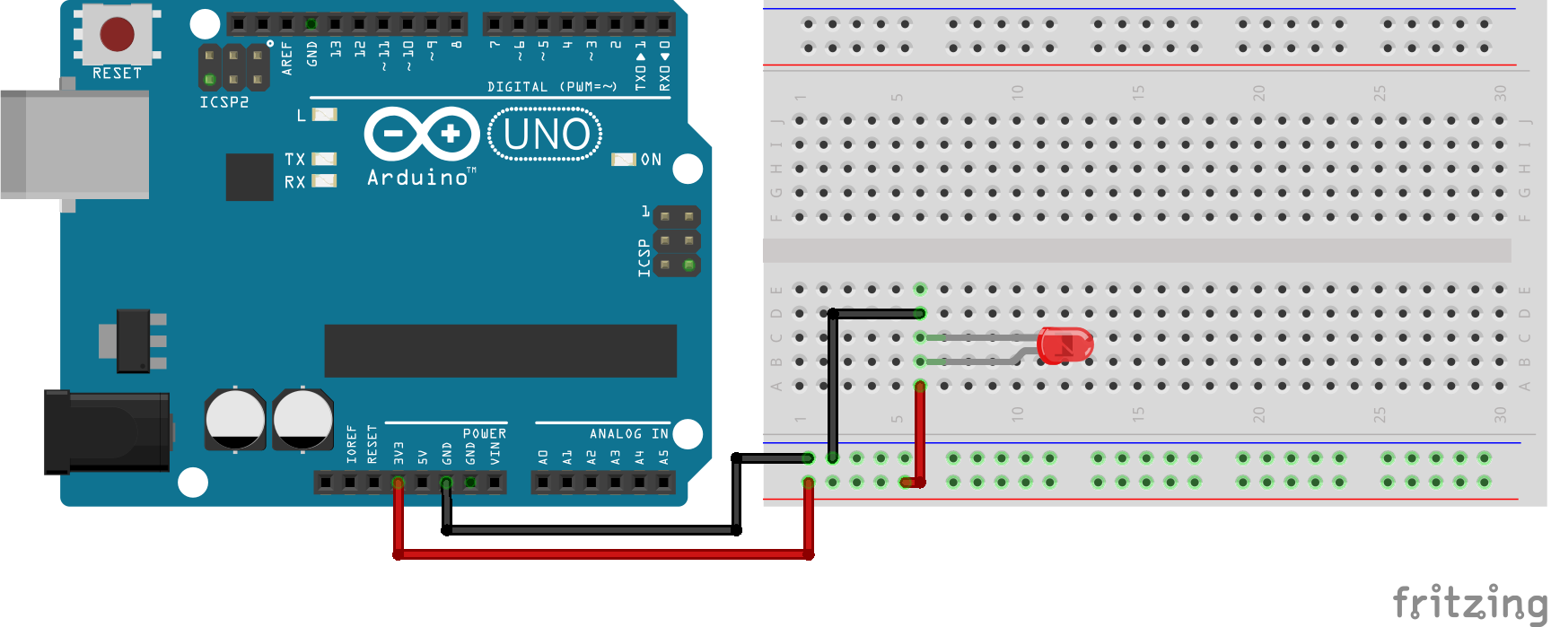
What if... ?

Slide 13
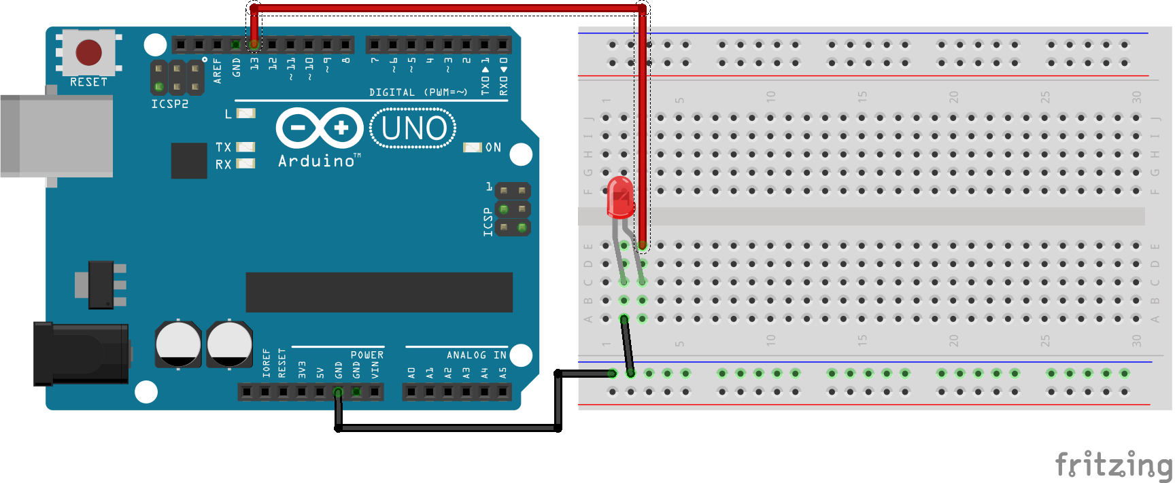
A regulated blinking LED

Slide 14
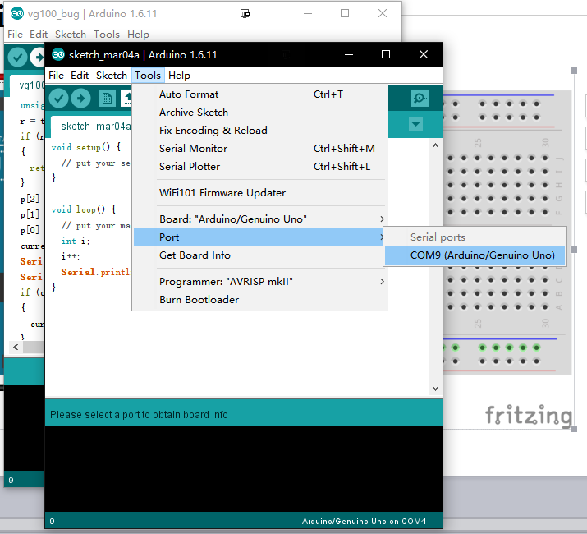
A regulated blinking LED

Slide 15
A regaulated blinking LED
Although every other tutorial would look like this...
void loop() {
digitalWrite(13, HIGH);
delay(1000); // wait for a second
digitalWrite(13, LOW);
delay(1000); // wait for a second
}

Slide 16
A regaulated blinking LED
Never f**king use delay() for anything non-trivial outside setup()!!!
Hangs up the excecution of any code;
Your rig stops responding to any input.

Slide 17
Driving a Motor
2
Your first moving part

Slide 18
Driving a servo motor
What's special about a servo motor:
Can set its orientation precisely;
Often has limited range of rotation;
Beware of a motor's torque and resolution!

Slide 19
Serial output
Serial.println() can be useful for debugging.
Tools -> Serial Monitor for the serial command line.
Pin 0(RX) and 1(TX) will be occupied; beware!

Slide 20
Using EEPROM
3
Store essential information on the board

Slide 21
How to fine-tune my system?
Sometimes you need to set a few parameters

Slide 22
Credits
Special thanks to all the people who made and released these awesome resources for free:
Presentation template by SlidesCarnival
Photographs by Unsplash

