Slide 1
The Arduino seminar: Part I

Slide 2

Hello!
I am Shen Zheyu, 沈哲宇
Email: arsdragonfly@sjtu.edu.cn
Github: https://github.com/arsdragonfly

Slide 3
Prologue
All course material are available here:
https://github.com/SSTIA/arduino-seminar
Raise your hand if you have any questions.
The slides are copyrighted; do not redistribute!

Slide 4
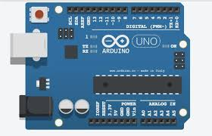
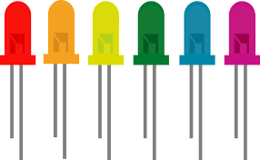
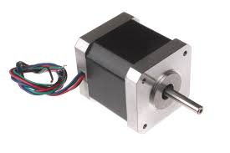
What is Arduino?
A micro computer able to control various hardware;
Vibrant community; easy-to-use

Slide 5
Before we start...
Download & install the Arduino IDE from here:
www.arduino.cc

Slide 6
Blinking an LED
1
That's how you get started with Arduino

Slide 7
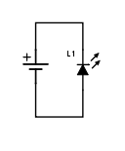
The most basic circuit

Slide 8
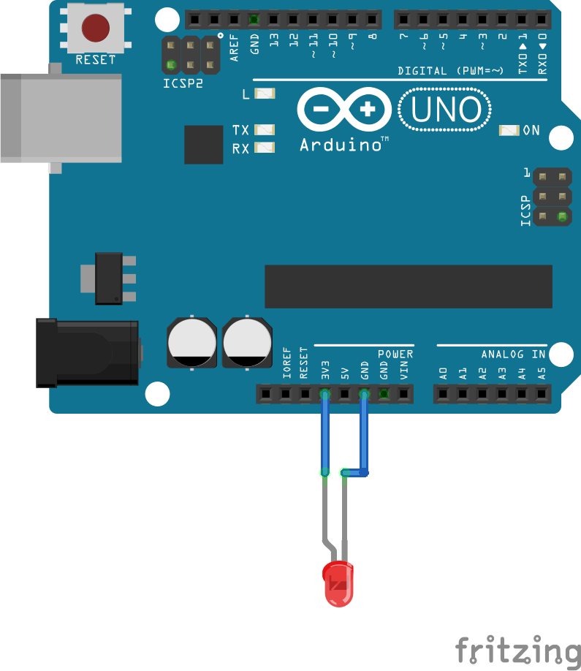
The most basic circuit

Slide 9
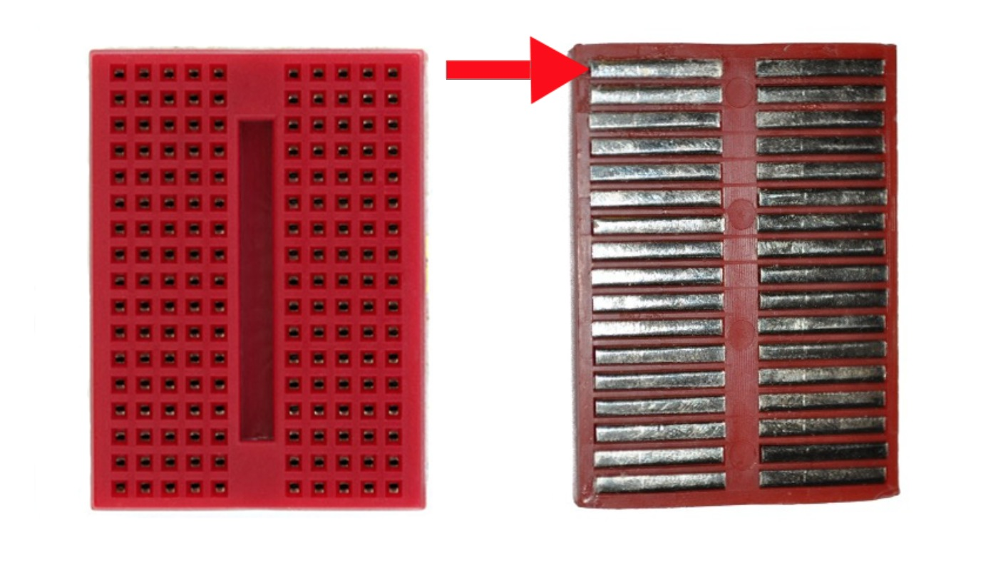
Breadboard

Slide 10
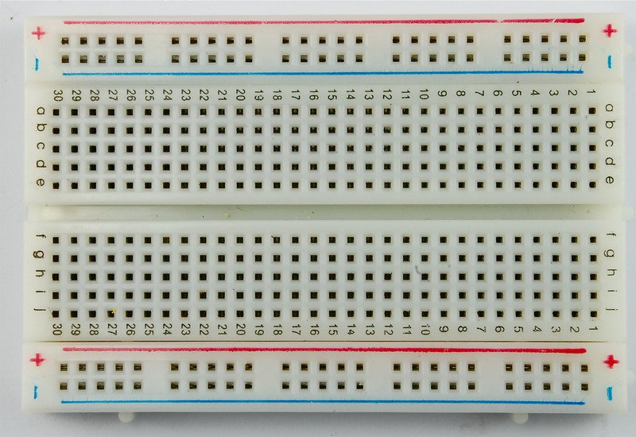
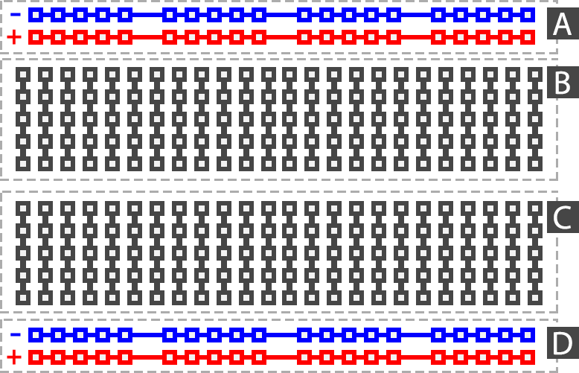
Breadboard

Slide 11
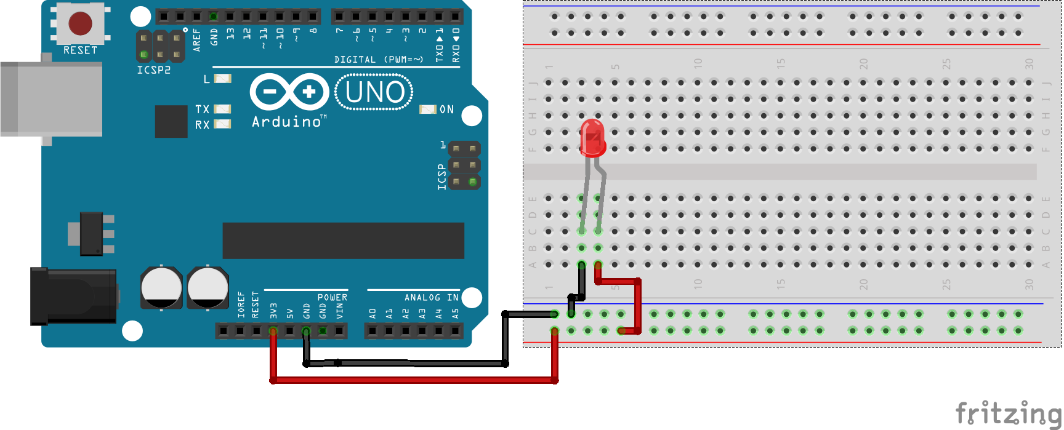
Same circuit using the breadboard

Slide 12
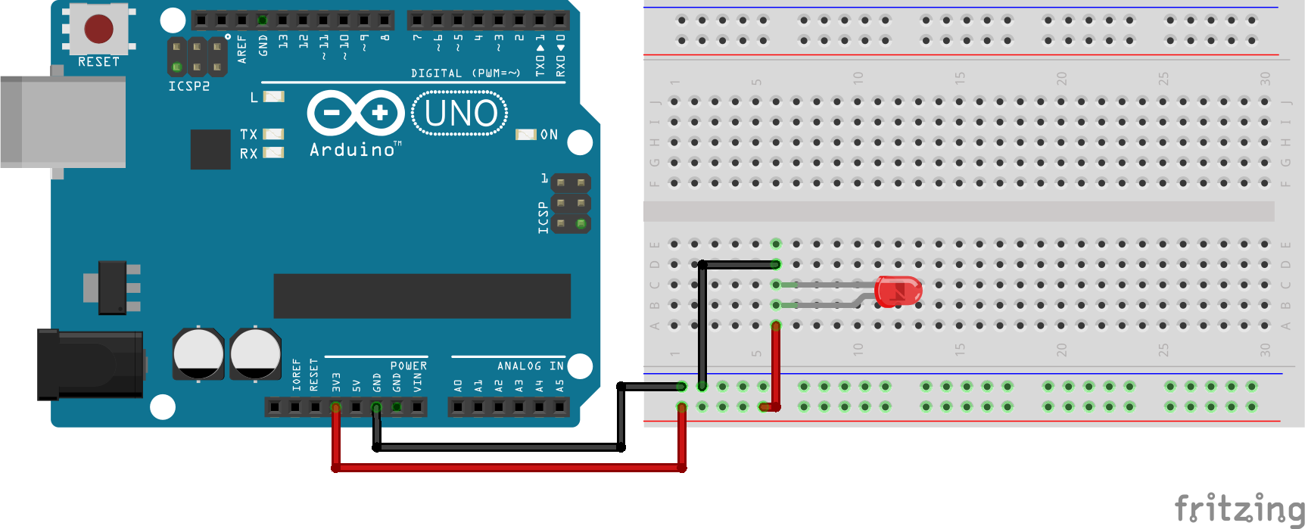
What if... ?

Slide 13
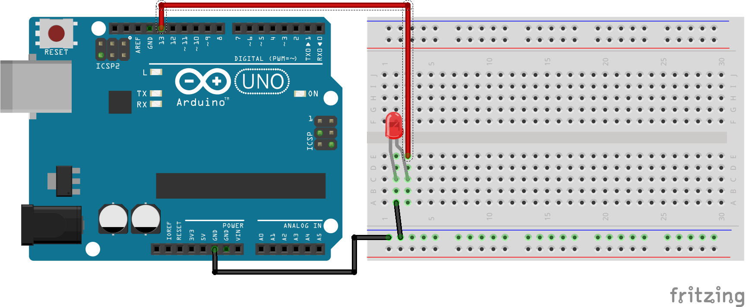
A regulated blinking LED

Slide 14
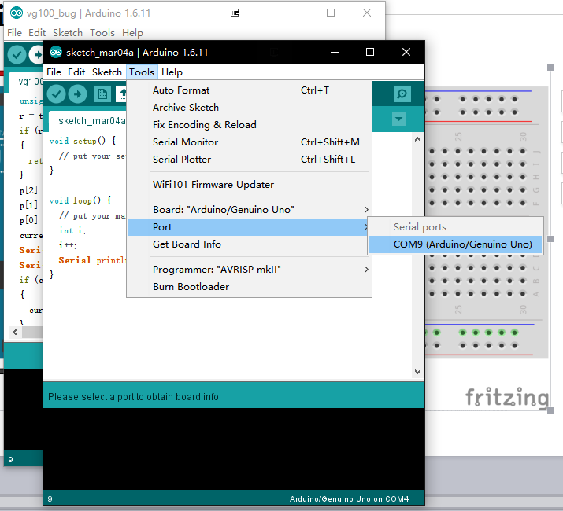
A regulated blinking LED

Slide 15
A regaulated blinking LED
Although every other tutorial would look like this...
void loop() {
digitalWrite(13, HIGH);
delay(1000); // wait for a second
digitalWrite(13, LOW);
delay(1000); // wait for a second
}

Slide 16
A regaulated blinking LED
Never f**king use delay() for anything non-trivial outside setup()!!!
Hangs up the excecution of any code;
Your rig stops responding to any input.

Slide 17
Driving a Motor
2
Your first moving part

Slide 18
Driving a servo motor
What's special about a servo motor:
Can set its orientation precisely;
Often has limited range of rotation;
Beware of a motor's torque and resolution!

Slide 19
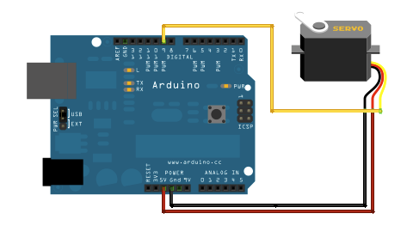
Driving a servo motor

Slide 20
Serial output & input
Serial.println() can be useful for debugging.
Tools -> Serial Monitor for the serial command line.
Pin 0(RX) and 1(TX) will be occupied; beware!
Bluetooth also works through serial I/O.

Slide 21
Using EEPROM
3
Store essential information on the board

Slide 22
How to fine-tune my system?
Sometimes you need to set a few parameters by trial-and-error:
The speed of your motors can be a bit off;
Your mechanical arm may need to be positioned upright;
...

Slide 23

Hard-coding everything can be time-consuming!
You need to hook up your rig every time you want you make a change. This drastically slows down your development process.

Slide 24
What is an EEPROM?
It functions like hard-drives (or SSDs) on your computer.
able to save data across reboots
Plan your space carefully; only 1024 bytes on Arduino Uno!

Slide 25
What is a library?
Compare programming to building a house, and a library will be the prefabricated walls. It makes things easier!
Whenever you find a particular part of your programming difficult, it's time to go look for a library!

Slide 26
EEPROM code example
EEPROMAnything.h is a tiny library that simplifies the usage of EEPROM.
Send 'S' to the Serial Monitor for a shorter blinking cycle; 'L' for a longer one.
Unplug the Arduino, then plug in again; watch how your previous configuration is maintained.

Slide 27
Thanks!
Any questions ?
You can find me at
arsdragonfly@sjtu.edu.cn
https://github.com/arsdragonfly/

Slide 28
Credits
Special thanks to all the people who made and released these awesome resources for free:
Presentation template by SlidesCarnival
Photographs by Unsplash

