Slide 1
The Arduino seminar: Part III

Slide 2
Using LCD display
1
Debug swiftly on-the-go.

Slide 3
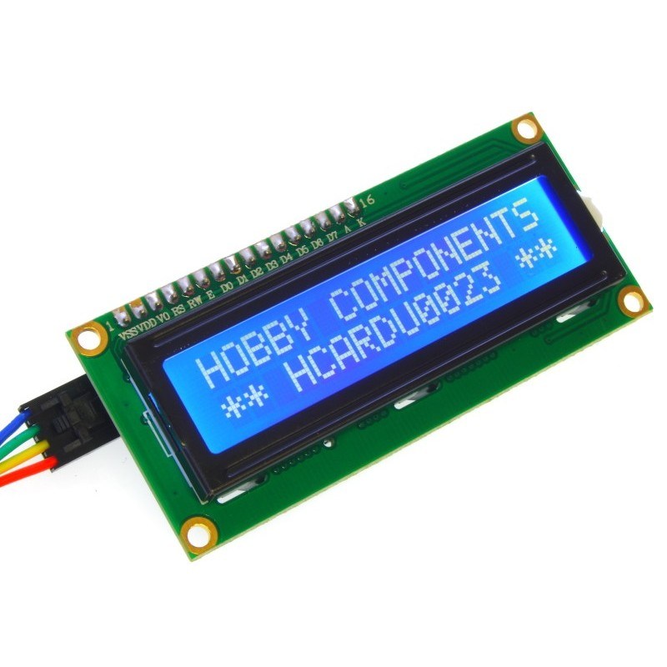
Why LCD?
It enables you to display & see debug output on-the-go, i.e. no need to plug into your PC.
Accelerates your development

Slide 4
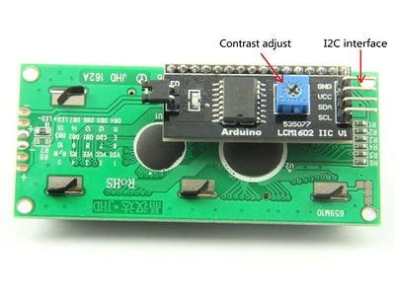
Choose an appropriate LCD
LCDs with I2C pins are favorable (less pins needed than those that don't have it)

Slide 5
Connection
VCC -> 5V
GND -> GND
SDA -> A4
SCL -> A5

Slide 6
Adding third-party libraries
Download the LiquidCrystal-I2C library from here:
https://github.com/fdebrabander/Arduino-LiquidCrystal-I2C-library
Then Sketch -> Include library -> Add .zip library
Add #include <LiquidCrystal_I2C.h> to your code and you're ready to go!

Slide 7
Credits
Special thanks to all the people who made and released these awesome resources for free:
Presentation template by SlidesCarnival
Photographs by Unsplash

