Slide 1
The Arduino seminar: Part I

Slide 2

Hello!
I am Shen Zheyu, 沈哲宇
Email: arsdragonfly@sjtu.edu.cn
Github: https://github.com/arsdragonfly

Slide 3
Prologue
All course material are available here:
https://github.com/SSTIA/arduino-seminar
Raise your hand if you have any questions.
The slides are copyrighted; do not redistribute!

Slide 4
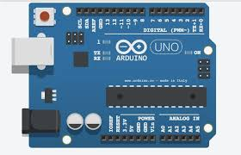
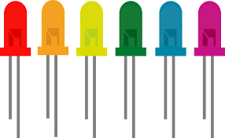
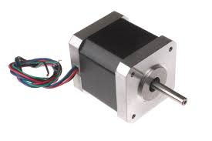
What is Arduino?
A micro computer able to control various hardware;
Vibrant community; easy-to-use

Slide 5
Before we start...
Download & install the Arduino IDE from here:
www.arduino.cc

Slide 6
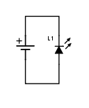
The most basic circuit

Slide 7
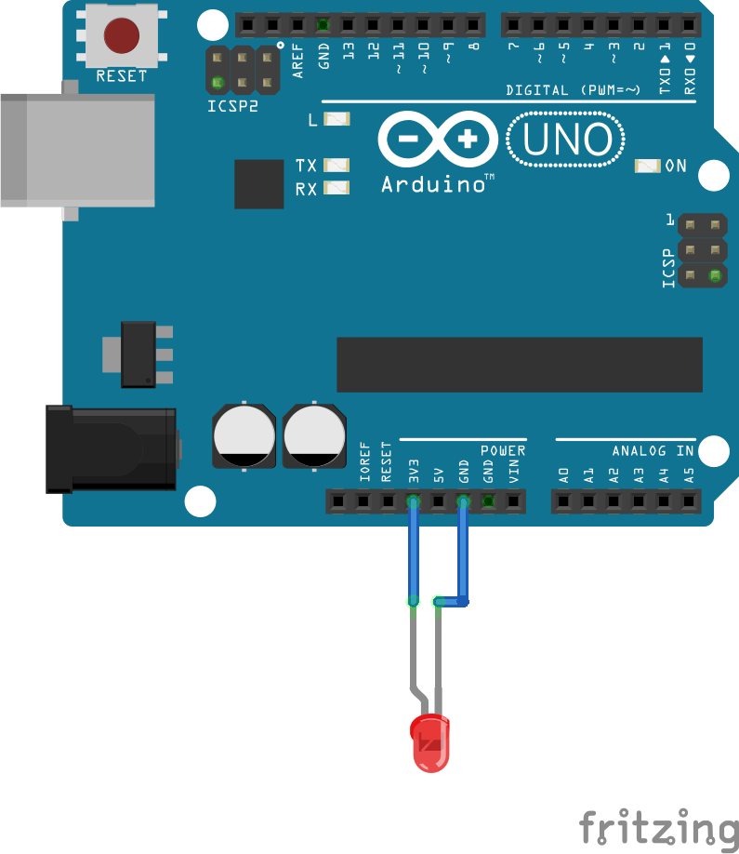
The most basic circuit

Slide 8
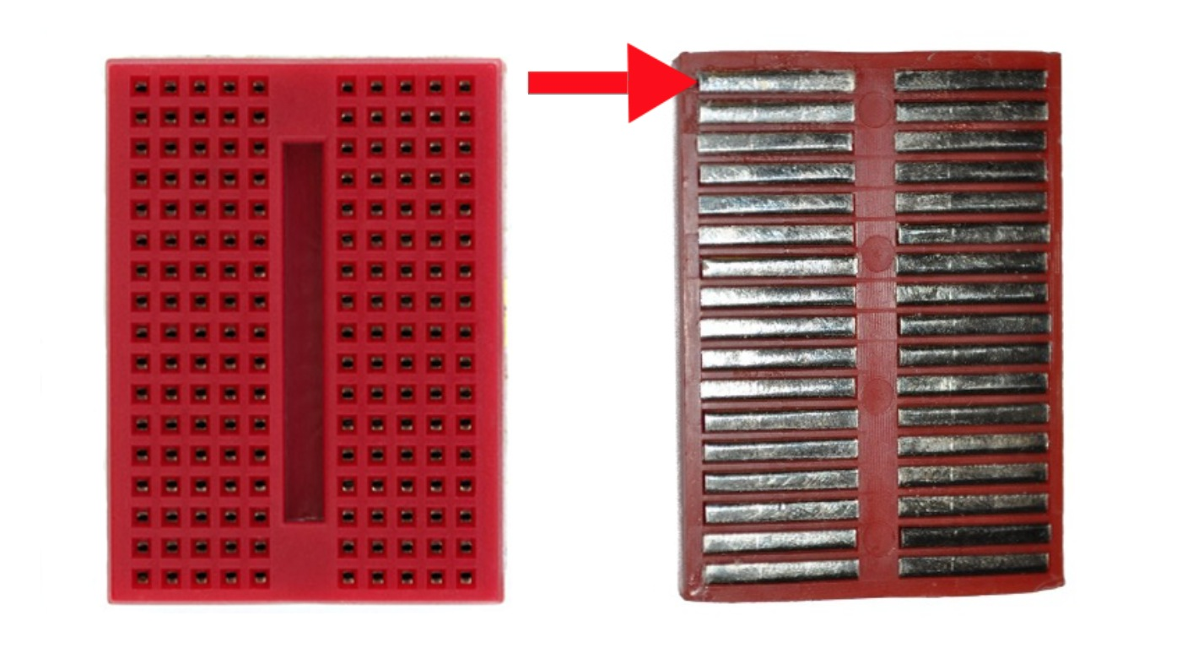
Breadboard

Slide 9
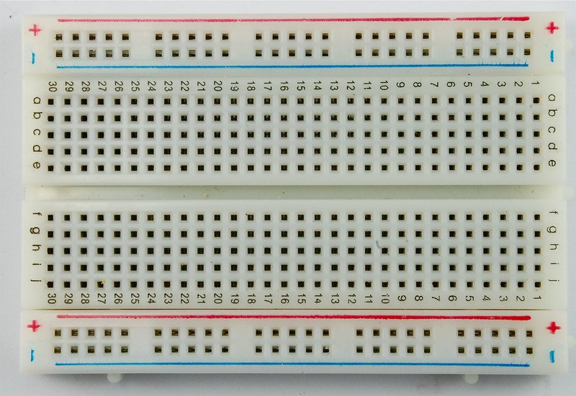
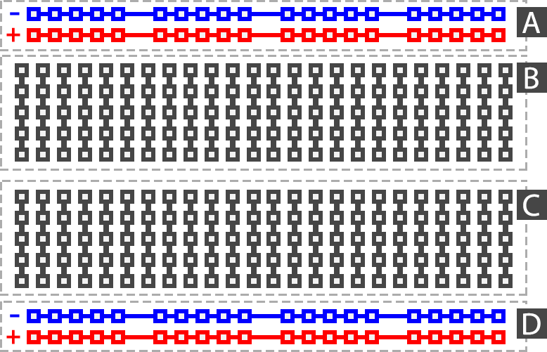
Breadboard

Slide 10
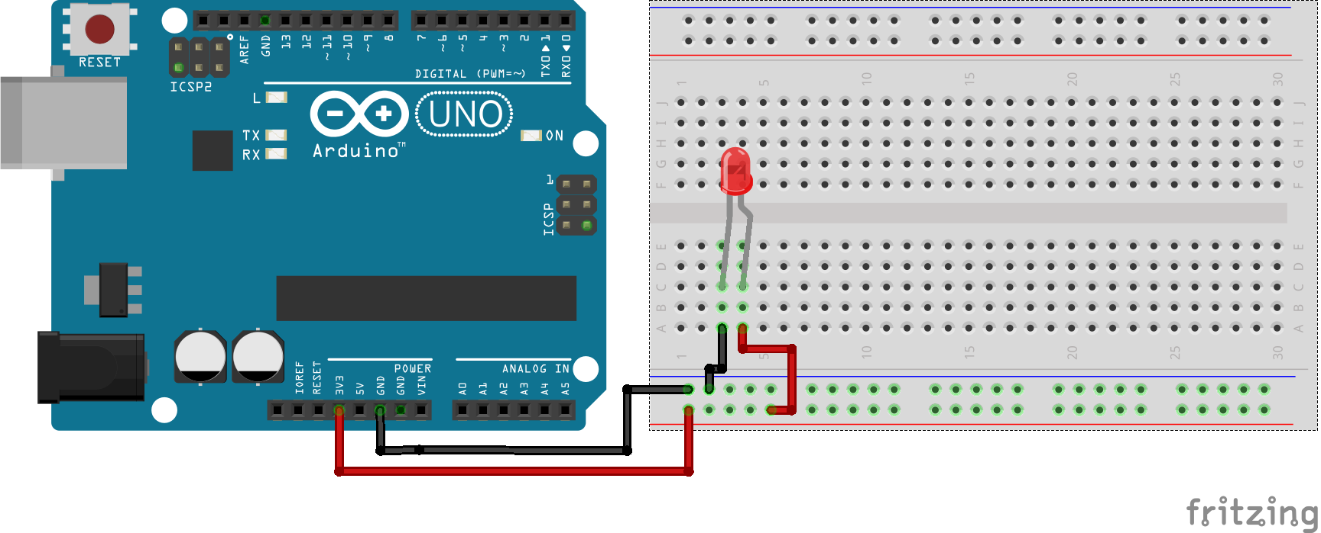
Same circuit using the breadboard

Slide 11
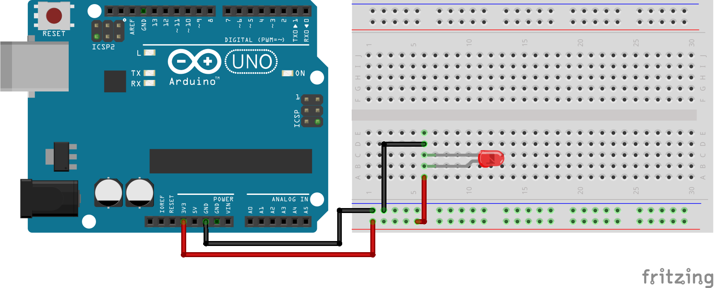
What if... ?

Slide 12
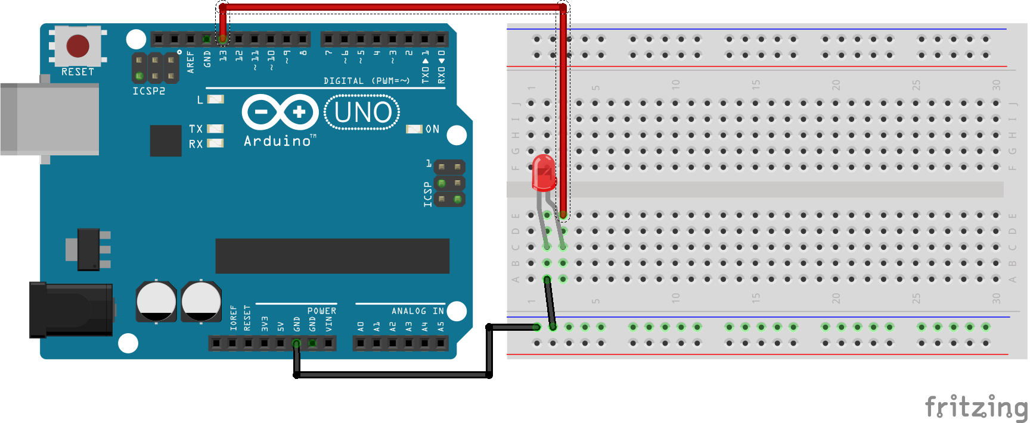
A regulated blinking LED

Slide 13
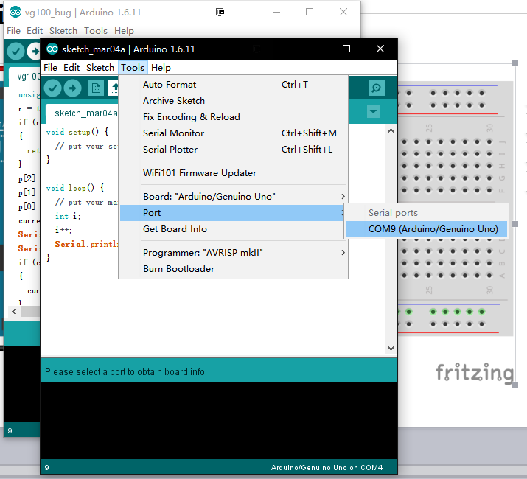
A regulated blinking LED

Slide 14
A regaulated blinking LED
Although every other tutorial would look like this...
void loop() {
digitalWrite(13, HIGH);
delay(1000); // wait for a second
digitalWrite(13, LOW);
delay(1000); // wait for a second
}

Slide 15
A regaulated blinking LED
Never f**king use delay() for anything serious!!!
Hangs up the excecution of any code;
Your rig stops responding to any input.

Slide 16
Credits
Special thanks to all the people who made and released these awesome resources for free:
Presentation template by SlidesCarnival
Photographs by Unsplash

