Slide 1
The Arduino seminar: Part III

Slide 2
Using LCD display
1
Debug swiftly on-the-go.

Slide 3
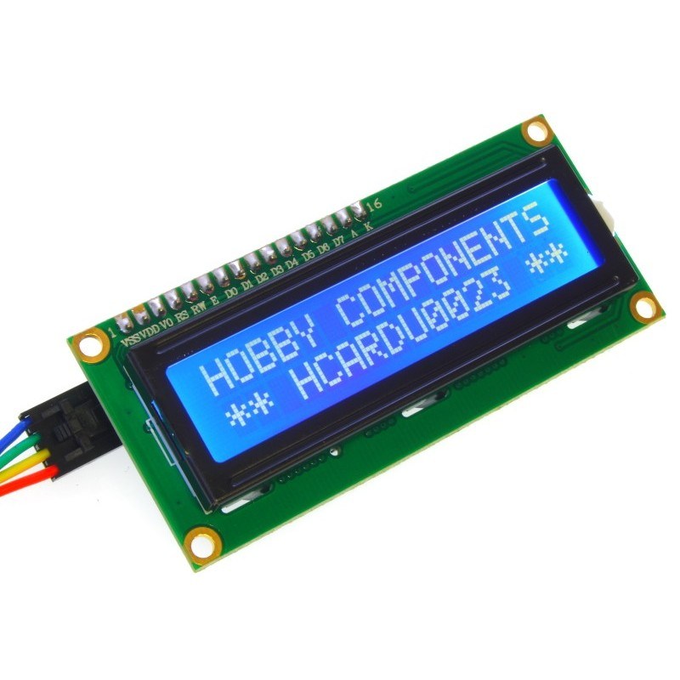
Why LCD?
It enables you to display & see debug output on-the-go, i.e. no need to plug into your PC.
Accelerates your development

Slide 4
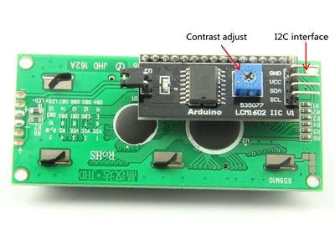
Choose an appropriate LCD
LCDs with I2C pins are favorable (less pins needed than those that don't have it)

Slide 5
Connection
VCC -> 5V
GND -> GND
SDA -> A4
SCL -> A5

Slide 6
Adding third-party libraries
Download the LiquidCrystal-I2C library from here:
https://github.com/fdebrabander/Arduino-LiquidCrystal-I2C-library
Then Sketch -> Include library -> Add .zip library
Add #include <LiquidCrystal_I2C.h> to your code and you're ready to go!

Slide 7
PS2 controller
2
Have fun steering your robot!

Slide 8
Library used
https://github.com/madsci1016/Arduino-PS2X
Sadly this library has no proper documentation
Open PS2X_lib.h in the library folder for the defined key constants & functions prototypes

Slide 9
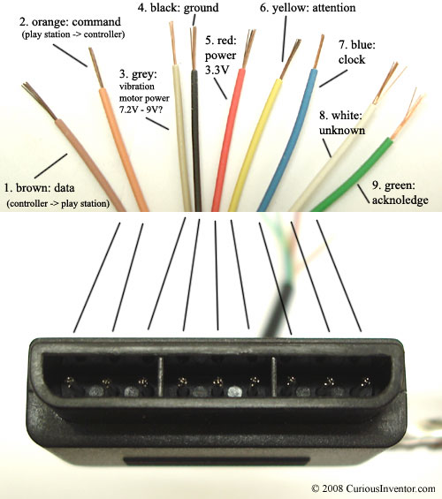
Wiring
Clock: 12,
Command: 11,
Attention: 10,
Data: 8
Ground: GND
Power: 3.3V

Slide 10
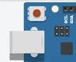
How to connect
Press the MODE button on the controller, so that the red MODE LED is on.
Open the Serial Monitor.
Press the RESET button on the Arduino board, i.e., the red button at the top-left corner.

Slide 11
Try out these keys...
Left, X, R2, SELECT, Joysticks (press down)
Output will be shown on the Serial Monitor.

Slide 12
Final practice
3
Finish to earn our free PS2 giveaways!

Slide 13
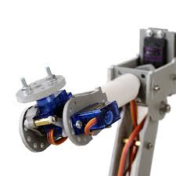
It looks a little bit off...
After installing, the mechanical arm might be a little bit off from your ideal upright position...

Slide 14
... so how to correct it?
If you adjust the servo by re-programming, it's going to take a lot of time.
You may use the PS2 controller to adjust the servo's position, then save the upright angle to the EEPROM.
Since the servo only moves from 0 to 180 degrees, use the LCD to display the servo's current angle. (You might find that you need to re-install!)

Slide 15
Free PS2 Giveaway
Your rig needs to have those features, namely
Adjusting Servo's angle with the controller
Saving the upright angle to the EEPROM & restoring the upright angle
LCD/Serial display of the Servo's angle.
Vibrational feedback when the Servo hits limit.
The first 3 groups that finish will have free PS2 Controller Kits!

Slide 16
Credits
Special thanks to all the people who made and released these awesome resources for free:
Presentation template by SlidesCarnival
Photographs by Unsplash

