Slide 1
Git seminar
Nov. 20 2016
Shen Zheyu, 沈哲宇
arsdragonfly@gmail.com

Slide 2

Introduction to Version Control
How to go back in time if you make mistakes?
A naive way of doing this: copy-pasting

Slide 3
Introduction to Version Control
What are the disadvantages of this method?
Storage-space consuming
Tedious
Easy to make a mistake
Can’t figure out when a bug is introduced

Slide 4
Introduction to Version Control
…plus the challenges proposed by modern software development:
Multiple developers can be working on the same project
Many features can be under development concurrently

Slide 5

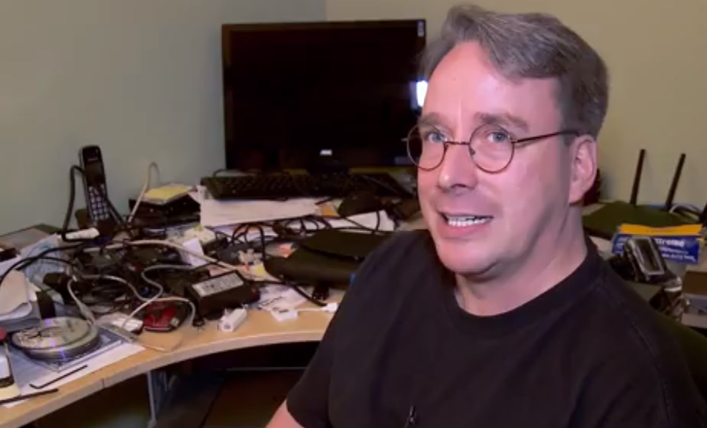
Introduction to Git
Developed by Linus Torvalds
Free & open-source VCS

Slide 6

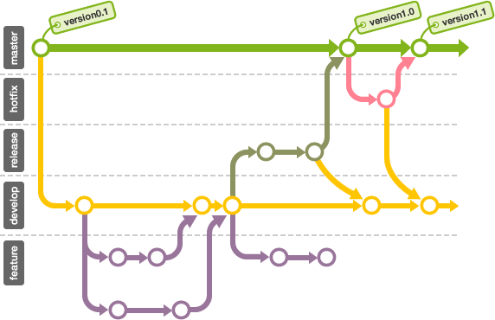
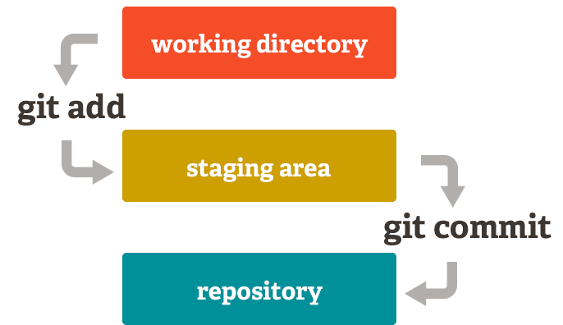
Introduction to Git
Code history is organized in commits
Staging area a.k.a. “index”

Slide 7
Init, add, commit, log & diff
Initializing a repository: git init
Adding file to the staging area: git add
Adding all files: git add .
Making a commit: git commit
Use git commit -m “commit message” if you’re unfamiliar with Vim.

Slide 8
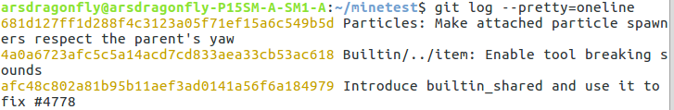
Init, add, commit, log & diff
Viewing the commit history: git log
“git log –pretty=oneline” to shorten the output
Commit hash

Slide 9
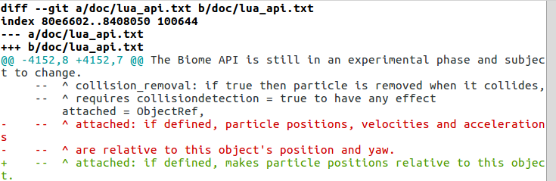
Init, add, commit, log & diff
Comparing different commits: git diff
“git diff 681d1 4a0a6”
“git diff HEAD HEAD~1” or “git diff HEAD HEAD^”
Use j,k to navigate, q to quit ($ man less)

Slide 10
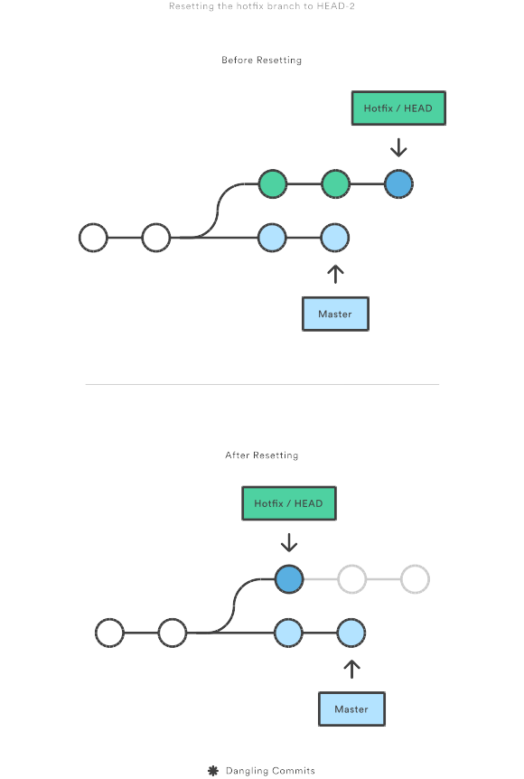
Reset, checkout & revert
Use these commands to go back in time
Commit-level resetting

Slide 11
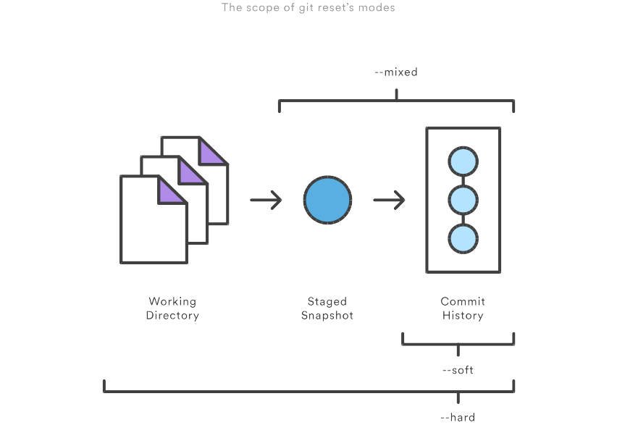
Reset, checkout & revert

Slide 12
Reset, checkout & revert
Use reflog and merge to undo a resetting
See HERE.

Slide 13
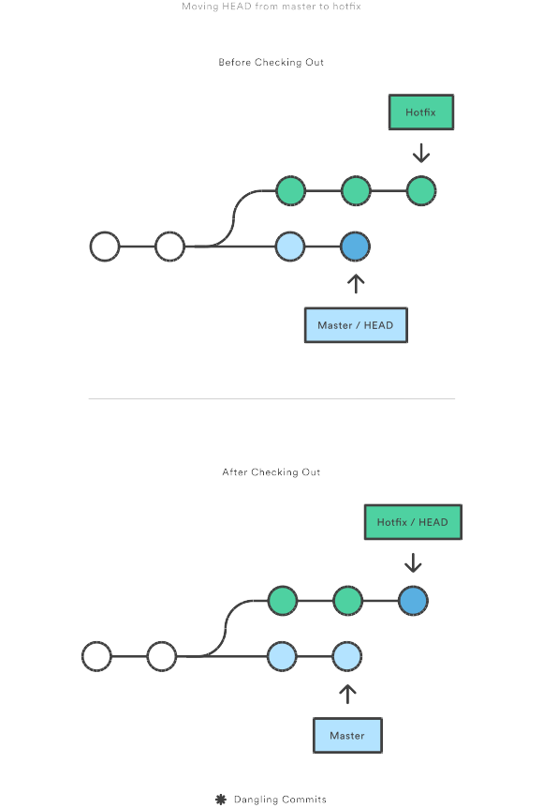
Reset, checkout & revert
Use checkout to switch between branches

Slide 14
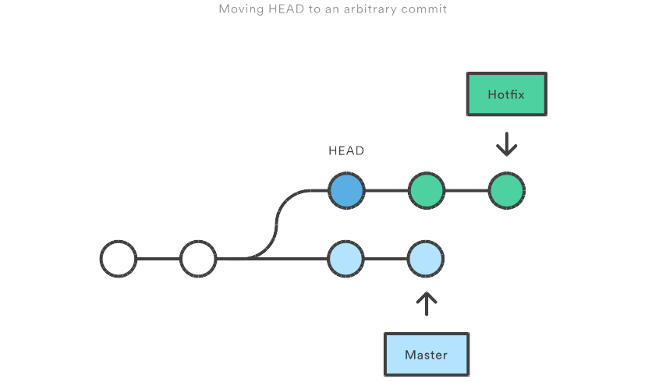
Reset, checkout & revert
Checking out a previous commit
Detached-HEAD state:
Use “git checkout master” to restore
Commits won’t be on any branch unless specified

Slide 15
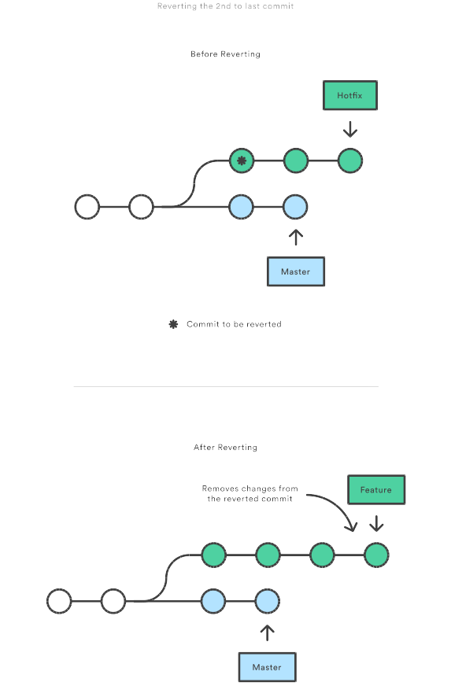
Reset, checkout & revert
Reverting a commit
A clean way to go back:
Only reverts the change in one commit
Only creates a commit

Slide 16
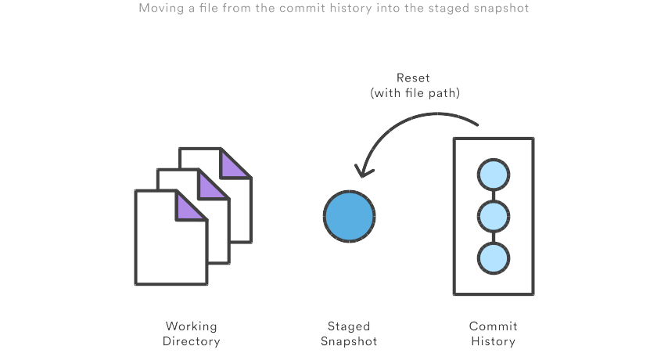
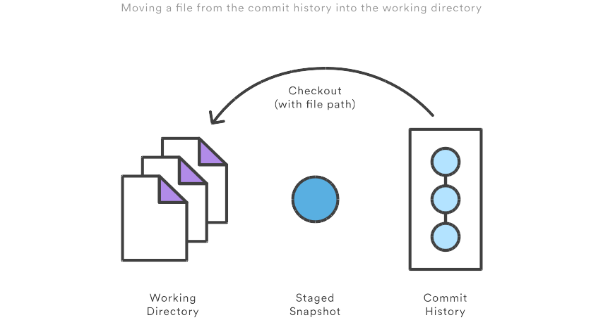
Reset, checkout & revert
File-level reset & checkout
Works differently from directories
Reset before checking-out if the file is staged

Slide 17
Branch, merge & rebase
Use branches to organize feature developments
Branching model

Slide 18
Branch, merge & rebase
Creating a branch: git branch new-branch
Viewing branches: git branch
Switching between branches: git checkout new-branch
Deleting a branch: git branch -d new-branch

Slide 19
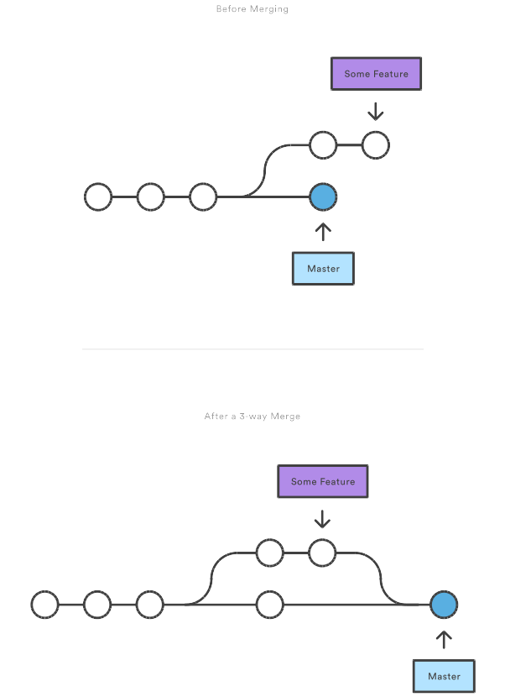
Branch, merge & rebase
Merging new-branch onto master: git merge new-branch
Would create a new merge commit in a 3-way merge

Slide 20
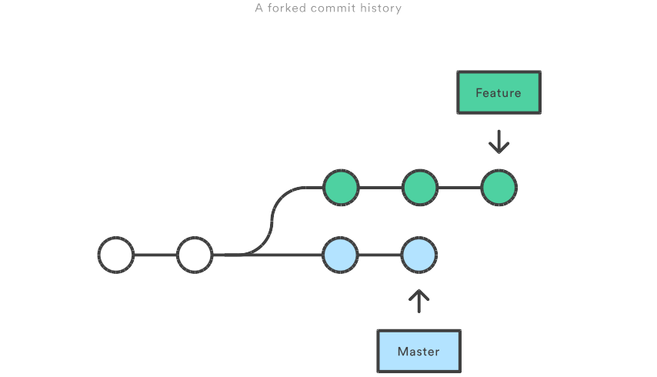
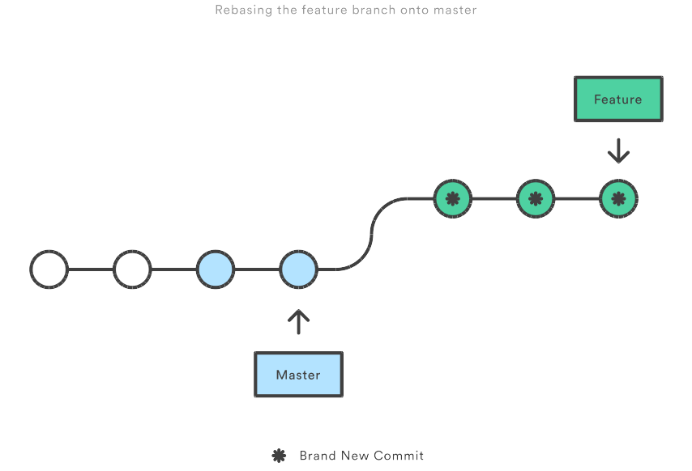
Branch, merge & rebase
Merge with linear history: rebase & merge
Fast-forwarding

Slide 21

Introduction to GitHub
Online hosting of Git repositories
“Build software better, together”

Slide 22

Introduction to GitHub
Octocats!
Octodex.github.com

Slide 23

Introduction to GitHub

Slide 24

Introduction to GitHub

Slide 25

Introduction to GitHub

Slide 26

Introduction to GitHub

Slide 27

Introduction to GitHub

Slide 28

Introduction to GitHub

Slide 29
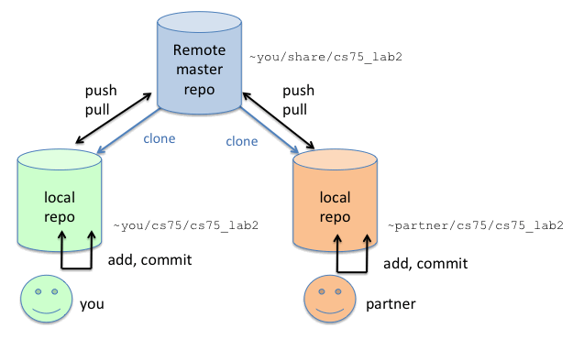
Remote, clone, push & pull
“git remote add origin ...” for a new repository

Slide 30


Fork & pull request

Slide 31
Fork & pull request
Fork the project for your own
Make changes & push to your repo
Compare & pull request

Slide 32
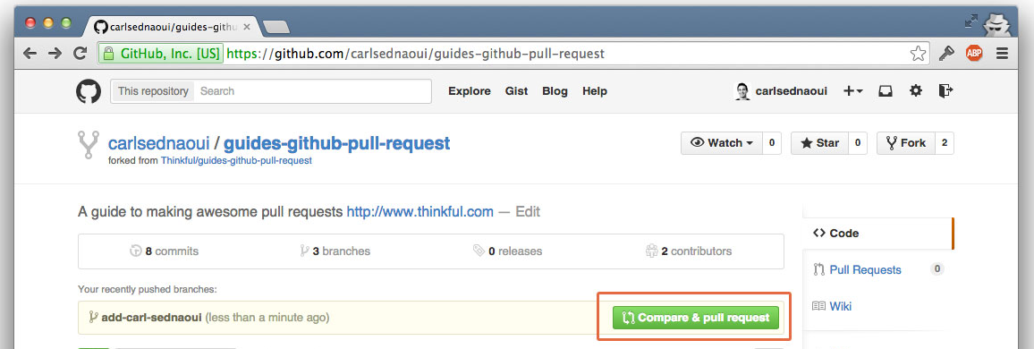
Fork & pull request

Slide 33
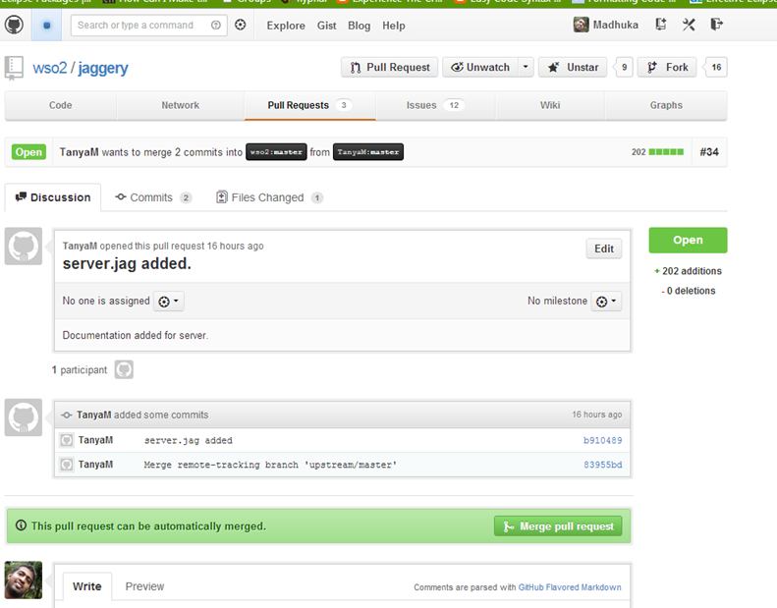
Fork & pull request

Slide 34
Golden rule of public repositories
Never rewrite commit history!
“git commit --amend ...” (unless within 5 mins before anyone sees it)
“git rebase”
“git reset” (use revert instead)

Slide 35
Bisect & blame
Using binary search to find when bugs are introduced: git bisect
“git bisect start”
“git bisect good/bad”
Finding out who wrote which line of code: git blame

Slide 36
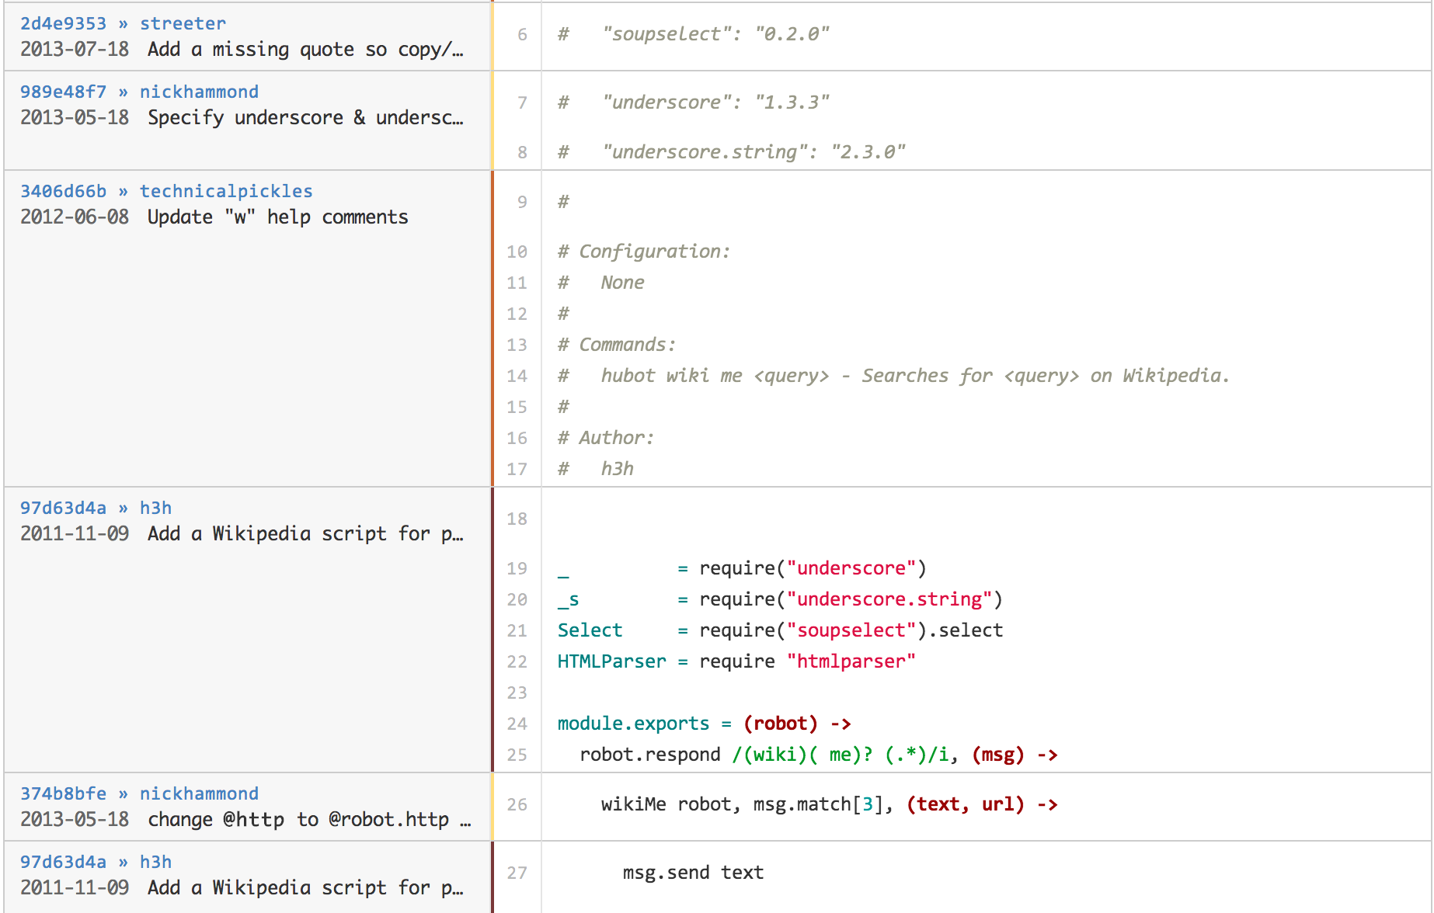
Bisect & blame

Slide 37
Sources
http://blogs.atlassian.com/2012/02/version-control-diffs-patches/
http://www.omgubuntu.co.uk/2014/07/linus-torvalds-messy-desk-video
https://backlogtool.com/git-guide/en/stepup/stepup1_5.html
https://git-scm.com/about
https://www.atlassian.com/git/tutorials/undoing-changes
https://www.thinkful.com/learn/github-pull-request-tutorial/
https://dzone.com/articles/merging-pull-request-github

Slide 38
Online materials
https://www.atlassian.com/git/tutorials/
https://try.github.io/
https://git-scm.com/docs/gittutorial
http://gitready.com/

Slide 39
Thank you!
arsdragonfly@gmail.com
https://github.com/arsdragonfly/
SHENZHEYU @ Baidu
arsdragonfly @ Bilibili

