Slide 1
Various API

Slide 2
1. 4 of the most interesting
1) Google Awareness API
2) Amazon Rekognition API
3) Craft.ai API
4) AnyChart API
2015.5th.jan

Slide 3

1.1 Google Awareness API
With Fence and Snapshot APIs, Awareness is able to do things like alert people when they’re close to restaurants they’re interested in, suggest a music playlist for walking, provide a coupon when you’re inside a particular store, and more.

Slide 4
1.2 Amazon Rekognition API
The API features object, facial, and sentiment recognition all powered by Amazon’s deep-learning artificial intelligence technology.

Slide 5

1.3 Craft.ai
Craft.ai is an AI engine for developers to use. Equipped with a visual coding language, developers can create services that adapt to each user’s needs in minutes.

Slide 6

1.4 AnyChart
AnyChart is a cross-platform charting library that uses HTML5 and JavaScript. The charts are built in real-time and can react to clients changing parts of the data.

Slide 7

2. 18 API Award
Plaid : API INFRASTRUCTURE
Red Hat 3scale API Management : API MANAGEMENT
Built.io Flow : API MIDDLEWARE
Approov : API SECURITY
Classy API : BUSINESS SOFTWARE API
SendGrid API v3 : COMMUNICATION STREAMING API
Tesla Cockpit Creators API : CAR API
Watson Conversation Service : ENTERPRISE API
Bank Account Starter : FINANCE API
Sikka APIs : HEALTH API
Alexa Skills Kit : HOME API
Houndify : INTERNET OF THINGS API
Payment Engine : PAYMENT API
Ziggeo : MUSIC/VIDEO API
Wordnik API : MEDIA API
Wipro's Open Banking API Platform : TRAVEL API
CA Microgateway : MICROSERVICES API
Europeana / REST API : DATA API

Slide 8

2.1 Plaid : API INFRASTRUCTURE
The Plaid API uses POST requests to
communicate and HTTP response codes
to indicate status and errors. All responses
come in standard JSON. The Plaid API is
served over HTTPS TLS v1.1+ to ensure
data privacy; HTTP and HTTPS with
TLS versions below 1.1 are not supported.
All requests must include a content-type of
application/json and the body must be valid JSON.
Product | Endpoint
Auth | POST / auth/ get
Transactions | POST / transactions / get
Identity | POST / identity / get
Income | POST / income / get
Balance | POST / accounts / balance / get

Slide 9

2.2 Red Hat 3scale API Management : API MANAGEMENT
Connect Red hat product smoothly

Slide 10

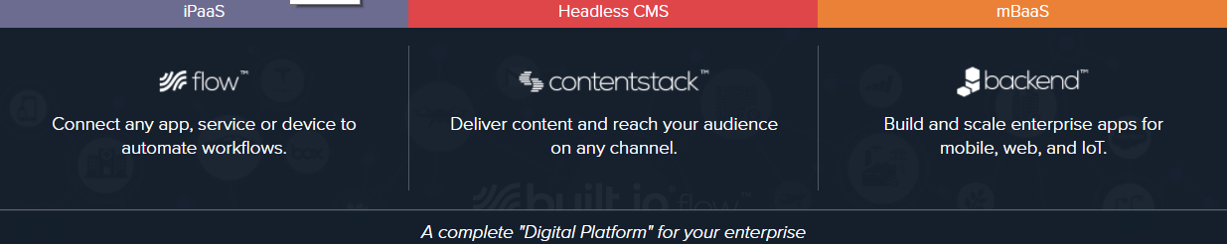
2.3 Built.io Flow : API MIDDLEWARE

Slide 11

2.4 Approov : API SECURITY
1. ANTI-AUTOMATION
2. APP LEGITIMACY
3. API KEY PROTECTION
Notes:
API에 대한 자동화 된 트래픽을 제어합니다. 자동화 된 스크립트 또는 불량 봇으로 중요한 데이터를 서버에서 긁어내는 무단 시도를 차단합니다.
허가 된 앱에만 액세스를 제한하여 API에 신뢰할 수있는 생태계를 사용하도록 설정합니다. 가짜 및 재 패키징 된 모바일 앱이 비즈니스에 영향을주지 않도록하십시오.
리버스 엔지니어링 및 악용에 취약한 전통적인 타사 API 키를 Approov 보호 클라우드 키 저장소로 보호하십시오.

Slide 12

2.5 Classy API : BUSINESS SOFTWARE API
Classy is the world’s largest fundraising platform for social good organizations. We enable nonprofits and social enterprises to raise the support they need to solve humanity’s greatest challenges

Slide 13

2.6 SendGrid API v3 : COMMUNICATION STREAMING API
SendGrid is a cloud-based SMTP provider that allows you to send email without having to maintain email servers. SendGrid manages all of the technical details, from scaling the infrastructure to ISP outreach and reputation monitoring to whitelist services and real time analytics.
Web API (support 7 languages)
1. Authentication
2. Requests
3. Responses
4. Rate Limits
5. Errors

Slide 14
2.7 Tesla Cockpit Creators API : CAR API
The Creators API is a platform for connected software to interact with Tesla vehicle data in order to enrich the ownership of the finest vehicle on this planet, by enthusiast, for enthusiast.
Support various languages like
C / C# / Ruby

Slide 15

2.8 Watson Conversation Service : ENTERPRISE API
ChatBot Enterprise

Slide 16

2.9 Bank Account Starter : FINANCE API
Our Bank Account Starter API allows you to give your customers the ability to securely open a Capital One 360 Savings, 360 Money Market or 360 CD account with no fees, no minimums, and no catches. You’ll create a seamless user experience for your customers, who can open the account and transfer the initial funds without ever leaving your site.

Slide 17

2.10 Sikka APIs : HEALTH API
Sikka Platform Cloud provides APIs so you can quickly build secure apps for over 96 % of dental, veterinary, audiology and optometry industries.Use our API to gain access to all the opt - in HIPAA / HITECH compliant rich data that a healthcare practice generates.

Slide 18
2.11 Alexa Skills Kit : HOME API
Alexa is Amazon’s voice service
enable to create a more personalized experience.

Slide 19
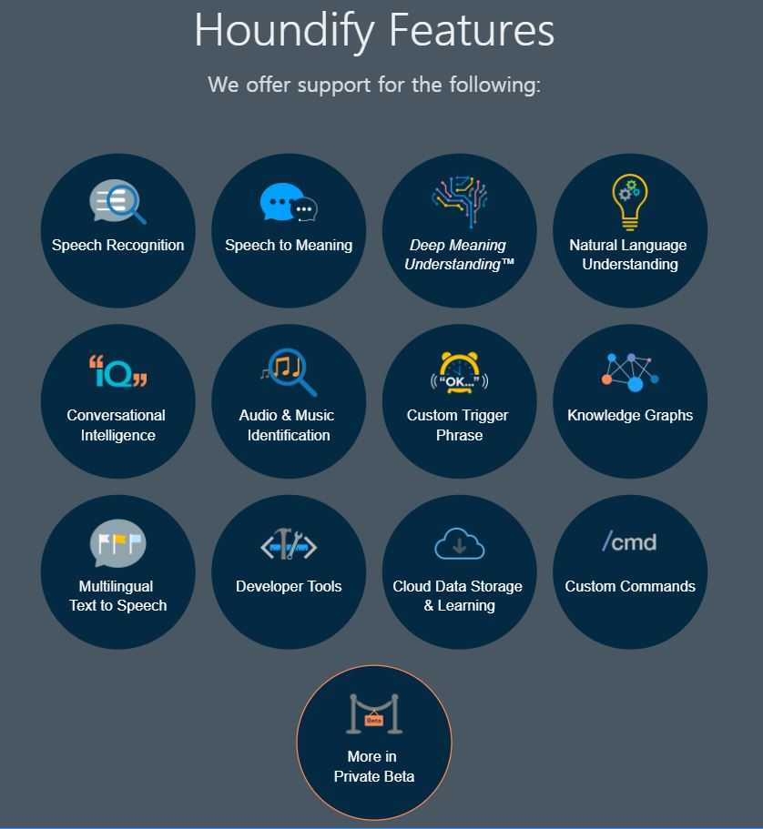
2.12 Houndify : INTERNET OF THINGS API

Slide 20

2.13 Payment Engine : PAYMENT API

Slide 21

2.14 Ziggeo : MUSIC/VIDEO API
Music, Video player
recorder, transcoder etc

Slide 22

2.15 Wordnik API : MEDIA API
The Wordnik API lets you request definitions, example sentences, spelling suggestions, related words like synonyms and antonyms, phrases containing a given word, word autocompletion, random words, words of the day, and much more.
Notes:
Wordnik API를 사용하면 정의, 예문, 맞춤법 추천, 동의어 및 반의어와 같은 관련 단어, 주어진 단어가 포함 된 단어, 단어 자동 완성, 임의의 단어, 오늘의 단어 등을 요청할 수 있습니다.

Slide 23

2.16 Wipro's Open Banking API Platform : TRAVEL API
Open banking is a new trend in financial technology that allows third-party developers to build applications and services for financial institutions using open APIs.
Banking Platform

Slide 24

2.17 CA Microgateway : MICROSERVICES API
Business Platform

Slide 25

2.18 Europeana / REST API : DATA API
You can write applications that use various cultural heritage objects stored in the Europeana repository.

Slide 26
Reference
http://meetup.toast.com/posts/92
https://azuqua.com/2017/01/4-of-the-most-interesting-and-exciting-apis-to-improve-your-applications
http://apiawards.co/#categories
Each technologies’ homepage

Slide 27
부록 - REST API
1) 탄생
Representational State Transfer라는 용어의 약자로서 2000년도에 로이 필딩(Roy Fielding)의 박사학위 눈문에서 최초로 소개되었습니다. 로이 필딩은 HTTP의 주요 저자중 한사람으로 그 당시 웹설계의 우수성에 비해 제대로 사용되어지지 못하는 모습에 안타까워 웹의 장점을 최대한 활용할 수 있는 아키텍쳐로써 REST를 발표하였습니다.
2) 구성 :
Resource(URI) + Verb(HTTP Method) + Representaion

Slide 28
부록 – REST API
특징
1) Uniform (유니폼 인터페이스) :
URI로 지정한 리소스에 대한 조작을 통일되고 한정적인 인터페이스로 수행하는 아키텍처 스타일
2) Stateless (무상태성) :
작업을 위한 상태정보를 따로 저장하고 관리하지 않는다.
3) Cachable (캐시가능) :
HTTP라는 기존 웹표준을 그대로 사용하기 때문에, 웹에서 사용하는 기존 인프라를 그대로 활용이 가능
4) Self-descriptiveness (자체 표현 구조) : REST API 메시지만 보고도 쉽게 이해할 수 있다
5) Client – Server
6) 계층형 구조 :
다중 계층으로 구성될 수 있으며 보안, 로드 밸런싱, 암호화 계층을 추가해 구조상의 유연성을 둘 수 있고 Proxy, gateway 같은 네트워크 기반의 중간매체를 사용 할 수 있게 한다.

