Slide 1
Obfuscation
2017-11-10
Notes:
난독화

Slide 2
What is Obfuscation?
One way to change some or all of your program code.
Provides readiness for reverse engineering by reducing code raedability.
Source code obfuscation VS Binary bofuscation

Slide 3
What is Reverse Engineering?
Reverse engineering : taking apart an object to see how it works
Infer sequence from final product
Software reverse engineering
Machine code => Source Code
In korea, Reverse Engineering of execution file is illegal, but file format or result of execution = >OK
Notes:
리버스 엔지니어링은 객체를 복제하거나 향상시키기 위해 객체가 어떻게 작동하는지 살펴보기 위해 분리한다.

Slide 4
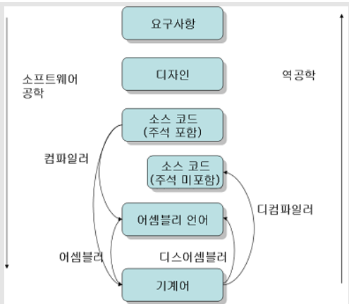
Reverse Engineering

Slide 5
How can we Protect this?
Code obfuscation protect attack through reverse engineering!
Virus/Worm developer <=> Vaccine developer

Slide 6
Code obfuscation
/detect which browser is used
var detect = navigator.userAgent.toLowerCase();
var OS,browser,version,total,thestring;
if (checkIt('konqueror'))
{
browser = "Konqueror";
OS = "Linux";
}
else if (checkIt('opera')) browser = "Opera"
else if (checkIt('msie')) browser = "Internet Explorer"
else if (!checkIt('compatible'))
{
browser = "Netscape Navigator"
version = detect.charAt(8);
}
else browser = "An unknown browser";
//version of browser
if (!version) version = detect.charAt(place + thestring.length);
//client OS
if (!OS)
{
if (checkIt('linux')) OS = "Linux";
else if (checkIt('x11')) OS = "Unix";
else if (checkIt('mac')) OS = "Mac"
else if (checkIt('win')) OS = "Windows"
else OS = "an unknown operating system";
}
//check the string
function checkIt(string)
{
place = detect.indexOf(string) + 1;
thestring = string;
return place;
}
var e=navigator.userAgent.toLowerCase();var f,b,c,total,d;if(a('konqueror')){b="Konqueror";f="Linux";};else if(a('opera'))b="Opera";else if(a('msie'))b="Internet Explorer";else if(!a('compatible')){b="Netscape Navigator";c=e.charAt(8);};else b="An unknown browser";if(!c)c=e.charAt(g+d.length);if(!f){if(a('linux'))f="Linux";else if(a('x11'))f="Unix";else if(a('mac'))f="Mac";else if(a('win'))f="Windows";else f="an unknown operating system";};function a(string){g=e.indexOf(string)+1;d=string;return g;};

Slide 7
Ways for Obfuscation
Basic
Remove or modify symbol data
Remove human understandable data
Case of Java, can’t remove symbol
Change name like MyString to M

Slide 8
Ways for Obfuscation
Complex code / code that does nothing
Add function not use or does nothing
Hard to analyze binary code
Opposite to optimizing compiler
It’s just a matter of time
Can find vulnerabilities if spend more time and effort
Making it difficult enough for an attacker to give up and find other targets of attacker

Slide 9
Ways for Obfuscation
Copy, move Code
Take apart as far as enough
Inline function
Anonymous function that contains few statement
This includes all the ways to shuffle code without seriously affecting performance

Slide 10
Ways for Obfuscation
Encoding data = hard to understand
Encode string
It is often found this kind of code
Char passwd[] = “1234”;
Encode/Decode String when use it.
Can use cryptographic algorithm but not a perfect defence.

Slide 11
Thank you!

