Slide 1
Virtual Reality

Slide 2
Index
What is VR?
History of VR
Classification according to presentation method
Classification according to system environment
Basic technology and advance
VR Bottom line
Way to make VR contents

Slide 3
What is VR?
Virtual reality(VR) refers to a specific environment or situation, or technology itself, that is similar to the reality created by artificial technology using computers, but is not actual.
Notes:
가상현실(假想現實, 영어: virtual reality, VR)은 컴퓨터 등을 사용한 인공적인 기술로 만들어낸 실제와 유사하지만 실제가 아닌 어떤 특정한 환경이나 상황 혹은 그 기술 자체를 의미한다

Slide 4
History of VR
The first references to the more modern concept of virtual reality came from science fiction(Pygmalion 's Spectacles, 1935).
By the 1980s the term "virtual reality" was popularized by Jaron Lanier(made VR product), one of the modern pioneers of the field.
The 1990s saw the first widespread commercial releases of consumer headsets.
Now there are more than 230 companies developing VR-related products

Slide 5
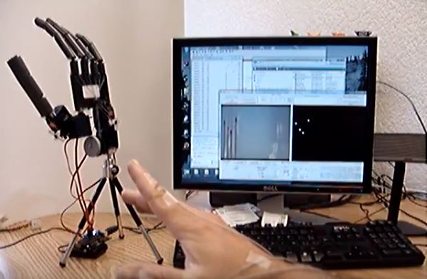
Classification according to presentation method
Computer to User
Example : 3D Game
User to computer
When user is remote to object, user needs to share space using VR
Example : remote tele-robotics

Slide 6
Classification according to system environment
Immersive
virtual reality
: humans feel effect that they actually see and touch
2. Remote Robotics
: (1) + Robots
3. Desktop VR
: Monitor + joy sticks
4. Third person VR
: A system that makes you feel like you are directly in virtual space that made by computer
Notes:
몰입형 가상현실 : 특수 장비를 통해 인간으로 하여금 실제로 보고 만지는 것 같은 감각적 효과를 느끼게 해 생생한 환경에 몰입하도록 하는 시스템을 말한다.
원거리 로보틱스 : 로봇을 이용하여 먼 거리에 있는 공간에 사용자가 현전하는 효과를 주는 시스템을 말한다..
데스크톱 가상현실 : 일반 컴퓨터 모니터에 간단한 입체안경, 조이스틱 등만 첨가하여 책상 위에서 쉽게 만날 수 있는 가상현실 시스템을 말한다.
삼인칭 가상현실 : 비디오카메라로 촬영된 자신의 모습을 컴퓨터가 만들어내는 가상공간에 나타나게 하여 자신이 가상공간에 직접 존재하는 것처럼 느끼게 하는 시스템을 말한다. 주로 오락용으로 많이 쓰이며 대표적인 예로 Xbox 키넥트(KINECT)가 있다.

Slide 7
Basic technology and advance
System of acquisition and presentation of information
Distributed processing system · Artificial intelligence system
Track the location of a person or object
A sense of man Interaction and Collaboration
Simulator Augmented Reality, Composite Reality
Navigation
Notes:
정보의 취득과 제시의 시스템
분산 처리 시스템·인공지능 시스템
인물이나 물체의 위치 추적
사람의 감각
상호작용과 공동 작업
시뮬레이터
증강현실, 복합현실
내비게이션

Slide 8
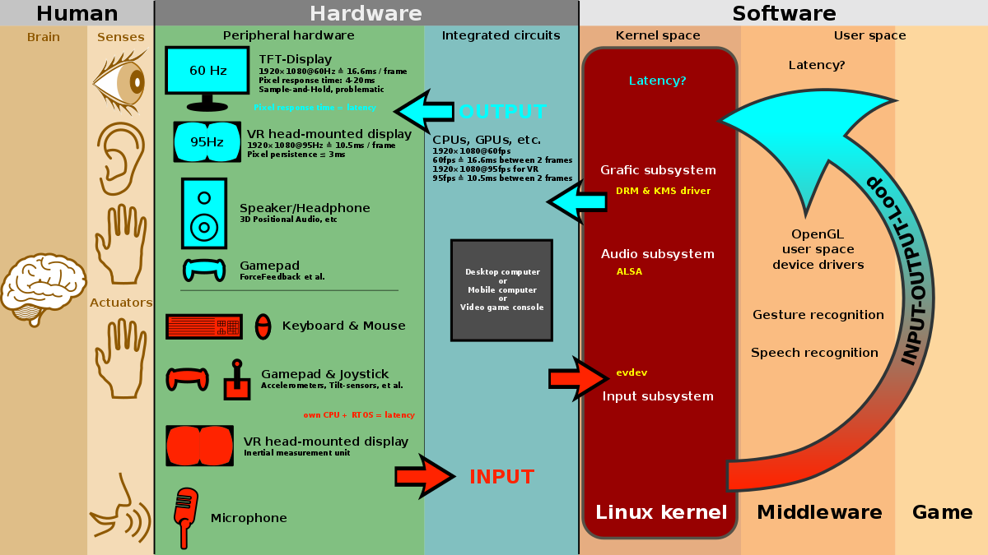
VR Bottom line
Paramount for the sensation of immersion into virtual reality are a high frame rate (at least 95 fps), as well as a low latency .
Furthermore, a pixel persistence lower than 3 ms is required, because if not, users will feel sick when moving their head around

Slide 9
Way to make VR contents
VR headset or Android SDI(when you use smart-phone)
Realtime-Engines(Unreal, Unity, Cryengine, Lumberyard.. etc)
Modeling Software(Blender, Sculptris)
And other image and sound control programs

Slide 10
Reference
https://www.youtube.com/watch?v=hgiTjwoqmTM
https://ko.wikipedia.org/wiki/%EA%B0%80%EC%83%81%ED%98%84%EC%8B%A4
https://makezine.com/2016/03/24/makers-introduction-vr-best-software-tools-free/
https://hackernoon.com/how-to-make-a-vr-app-with-zero-experience-927438e2dede
https://en.wikipedia.org/wiki/Virtual_reality

