Slide 1


Hacking Tools
Made by. 43516ED4405CCDFCC07FD09668726ECD

Slide 2


Hacking Tools
Nmap (Network Mapper)
Used to Scan Ports and Map Networks – and a whole bunch more
Also has GUI Version : Zenmap
Cost : Free
( = Open Source hackers tool)
Can detect what services(application & version) those hosts use, what OS(fingerprinting) and what type or version of packet filters/firewall are used in target
Made by. 43516ED4405CCDFCC07FD09668726ECD

Slide 3
Hacking Tools
Nmap (Network Mapper)
How to install Nmap in Linux
# yum install nmap // on Red Hat based system
$ sudo apt-get install nmap // on Debian based system
How to Use Nmap command
# nmap [Scan Type (s)] [Options] {target specification}
// specification can be ip address & DNS
// option –v giving more details
Made by. 43516ED4405CCDFCC07FD09668726ECD

Slide 4
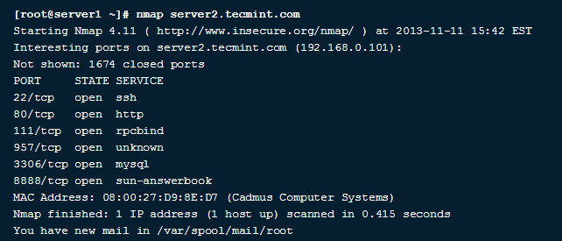
Hacking Tools
Nmap (Network Mapper)
Examples (DNS)
Made by. 43516ED4405CCDFCC07FD09668726ECD

Slide 5
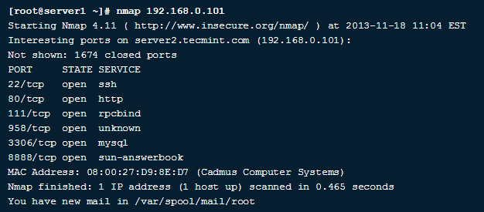
Hacking Tools
Nmap (Network Mapper)
Examples (IP)
Made by. 43516ED4405CCDFCC07FD09668726ECD

Slide 6

Hacking Tools
Metasploit Project
Vulnerability Exploitation Tool
Popular penetration testing or hacking framework
Cost : Free & Paid
( = Open Source hacking modules)
Find vulnerability and make it into shell code
Made by. 43516ED4405CCDFCC07FD09668726ECD

Slide 7
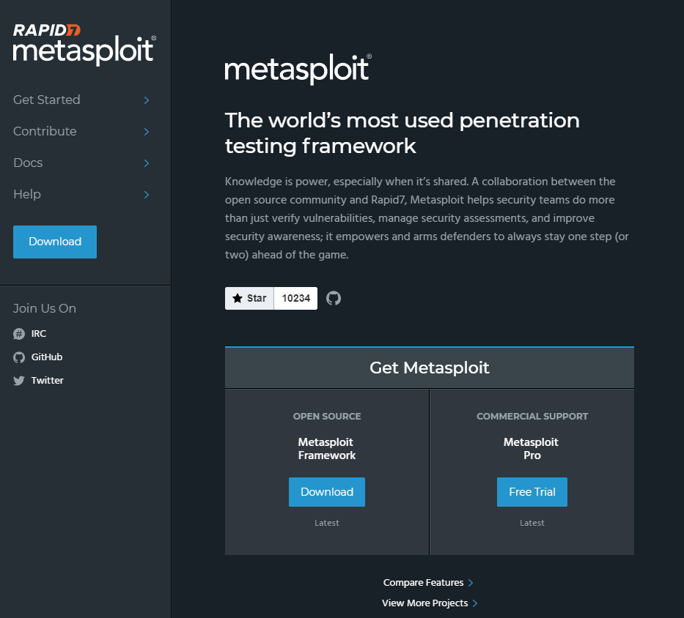
Hacking Tools
Metasploit Project
Official Site
(https://www.metasploit.com/)
OSCP & CEH include this
Made by. 43516ED4405CCDFCC07FD09668726ECD

Slide 8

Hacking Tools
JTR(John The Ripper)
Crack even very complicated passwords
Usually compare with THC Hydra, JTR is offline password cracker, THC Hydra is online cracker
Johnny = GUI version of JTR
Cost : Free
Made by. 43516ED4405CCDFCC07FD09668726ECD

Slide 9
Hacking Tools
JTR(John The Ripper)
<Sequence of cracking>
Listing sample text(popular, complex or cracked before)
Encrypt sample text in the same way as the password
Compare the output to encrypted String
Made by. 43516ED4405CCDFCC07FD09668726ECD

Slide 10
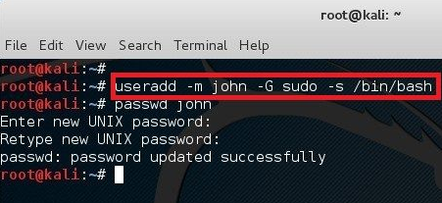
Hacking Tools
JTR(John The Ripper)
Add user for testing
Made by. 43516ED4405CCDFCC07FD09668726ECD

Slide 11
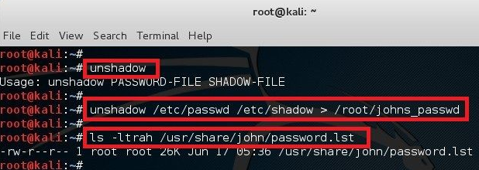
Hacking Tools
JTR(John The Ripper)
UnShadowing password ( /etc/shadow & /etc/passwd)
Create 1 file with username and password details
Made by. 43516ED4405CCDFCC07FD09668726ECD

Slide 12
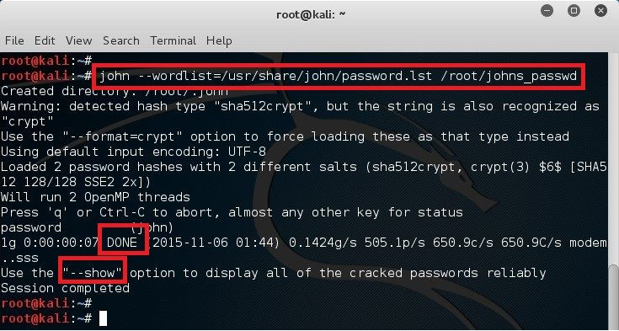
Hacking Tools
Add user for testing
JTR(John The Ripper)
Cracking process with John The Ripper
wordlist == sample text
crypt wordlist by detected hash type and compare the output with hashed passwd
Made by. 43516ED4405CCDFCC07FD09668726ECD

Slide 13

Hacking Tools
THC Hydra
Password Cracking Tool
(fast and stable Network Login Hacking Tool)
Cost : Free
( = Open Source hackers tool)
Dictionary or brute-force attacks
This tool supports protocols, mail, DB, VNC, SMB, etc
Made by. 43516ED4405CCDFCC07FD09668726ECD

Slide 14
Hacking Tools
THC Hydra
<Sequence of Execution>
Specify target IP & protocol
Set wordlist ( same as JTR )
Setting Tuning Area ( Performance Options & Proxy Setting )
Start Cracking & Check the Answer
Made by. 43516ED4405CCDFCC07FD09668726ECD

Slide 15

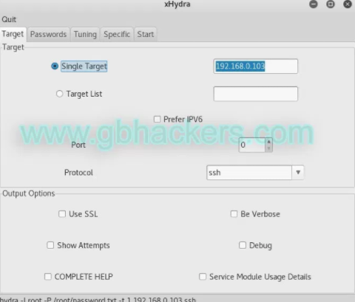
Hacking Tools
THC Hydra
Get info of target’s IP & protocol
Set the target
Set the target protocol
Made by. 43516ED4405CCDFCC07FD09668726ECD

Slide 16
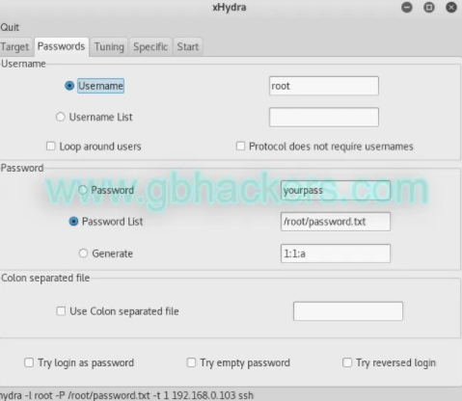
Hacking Tools
THC Hydra
Change the tap
(Target -> Passwords)
Set password list
(Kali has default wordlist
root :~# locate *.lst // find list )
Made by. 43516ED4405CCDFCC07FD09668726ECD

Slide 17
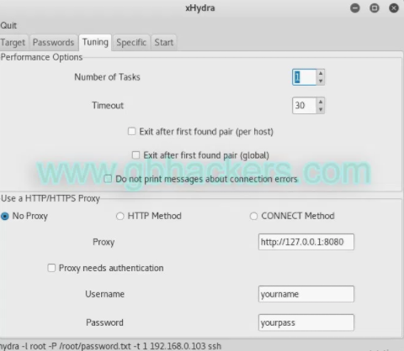
Hacking Tools
THC Hydra
Change the tap
(Passwords -> Tunning)
Set the # of Task
Set Proxy -> No Proxy
Made by. 43516ED4405CCDFCC07FD09668726ECD

Slide 18
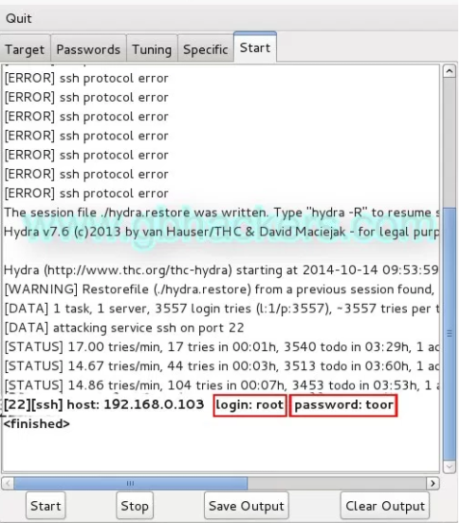
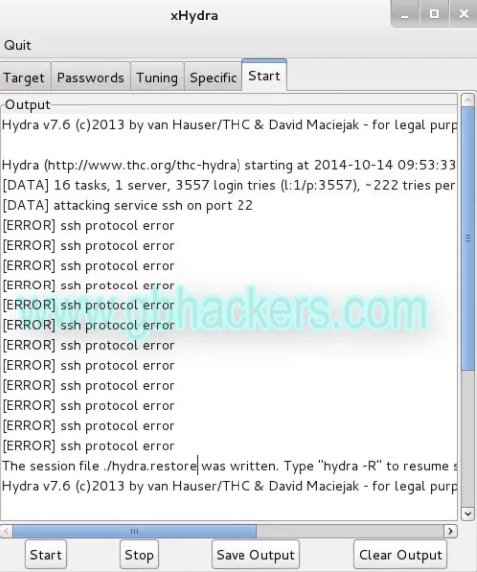
Hacking Tools
THC Hydra
Get Answer (passwords)
Start Cracking by Clicking start button
Made by. 43516ED4405CCDFCC07FD09668726ECD

Slide 19

Hacking Tools
Nmap (Network Mapper)
Used to Scan Ports and Map Networks – and a whole bunch more
Also has GUI Version : Zenmap
Cost : Free
( = Open Source hackers tool)
Can detect what services(application & version) those hosts use, what OS(fingerprinting) and what type or version of packet filters/firewall are used in target
Made by. 43516ED4405CCDFCC07FD09668726ECD

Slide 20
Hacking Tools
Nmap (Network Mapper)
How to install Nmap in Linux
# yum install nmap // on Red Hat based system
$ sudo apt-get install nmap // on Debian based system
How to Use Nmap command
# nmap [Scan Type (s)] [Options] {target specification}
// specification can be ip address & DNS
// option –v giving more details
Made by. 43516ED4405CCDFCC07FD09668726ECD

Slide 21
Hacking Tools
Nmap (Network Mapper)
Examples (DNS)
Made by. 43516ED4405CCDFCC07FD09668726ECD

Slide 22
Hacking Tools
Nmap (Network Mapper)
Examples (IP)
Made by. 43516ED4405CCDFCC07FD09668726ECD

Slide 23

Hacking Tools
Nmap (Network Mapper)
Used to Scan Ports and Map Networks – and a whole bunch more
Also has GUI Version : Zenmap
Cost : Free
( = Open Source hackers tool)
Can detect what services(application & version) those hosts use, what OS(fingerprinting) and what type or version of packet filters/firewall are used in target
Made by. 43516ED4405CCDFCC07FD09668726ECD

Slide 24
Hacking Tools
Nmap (Network Mapper)
How to install Nmap in Linux
# yum install nmap // on Red Hat based system
$ sudo apt-get install nmap // on Debian based system
How to Use Nmap command
# nmap [Scan Type (s)] [Options] {target specification}
// specification can be ip address & DNS
// option –v giving more details
Made by. 43516ED4405CCDFCC07FD09668726ECD

Slide 25
Hacking Tools
Nmap (Network Mapper)
Examples (DNS)
Made by. 43516ED4405CCDFCC07FD09668726ECD

Slide 26
Hacking Tools
Nmap (Network Mapper)
Examples (IP)
Made by. 43516ED4405CCDFCC07FD09668726ECD

Slide 27

Hacking Tools
Nmap (Network Mapper)
Used to Scan Ports and Map Networks – and a whole bunch more
Also has GUI Version : Zenmap
Cost : Free
( = Open Source hackers tool)
Can detect what services(application & version) those hosts use, what OS(fingerprinting) and what type or version of packet filters/firewall are used in target
Made by. 43516ED4405CCDFCC07FD09668726ECD

Slide 28
Hacking Tools
Nmap (Network Mapper)
How to install Nmap in Linux
# yum install nmap // on Red Hat based system
$ sudo apt-get install nmap // on Debian based system
How to Use Nmap command
# nmap [Scan Type (s)] [Options] {target specification}
// specification can be ip address & DNS
// option –v giving more details
Made by. 43516ED4405CCDFCC07FD09668726ECD

Slide 29
Hacking Tools
Nmap (Network Mapper)
Examples (DNS)
Made by. 43516ED4405CCDFCC07FD09668726ECD

Slide 30
Hacking Tools
Nmap (Network Mapper)
Examples (IP)
Made by. 43516ED4405CCDFCC07FD09668726ECD

Slide 31

Hacking Tools
Nmap (Network Mapper)
Used to Scan Ports and Map Networks – and a whole bunch more
Also has GUI Version : Zenmap
Cost : Free
( = Open Source hackers tool)
Can detect what services(application & version) those hosts use, what OS(fingerprinting) and what type or version of packet filters/firewall are used in target
Made by. 43516ED4405CCDFCC07FD09668726ECD

Slide 32
Hacking Tools
Nmap (Network Mapper)
How to install Nmap in Linux
# yum install nmap // on Red Hat based system
$ sudo apt-get install nmap // on Debian based system
How to Use Nmap command
# nmap [Scan Type (s)] [Options] {target specification}
// specification can be ip address & DNS
// option –v giving more details
Made by. 43516ED4405CCDFCC07FD09668726ECD

Slide 33
Hacking Tools
Nmap (Network Mapper)
Examples (DNS)
Made by. 43516ED4405CCDFCC07FD09668726ECD

Slide 34
Hacking Tools
Nmap (Network Mapper)
Examples (IP)
Made by. 43516ED4405CCDFCC07FD09668726ECD

Slide 35

Hacking Tools
Nmap (Network Mapper)
Used to Scan Ports and Map Networks – and a whole bunch more
Also has GUI Version : Zenmap
Cost : Free
( = Open Source hackers tool)
Can detect what services(application & version) those hosts use, what OS(fingerprinting) and what type or version of packet filters/firewall are used in target
Made by. 43516ED4405CCDFCC07FD09668726ECD

Slide 36
Hacking Tools
Nmap (Network Mapper)
How to install Nmap in Linux
# yum install nmap // on Red Hat based system
$ sudo apt-get install nmap // on Debian based system
How to Use Nmap command
# nmap [Scan Type (s)] [Options] {target specification}
// specification can be ip address & DNS
// option –v giving more details
Made by. 43516ED4405CCDFCC07FD09668726ECD

Slide 37
Hacking Tools
Nmap (Network Mapper)
Examples (DNS)
Made by. 43516ED4405CCDFCC07FD09668726ECD

Slide 38
Hacking Tools
Nmap (Network Mapper)
Examples (IP)
Made by. 43516ED4405CCDFCC07FD09668726ECD

Slide 39

Hacking Tools
Nmap (Network Mapper)
Used to Scan Ports and Map Networks – and a whole bunch more
Also has GUI Version : Zenmap
Cost : Free
( = Open Source hackers tool)
Can detect what services(application & version) those hosts use, what OS(fingerprinting) and what type or version of packet filters/firewall are used in target
Made by. 43516ED4405CCDFCC07FD09668726ECD

Slide 40
Hacking Tools
Nmap (Network Mapper)
How to install Nmap in Linux
# yum install nmap // on Red Hat based system
$ sudo apt-get install nmap // on Debian based system
How to Use Nmap command
# nmap [Scan Type (s)] [Options] {target specification}
// specification can be ip address & DNS
// option –v giving more details
Made by. 43516ED4405CCDFCC07FD09668726ECD

Slide 41
Hacking Tools
Nmap (Network Mapper)
Examples (DNS)
Made by. 43516ED4405CCDFCC07FD09668726ECD

Slide 42
Hacking Tools
Nmap (Network Mapper)
Examples (IP)
Made by. 43516ED4405CCDFCC07FD09668726ECD

Slide 43
Operating System
Made by. 43516ED4405CCDFCC07FD09668726ECD

Slide 44
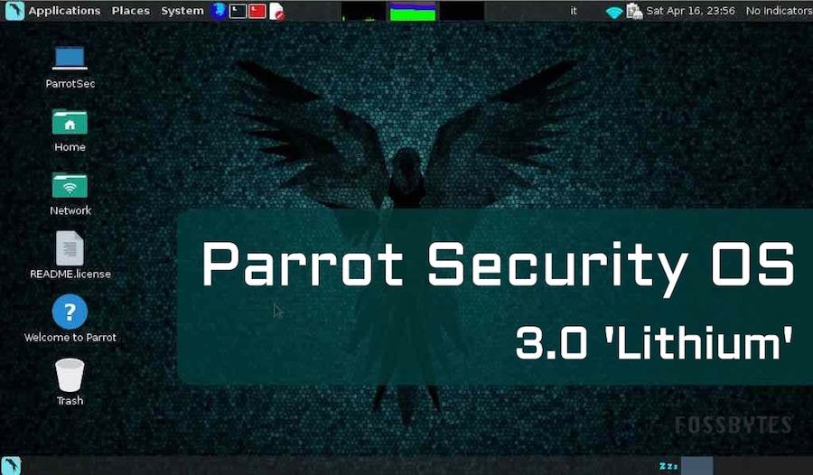
Hacking Tools
Parrot Security OS
A kind of popular Hacking OS (Like kali linux)
Oriented by Kali Linux
Cost : Free
A big different of Kali
1st : has anonimity protocol
(like I2P, Tor etc . . .)
2nd : more light ans fast
(Do not use excessive computer resourse)
Made by. 43516ED4405CCDFCC07FD09668726ECD

