Slide 1




Make Yourself a Simulation of an Ecosystem

Slide 2
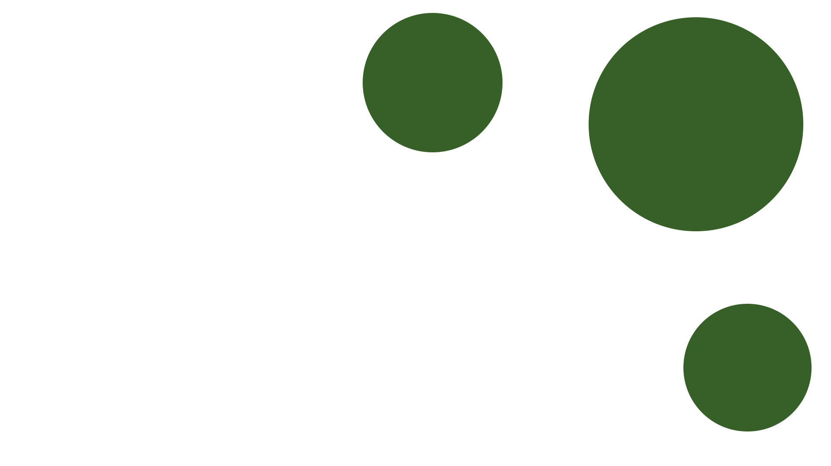


Table of Contents
Our Team
Our Goal
Stages of Realization
What We Used

Slide 3








Our Team
Stas Uzunov
Vasil Mladenov
Daniel Georgiev
VIktor Kirov
Scrum Master
Back-End Developer
Front-End Developer
QA Engineer

Slide 4
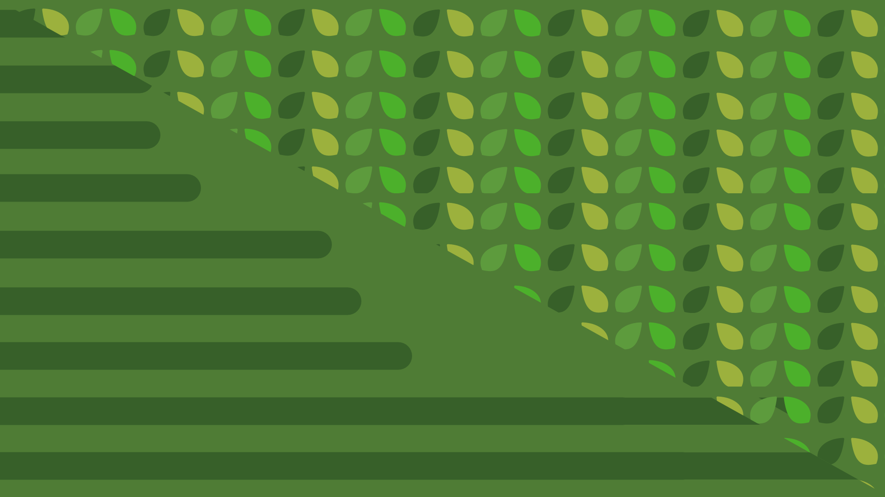

Our Goal
It's main goal is to teach people how a small ecosystem works and how the different types of animals are connected with one another.

Slide 5

Stages of
Realization
ORGANIZATION
REALISATION
PRESENTATION

Slide 6







What We Used

Slide 7

Let’s Continue
With a Demonstration

