Slide 1
Objectives
In this lesson, you will learn to:
Create tables
Insert rows into tables
Delete tables
Create user-defined datatype
List various types of data integrity
Add the following constraints to tables:
  PRIMARY KEY
  UNIQUE
  FOREIGN KEY
  CHECK
  DEFAULT

Slide 2
5.D.1 Creating a Table
The details about a newspaper that publishes advertisements for Tebisco, Inc. have to be stored in the Recruitment database.
Attributes
Data
Newspaper Code
0001
Newspaper Name
Texas Times
Region
Texas
Type of Newspaper
General
Contact Person
Jackson Demello
HO Address
4723 West Alabama
City
Houston
State
Texas
Zip
77015-4568
Country Code
001
Fax
(713)451-6797
Phone
(713)451-6850

Slide 3
Task List
Draft the statement to create a table
Create the table in the database
Check whether the table has been created
Insert a row into the table

Slide 4
Draft the statement to create a table
Tables: A table is a database object used to store data
  Data in a table is organized in rows and columns
  Each row in a table represents a unique record and each column represents an attribute of the record
The CREATE TABLE Statement: Is used to create a table
  Syntax
CREATE TABLE table_name
(column_name datatype [NULL | NOT NULL]
[IDENTITY (SEED,INCREMENT)],
column_name datatype …)
[ON {filegroup} | DEFAULT]
Result:
  The name of the table to be created is Newspaper

Slide 5
Create the table in the database
Action
  In the Query Analyzer window, type the given CREATE TABLE statement
CREATE TABLE NewsPaper
(cNewsPaperCode char(4) NOT NULL,
cNewsPaperName char(20) NOT NULL,
vRegion varchar(20),
vTypeOfNewsPaper varchar(20),
vContactPerson varchar(35),
vHOAddress varchar(35),

Slide 6
Create the table in the database (Contd.)
cCity char(20),
cState char(20),
cZip char(10),
cCountryCode char(3),
cFax char(15),
cPhone char(15))
  Press F5 to execute the statement

Slide 7
Check whether the table has been created
You can use the sp_help command to view the structure of the table
  Syntax
sp_help table_name
  Action:
    In the Query Analyzer window, type:
sp_help Newspaper
    Press F5 to execute

Slide 8
Insert a row into the table
The INSERT Statement
  After the table structure has been created, data can be inserted into the table. You can insert data into the table by using the INSERT command
  Syntax
INSERT [INTO] table_name [column_list]
VALUES (values_list)

Slide 9
Insert a row into the table (Contd.)
Action:
  In the Query Analyzer, type the INSERT statement given below:
INSERT Newspaper
VALUES('0001', 'Texas Times', 'Texas', 'General', 'Jackson Demello',
'4723 West Alabama', 'Houston', 'Texas', '77015-4568', '001', '(713)451-6797', '(713)451-6850')
  Press F5 to execute

Slide 10
5.P.1 Creating a Table
You want to store the details about the colleges that Tebisco, Inc. visits for recruitment. A sample row is given below:
The college code and name cannot be left blank.
Attribute
Data
College Code
0002
College Name
Cromwell College
College Address
4010 Gartner Ave
City
Abilene
State
Texas
Zip
79605-4123
Phone
(915)692-6628

Slide 11
5.D.2 Deleting a Table
Remove the Newspaper table from the database.

Slide 12
Task List
Draft the statement to remove a table from the database
Remove the Newspaper table from the database
Verify that the table has been removed from the database

Slide 13
Draft the statement to remove a table from the
database
The DROP TABLE Statement
  Used to remove the table from the database
  Syntax
DROP TABLE table_name
Result:
  The statement to remove the Newspaper table is:
DROP TABLE Newspaper

Slide 14
Remove the Newspaper table from the database
Action
  In the Query Analyzer window, type:
  DROP TABLE Newspaper
  Press F5 to execute

Slide 15
Verify that the table has been removed from the
database
Type the following command to view the table structure:
sp_help Newspaper
Action
  In the Query Analyzer window, type:
sp_help Newspaper
  Press F5 to execute

Slide 16
Just a Minute…
Draft the statement to remove the College table from the database.

Slide 17
Data Types in SQL
Int
Smallint
Float
Money
Datetime
Char
Varchar
Text

Slide 18
User-Defined Datatypes
Creating a User-Defined Datatype
  A user-defined datatype is created using the sp_addtype system stored procedure
  Syntax
sp_addtype name, [system_data_type]
  [, 'null_type']

Slide 19
User-Defined Datatypes (Contd.)
Dropping a User-Defined Datatype
  A user-defined datatype can be dropped using the sp_droptype system stored procedure
  Syntax
sp_droptype type

Slide 20
5.D.3 Creating User-defined Datatypes
The NewsAd and the Newspaper tables do not have the same datatype for the cNewspaperCode attribute. Create a user-defined datatype called typNewspaperCode that can be used to create the NewsAd and the Newspaper table. Create the NewsAd table in which the newspaper code is of typNewspaperCode datatype.

Slide 21
Task List
Identify the inconsistency in the table structures
Identify the system-defined datatype that can be converted to a user-defined datatype
Identify the name for the user-defined datatype
Create a user-defined datatype
Verify that the datatype has been created
Create the NewsAd table with the new datatype

Slide 22
Identify the inconsistency in the table structures
User-defined datatypes
  Can be used to remove the inconsistency in table structures which arises when two attributes that should have the same system datatype use different system datatypes.
Result:
  The cNewspaperCode attribute in the Newspaper table is of datatype char(4). The cNewspaperCode attribute in the NewsAd table is of datatype varchar(2). The datatype and the length of both these attributes are different. This gives rise to inconsistency in the table structure.

Slide 23
Identify the system-defined datatype that can be
converted to a user-defined datatype
Result:
  The system-defined datatype of both attributes should be char(4)

Slide 24
Identify the name for the user-defined datatype
The name of the datatype can be prefixed with the letters 'typ' for identifying the user-defined datatype
Result:
  Name for the user-defined datatype is typNewspaperCode

Slide 25
Create a user-defined datatype
Action:
  In the Query Analyzer window, type:
sp_addtype typNewspaperCode, 'char(4)'
  Execute the query by clicking the Execute Query button

Slide 26
Verify that the datatype has been created
The sp_help system stored procedure gives specific information about the object specified
  Syntax
sp_help datatype_name
Action:
  In the Query Analyzer window, type:
sp_help typNewspaperCode
  Press F5 to execute

Slide 27
Create the table NewsAd with the new datatype
Action:
  In the Query Analyzer window, type:
CREATE TABLE NewsAd
(
cNewsAdNo char(4) NOT NULL,
cNewspaperCode typNewspaperCode NOT NULL,
dAdStartDate datetime,
dDeadline datetime
)
  Press F5 to execute

Slide 28
Data Integrity
Data integrity ensures the consistency and correctness of data stored in a database. It is broadly classified into the following four categories:
  Entity integrity
  Domain integrity
  Referential integrity
  User-defined integrity
Entity Integrity
  Ensures that each row can be uniquely identified by an attribute called the primary key

Slide 29
Data Integrity (Contd.)
Domain Integrity
  Ensures that only a valid range of values is allowed to be stored in a column
Referential Integrity
  Ensures that the values of the foreign key match with the value of the corresponding primary key
User-Defined Integrity
  Refers to a set of rules specified by a user, which do not belong to the entity, domain, and referential integrity categories

Slide 30
Just a Minute...
Which integrity ensures that the values in the foreign key match with the value of the corresponding primary key?

Slide 31
Creating Constraints
Constraints are created to ensure data integrity
Constraints define rules that must be followed to maintain consistency and correctness of data
A constraint can either be created at the time of creating a table or can be added later
Constraints can be enforced at two levels:
  Column level
  Table level

Slide 32
Creating Constraints (Contd.)
A constraint can be created using either of the following statements:
  CREATE TABLE statement
CREATE TABLE table_name
column_name CONSTRAINT constraint_name constraint_type [,CONSTRAINT constraint_name constraint_type]
  ALTER TABLE statement
ALTER TABLE table_name
[WITH CHECK | WITH NOCHECK]
ADD CONSTRAINT constraint_name constraint_type

Slide 33
Creating Constraints (Contd.)
Dropping Constraints
  A constraint can be dropped using the ALTER TABLE statement in the Query Analyzer
  Syntax
ALTER TABLE table_name
DROP CONSTRAINT constraint_name

Slide 34
Creating Constraints (Contd.)
Types of Constraints
  The PRIMARY KEY Constraint
    Is defined on a column or a set of columns whose values uniquely identify rows in a table
    Ensures entity integrity
  Syntax
[CONSTRAINT constraint_name PRIMARY KEY [CLUSTERED|NONCLUSTERED](col_name [, col_name [, col_name [, …]]])]

Slide 35
Creating Constraints (Contd.)
  The UNIQUE Constraint
    Is used to enforce uniqueness on non-primary key columns
    Multiple UNIQUE constraints can be created on a table
  Syntax
[CONSTRAINT constraint_name UNIQUE [CLUSTERED | NONCLUSTERED](col_name [, col_name [, col_name [, …]]])

Slide 36
Creating Constraints (Contd.)
  The FOREIGN KEY Constraint
    Is used to remove the inconsistency in two tables when data in one table depends on data in another table
  Syntax
[CONSTRAINT constraint_name FOREIGN KEY (col_name [, col_name [, …]])
REFERENCES table_name (column_name [,
  column_name [, …]])]

Slide 37
Creating Constraints (Contd.)
  The CHECK Constraint
    Enforces domain integrity by restricting the values to be inserted in a column
  Syntax
[CONSTRAINT constraint name] CHECK (expression)

Slide 38
Creating Constraints (Contd.)
  The DEFAULT Constraint
    It is used to assign a constant value to a column
    Only one DEFAULT constraint can be created for a column
    The column cannot be an IDENTITY column
  Syntax
[CONSTRAINT constraint_name] DEFAULT
  (constant_expression | NULL)

Slide 39
Just a Minute…
Which constraint enforces domain integrity by restricting the value to be inserted in a column?

Slide 40
5.D.4 Using Constraints
The Newspaper and NewsAd tables have been finalized. Create the Newspaper table with the following data integrity rules:
  The cNewspaperCode attribute should be the primary key
  The cPhone attribute should be of the format ([0-9][0-9] [0-9])[0-9][0-9][0-9][0-9][0-9][0-9][0-9])
  The cCountryCode attribute should be 001 by default
Modify the NewsAd table as specified below:
  cNewsAdNo should be the primary key
  cNewspaperCode should be the foreign key

Slide 41
Task List
Identify how to enforce data integrity
Draft the statement to create a table
Create the table with constraints
Verify constraints by inserting data

Slide 42
Identify how to enforce data integrity
You can enforce data integrity by using constraints
Result:
  For the Newspaper table:
    The phone number format can be given using the CHECK constraint
    The country code can be given using the DEFAULT constraint
    The newspaper code can be made the primary key using the PRIMARY KEY constraint

Slide 43
Identify how to enforce data integrity (Contd.)
  For the NewsAd table:
    The cNewsAdNo column can be made the primary key using the PRIMARY KEY constraint
    The cNewspaperCode attribute can be made the foreign key using the FOREIGN KEY constraint

Slide 44
Draft the statement to create a table
Result:
  The command to create the Newspaper table would be as follows:
CREATE TABLE Newspaper
(cNewspaperCode typNewspaperCode CONSTRAINT
pkNewspaperCode PRIMARY KEY,
  cNewspaperName char(20) NOT NULL,
vRegion varchar(20),
vTypeOfNewspaper varchar(20),
vContactPerson varchar(35),
vHOAddress varchar(35),

Slide 45
Draft the statement to create a table (Contd.)
cCity char(20),
cState char(20),
cZip char(10),
cCountryCode char(3) CONSTRAINT defCountryCode
DEFAULT(‘001’),
cFax char(15),
cPhone char(15) CONSTRAINT chkPhone
CHECK(cPhone
LIKE('([0-9][0-9][0-9])[0-9][0-9][0-9]-[0-9][0-
9][0-9][0-9]')))

Slide 46
Draft the statement to create a table(Contd.)
  The commands to modify the NewsAd table would be as follows:
ALTER TABLE NewsAd
  ADD CONSTRAINT pkNewsAdNo PRIMARY KEY
  (cNewsAdNo)
  ALTER TABLE NewsAd
  ADD CONSTRAINT fkNewspaperCode
  FOREIGN KEY (cNewspaperCode)
  REFERENCES Newspaper(cNewspaperCode)

Slide 47
Create the table with the constraints
Action:
  In the Query Analyzer window, type the query
  Execute the commands by clicking the Execute Query button

Slide 48
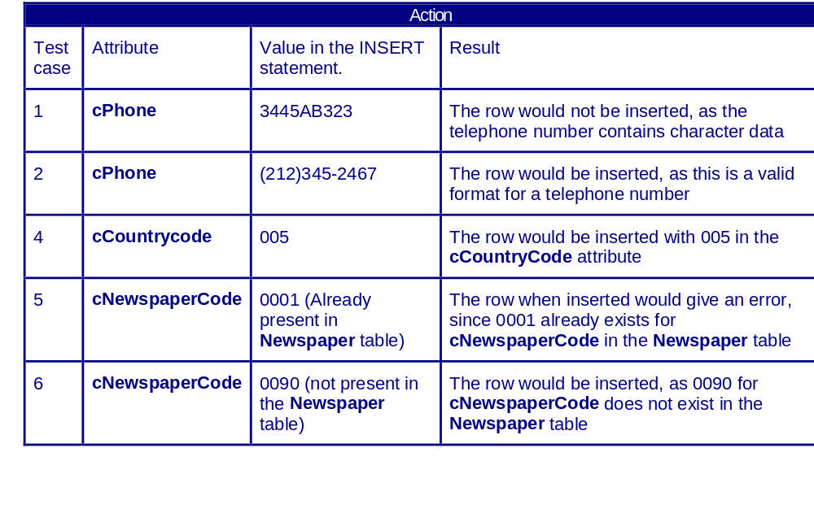
Verify the constraints by inserting data
Verify the constraint by inserting data (into the Newspaper table)

Slide 49
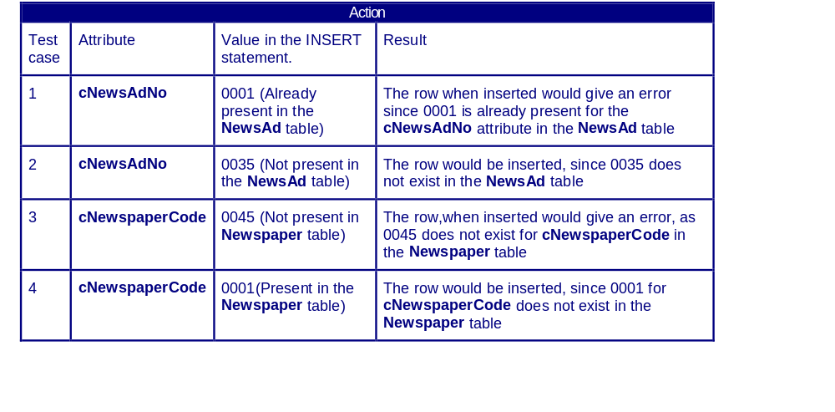
Verify the constraints by inserting data (Contd.)
Verify the constraint by inserting data (into the NewsAd table)

Slide 50
5.P.2 Using Constraints
Create the College table with the following data integrity rules:
  cCollegeCode should be the primary key
  The phone number should be of the format ([0-9][0-9][0-9])[0-9][0-9][0-9]-[0-9][0-9][0-9][0-9]
  cCity should be “New Orleans” by default
Create the CampusRecruitment table so that it satisfies the following data integrity rules:
  The cCampusRecruitmentCode column should be the primary key
  The cCollegeCode column should be the foreign key

Slide 51
Summary
In this lesson, you learned that:
A table is a database object used to store data
A table can be created using the CREATE TABLE statement
The INSERT statement is used to insert data into the table
The DROP TABLE statement is used to delete the table
A user-defined datatype is created by a user and is based on a system datatype
A user-defined datatype is created using the sp_addtype system stored procedure

Slide 52
Summary (Contd.)
A user-defined datatype can be dropped using the sp_droptype system stored procedure
sp_help provides information about a database object or a user-defined datatype
Data integrity ensures the completeness, accuracy, and reliability of data contained in the database
Data integrity can be classified as entity integrity, domain integrity, referential integrity, and user-defined integrity
Data integrity can be enforced through constraints
Constraints are rules that can be specified at either the table- level or the column-level

Slide 53
Summary (Contd.)
A constraint can be created using either the CREATE TABLE or the ALTER TABLE statements
A constraint can be dropped with the ALTER TABLE statement or by dropping the table
Constraints are classified as PRIMARY, FOREIGN, UNIQUE, CHECK, and DEFAULT

