Slide 1
Objectives
In this lesson, you will learn to:
Create rules
Create defaults
Maintain data in a table by using
  INSERT statement
  UPDATE statement
  DELETE statement
Truncate a table

Slide 2
6.D.1 Creating a Rule
The zip code in the Newspaper table should be of the character type and should have the following pattern:
[0-9][0-9][0-9][0-9][0-9]-[0-9][0-9][0-9][0-9]
An example of such a pattern is: 42482-4353
Without changing the table structure, how can you ensure that you can meet this requirement?

Slide 3
Task List
Identify how to implement the constraint without changing the table structure
Draft the statement to create a rule
Create the rule
Bind the rule to the column
Verify the constraint by inserting data in the table

Slide 4
Identify how to implement the constraint without
changing the table structure
A rule provides a mechanism for enforcing domain integrity for columns or user-defined datatypes. The rule is applied to the column or the user-defined datatype before an INSERT or UPDATE statement is issued.
Result:
  The constraint can be implemented by using rules.

Slide 5
Draft the statement to create a rule
The CREATE RULE Statement: Is used to create a rule
  Syntax
  CREATE RULE rule_name
  AS conditional_expression
Action:
  The rule would be applied on the cNewspaperCode attribute
  The condition to be applied is:
  @ZipCode LIKE '[0-9][0-9][0-9][0-9][0-9]-[0-9][0-9][0-9][0-9]'
  The name of the rule would be rulZipCode

Slide 6
Draft the statement to create a rule (Contd.)
  The rule can be created as follows:
  CREATE RULE rulZipCode
AS
@ZipCode LIKE '[0-9][0-9][0-9][0-9][0-9]- [0-9][0-9][0-9][0-9]'

Slide 7
Create the rule
Action:
  In the Query Analyzer window, type the query
  Press F5 to execute the query

Slide 8
Bind the rule to the column
Binding Rules
  A rule can be bound using the sp_bindrule system store procedure
  Syntax
  sp_bindrule rule_name, object_name [,FUTUREONLY]
Unbinding Rules
  A rule can be unbound from a column or user-defined datatype using the sp_unbindrule system stored procedure
  Syntax
  sp_unbindrule object_name [, FUTUREONLY]

Slide 9
Bind the rule to the column (Contd.)
Action:
  In the Query Analyzer, type:
sp_bindrule rulZipCode,'Newspaper.cZip'
  Press F5 to execute the code

Slide 10
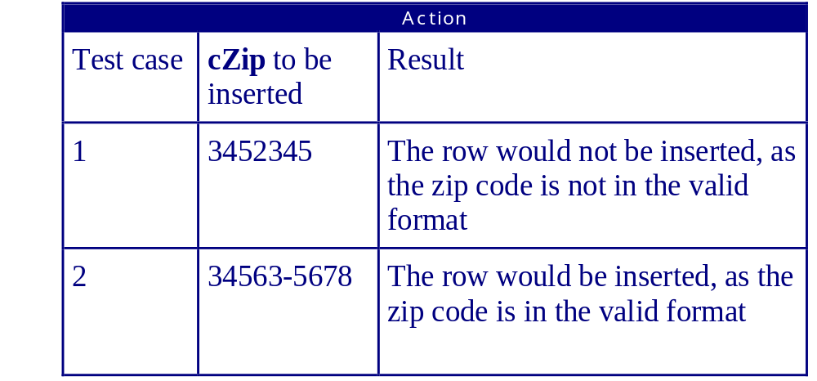
Verify the constraint by inserting data in the table

Slide 11
Just a Minute…
Which system stored procedure is used to bind and unbind a rule?

Slide 12
6.D.2 Creating a Default
The data entry operator complains that for most rows, he has to repeatedly enter the code 001 for the cCountryCode attribute of the Newspaper table. You need to simplify the data entry task without modifying the table structure.

Slide 13
Task List
Identify how the data entry task can be simplified
Draft the statement to create a default
Create the default
Bind the default to the column
Verify the default by adding a row with the DEFAULT value

Slide 14
Identify how the data entry task can be simplified
Default
  It is a constant value assigned to a column, into which the user need not insert values
Result:
  The data entry task can be simplified by using defaults

Slide 15
Draft the statement to create a default
The CREATE DEFAULT Statement
  Syntax
  CREATE DEFAULT default_name
  AS constant_expression
Action:
  The default would be applied on the Newspaper table
  The column on which the default would be applied is cCountryCode
  The default value is '001’

Slide 16
Draft the statement to create a default (Contd.)
  The code for creating the default can be written as
  CREATE DEFAULT defCountry
  AS '001'

Slide 17
Create the default
Action:
  In the Query Analyzer window, type the query
  Press F5 to execute the code

Slide 18
Bind the default to a column
Binding Defaults - After a DEFAULT is created, it needs to be bound to a column or a user-defined datatype
  Syntax
  sp_bindefault default_name, object_name [, FUTUREONLY]
Unbinding Defaults - Defaults can be unbound from a column or user-defined datatype using the sp_unbindefault system stored procedure
  Syntax
sp_unbindefault object_name [, FUTUREONLY]

Slide 19
Bind the default to a column (Contd.)
Action:
  In the Query Analyzer, type:
sp_bindefault
defCountry,'Newspaper.cCountryCode'
  Press F5 to execute the code

Slide 20
Verify the default by adding a row with the DEFAULT
value
Action:
  In the Query Analyzer, type:
  INSERT INTO Newspaper
  VALUES('0008','Kansas Today','Kansas','Genral','Robin Paul','1925 Shawnee Dr ','Kansas City','Kansas','66106-3025',DEFAULT,'(913)362-9529','(913)362-9515')
  Press F5 to execute

Slide 21
Maintaining Databases
Data Manipulation Language - Data manipulation involves inserting, modifying, and deleting data. The Data Manipulation Language (DML) of Transact–SQL is used to manipulate data
The three operations that you will typically perform to maintain a database are:
  Insert Rows
  Update Rows
  Delete Rows

Slide 22
6.D.3 Storing Details in a Table
Recruitment of candidates is done through recruitment agencies. One of the new recruitment agencies is called ‘Head Hunters’. The details of the Head Hunters are:
The above details are required to be stored in the RecruitmentAgencies table
Attributes
Data
Agency Code
0010
Name
Head Hunters
Address
223 Hill Street
City
Cleveland
State
Ohio
Zip
44167-5943
Phone
(440)345-8872
Fax
(440)345-8943
Charge
7
Total Paid
1000

Slide 23
Task List
Decide in which table the information is to be added
Identify the values to be inserted
Insert rows into the table
Query the table to verify that data has been inserted

Slide 24
Decide in which table the information is to be added
Result:
  The information is to be added in the RecruitmentAgencies table

Slide 25
Identify the values to be inserted
Result:
  In the RecruitmentAgencies table, the values to be inserted are:
    cAgencyCode = '0010'
    cName = ‘Head Hunters ',
    vAddress = ‘223 Hill Street ',
    cCity = 'Cleveland',
    cState = ‘Ohio’
    cZip = '44167-5943',
    cPhone = '(440)345-8872',
    cFax = '(440)345-8943',
    siPercentageCharge = 7,
    mTotalPaid = 1000

Slide 26
Insert rows into the table
The INSERT Statement
  You must add data to the database to maintain the latest information about the organization and the transactions performed by it. This is done using the INSERT statement
  Syntax
  INSERT [INTO]{table_name}[(column_list)]
  VALUES {DEFAULT values_list|select_statement}

Slide 27
Insert rows into the table (Contd.)
Action:
  In the Query Analyzer Window, type:
INSERT INTO RecruitmentAgencies
VALUES('0010','Head Hunters','223 Hill
Street','Cleveland', 'Ohio','44167-
5943','(440)345-8872','(440)345-
8943',7,1000)
  Press F5 to execute the query

Slide 28
Query the table to verify that data has been
inserted
Action:
  In the Query Analyzer window, type:
SELECT * FROM RecruitmentAgencies
  Press F5 to execute the query

Slide 29
6.D.4 Storing Data From an Existing Table Into a new
Table
Data for the external candidates with a rating of eight or above from the ExternalCandidate table is to be copied into a new table called PreferredCandidate. (The PreferredCandidate table does not exist).
After the PreferredCandidate table has been created with the required values, it needs to be updated by adding rows of external candidates with a rating of seven.

Slide 30
Task List
Identify rows to be inserted
Create the new table with the selected values
Add more rows to the table that has been created
Query the table to check if the rows have been added

Slide 31
Identify rows to be inserted
Result:
  The rows to be inserted are of those candidates with a rating of eight or above from the ExternalCandidate table

Slide 32
Create the new table with the selected values
The SELECT INTO Statement is used to copy contents of one table into another table
  Syntax
  SELECT columns_list
  INTO new_table_name
  FROM table_names
  WHERE conditions
Action:
  In the Query Analyzer window, type:
SELECT * INTO PreferredCandidate
FROM ExternalCandidate
WHERE cRating >= 8
  Press F5 to execute the query

Slide 33
Add more rows to the table that has been created
The INSERT INTO Statement is used to add data from one table to another
  Syntax
  INSERT [INTO] table_name1
  SELECT column_name(s)
  FROM table_name2
  [WHERE condition]
Action:
  In the Query Analyzer window, type:
INSERT INTO PreferredCandidate
SELECT * FROM ExternalCandidate
WHERE cRating = 7
  Press F5 to execute the query

Slide 34
Query the table to check if the rows have been added
Action:
  In the Query Analyzer window, type:
SELECT * FROM PreferredCandidate
  Press F5 to execute the query

Slide 35
Just a Minute…
Which statements allow you to copy contents of one table into another table?

Slide 36
6.D.5 Updating a Table
The test score of Jane Schaffer who is an external candidate (cCandidateCode 000049) is to be increased by 2 marks, due to an error detected in the test correction process.

Slide 37
Task List
Identify attributes that have to be updated
Identify values to be updated
Update rows
Query tables

Slide 38
Identify attributes that have to be updated
Result:
  In the ExternalCandidate table, the siTestScore attribute has to be updated

Slide 39
Identify values to be updated
Result:
  The test score of Jane Schaffer who is an external candidate is to be increased by 2 marks. The cCandidateCode of Jane is 000049

Slide 40
Update rows
The UPDATE Statement is used to modify data in a database
  Syntax
  UPDATE table_name
  SET column_name = value[,column_name = value]
  [FROM table_name]
  [WHERE condition]
Action:
  In the Query Analyzer window, type:
  UPDATE ExternalCandidate
  SET siTestScore=siTestScore+2
  WHERE cCandidateCode='000049'
  Press F5 to execute the query

Slide 41
Query Tables
Action:
  In the Query Analyzer window, type:
  SELECT * from ExternalCandidate
  WHERE cCandidateCode = '000049'
  Press F5 to execute the query

Slide 42
6.D.6 Deleting Data
The ExternalCandidate table contains data on all external candidates who were rejected after the entrance test. Some of the data in this table present now is more than two years old. It is occupying hard disk space that can be used for some other purpose. This data is not required anymore. You are required to ensure that this old data is removed from the ExternalCandidate table.

Slide 43
Task List
Identify rows that need to be deleted
Delete the row(s)
Query the table

Slide 44
Identify rows that need to be deleted
Result:
  The rows containing data about the candidates who took the entrance test more than two years ago

Slide 45
Delete the row(s)
The DELETE Statement is used to delete a row from a table
  Syntax
DELETE [FROM] table_name
[ FROM table(s)]
[WHERE condition]
Action:
  In the Query Analyzer window, type:
  DELETE FROM ExternalCandidate
  WHERE dTestDate < dateadd(yy,-2,getdate())
  Press F5 to execute the query

Slide 46
Query the table
Action:
  In the Query Analyzer window, type:
  SELECT * FROM ExternalCandidate
  WHERE dTestDate < dateadd(yy,-2,getdate())
  Press F5 to execute

Slide 47
Just a Minute…
Which statement allows the modification of data in a database?

Slide 48
Truncating a Table
The TRUNCATE TABLE statement
  Is used to remove rows from a table
  Is identical (functionally) to the DELETE statement
  Is faster than DELETE statement
  Does not fire a trigger
    Syntax
  TRUNCATE TABLE table_name

Slide 49
Summary
In this lesson, you learned that:
Rules and defaults are objects that are bound to columns or user-defined datatypes for specifying the restricted values and default values respectively
A rule is created using the CREATE RULE statement, and bound to the column and user-defined datatypes using the sp_bindrule procedure
A rule is unbound using the sp_unbindrule procedure
A default is created using the CREATE DEFAULT statement, and bound to the column and user-defined datatypes using the sp_bindefault procedure

Slide 50
Summary (Contd.)
A default is unbound using the sp_unbindefault procedure
Data is modified in the database to keep the data up-to-date
The INSERT statement is used to insert rows into tables
You can copy contents of one table into another table by using the SELECT INTO command
SQL Server provides a row update statement called UPDATE to modify values within tables
You can delete a row from a table by using the DELETE statement
You use the TRUNCATE TABLE statement to remove all the rows from a table

