Slide 1

Enterprise Software Development

Slide 2
SSW.PointBank
Bringing high interest rates to boring tasks

Slide 3
What we think of tasks today
Employees:
Boring and repetitive
No discernible benefit
Better things to do
Employers:
Valuable for business
Want to incentivise
Not worth the admin time

Slide 4
Unlock employee knowledge
Everyone loves Scrum
Employees have a lot of useful knowledge
We could inform decisions if we unlock it

Slide 5



Real Life Example
Should I prioritise stand up desks or a fingerprint scanner on the door? I need to ask my employees
Great…another questionnaire…I would rather be working on my new VR app
My employees don’t want to
My admins don’t have time
Guess I can’t get my data…
If I spend my day chasing up questionairres, I wont get anything else done…
Boss
Employee
Admin

Slide 6
Goals
Easy to use
Worthwhile to use
Minimal admin
Valuable Data

Slide 7


Existing Products
Many gamified todo list apps…not many gamified, business managed and automated
No leaderboards or rewards built in
Repeated user defined tasks and completion, has leaderboards

Slide 8
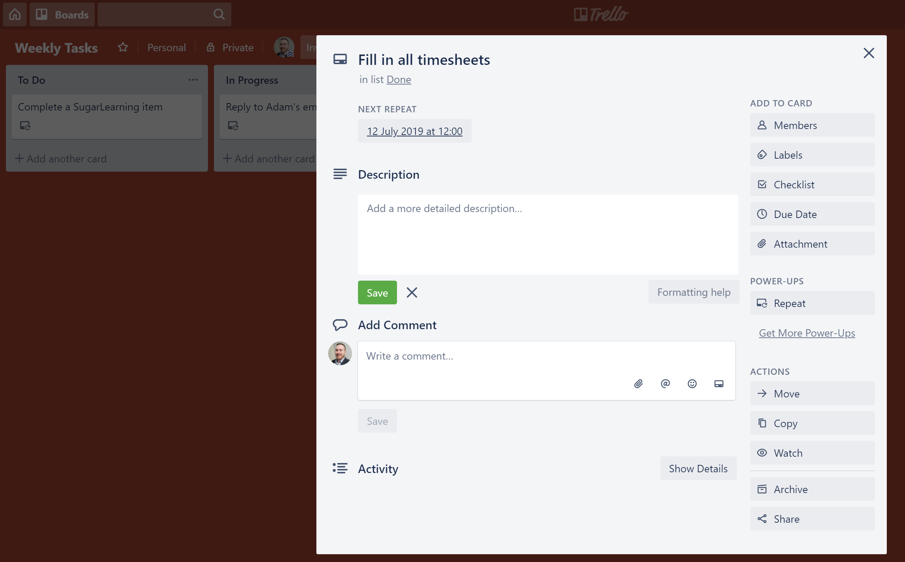

Slide 9
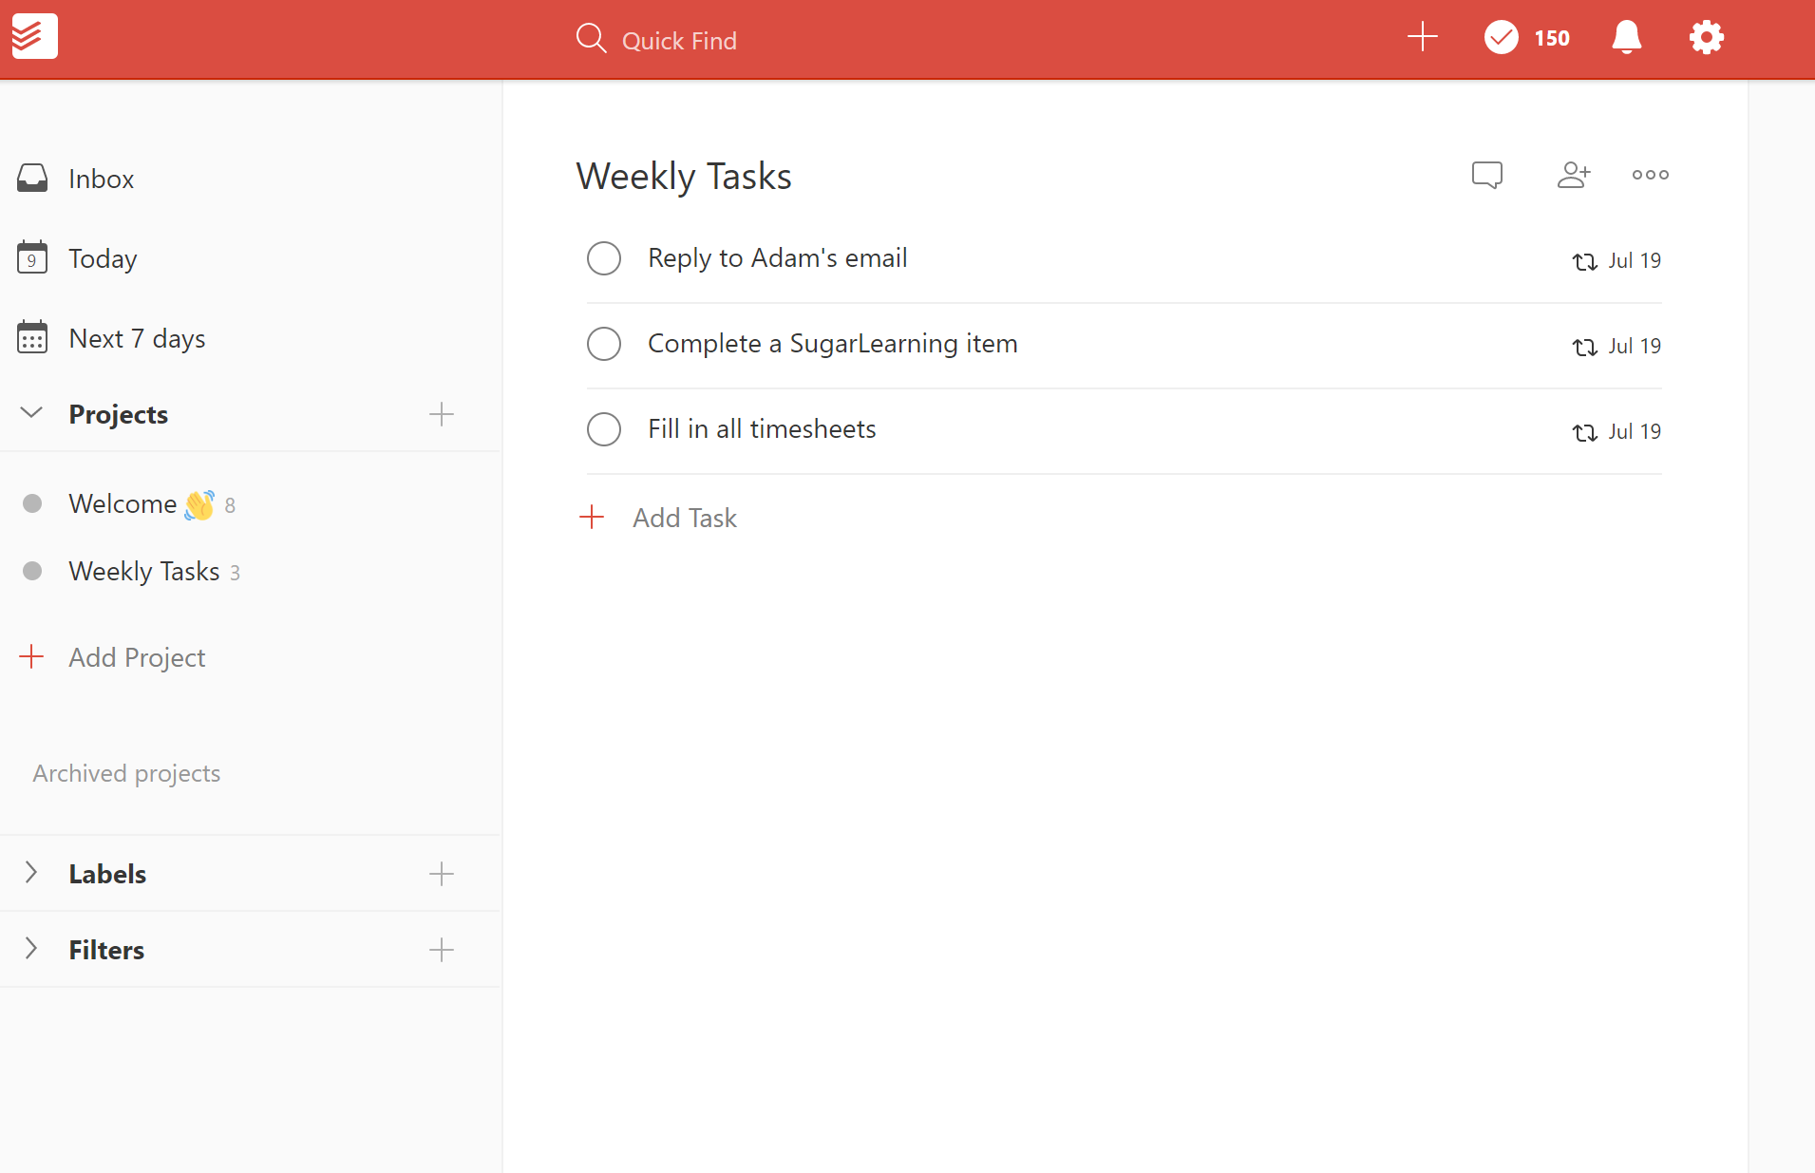
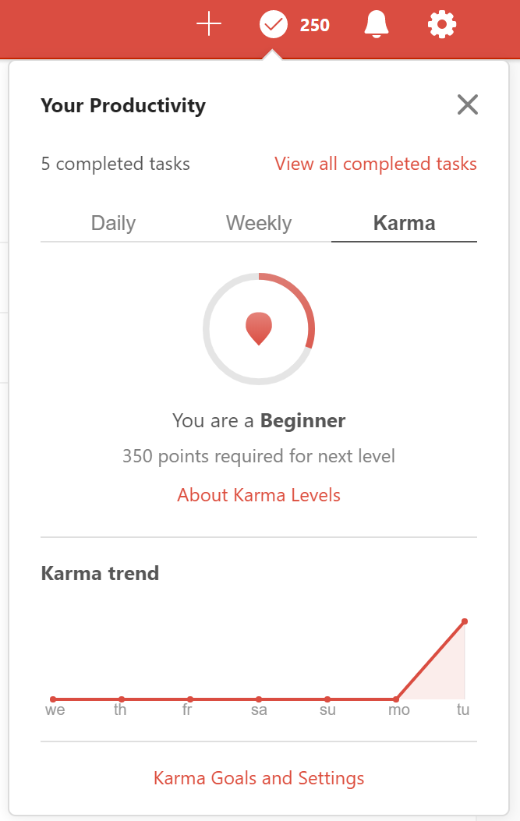

Slide 10
The Solution: SSW.PointBank
Task incentivization platform
Seamlessly integrate with any system that has an API
Engaging employees via gamification

Slide 11
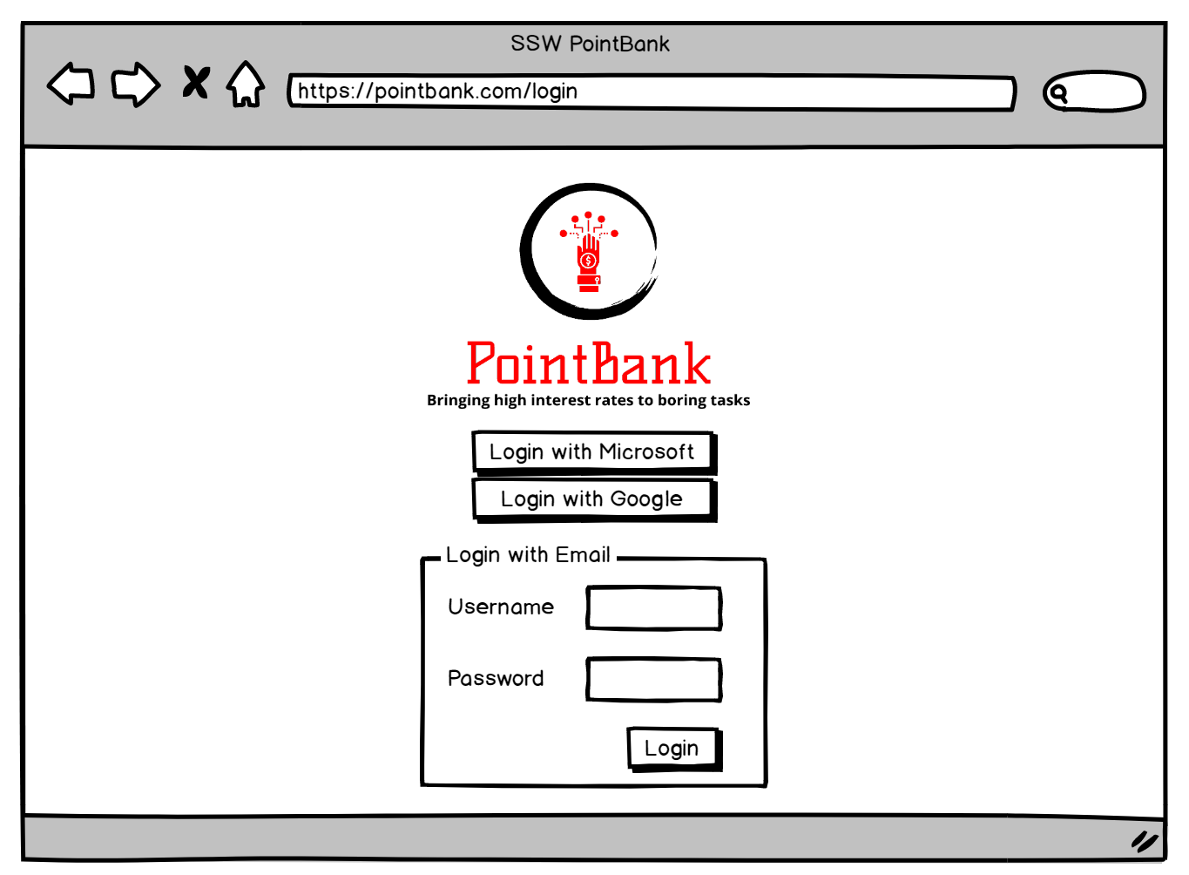

Slide 12
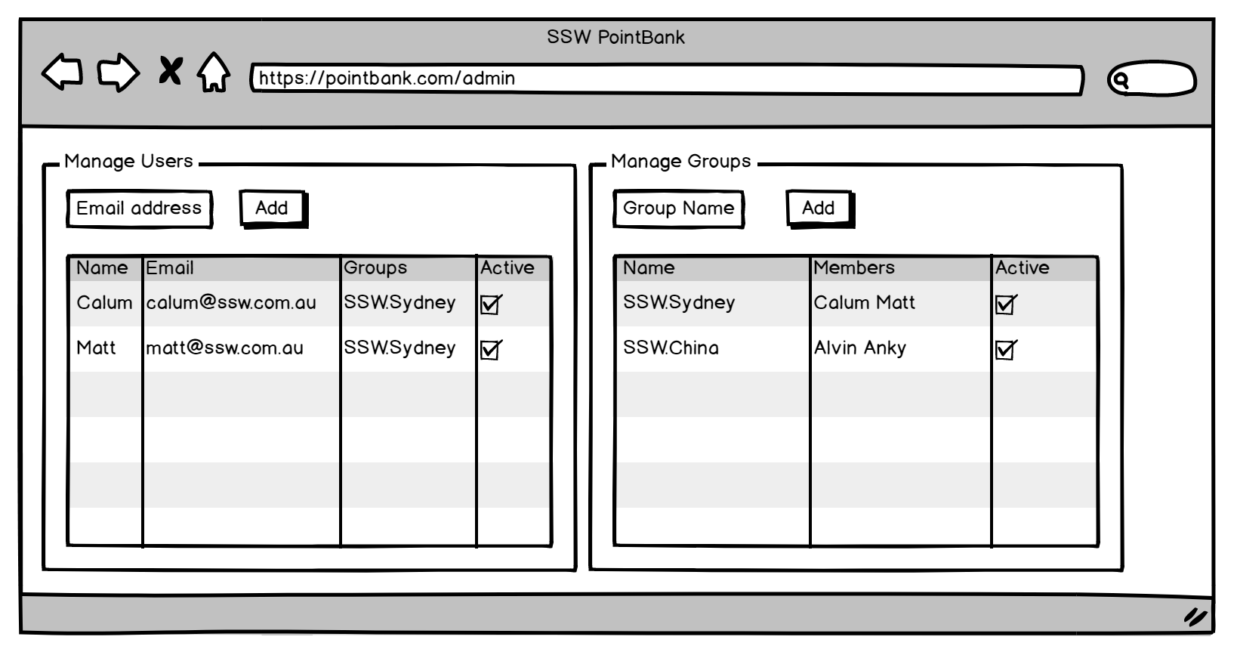

Slide 13
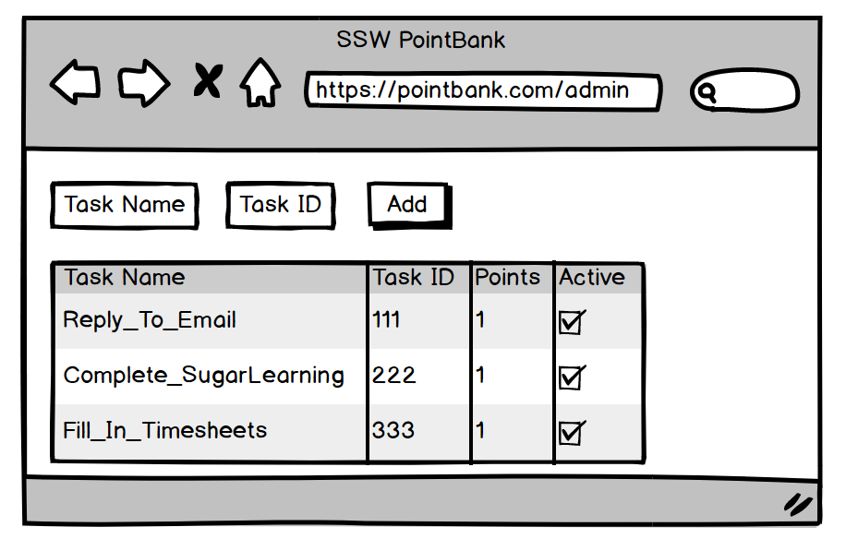

Slide 14
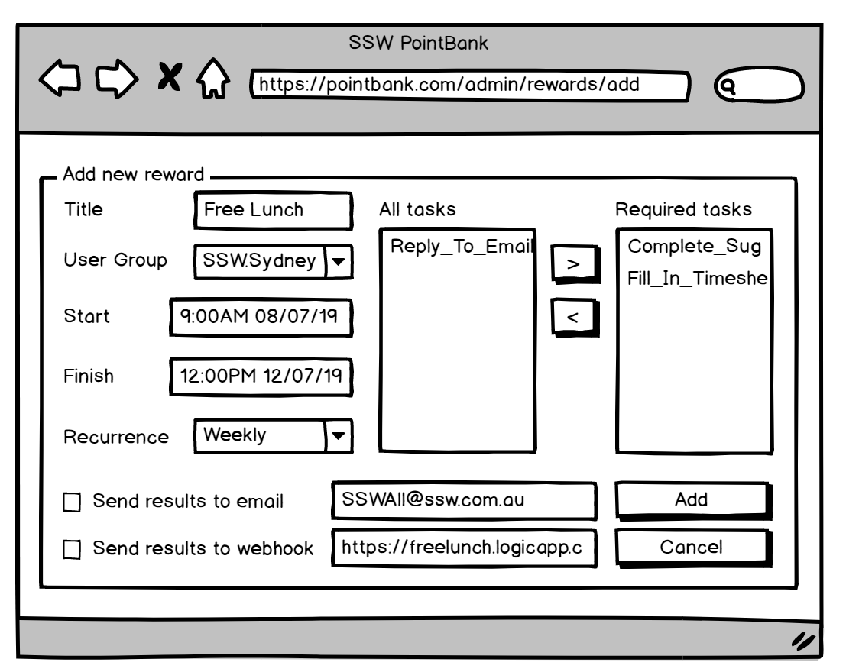

Slide 15



Input
SSW.PointBank API
Data
User | Task | DateTime
Calum | 111 | 2019-06-27 9:00
Calum | 222 | 2019-06-27 9:01
Calum | 333 | 2019-06-27 9:05
Matt | 111 | 2019-06-27 9:10
…

Slide 16

Output
External
Data
User Group | Tasks | Time Frame | Recurrence | Webhook
SSW.Sydney | [111,222,333] | 7 days | Weekly on Friday at 12:00PM | https://ssw.free-lunch-email-logicapp.com
SSW.China | [111,222,333] | 7 days | Weekly on Friday at 3:00PM | https://ssw.free-lunch-email-logicapp.com
SSW.PointBank API
Data
Data
User | Task | DateTime
Calum | 111 | 2019-06-27 9:00
Calum | 222 | 2019-06-27 9:01
Calum | 333 | 2019-06-27 9:05
Matt | 111 | 2019-06-27 9:10
User | Points
Calum | 3
Matt | 1
…
 Email

Slide 17


Output
External
Data
User Group | Tasks | Time Frame | Recurrence | Webhook
SSW.Sydney | [111,222,333] | 7 days | Weekly on Friday at 12:00PM | https://ssw.free-lunch-email-logicapp.com
SSW.China | [111,222,333] | 7 days | Weekly on Friday at 3:00PM | https://ssw.free-lunch-email-logicapp.com
SSW.PointBank API
Data
Data
User | Task | DateTime
Calum | 111 | 2019-06-27 9:00
Calum | 222 | 2019-06-27 9:01
Calum | 333 | 2019-06-27 9:05
Matt | 111 | 2019-06-27 9:10
User | Points
Calum | 3
Matt | 1
…
Leaderboard
User | Points
Calum | 3
Matt | 1

Slide 18
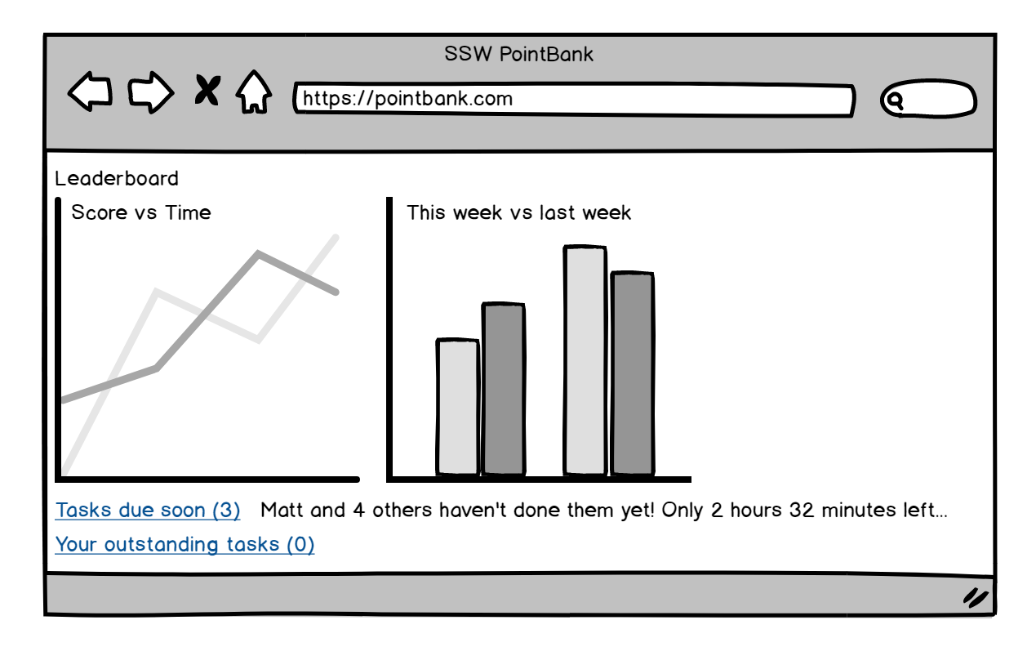

Slide 19
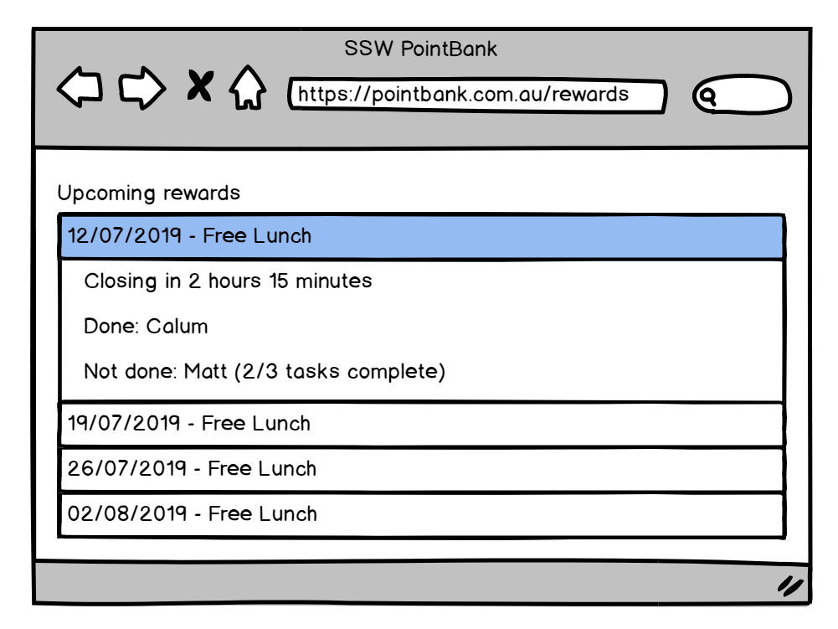

Slide 20
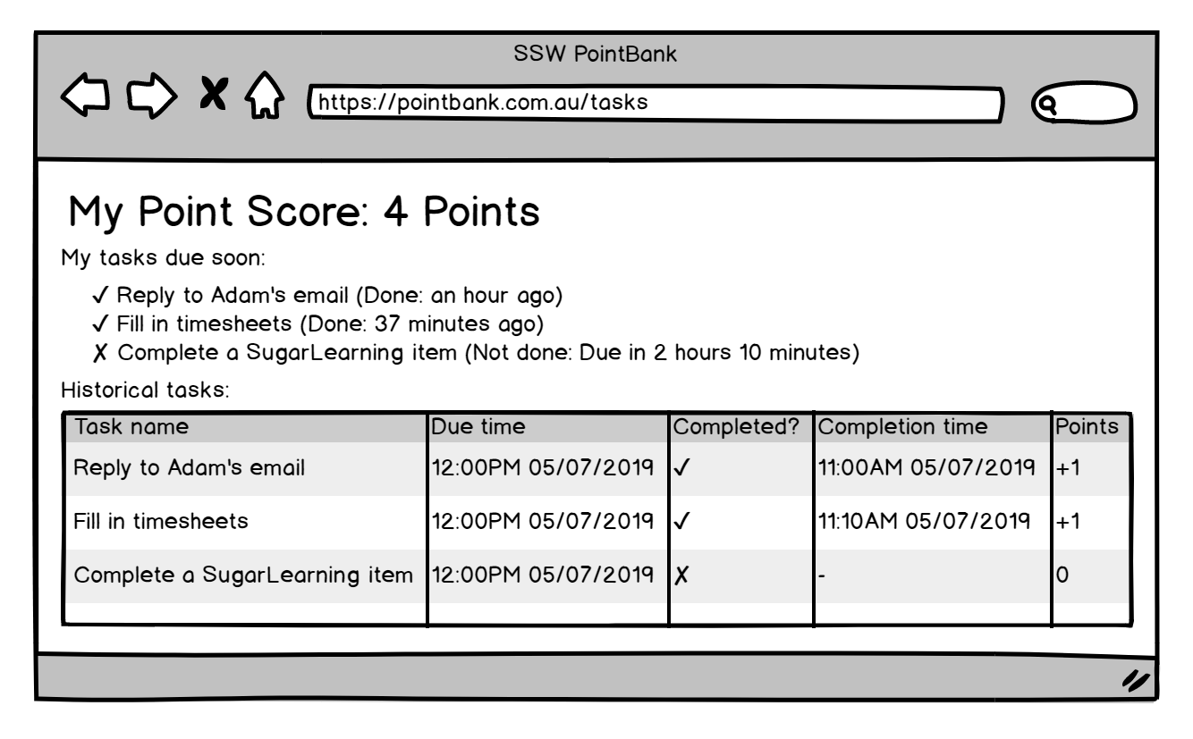

Slide 21
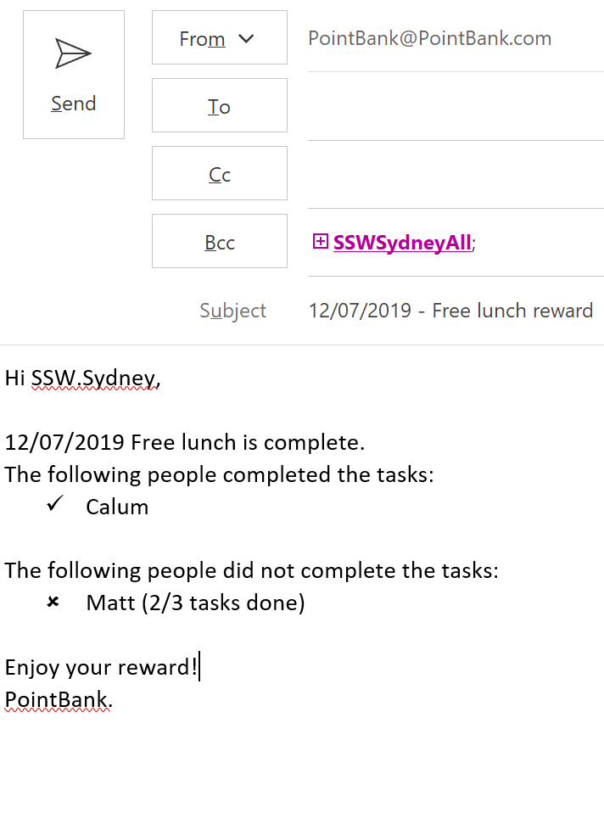

Slide 22
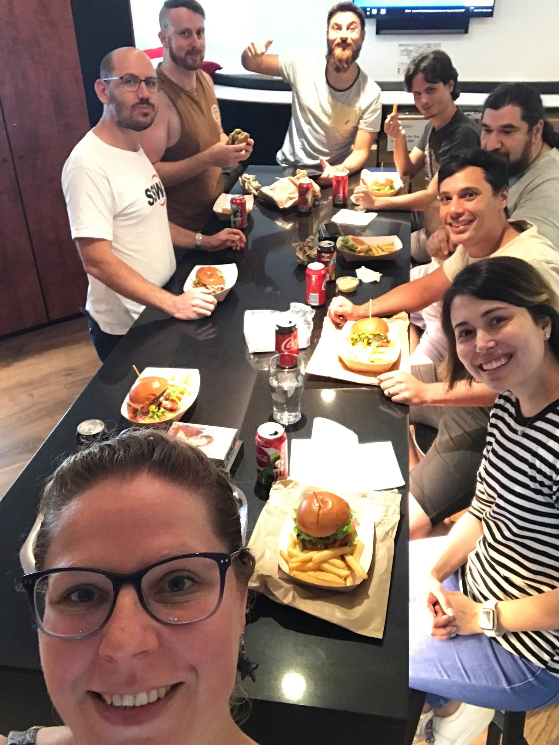

Slide 23
Thank you! info@ssw.com.au www.ssw.com.au Sydney | Melbourne | Brisbane

