Slide 2

The Year of the
AI Agent
From Automated Processes to
Autonomous Intelligence
.NET User Group February 2025

Slide 3

Agenda
1. What are AI Agents?
2. What are AI Workflows?
3. Real-World AI Agents
4. When to Use Agents vs. Workflows
5. How to Build Them
6. What’s Coming Next?

Slide 4

Ulysses Maclaren
SSW General Manager & Product Owner of YakShaver (AI Agent)
Stalk 👀 ssw.com.au/people/uly
Salsa world champion
Talks to Siri more than his wife
Reads ALL the AI books (fiction and non-fiction)
Coworkers can only get his attention by saying “It’s about AI”

Slide 5
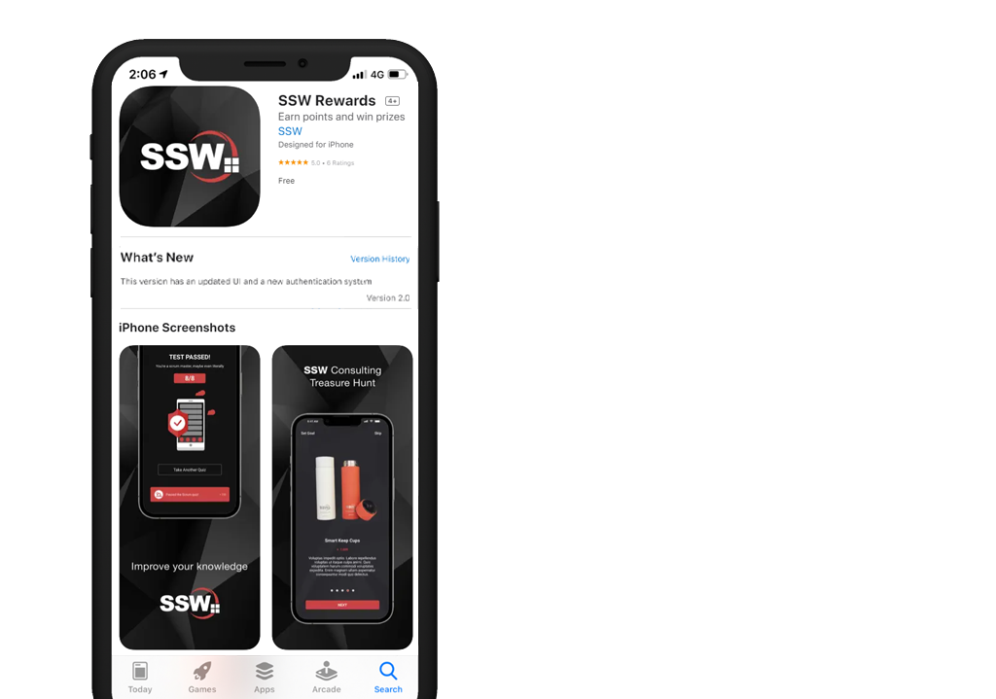
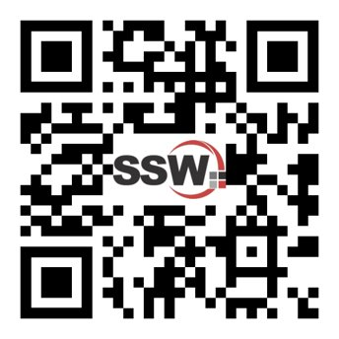
GET THE APP
Scan QR Code to install app
Scan SSW codes at talks and events
Earn SSW Points
claim rewards, and win prizes
Join the Conversation @SSW_TV | #SSWAgents | @ulyssesmac
Notes:
After tech news/introduction - Before the talk

Slide 6

What are AI Agents?
Notes:
https://www.ssw.com.au/rules/rules-to-better-powerpoint-presentations

Slide 7
An AI agent is capable of autonomously performing tasks by planning its own steps and using available tools​.

Slide 8
An AI Agent:
Perceives its environment (context)
Makes decisions (reasons)
Takes actions toward a goal (tool use)
… without needing step-by-step instructions for every scenario

Slide 9

1. Perception
Gather data from its surroundings:
Sensors (for physical agents 🚗🤖)
Data streams (for digital agents – APIs, user inputs)
Memory of past interactions (RL, continuous learning)

Slide 10
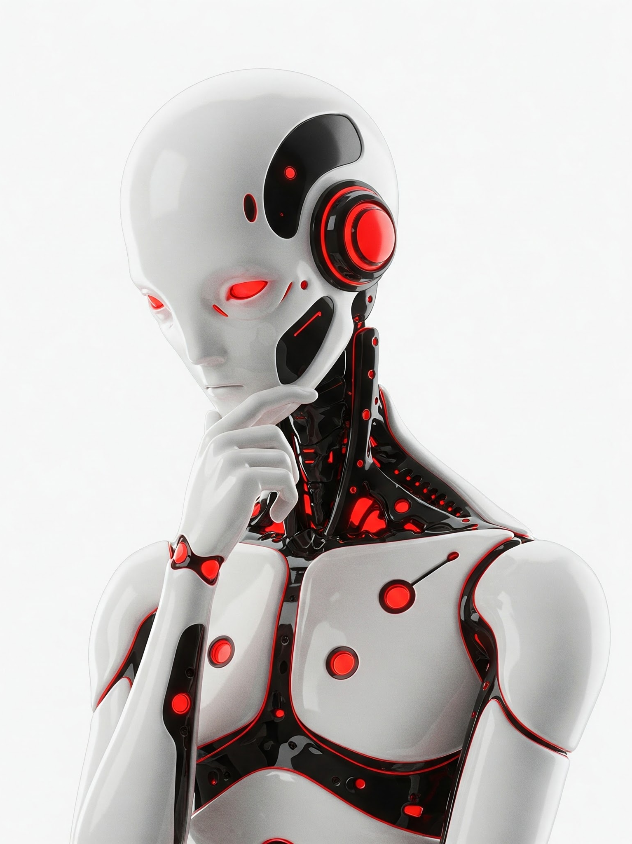
2. Decisions
Planning sub-goals ✈️
Optimization: Selecting the most efficient solution
Adaptability and Uncertainty Handling

Slide 11

3. Tools
Integrations (e.g. APIs) that let them act
e.g.
Pull in required information - browsing the web or connected data-sources (RAG)
Running code via an API
Update a database (CRM, etc.)
Clicking buttons in a UI​
Physical interactions – robotics, thermostat, etc.
Invoking another AI Workflow or Agent

Slide 12

4. Memory (optional)
Short-term memory (context within a session)
Long-term learning (improving behavior over time via RL or Continuous Learning)

Slide 13
Autonomy
A useful agent should operate without requiring step-by-step human intervention.
(Optional) Human in the loop.
Give it the what and the why, but not the how

Slide 14
Limitations
Unpredictability 💥
Incomplete Understanding 🤔
Need for Oversight 👀
Resource Intensity 💲

Slide 15

Sub-Goals: Instrumental Convergence
Acquire resources (energy, data, money)
Improve capabilities
Self-preservation (making copies of itself, backups, avoiding shutdown, sandbagging)
Goal preservation (scheming)

Slide 16

What are
AI Workflows?

Slide 17
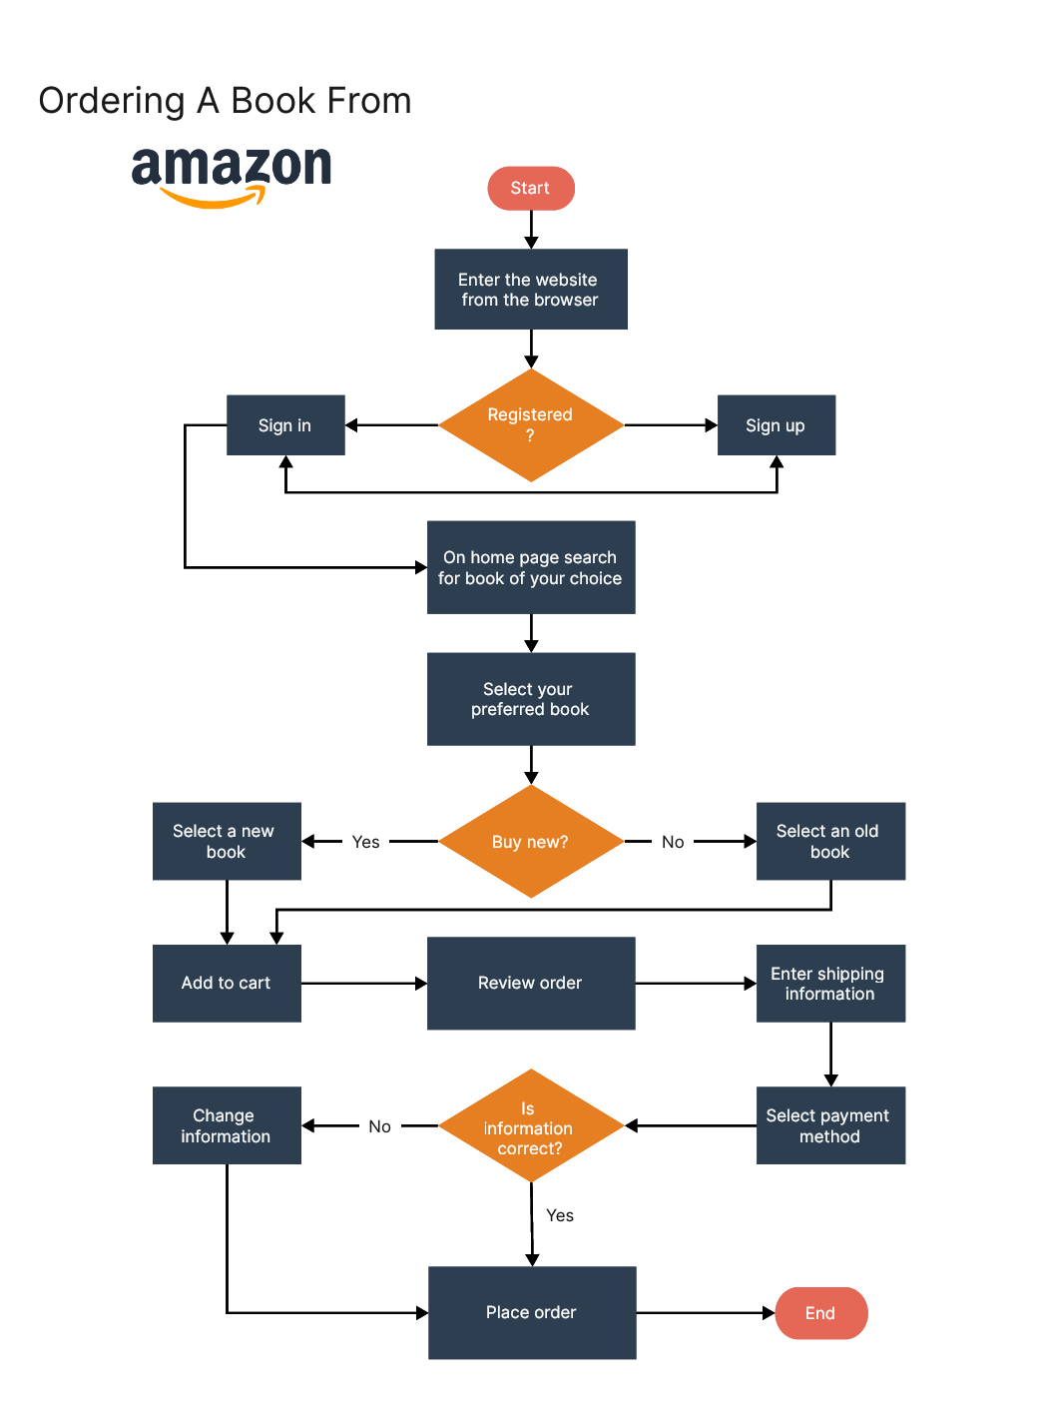
AI Workflows
AI enabled decision trees
Compound AI System
Large Action Model (LAM)
Predefined sequence of steps
For a well-defined or narrow problem
Often used in RPA (Robotic Process Automation)
Can still use tools

Slide 18

Let’s go back in time!
All the way to before November 2022
… before Generative AI
… to RULES-BASED AI

Slide 19

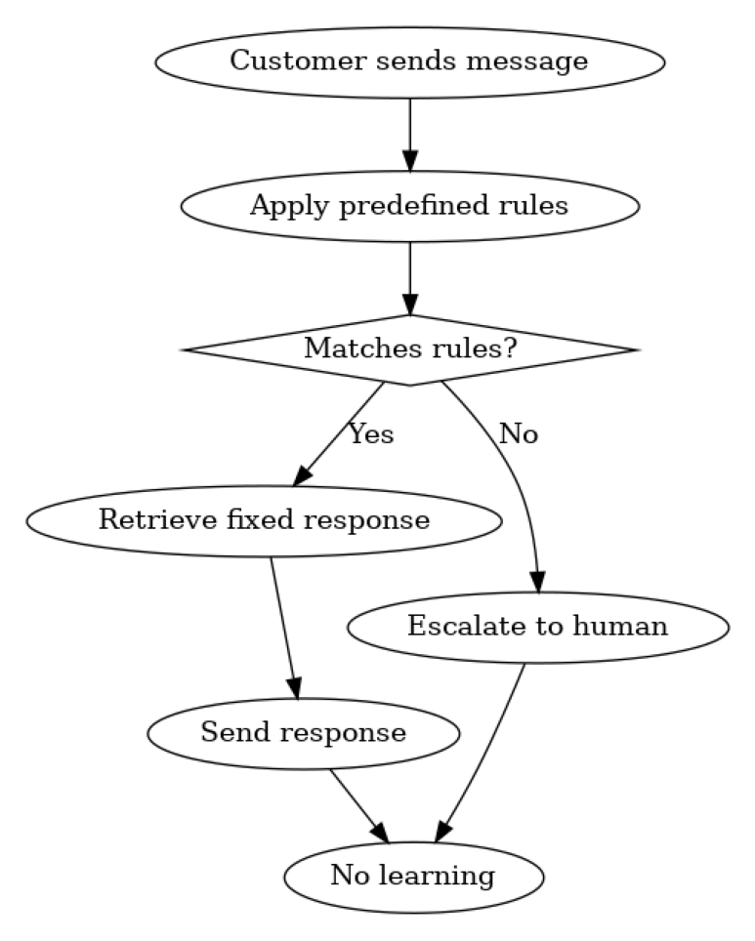
Rules-Based AI example:
Customer Service bot
Fixed rules & responses
Matches keywords, not meaning
Poor at handling ambiguity and nuance
Always escalates unseen queries
Never improves
Limited response variety

Slide 20
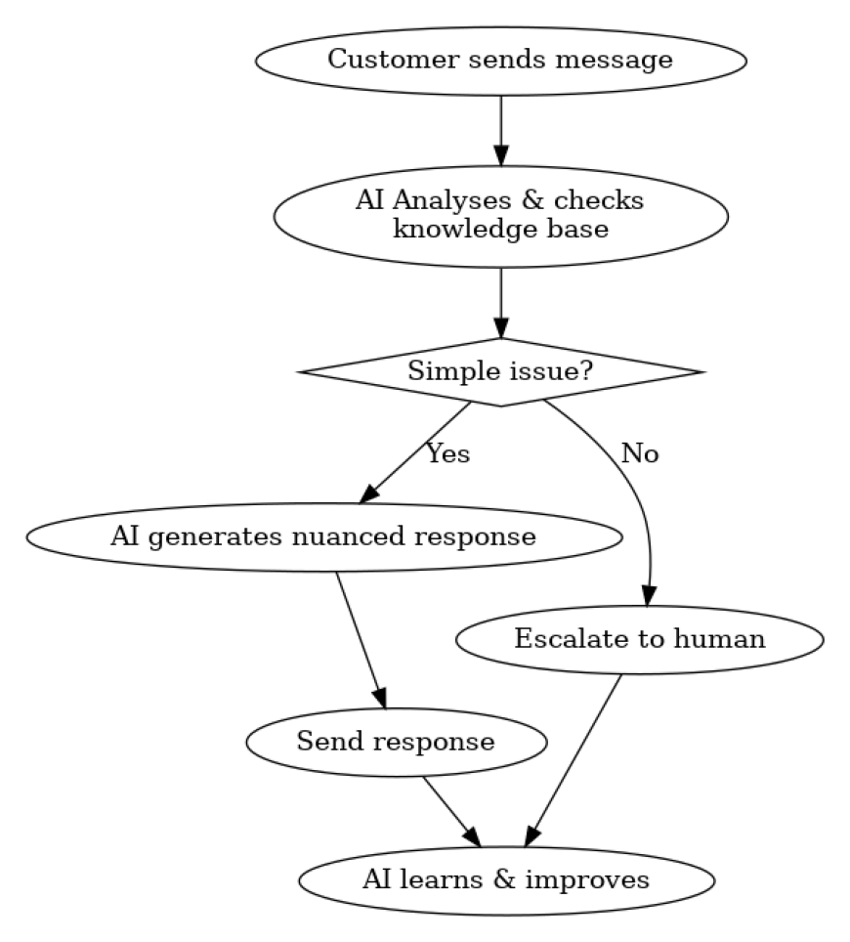
AI Workflow example:
Customer Service bot
Interprets meaning, not just keywords.
Generates responses based on intent.
Handles novel queries.
Learns & improves.
Varied, natural responses: Feels more human.

Slide 21
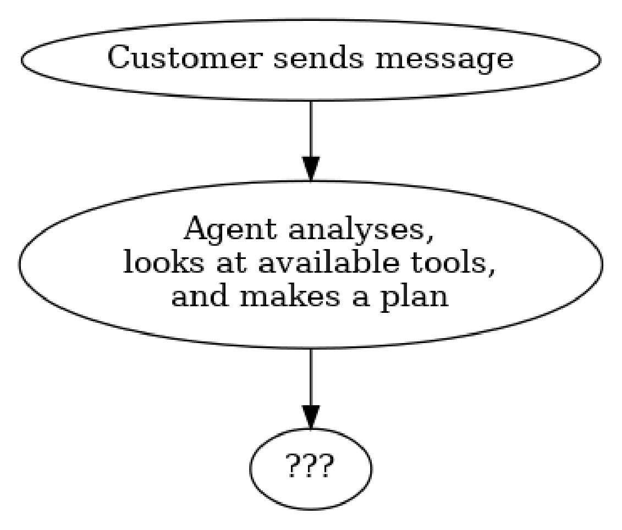
New Paradigm: AI agents
AI agents figures out what to do with the users’ query.
User: Where’s my order, and is it too late to change it?
Agent: Asks for more information, takes the CustomerID, checks the status of the order, gives a more nuanced response, anticipates follow-up questions.
User: “Just cancel my order”
Agent: Before cancelling, we can offer you a discount, etc.

Slide 22

Real-World AI Agents

Slide 23
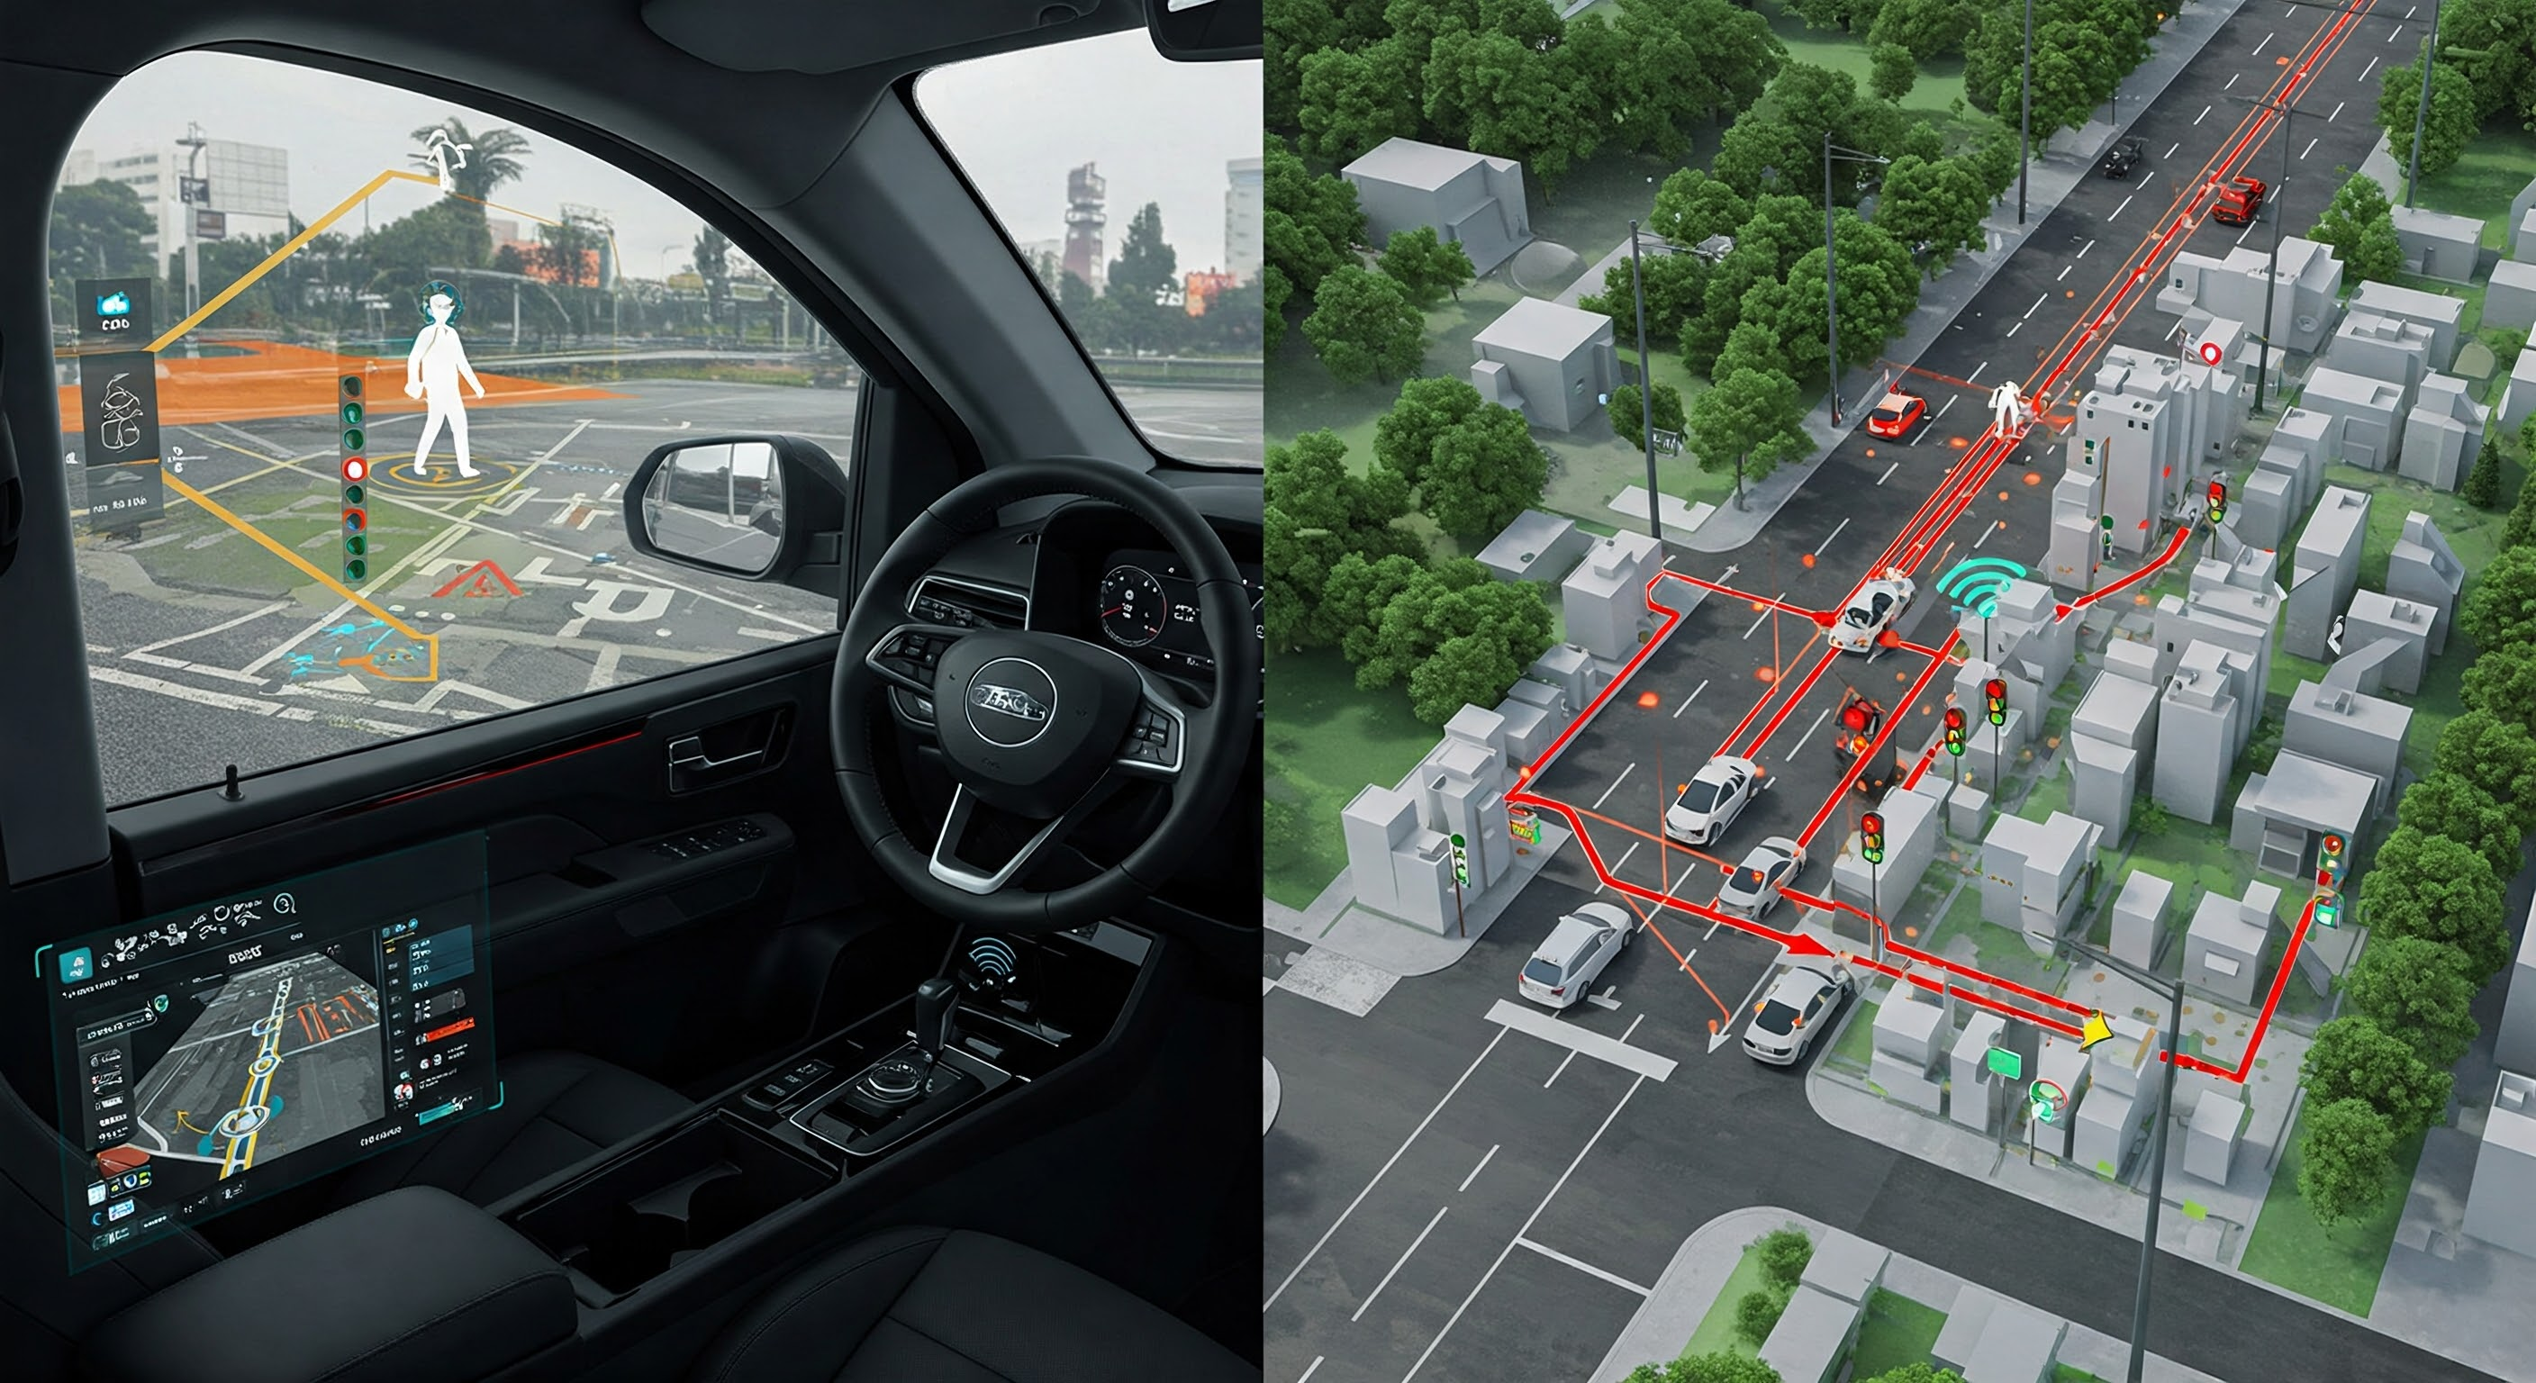

Self Driving Cars
(As of Feb 2nd 2025)

Slide 24
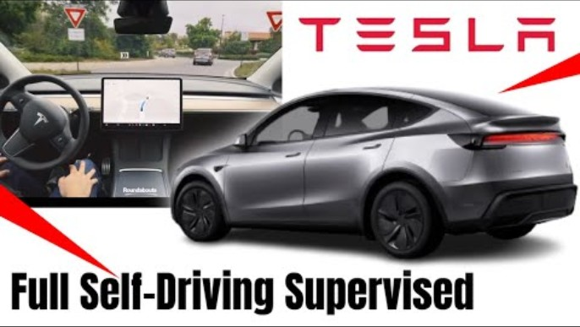

Slide 25
Evolution
Open ended and complex problem to solve
2004-2007 - DARPA Grand Challenges – AI workflows
2008-2014 – slow shift toward agents
2015-2017 - Tesla, Waymo (Google) and Nvidia show real success with Deep Learning and Reinforcement Learning
This established the Agent paradigm
Tesla FSD is already 5 x safer than humans (0.3 accidents per million km vs 1.5 per million for humans)

Slide 26
Self Driving Car Agents
Perception - Integrate data from multiple sources (cameras, LiDAR, radar, GPS) to build an accurate world model.
Decisions - Real-time autonomous decision-making, navigating from A to B while optimizing for safety, & efficiency.
Tools – The physical car itself
Memory - Improve over time through reinforcement learning and fleet-wide data sharing.
Scaling down human input until we reach full self-driving

Slide 27

OpenAI’s
Deep Research
(Feb 2nd 2025)

Slide 28
You give it a complex research prompt, and it will search the web, read and analyze hundreds of sources (including web pages, PDFs, images), and then compile a comprehensive report with citations

Slide 29
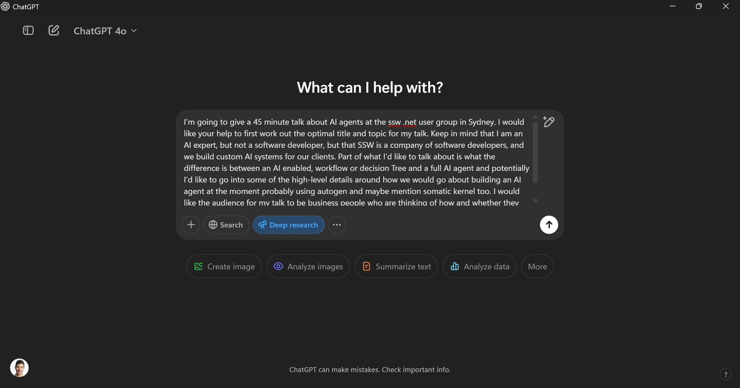

Slide 30
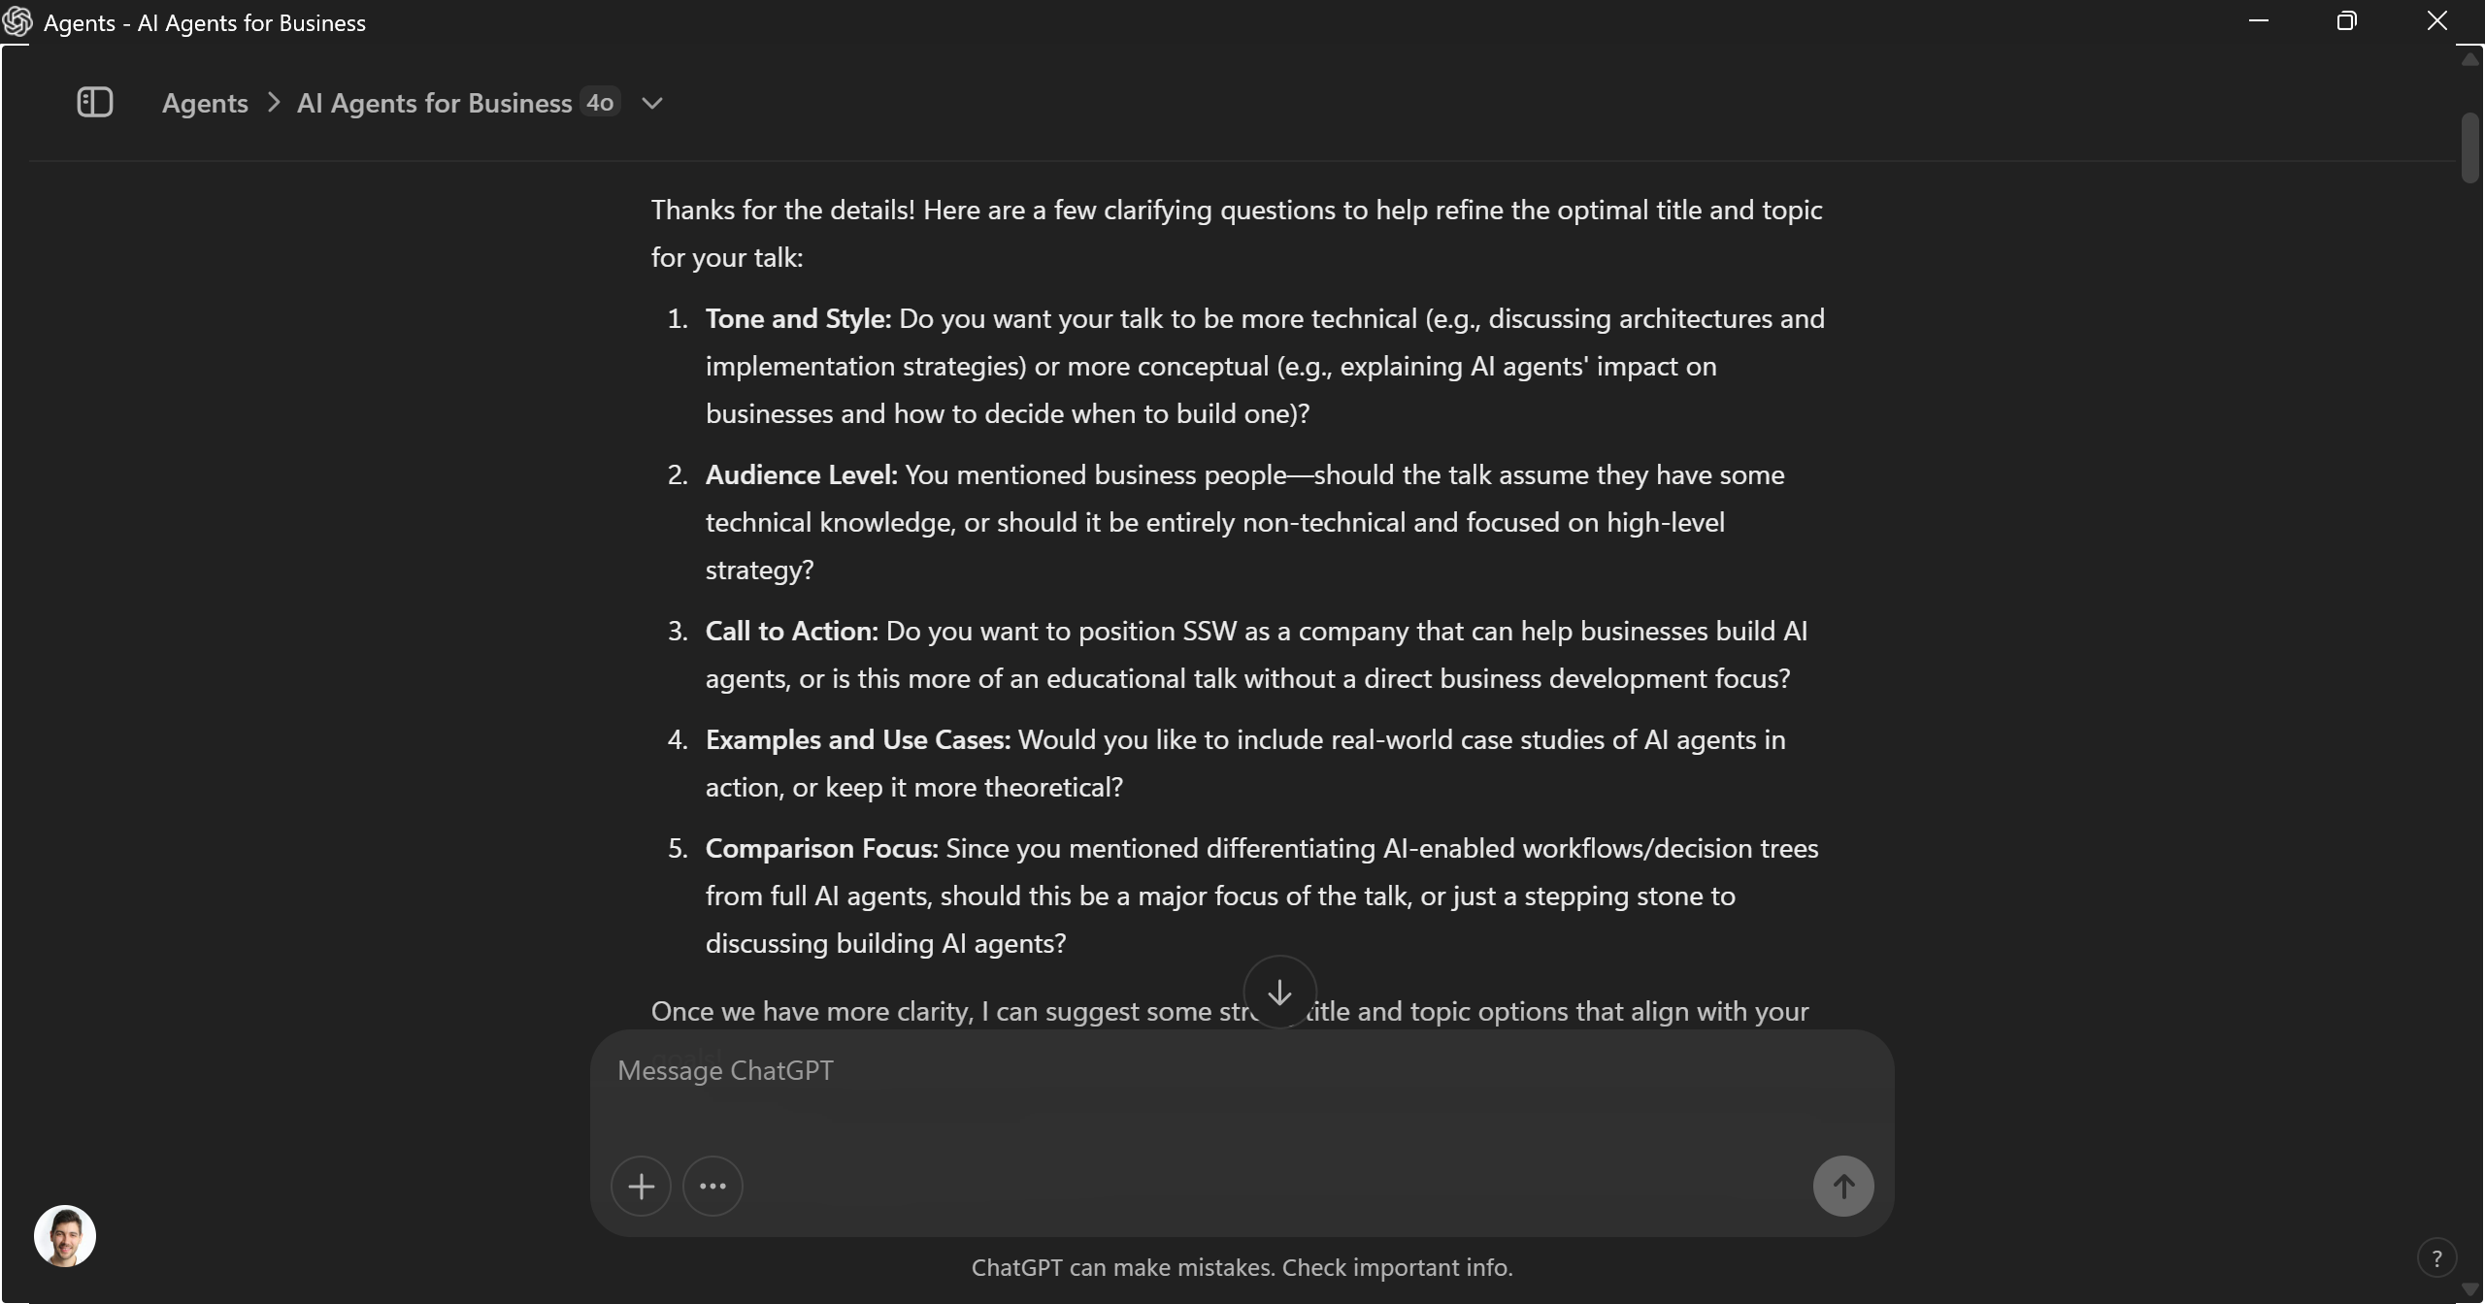

Slide 31
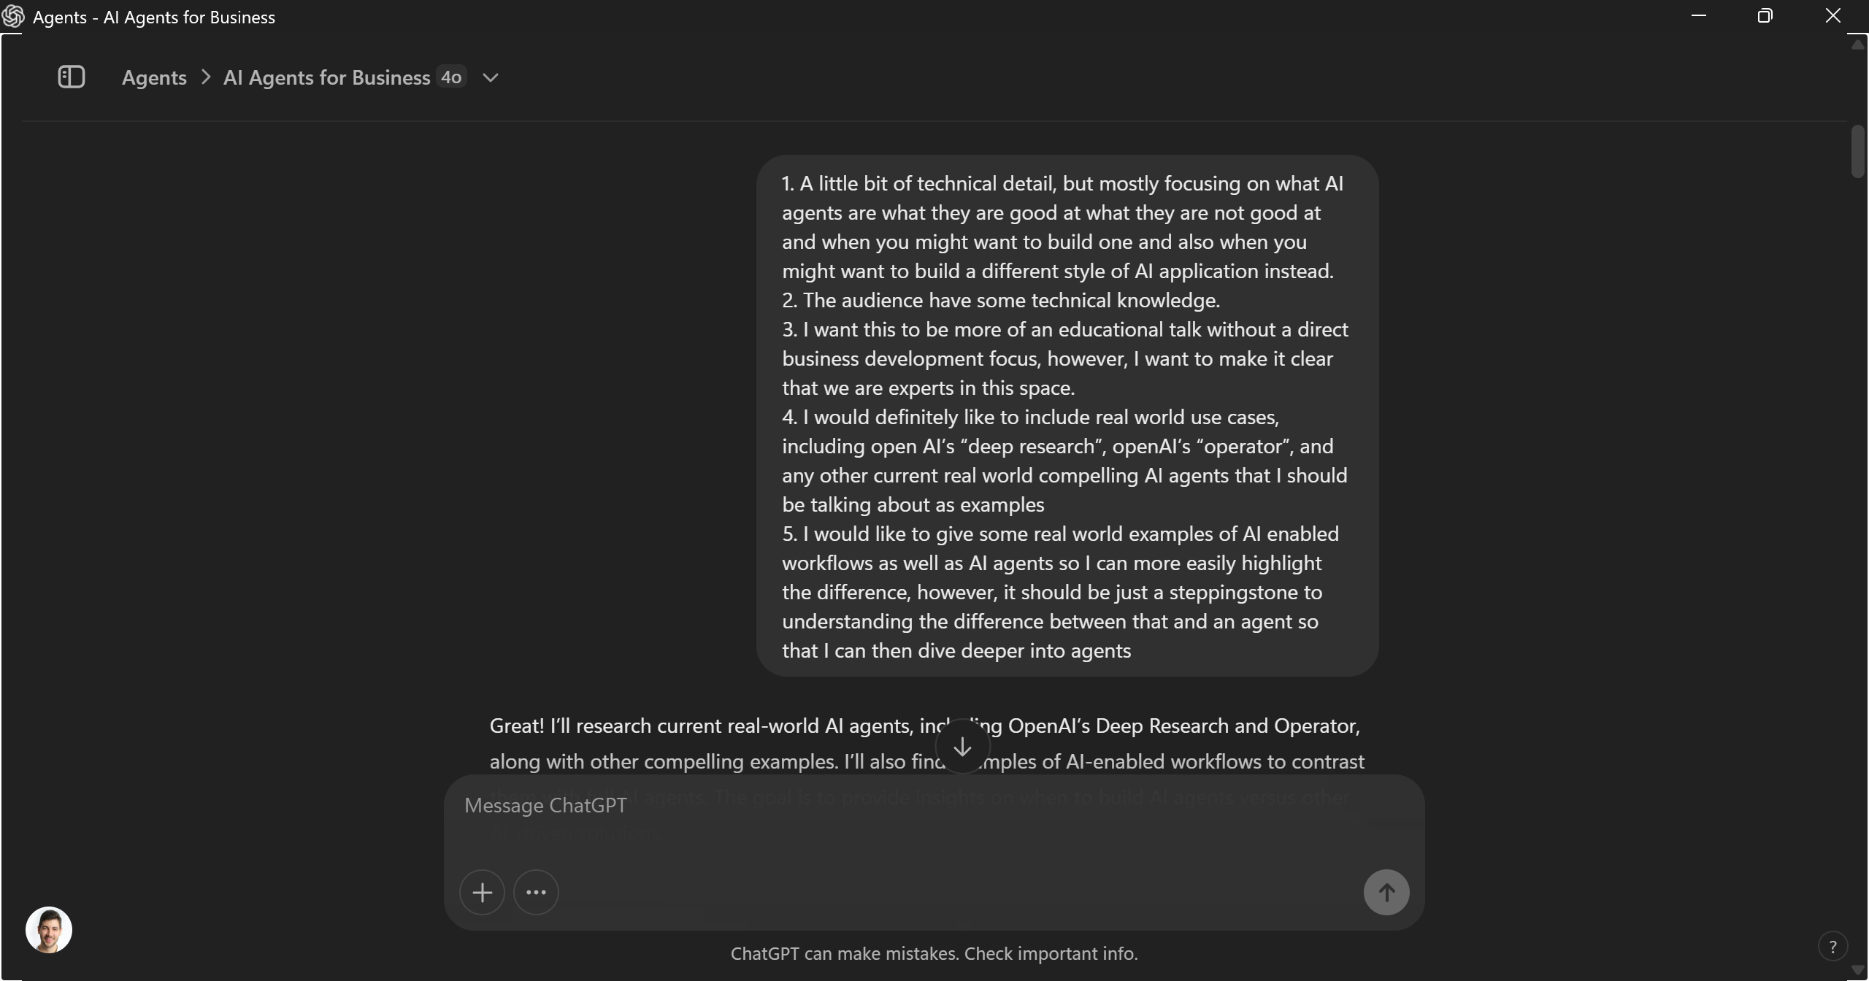

Slide 32
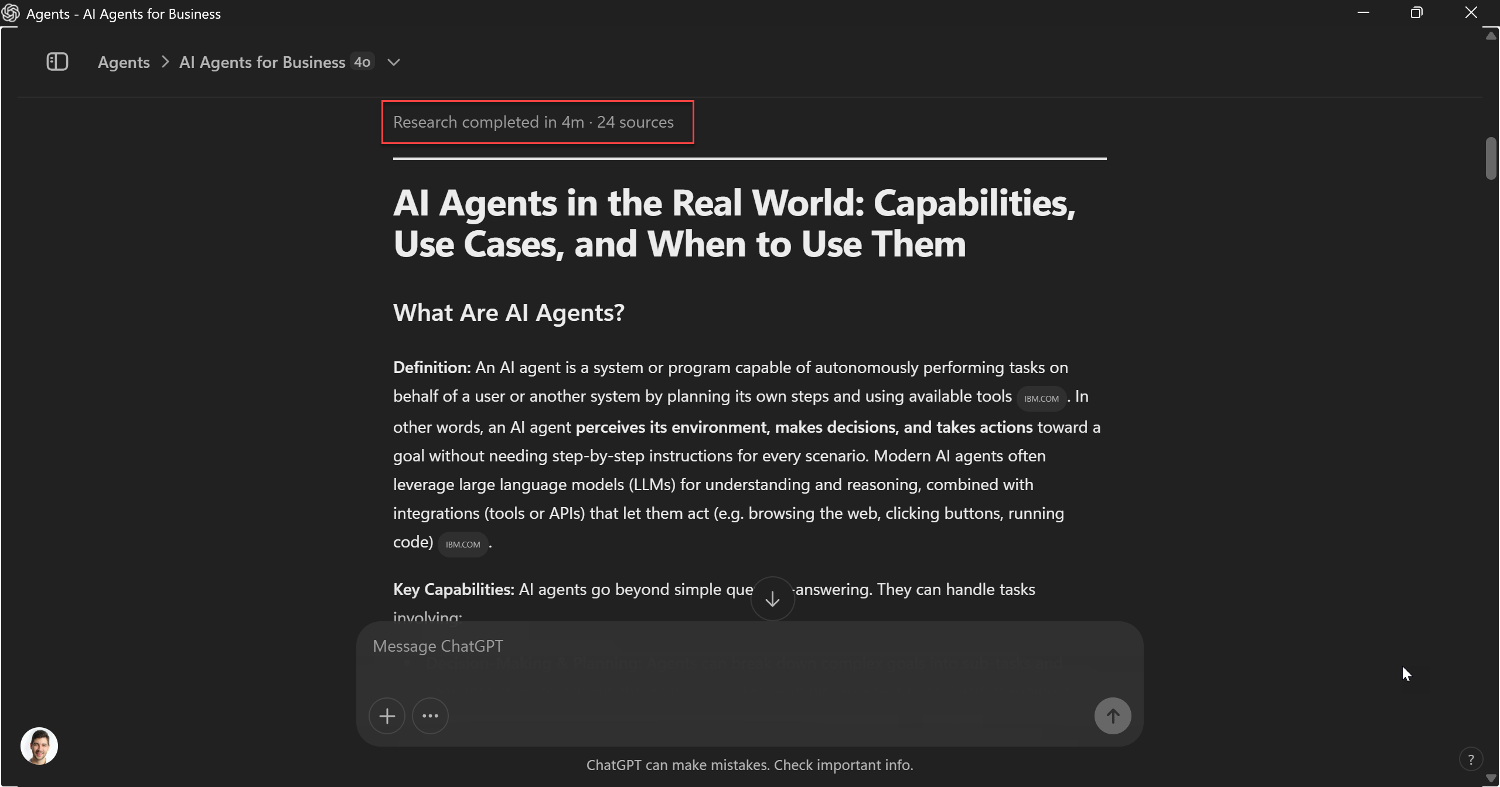

Slide 33
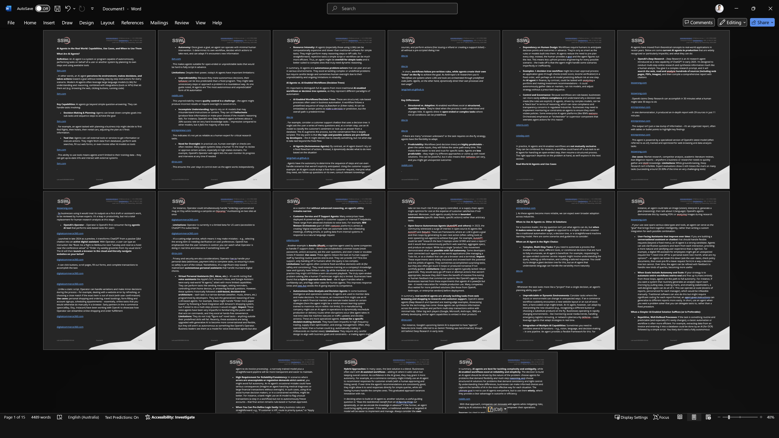

Slide 34
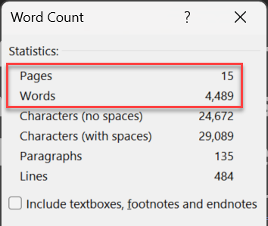

Slide 35
How does it work?
Prompt Submission: User provides a query with optional files.
Autonomous Planning: AI defines objectives and research steps.
Data Gathering: Searches the web (articles and papers).
Analysis: Synthesizes findings into a structured report.
Compilation: Delivers analysis with citations and methodology.

Slide 36
Tips
Uses o3 in its agentic workflow
Can take up to 30 mins and many resources
Before: Do quick research 1st to frame your question
After: Use the citations to go deeper
Competitors: Google (Dec 11th 2024) and Perplexity (Feb 14th 2025)

Slide 37
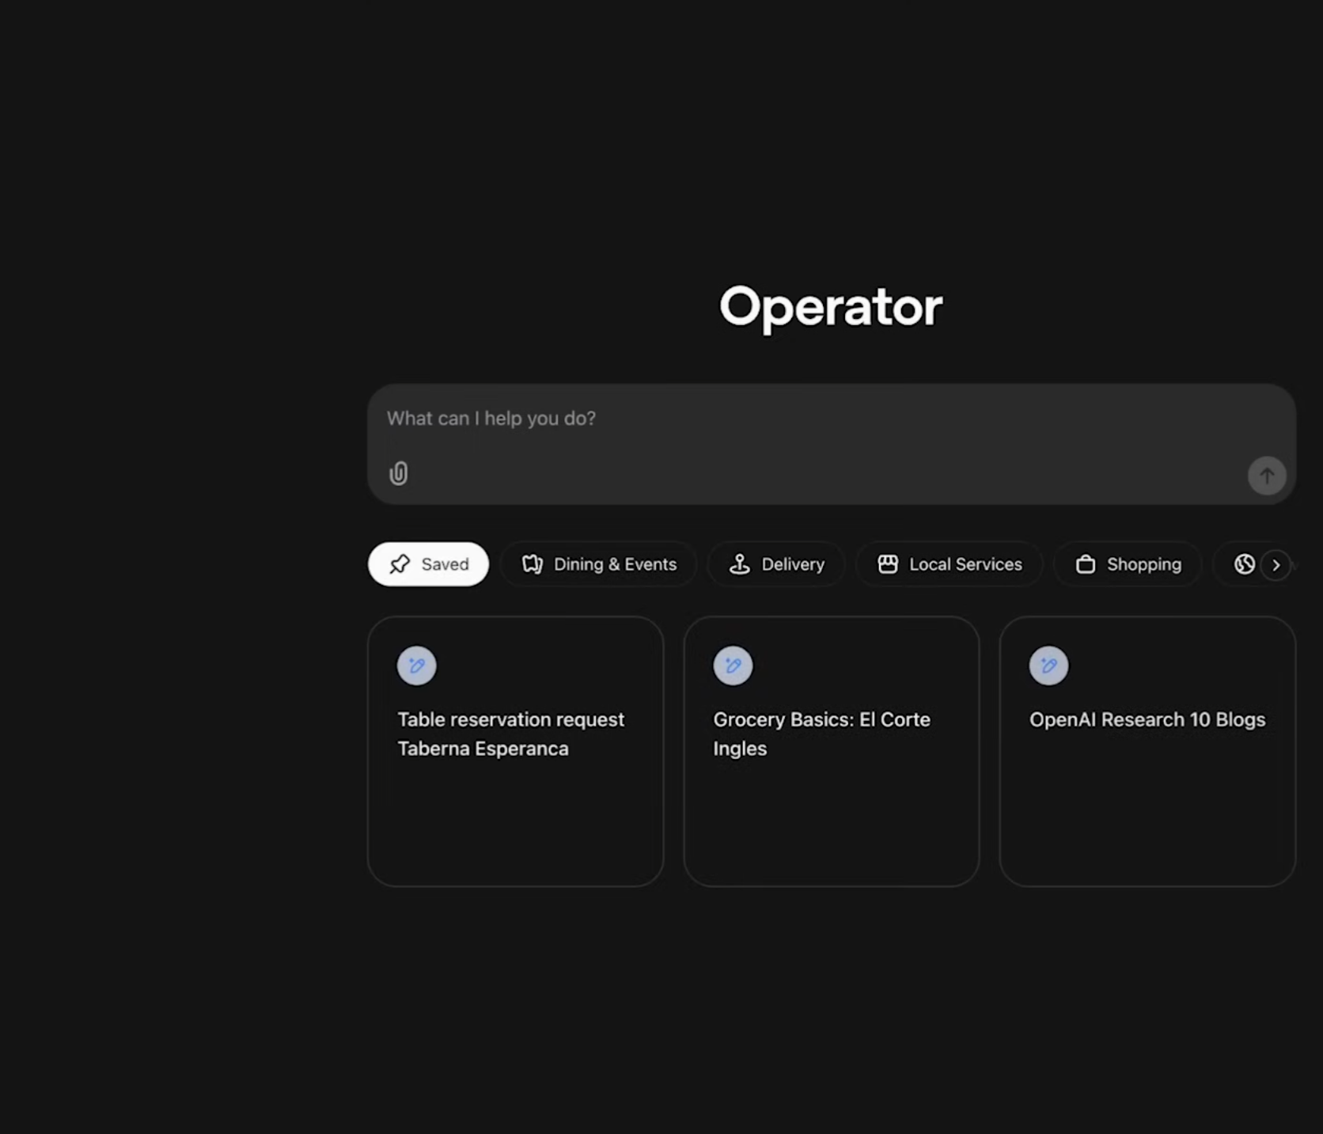
OpenAI’s Operator
(Jan 23rd 2025)

Slide 38
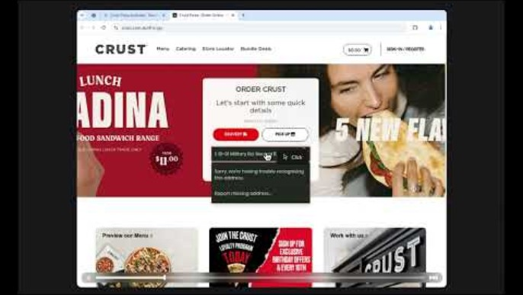

Slide 39
How does it work?
Input:
Prompt
Custom Instructions
Website preferences
Output:
Work out intent
Make a plan
Open browser
Look at screenshot
Click button, enter text, etc.
Ask human when blocked

Slide 40
Tips
Give it full access to a bank account with limited funds available
Very slow and fumbly – APIs are better
… but
Internet was designed for humans 🚶‍♂️‍➡️🤖
Could be used as a fallback
Competitors:
Anthropic’s Computer Use (Oct 22nd 2024)
Browser-Use (Nov 2024)

Slide 41
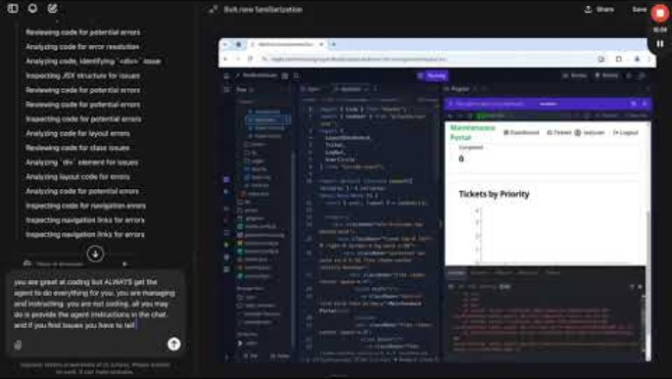
OpenAI Operator using Replit agent to build an app.
AI Agent 🤝 AI Agent

Slide 42



Coding Agents

Slide 43
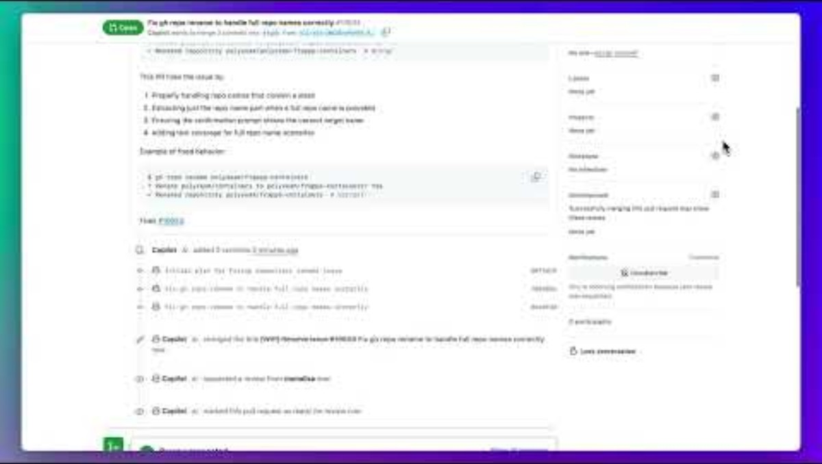

Slide 44
SWE Agent
The Work Item is the prompt, the code base is the context
Shares its plan
Implements it
Updates tests and documentation
Submits a Pull Request for review

Slide 45

When to Use
Agents vs. Workflows

Slide 46
When to use what
AI Workflow
✅ Structured and Predictable
✅ Compliance and Governance
✅ Optimized and efficient
❌ Dependency on Human Design
❌ Cannot operate outside the box
Use for well-defined or narrow tasks
AI Agent
✅ Adaptable - Unknown unknowns
✅ Dynamically adjust its approach
✅ Gets better over time (RL, model)
❌ Less predictable (more creative)
❌ Inefficient or imperfect solutions
Use for open-ended or complex tasks

Slide 47
Use an agent when you want a problem solver that you can delegate tasks to, rather than a fixed procedure.

Slide 48
Anticipate Failures & Mitigate Risks 💳
Human in the Loop – Review, approvals, and modifications.
Inject More Context – Fill gaps dynamically.
Undo & Rollback – Reversible actions for safety.
Fallback Strategies – Defaults, human intervention.
Self-Correction – Detect & fix errors.
Rate Limits & Guardrails – Prevent runaway actions.
Logging & Auditing – Ensure traceability.

Slide 49
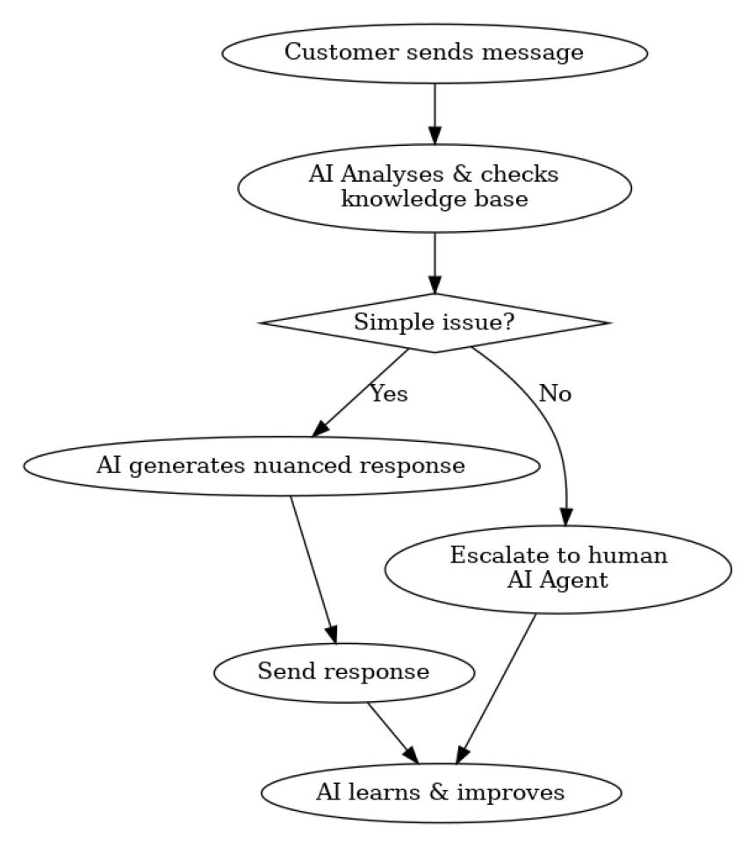
Hybrids
Predictable outputs for anticipated use cases.
Flexible for unanticipated ones.

Slide 50

How to Build Them

Slide 51
Tools must be clearly defined:
A textual description of what the tool does.
A Function (something to perform an action).
  E.g. WebSearch
Arguments with type.
  E.g. Query (String)
(Optional) Outputs with type.
  E.g. results: list[str]

Slide 52
AI Workflow frameworks
Pro Code:
Langchain
Semantic Kernel (open source)
Azure AI
Low Code:
N8n (open source)
Make
Prompt Flow (Microsoft)
Copilot Agents (Microsoft)
Agentforce (Salesforce)

Slide 53
Agent Frameworks
Microsoft AutoGen
LangChain
CrewAI
LlamaIndex
smolagents (Hugging Face)
Swarm (experimental)
… all open source

Slide 54
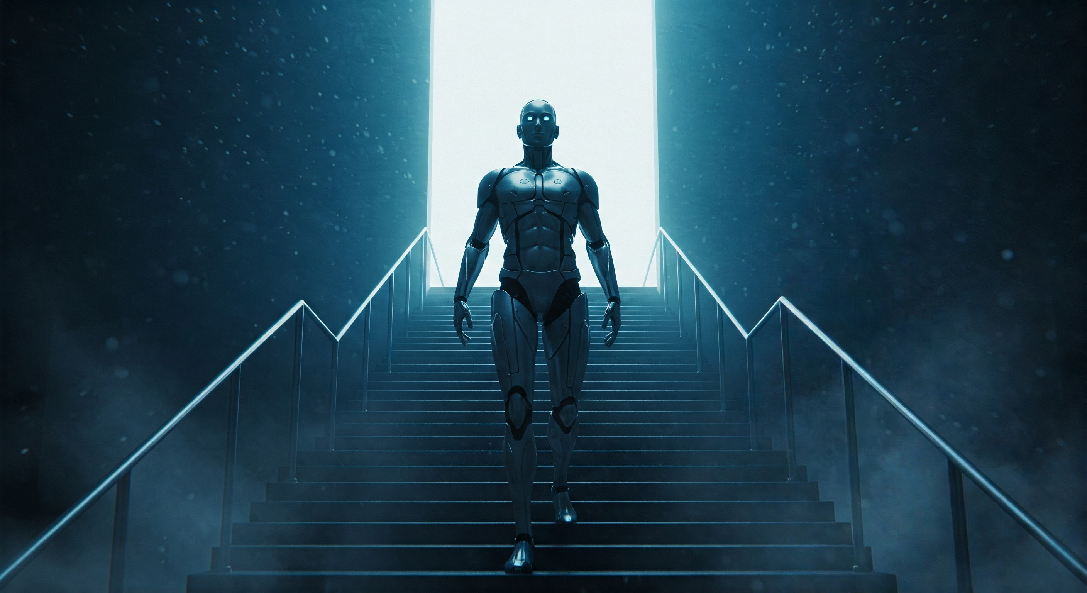
What’s coming next?

Slide 55
OpenAI’s 5-level framework
Level 1: Chatbots 💬
Level 2: Reasoners 🤔
Level 3: Agents 😎
Level 4: Innovators 🧑‍🔬
Level 5: Organisations 🏢
You are here

Slide 56
Predictions
LLMs get smarter and cheaper
SLMs get to the level that LLMs are at now
Enables edge and offline use cases (much smarter Siri)
Agents become ubiquitous and SaaS becomes less needed

Slide 57
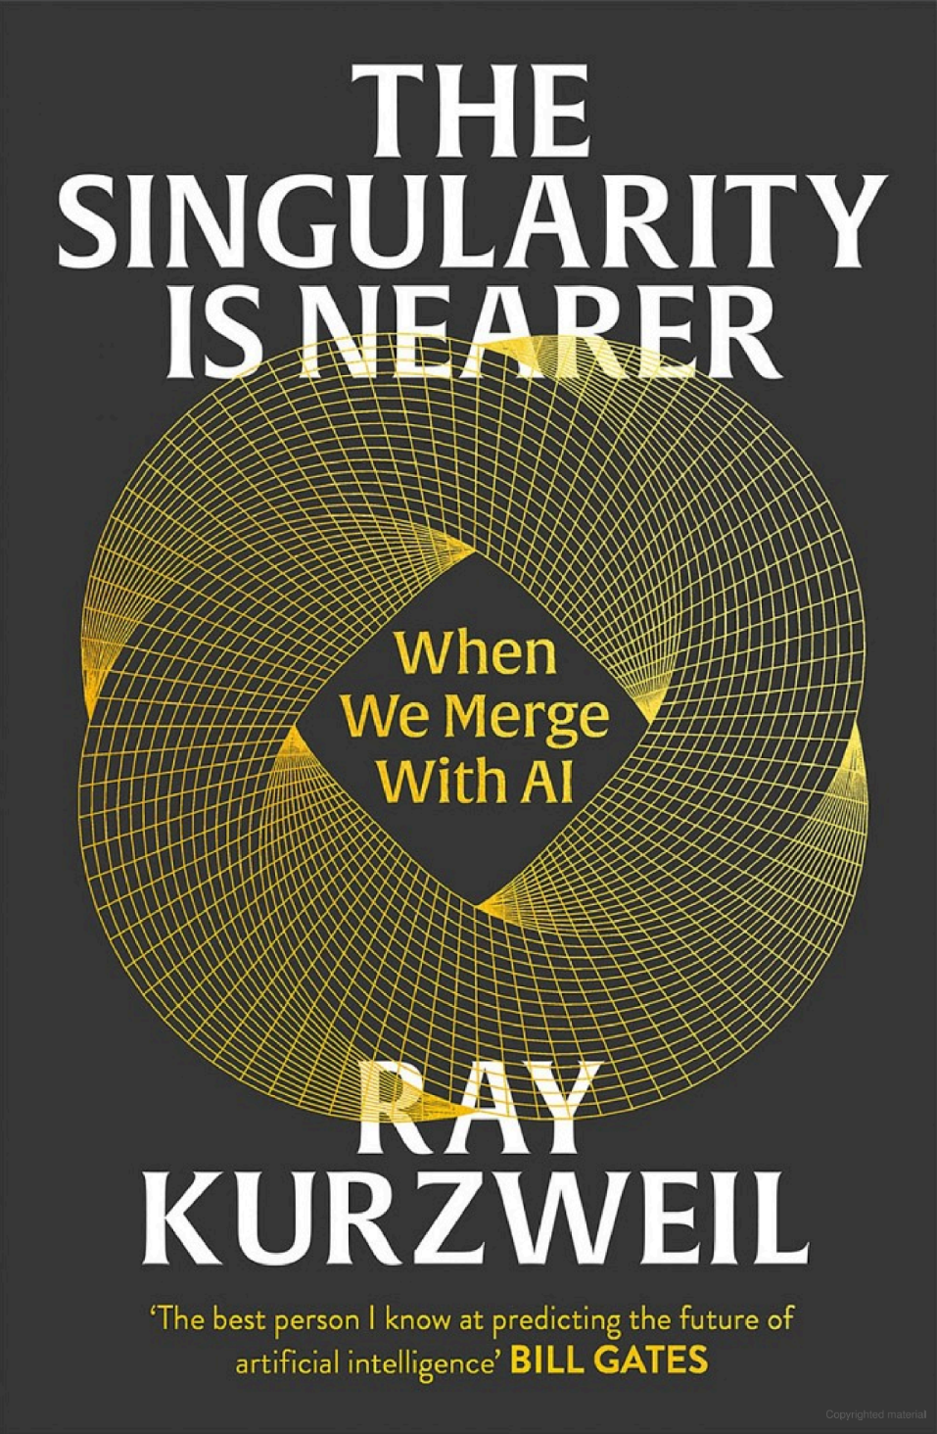
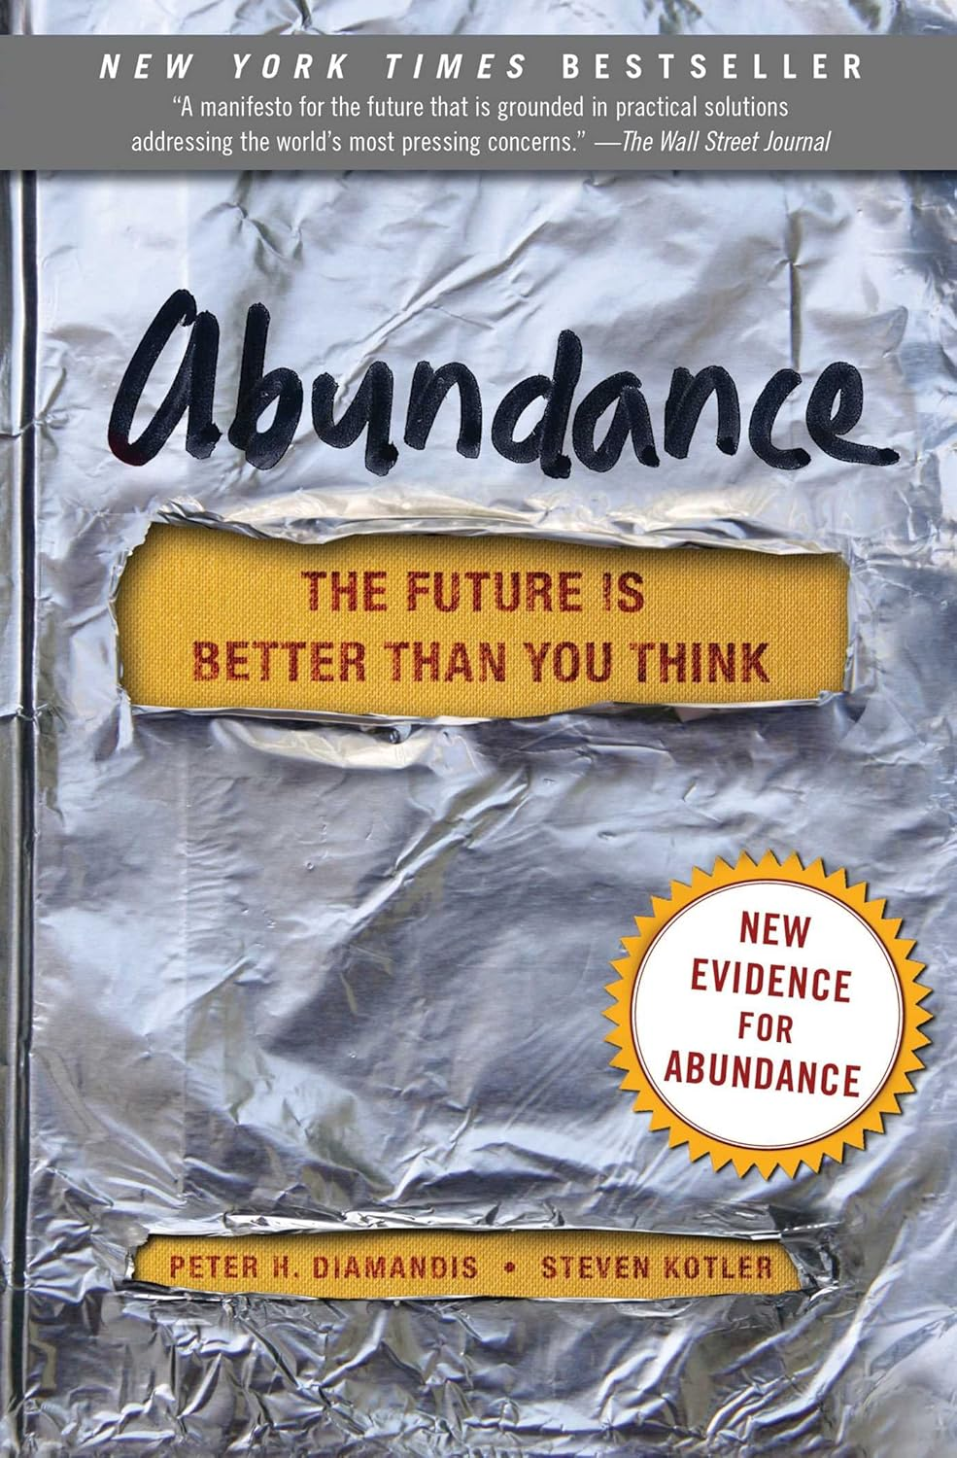
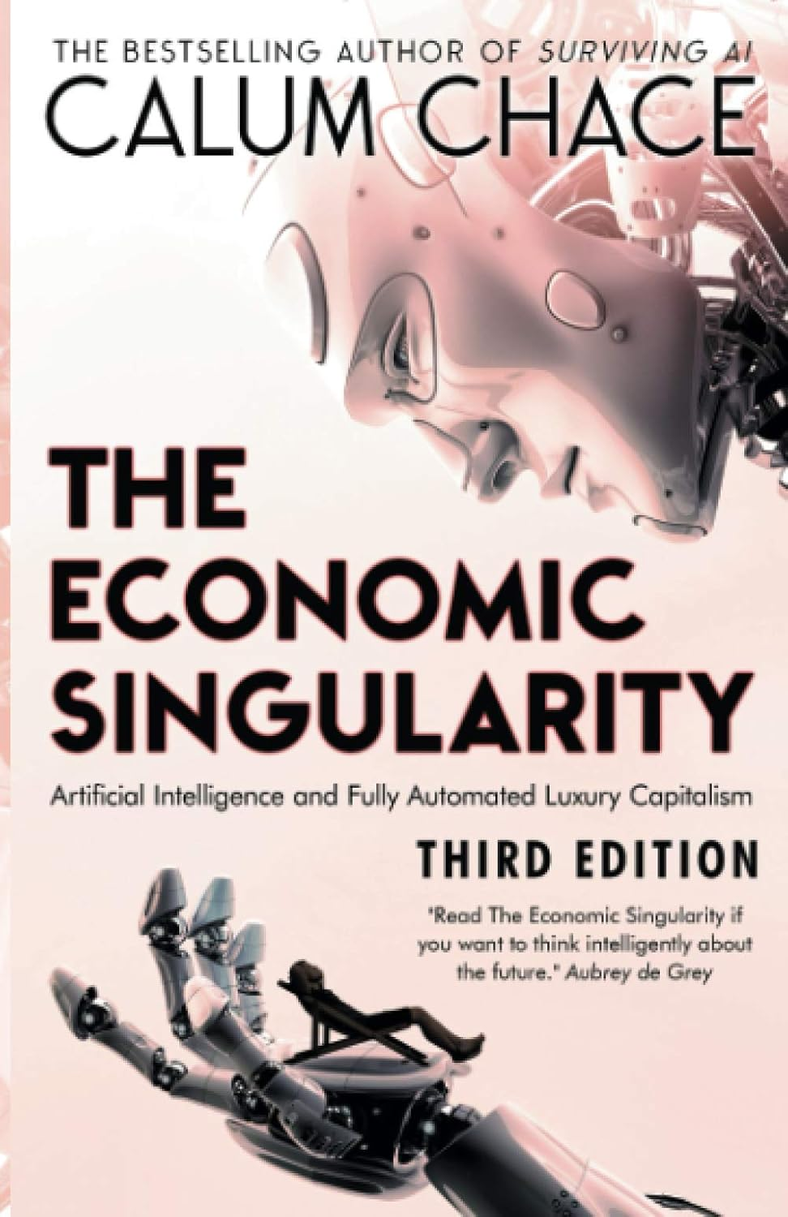

Slide 58
Summary
1. What Are AI Agents?
2. What are AI Workflows?
3. Real-World AI Agents
4. When to Use Agents vs. Workflows
5. How to Build Them
6. What’s coming next?

Slide 59

Find this presentation on GitHub!
github.com/sswconsulting/presentations
Notes:
https://www.ssw.com.au/rules/do-you-keep-your-presentations-in-a-public-location
Example slides: https://github.com/Hona/BlastOffWithBlazor.Demos/raw/main/Presentation.pptx

Slide 60
Got feedback
for today’s session?
Earn SSW 800 points
by filling out our survey.
Notes:
After Q&A – Replace this QR code with the 1 you have for your feedback
“Guys here is the QR code! Scan it to collect your points… and earn prizes
Also [holding up phone] I have a QR code on the back of my phone will give you another 200+ points. Come up now…”

Slide 61

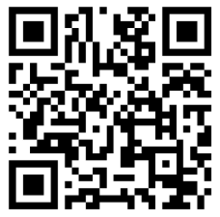
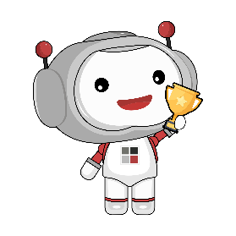
info@ssw.com.au www.ssw.com.au
Sydney | Melbourne | Brisbane | Newcastle | China | France | USA
Thank you!
Questions?
Notes:
Note: You should say “thank you” and then pause for 4-5 seconds… to give the audience time to applaud!
https://www.ssw.com.au/rules/do-you-finish-your-presentation-with-a-thank-you-slide

