Slide 1

SSW Code Auditor
Notes:
Insert witty intro

Slide 2
What is Code Auditor?
Consistent code is crucial
Take control of code
Notes:
As a project or company grows, managing code standards throughout your team becomes virtually impossible. But consistent code is crucial to future development and maintenance.
Built in C#, SSW Code Auditor lets you take control of your code and automatically review your web apps and projects - giving you more opportunity to spend time where it really matters.

Slide 3
Key Features & Benefits
SSW Code Auditor allows to you:
Find bugs
Keep standards
Prevent bad practises
All in a simple wizard interface
Notes:
Without going through all the technical details, SSW Code auditor has these benefits

Slide 4
More Technical
Features include:
Check any text file
Check file names
Scan project directories for code that violates your rules
Perform deep traversal of directories
Scan websites for HTML that violates your rules (checking the result after it is served by the web server)
Runs Tidy HTML to validate HTML

Slide 5
(cont…)
Use the report that is written to an .mdb, or to export to XML
Organize jobs into separate projects
Allow exceptions to rules, thus ignoring files that you are aware of
Setup on a schedule to run every night
Use Regular Expression to define more rules
Regular Expression builder included

Slide 6
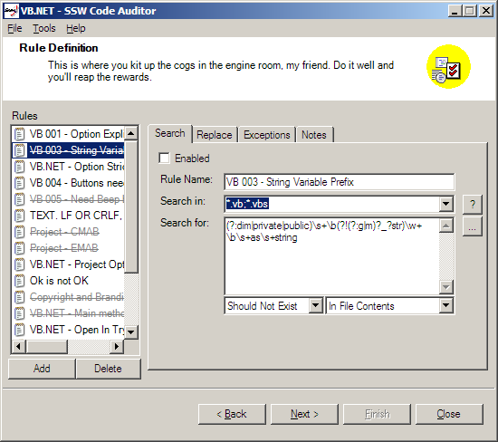
Rule definition screen

Slide 7
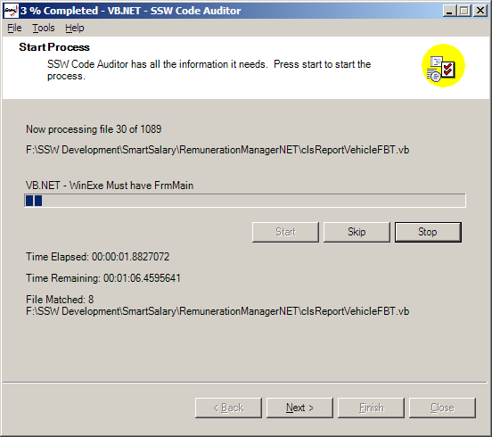
Progress Indication screen

Slide 8
Quote from happy customer
SSW Code Auditor makes this much easier for novices by including a wizard to build and test regular expressions for you -- that alone is worth the price of the tool if you're struggling with regex's.
Mike Gunderloy, MCPmag.com

Slide 9
Innovation
Creating a business advantage
Expanding user horizons
Social change or empowerment of users
Notes:
Creating a business advantage
Maintainable software is the key for successful software systems. SSW Code Auditor can help you achieve this goal.
Expanding user horizons
SSW Code Auditor has the unique ability to process a large number of files efficiently and scan for rule violations. This allows an organisation to implement and enforce standards on a broad scope.
Social change or empowerment of users
By performing audits on produced codes, junior programmers can produce extraordinarily clean and error free codes which enhances robustness and legibility of codes.

Slide 10
Performance
Enterprise quality system
Professionally executed code
Standards and codes compliance
Proof of real world performance
Real user benefits
Support

Slide 11
Potential
Designed for international use
Enterprise structured for growth
Global design standards
Identified potential markets
Success in home or export markets
Working with international collaborators

Slide 12
SSW
Superior Software for Windows (SSW)
  ABN: 21 069 371 900
Gateway Court Suite 10
81 - 91 Military Road
Neutral Bay, Sydney NSW 2089
AUSTRALIA

