Slide 1


Prepaid Services

Slide 2
What we started with
About 10 different files to manually import into 5 databases
Random data stored in Excel files
1 day to import all this data into the 5 databases
2 days to produce weekly Excel reporting by:
Write database query
Dump raw data into excel
Clean up any data
Crazy pivoting and VLookups across dozens of excel files

Slide 3


Slide 4


Enter SSW

Slide 5
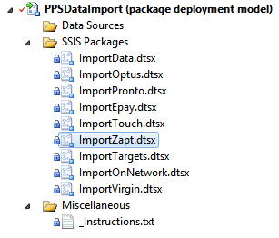
We automated…

Slide 6
We consolidated…
Shipments
Apply SSW Magic: - Primary Keys - Foreign Keys - zsValidate procs - Naming Conventions - Data validation
GAR
PPS
Activations
Regional
Recharge

Slide 7
We built…

Slide 8
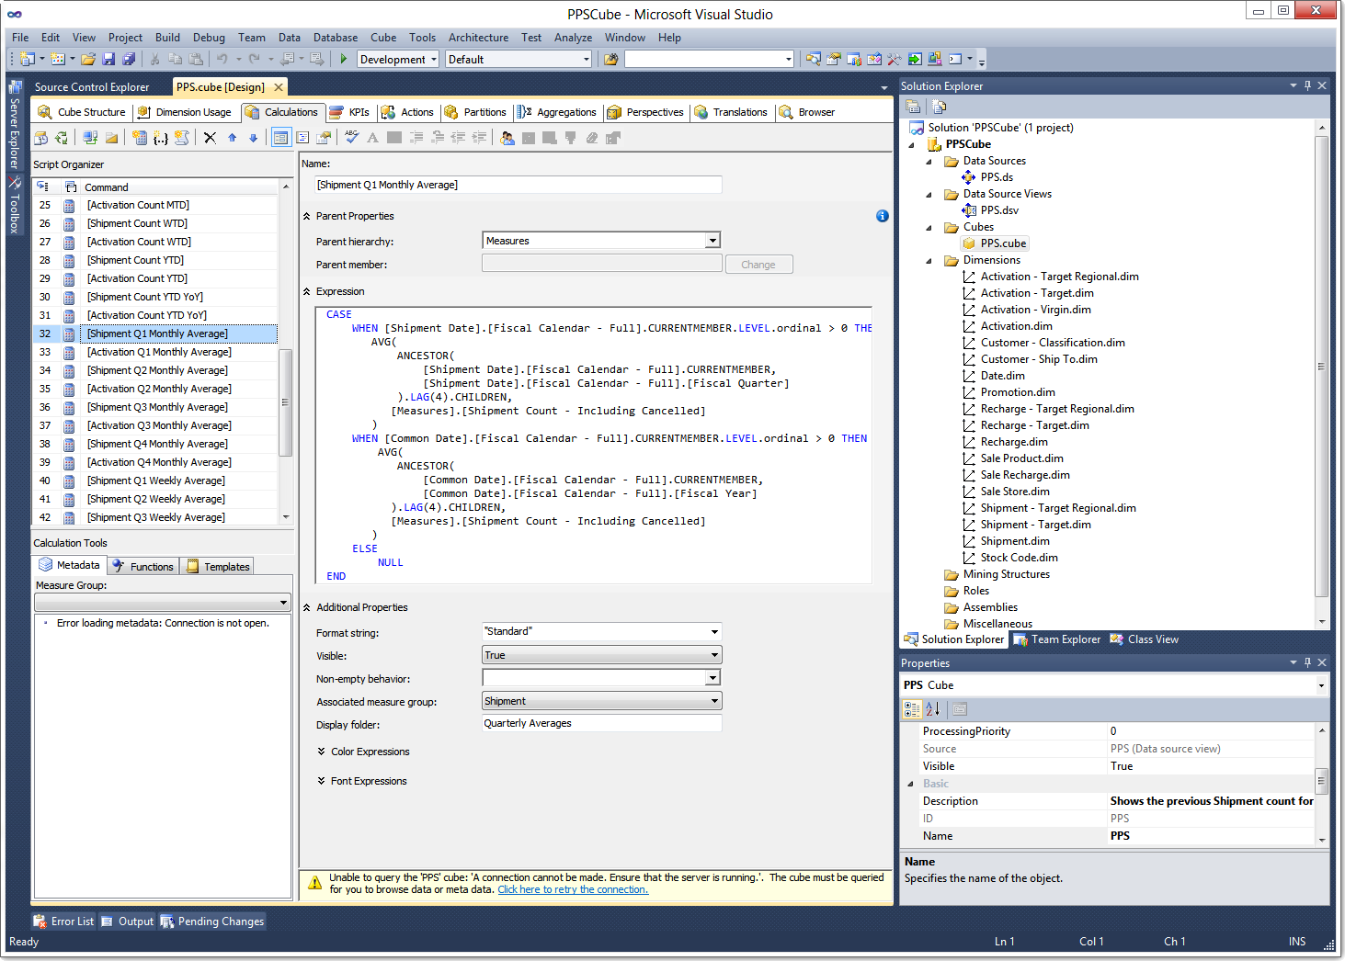

Slide 9
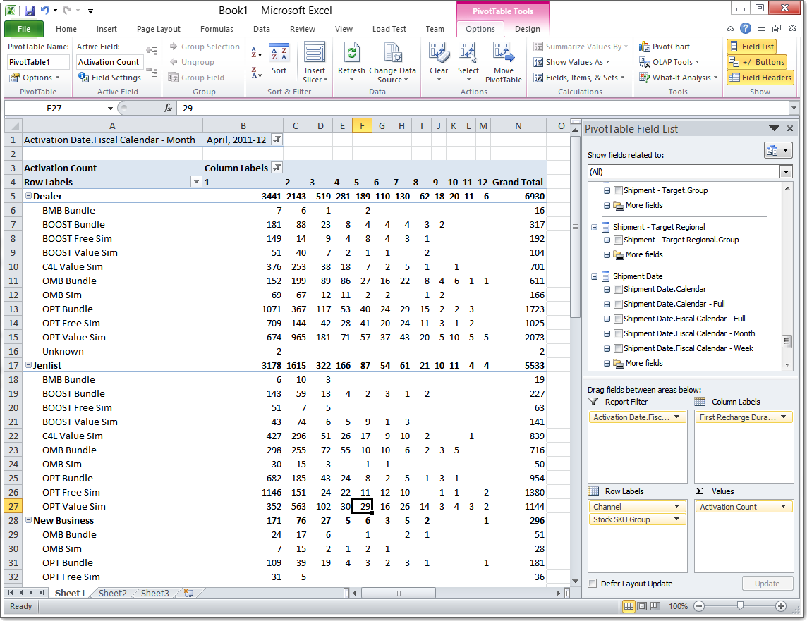

Slide 10
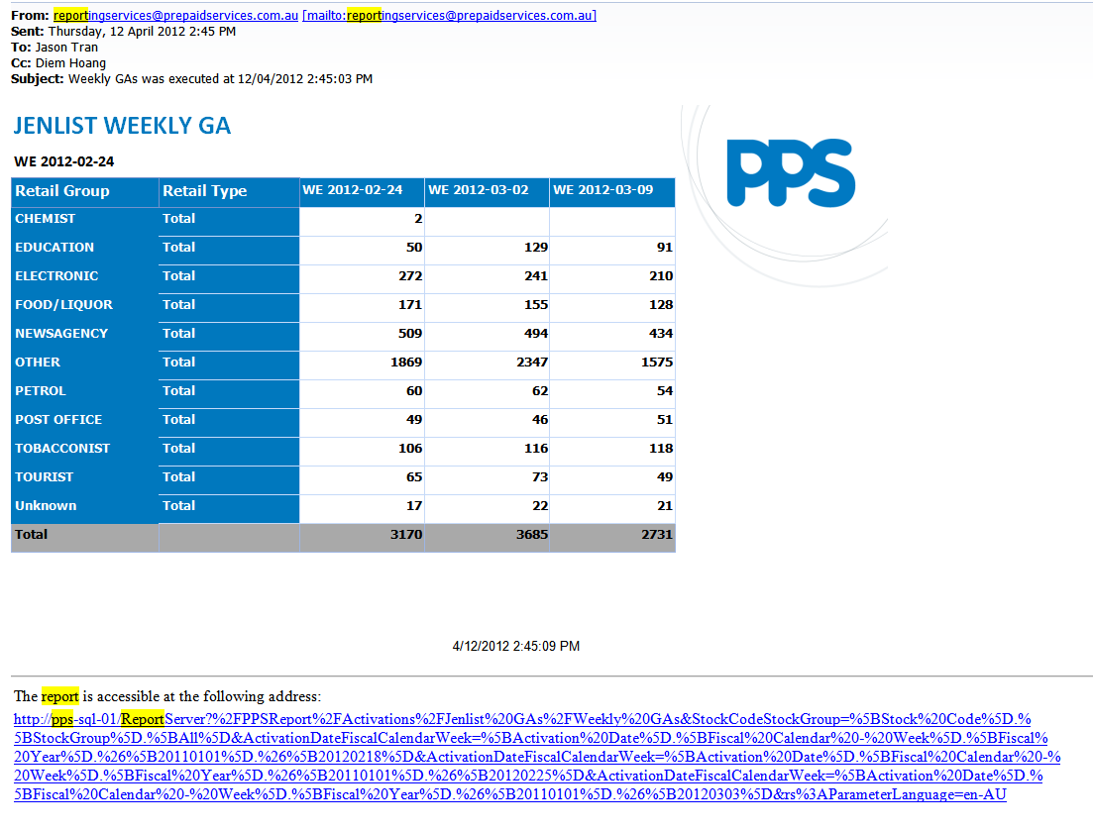
We created and automated…

Slide 11
Today
SSIS packages are scheduled nightly
Cube processing is scheduled nightly
Can do data loads daily, currently they only get their files monthly
Time to build ad-hoc reports:
Before: Hours/Days
Now: 5 – 30 minutes

Slide 12
We also deployed an MVC 4 app
For helping them match customers coming from two different systems with no unique identifier
Razor, jQuery
1.5 days

Slide 13
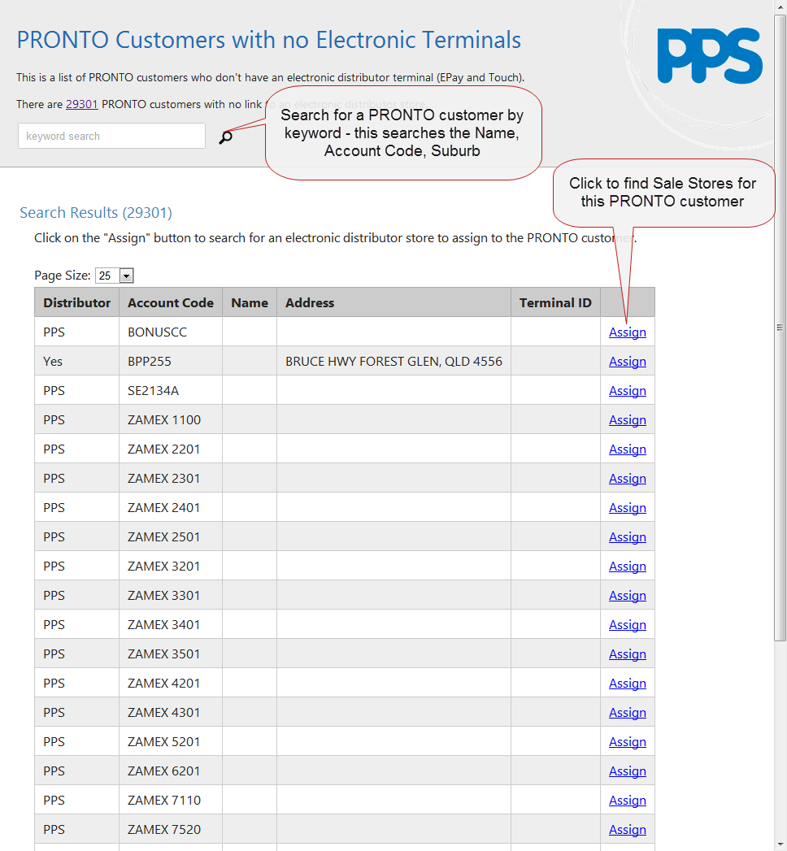

Slide 14
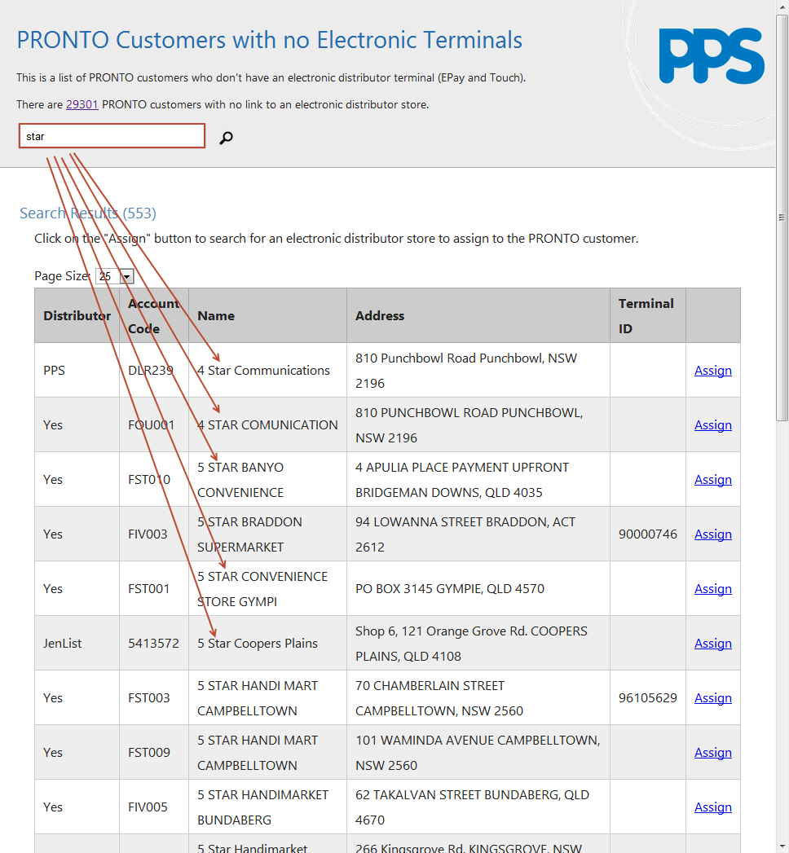

Slide 15
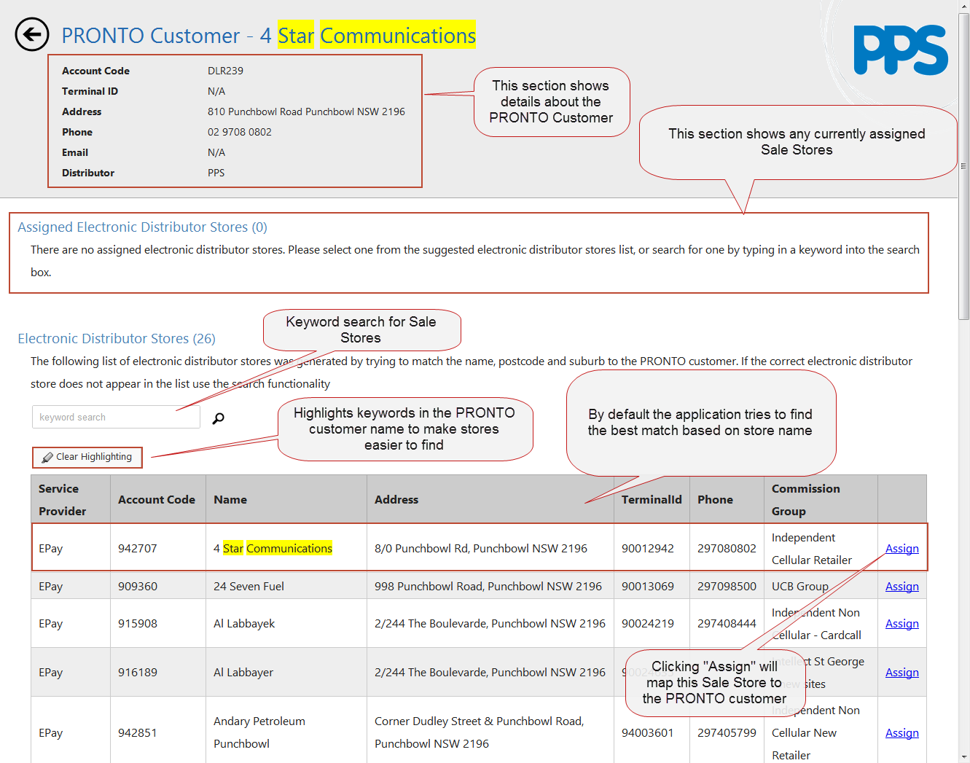

Slide 16
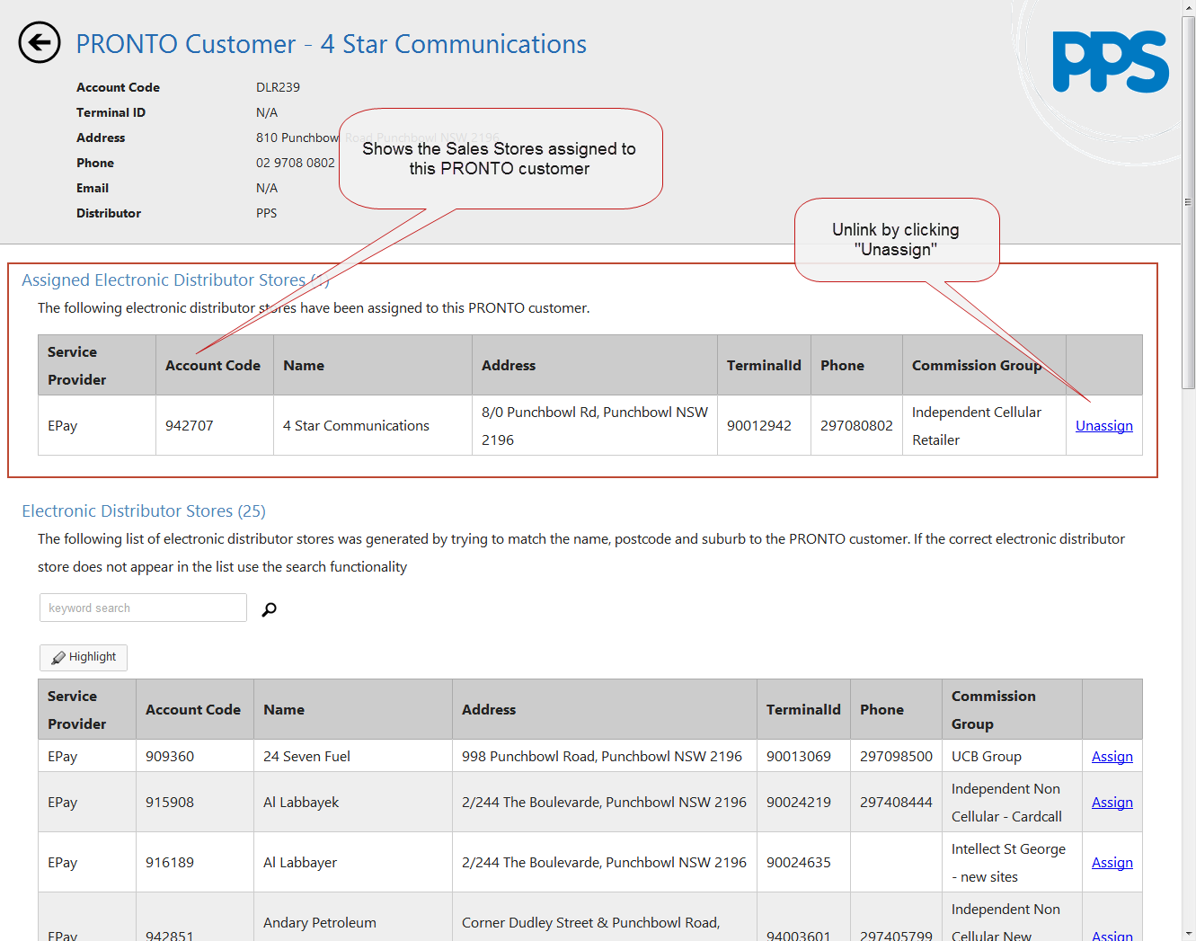

Slide 17
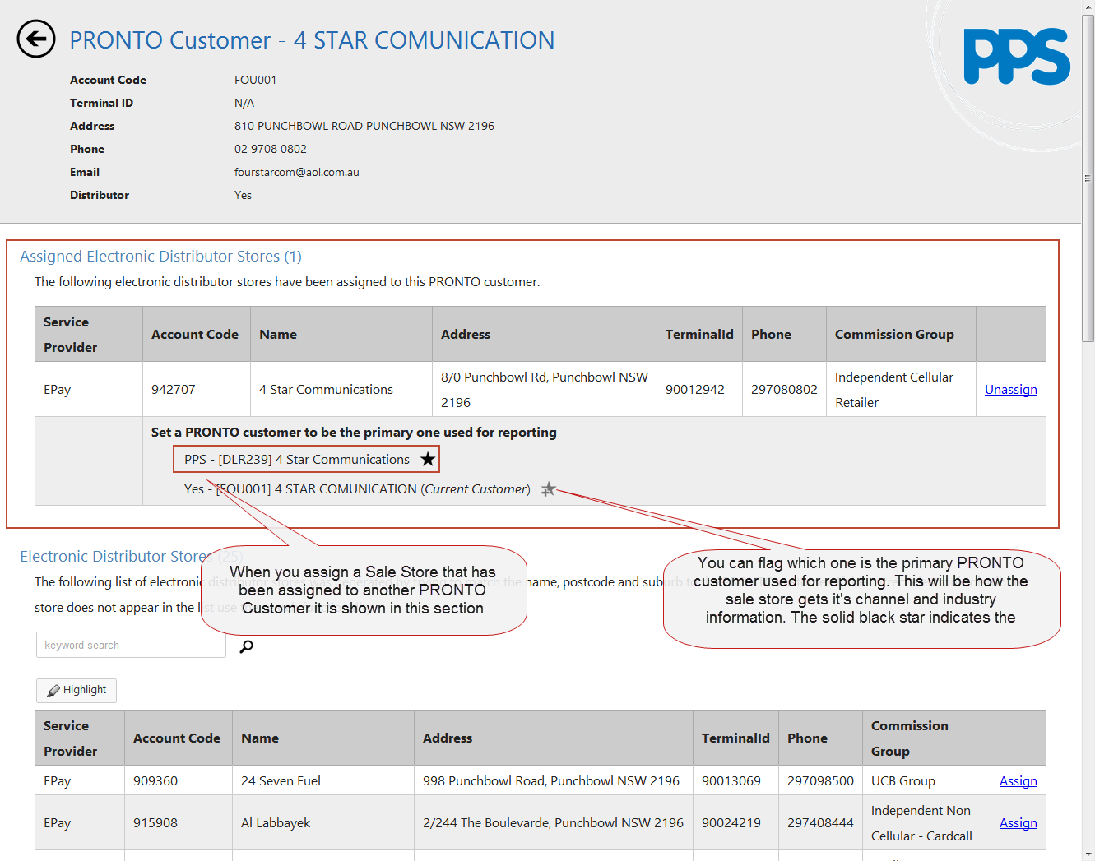

Slide 18

Thank You!
Sydney | Melbourne | Brisbane | Adelaide
info@ssw.com.au
www.ssw.com.au

