Slide 1
Third-Party Tools for Web Development
Presented by Adam Cogan

Slide 2
About
Third-party tools which complement ASP.NET and help Web developers to do their job faster

Slide 3

What’s Great ?
xxx Happy
use Word document
to write the answers

Slide 4
My Pleasures
xxxHappy
Membership
Rich Server Controls
GridView
Data Binding
DataList/Repeater
Validation Controls
ADO.NET
Ad Rotator
Standards-compliant markup Every ASP.NET control included in the ASP.NET 2.0 framework renders valid XHTML by default. In other words, you don't need to do anything special to generate valid XHTML markup when adding ASP.NET controls to a page.

Slide 5
Introduction
xxxSad
What problems do you have?
What problems have you solved?
(in Order)
use Word document
to write the answers

Slide 6
My Pain (ASP.NET 1.1)
xxx Sad
DataGrid
  One downside of a DataGrid is its rather "blocky" display. That is, the DataGrid displays each DataSource record as a row in an HTML <table>, and each field as a column in said table. While the DataGrid allows for the developer to customize the output for a particular column through the <asp:TemplateColumn>, it still is restrictive in that each DataSource record occupies precisely one HTML <table> row.
  Sorting would not work with JS turned off.
  Default paging requires bringing in data for all pages at once.
Solutions via Javascript:
- Use of proprietory JS which does not work in other browsers
- Auto-generated JS sprinkled througout the page makes it difficult to read
Addition of unnecessary html markup for some asp.net controls. For example, <asp:checkbox> renders <span> around <input> field.
Styles specified as attributes of asp.net controls are rendered inline which makes page bloated. Especially in datagrids when they repeat for every row.
Broken Links

Slide 7
Data Grid
Link to current 2.0 – demo isn’t ready
http://www.ssw.com.au/ssw/demos/grid/DataGrid.aspx
  Column sorting
http://www.componentart.com/demos/grid/features/ajax_grid/WebForm1.aspx

Slide 8
Infragistics NetAdvantage
Infragistics is the world leader in Presentation Layer Technology.
NetAdvantage is the ultimate presentation layer toolset for Windows Forms, ASP.NET, Tablet PC & COM.
NetAdvantage 2005 Volume 3 is the latest toolset version http://samples.infragistics.com/2005.3/

Slide 9
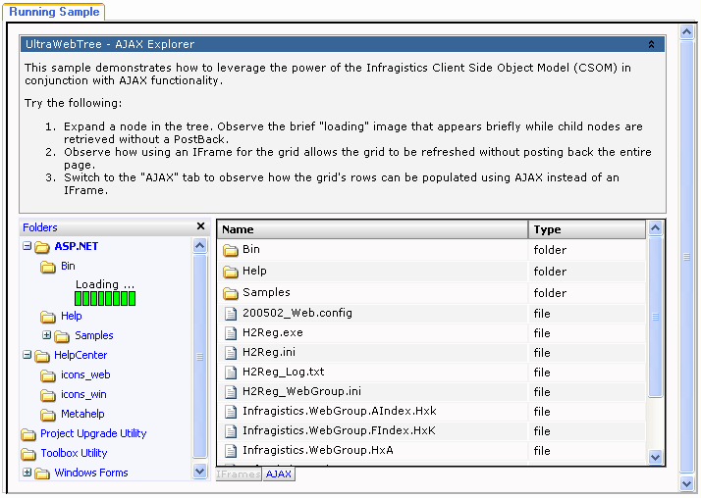
Infragistics UltraWebTree
This sample demonstrates how to leverage the power of the Infragistics Client Side Object Model (CSOM) in conjunction with AJAX functionality.

Slide 10
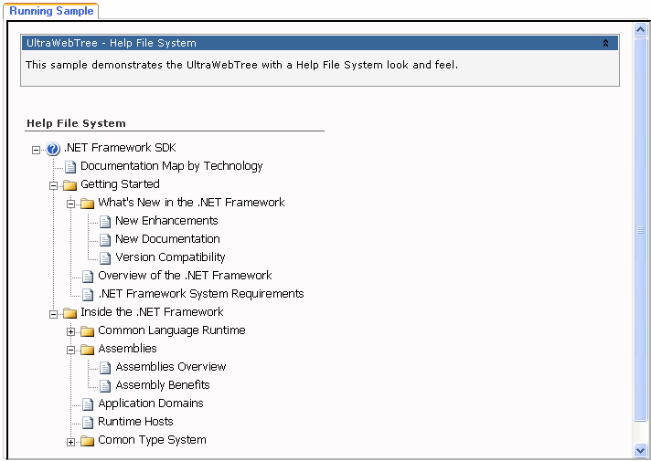
Infragistics UltraWebTree
This sample demonstrates the UltraWebTree with a Help File System look and feel.
Notes:
This sample demonstrates the UltraWebTree with a Help File System look and feel.

Slide 11
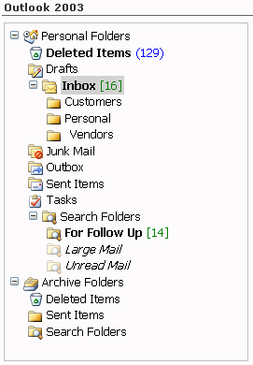
Infragistics UltraWebTree
This sample demonstrates the UltraWebTree with an Outlook 2003 look and feel.

Slide 12
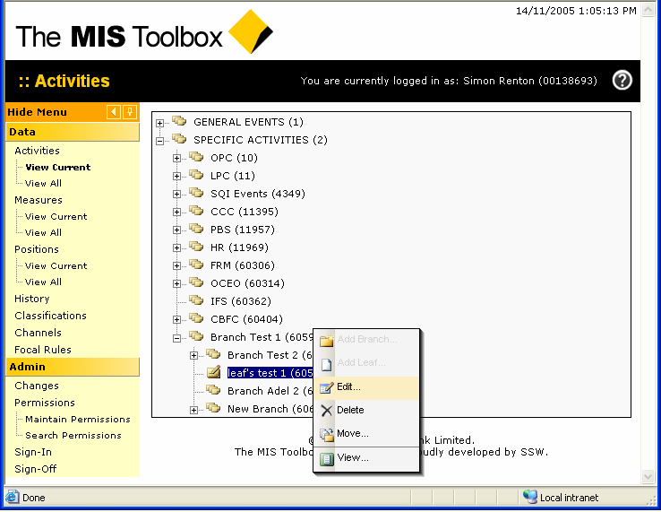
MISToolbox project at CBA

Slide 13
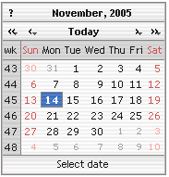
Dynarch JS Calendar
Romanian company Dynarch is run by Mihai Bazon. He created a few useful dhtml controls. His JS Calendar is one of the best on the market today.
Web-site: http://www.dynarch.com/projects/calendar/
What is it?
  » Popup or flat DHTML calendar
  » Suitable for selecting date/time
Supported browsers
  » Internet Explorer 5.0+ for Windows
  » Mozilla, Netscape 7.x, Mozilla FireFox (any platform)
  » Other Gecko-based browsers (any platform)
  » Konqueror 3.2+ for Linux and Apple Safari for Macintosh
  » Opera 7+ (any platform)
Features
  » The look is customizable through external CSS
  » High quality color themes
  » Keyboard navigation
  » Can show days from adjacent months
  » Can show week numbers
  » Translated into many languages
  » Any day can be “the first day of week”
  » The default “first day of week” can be configured in the language file
  » One can easily jump back or forward with 24 years
  » Provides help hints (also configurable)
  » Includes an optional time selector with 1 minute resolution
  » Special days (configurable list of days that are displayed differently)
  » Allows multiple days selection
  » Fast and very easy to setup

Slide 14
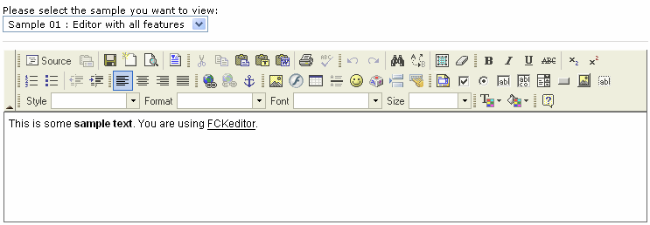
FCKEditor
This HTML text editor brings to the web many of the powerful functionalities of desktop editors like MS Word. It's lightweight and doesn't require any kind of installation on the client computer. The FCKeditor project is managed and maintained by Frederico Caldeira Knabben.
Web-site: http://www.fckeditor.net/
Features: Internet Explorer 5.5+ and Gecko browser (Mozilla / Firefox / Netscape) compatibility
XHTML 1.0 support
Font formatting: type, size, color, style, bold, italic, etc
Text formatting: alignment, indentation, bullets list, etc
Cut, Paste and Paste as Plain Text, Undo and Redo
Paste from Word cleanup with auto detection
Link creation and many more…

Slide 15
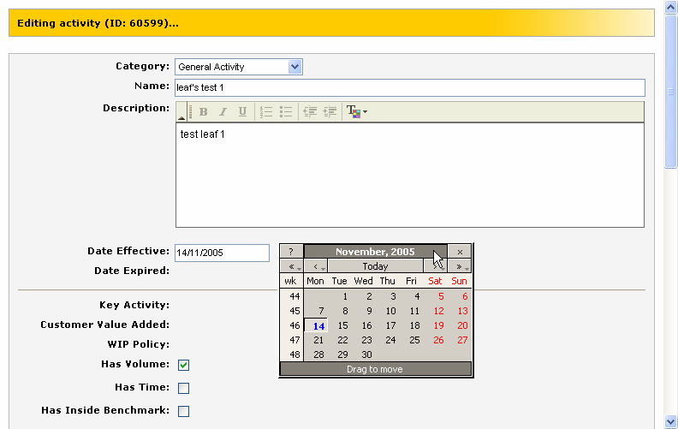
MISToolbox project at CBA
We used those controls on CBA project.

Slide 16
AJAX.NET library
“AJAX” is shorthand for Asynchronous JavaScript + XML, and it represents a fundamental shift in what’s possible on the Web.
AJAX isn’t a technology but rather a grouping of technologies. AJAX uses a communication technology (typically SOAP and XML) to send and receive an asynchronous request/response to the server, and then leverages presentation technologies (JavaScript, DOM, HTML, and CSS) to process the response.
AJAX incorporates:
standards-based presentation using XHTML and CSS;
dynamic display and interaction using the Document Object Model;
data interchange and manipulation using XML and XSLT;
asynchronous data retrieval using XMLHttpRequest;
and JavaScript binding everything together.
Applications using AJAX, such as GMail, Google Maps, Google Suggest, Flickr, are legitimate today, because most browsers support the necessary technology.
There are a number of tools developers can use to get started quickly with AJAX.
Specifically, free and open-source Ajax.NET written by Michael Schwarz from Germany (web-site: http://ajax.schwarz-interactive.de). Ajax.NET is a specific implementation that helps you build solutions that take advantage of the AJAX framework. Ajax.NET takes care of all the implementation details, is .NET-aware, and can be extended.
Microsoft ASP.NET 2.0 introduces its own flavor of asynchronous callbacks through the Client Callback functionality, and it was recently announced that an AJAX implementation, code-named "Atlas”.
Ajax is an important development for Web applications, and its importance is only going to grow. And because there are so many developers out there who already know how to use these technologies, many more organizations will follow Google’s lead in reaping the competitive advantage Ajax provides.
The first and most used today Ajax library for Microsoft.NET was developed by Michael Schwarz from Germany.

Slide 17
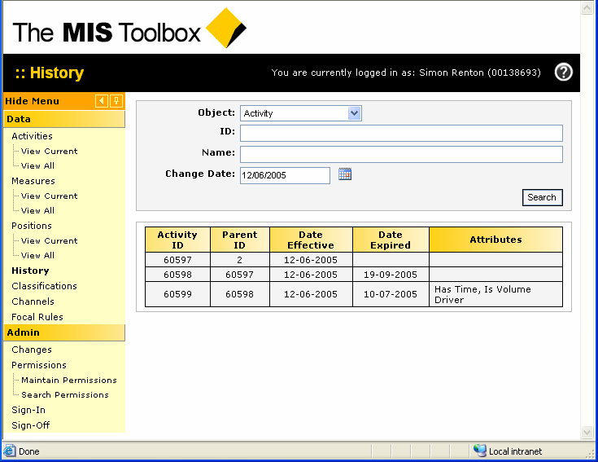
MISToolbox project at CBA
On this Search page we used Ajax to return search results. When page consists of many usercontrols populated using complex logic, Ajax greatly helps to reduce network traffic and response time.

Slide 18
Poll: Making Effective Decisions
Polling is one the most common way to get the users to interact with your site.
Polling draw users back to the site.
Polling is the best way to Market Research
Eg.
www.cnn.com
www.ssw.com.au

Slide 19
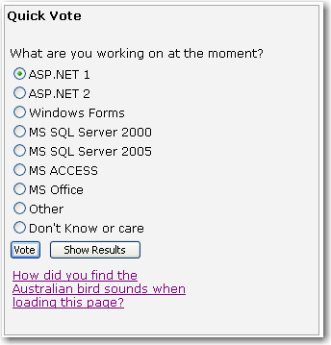
Poll: Peter's Polling Package
Xx results

Slide 20
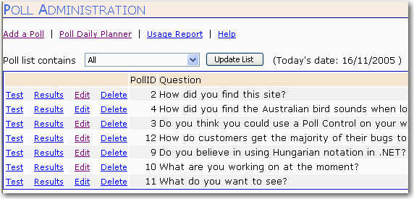
Poll: Admin Screen #1
www.ssw.com.au/ssw/demos

Slide 21
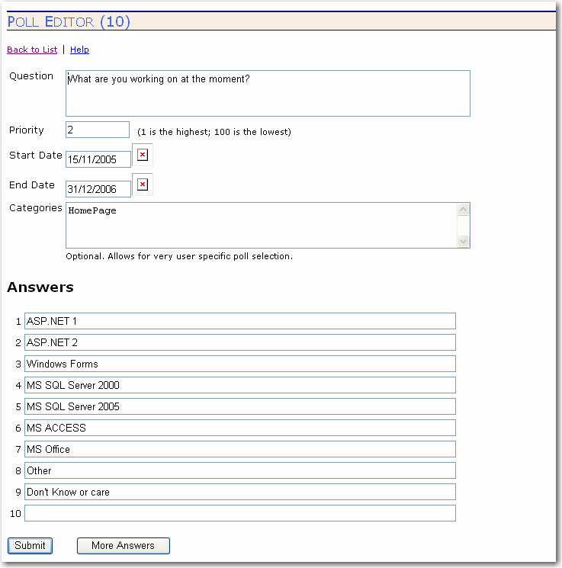
Poll: Admin Screen #2

Slide 22
Poll: 5 pieces required
The pieces required
  entry view and
  results view
  a database
  admin web forms to edit the polling data and
  analyze data collected from the users
This Polling package includes all of the pieces
xx man

Slide 23
Peter's Polling Package
Any Database - Support for Sql and OleDb connections. Includes a SQL script to define tables and stored procs.
Run several polls at the same time, changing them daily.
Customizable Poll Web Control - template-driven headers and footers.

Slide 24
Peter's Polling Package
Create the database
Add to Web.Config
    <appSettings>
    <add key="PollConnectionString" value="server=(local); integrated security=SSPI;database=testPoll"></add>
    <add key="PPP_LicenseVirtualPath" value="/TestPollWebSite1/Licenses/" />
    </appSettings>
Add the Licence - \Licence\*.lic
Add to Toolbox
Drag and drop Poll control
Set “xLicensing” property – xxx|toucan
Set “xCategories” property for poll selection
Add License file to \aspnet_clients\
<Poll:Poll id="pollSSW" runat="server" xPollUsedMode="eDatabase" CssClass="clsSSWTable" xLicensing="01-1243403174“>

Slide 25
More Resources
http://www.ssw.com.au/ssw/Standards/DeveloperGeneral/WebdevelopmentTools.aspx
http://www.ssw.com.au/ssw/Standards/DeveloperGeneral/WebdevelopmentToolsASPNET.aspx

Slide 26
Summary
Xxx Leave this to Adam

Slide 27

2 things
adamcogan@ssw.com.au

Slide 28

Thank You!
.NET is Cool

