Slide 1

Welcome to the
Microsoft .Net
User Group, Sydney
Mission: To Teach Old Dogs New Tricks
www.ssw.com.au/NetUG

Slide 2
Any New Members ?
Who you are?
What you are doing at work?
How you heard of us?
What areas you would like to learn more about?

Slide 3
Tonight’s Agenda
XML Support in Yukon – Gideon Schaller
SSW Exchange Reporter
Top 5 things that Access has that .NET doesn’t

Slide 4
SSW Exchange Reporter
www.ssw.com.au/SSW/ExchangeReporter

Slide 5
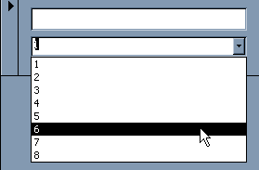
Top 5 things Access has that .NET doesn’t
Continuous Forms
White background for ReadOnly text boxes
Read-only Combo Boxes

Slide 6
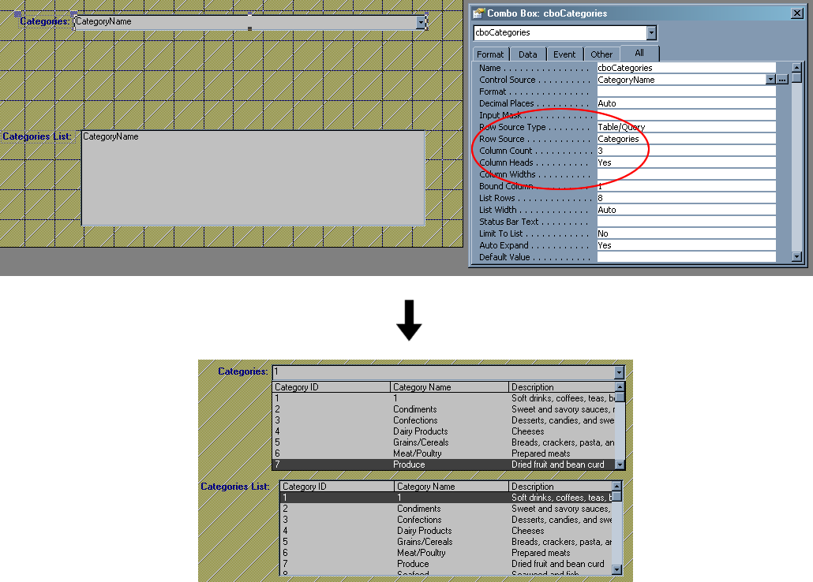
Top 5 things Access has that .NET doesn’t
4. Multi-column Combo Boxes and List Boxes

Slide 7
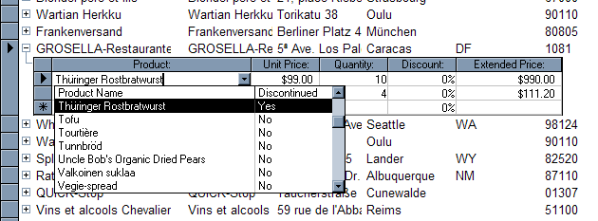
Top 5 things Access has that .NET doesn’t
5. Advanced Datasheet View

Slide 8
Tech Breakfast – November 9 – Access to the Enterprise
Moving from Access 97 to Access 2003
Moving from Access to SQL Server
Moving from Access reports to Reporting Services
Moving from Access Forms to .NET Winforms
Rebecca or Scott: 9953 3000
See you there!

Slide 9
Finished!
Questions?

