Slide 1
Making Visual Studio Team System work in your Organisation
Streamline your bug handling and development management system
Bikes…

Slide 2
About Adam
Chief Architect for www.ssw.com.au doing:
  internal corporate development and
  generic off-the-shelf databases
  Clients: Royal & SunAlliance, Westbus, Microsoft…
SSW Develops custom solutions for businesses across a range of industries such as Government, banking, insurance and manufacturing since 1990
President .Net User Group, Sydney
Speaker for Microsoft TechEd and Roadshows, Dev Conn, VSLive….
Microsoft Regional Director, Australia
AdamCogan@ssw.com.au

Slide 3

Agenda
History of Bug Systems
Exploring VSTS / TFS (a tour)
What’s wrong with VSTS for me
The Education
  - What you can customize
The Solution
  - including 3rd Parties

Slide 4
How Bug Tracking Systems Work
Everyone needs one – even Microsoft!
Basic Requirements
  Searchable
  Reportable
  Notifications when done
Nice-To-Haves
  Source Control Integration
  IDE integration (optional)
Many solutions available for tracking tasks and bugs
  Different storage mechanisms - Spreadsheets/ Databases/ Emails
  Different Interfaces - Thin Client/Rich Client
Notes:
VSTS is deployed internally by MS

Slide 5
History of Microsoft
MS Excel
MS Project

Slide 6
Third Parties
Mantis Bug Tracking System
www.mantisbt.org/download.php

Slide 7
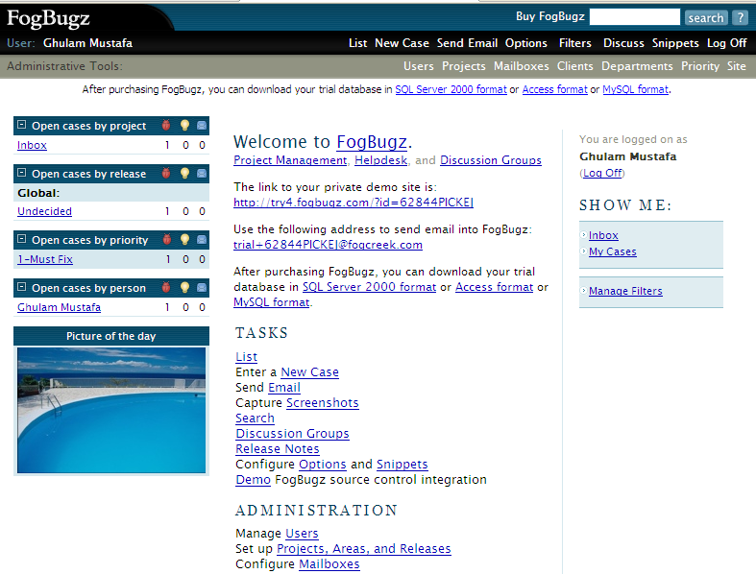
Third Parties
  FogBugz (www.fogcreek.com.au)

Slide 8


History of SSW
A year ago… Extreme Emails

Slide 9
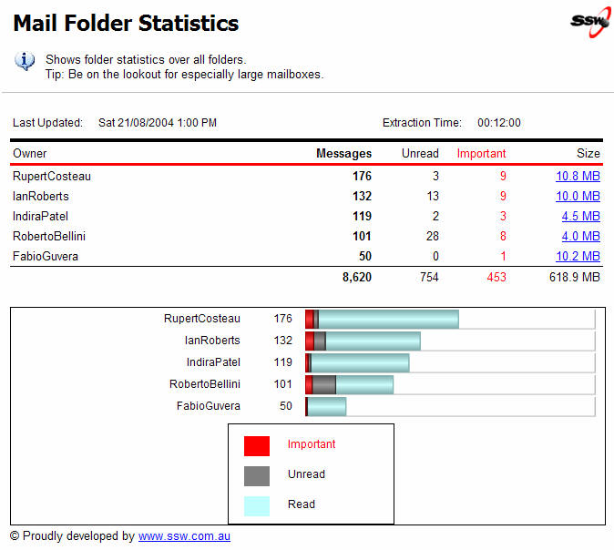
And for Reporting…
www.ssw.com.au/ssw/ExchangeReporter

Slide 10
What is something grand?
  Enormous
  Millions of men involved

Slide 11

Easter Island Statues

Slide 12

Titantic

Slide 13
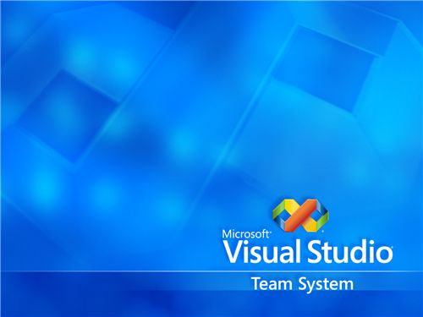
Visual Studio Team System (VSTS)

Slide 14
Agenda
History of Bug Systems
Exploring VSTS / TFS (a tour)
What’s wrong with VSTS for me
The Education
  - What you can customize
The Solution
  - including 3rd Parties

Slide 15
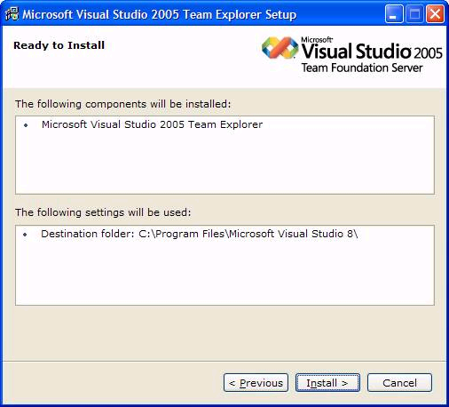
Installing TFS

Slide 16
How VSTS does it?
  VS 2005 Integrated IDE
  6 SQL Server 2005 Databases
  Reports in SharePoint
  Notifications via email
Solves many problems – 7 big ones for me

Slide 17

Problem #1
Young Developers (Tatham Oddie)

Slide 18
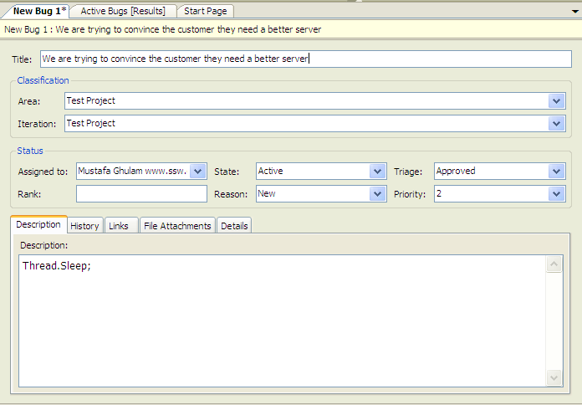
Problem #1
You can’t work out why the developers made the change
SOLUTION: TFS associates work items with the check-ins made. This allows you to determine the WHY rather than just the WHAT.

Slide 19
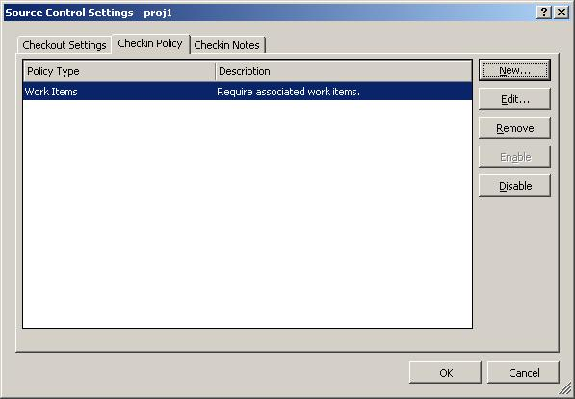
Problem #1
HOW: The Manager defines the policy for Source Control

Slide 20

Problem #2
Some developers cause more problems then they solve

Slide 21
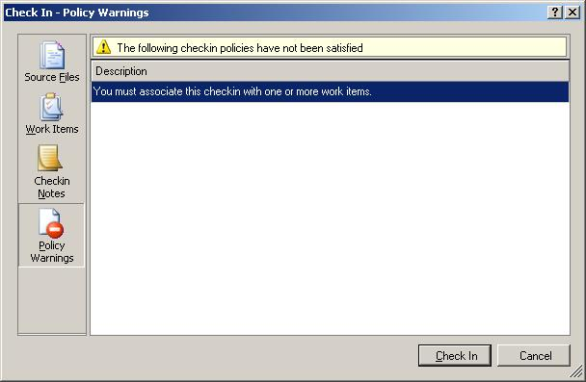
Problem #2
Developers regularly check in changes that break.
Bugs are detected the day before release!
SOLUTION: VSTS has Unit Testing support built in. You can also use Team Foundation Server to perform a nightly build. Bugs will be found SOONER rather than LATER.
Notes:
URL for overnight builds
http://msdn.microsoft.com/vstudio/teamsystem/reference/foundation/default.aspx?pull=/library/en-us/dnvs05/html/ntbldtmsrv.asp
For Problem 1 (tracing back to work items)
http://msdn.microsoft.com/vstudio/teamsystem/reference/foundation/default.aspx?pull=/library/en-us/dnvs05/html/teamfoundatwrk.asp
Problem 4
It is difficult to report on the current status of the project because you have to keep getting updates from the developers and testers to update your Excel spreadsheet/Project database

Slide 22


Problem #3
Senior Developers

Slide 23
Problem #3
Developers check in changes that don’t comply with company standards
SOLUTION: VSTS Source Control support allows check-in policies to enforce code rules and provides Code Analysis
Eg. FxCop, SSW Code Auditor

Slide 24

Problem #4
Business People
Should be able
to understand

Slide 25
Problem #4
Your project fails because you don’t know the true state of the project (poor visibility)
SOLUTION: reporting off these (into Project and SharePoint).
* see who is doing what work
* see how much work is left to be done
eg. Lets imagine you have 3 offices… can business people understand?

Slide 26
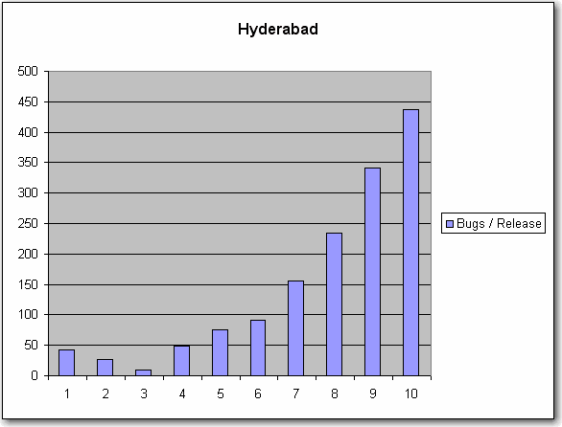
Problem #4

Slide 27
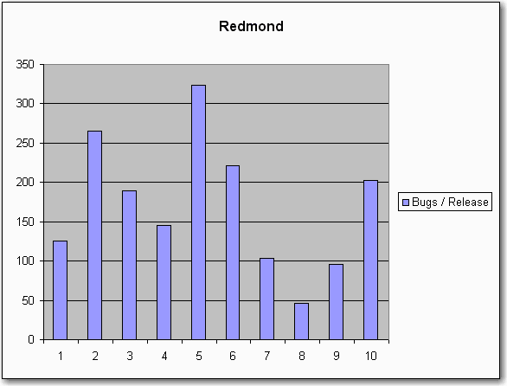
Problem #4

Slide 28
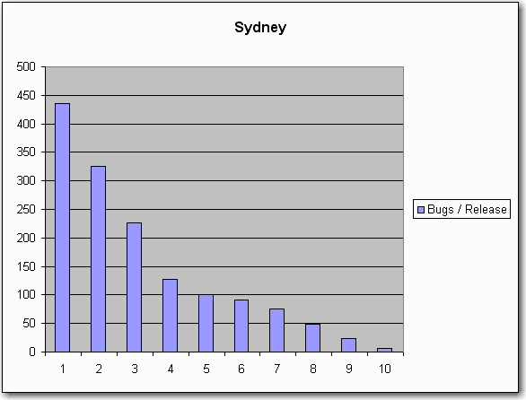
Problem #4

Slide 29

Problem #5
Toll Collector

Slide 30
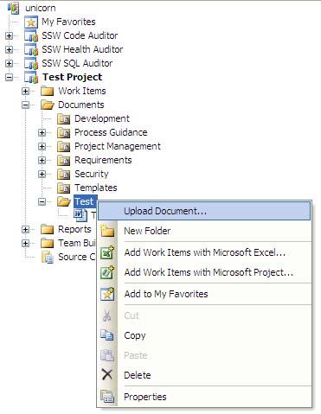
Problem #5
Your project managers have to manually enforce edit, test deploy methodology
SOLUTION: VSTS Process Templates enforce your testing, deployment and approval standards

Slide 31
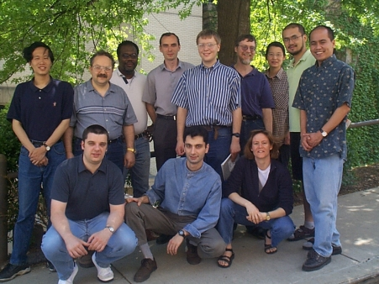
Problem #6
Bugs

Slide 32
Problem #6
You are getting a lot of runtime exceptions in your application because there are not many unit tests
SOLUTION: Project Managers see Code Coverage Report
Eg. determine they want 90% coverage… lets see…

Slide 33
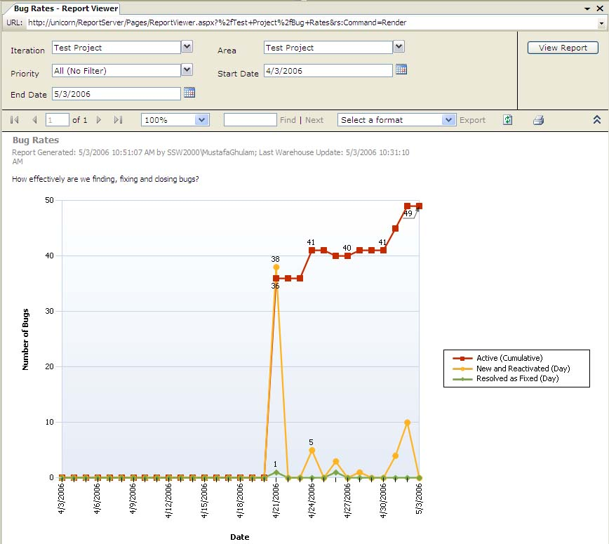
Problem #6

Slide 34

Problem #7
Performance Problems?

Slide 35
Problem #7
The app is becomes slow
SOLUTION: VSTS Unit Testing functionality supports Performance metrics are also built into the VSTS suite.
Xx
Jet Brains

Slide 36
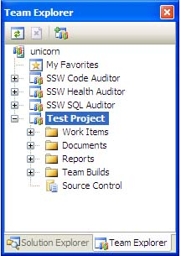
VSTS Tour for the Programmer
Team Explorer

Slide 37
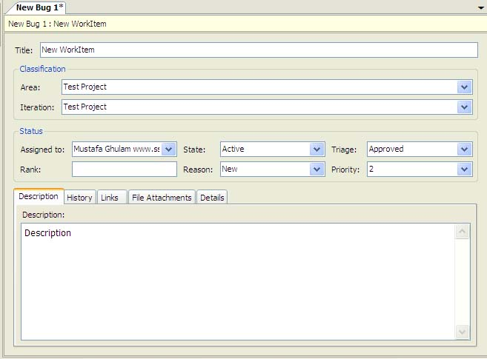
VSTS Tour for the Programmer
Add Work Items

Slide 38
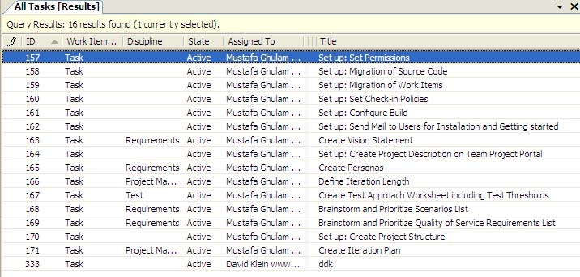
VSTS Tour for the Programmer
View Task Lists

Slide 39
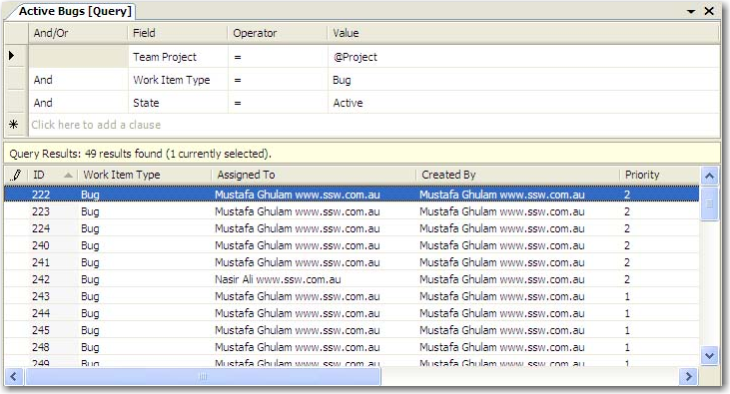
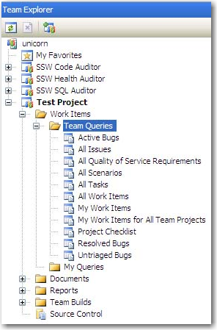
VSTS Tour for the Programmer
Built in Queries

Slide 40
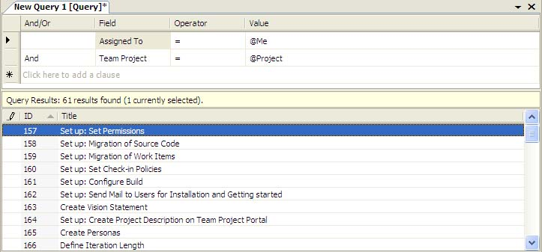
VSTS Tour for the Programmer
Custom Queries

Slide 41
VSTS Tour for the Programmer
Write Tests
Documents

Slide 42
Agenda
History of Bug Systems
Exploring VSTS / TFS (a tour)
What’s wrong with VSTS for me
The Education
  - What you can customize
The Solution
  - including 3rd Parties

Slide 43
What’s wrong with VSTS for me
?

Slide 44

What’s wrong with VSTS for me?
Unnecessary fields
Data in combos
Getting bugs from Outlook
Responding with history
The Reports

Slide 45
Agenda
History of Bug Systems
Exploring VSTS / TFS (a tour)
What’s wrong with VSTS for me
The Education
  - What you can customize
The Solution
  - including 3rd Parties

Slide 46
VSTS – Going Hardcore
VSTS Changes
  Customize Process Templates
  Customize Work Item
Integration
  Object Model – give UI
  Web Services – give UI

Slide 47
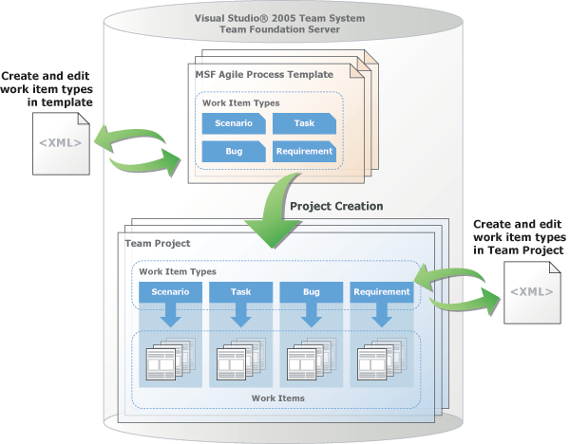
VSTS – Going Hardcore
Customize Process Templates

Slide 48
Customising Process Templates
Process Templates
    ProcessTemplate.xml
    Task.xml
  Visual Studio Team System Process Template Editor http://www.gotdotnet.com/Workspaces/Workspace.aspx?id=812a68af-5e74-48c6-9623-1a4469142a84
Notes:
Bissubscribe - http://msdn.microsoft.com/msdnmag/issues/06/03/TeamSystem/default.aspx

Slide 49
Integration with Work Items
?

Slide 50
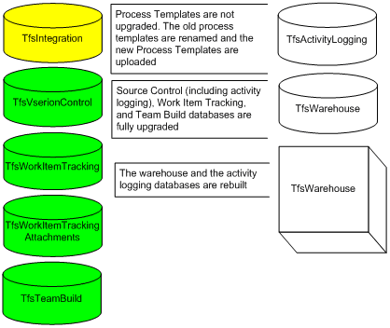
Integration
Uses 6 SQL Server 2005 databases
TfsWorkItemTrackingAttachments
TfsIntegration
TfsVersionControl
TfsWorkItemTracking
TfsTeamBuild

Slide 51
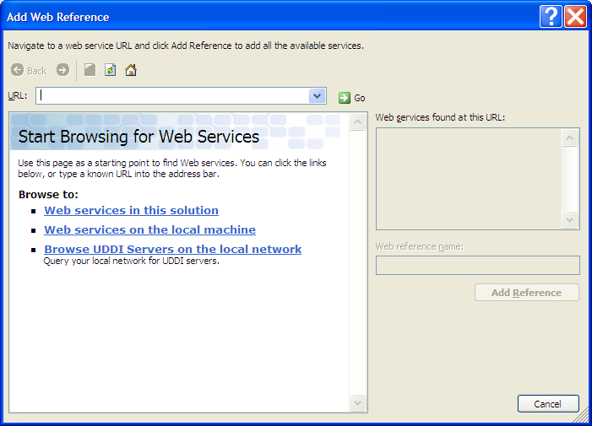
Integration
Program via Web Services – gives UI

Slide 52
Integration
Uses web services – although not documented
    E.g. http://unicorn:8080/VersionControl/v1.0/Repository.asmx QueryItem(), Checkin() Web Methods
    Web Services Trace/IIS Log

Slide 53

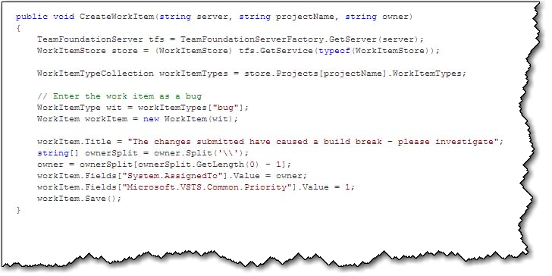
Integration
Program via Object Model
Notes:
Store = Server
WorkItemType = BUG, TASK
Different required fields – tasks don’t have priority, Bugs do

Slide 54
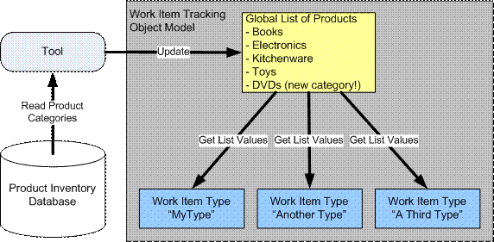
VSTS – Going Hardcore
Customize Work Item
xx

Slide 55
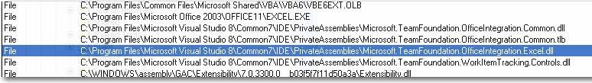
The Education
This is what it does underneath the toolbar
what dll it is using with Sys Internals Process Explorer?

Slide 56
Integration
Using the TFS Object Model (TFSOM)
  Reference C:\Program Files\Microsoft Visual Studio 8\Common7\IDE\PrivateAssemblies
  Microsoft.TeamFoundation.WorkItemTracking
  Team Foundation Namespace
    TeamFoundationServer
    WorkItemStore
    WorkItem
Notes:
Process Templates - http://msdn.microsoft.com/library/default.asp?url=/library/en-us/dnvs05/html/witinvs05tmsys.asp
Object Model Guide - http://teamsystemrocks.com/blogs/mickey_gousset/archive/2006/02/07/654.aspx
TeamFoundationServer tfs = TeamFoundationServerFactory.GetServer("MSTFS")
Object model: http://msdn.microsoft.com/vstudio/teamsystem/team/default.aspx
TeamFoundationServer tfs =TeamFoundationServerFactory.GetServer("TeamFoundationServerName");
WorkItemStore store = (WorkItemStore) tfs.GetService(typeof(WorkItemStore));
// Get the work item by the ID or by the URL from WorkItemStore.
WorkItem wibyId = store.GetWorkItem(id);
WorkItem wibyURL = store.GetWorkItem(url);

Slide 57
The Education
Reading and writing data
Microsoft.TeamFoundation.dll
- (Abstract classes for Accessing TFS data from Databases)
Microsoft.TeamFoundation.Client.dll
- (Assigning Permission, Adding deleting Groups and users)
Microsoft.TeamFoundation.Common.dll
- (All type of Exception utilities)
Microsoft.TeamFoundation.WorkItemTracking.Controls.dll
- (Connection and Controls of TFS UI)
Microsoft.TeamFoundation.WorkItemTracking.Client.dll
- (Adding, Updating WorkItems)

Slide 58
Integration
Hooking your application into TFS events
  Team Foundation Server Events
  Using BisSubscribe.exe to subscribe to events

Slide 59
VSTS – Tools
Tools
  MS Excel
  MS Project
  3rd Parties – Team Plain
  3rd Parties – Team Look
  3rd Parties – SSW eXtreme Emails!

Slide 60
VSTS – Tools
MS Excel

Slide 61
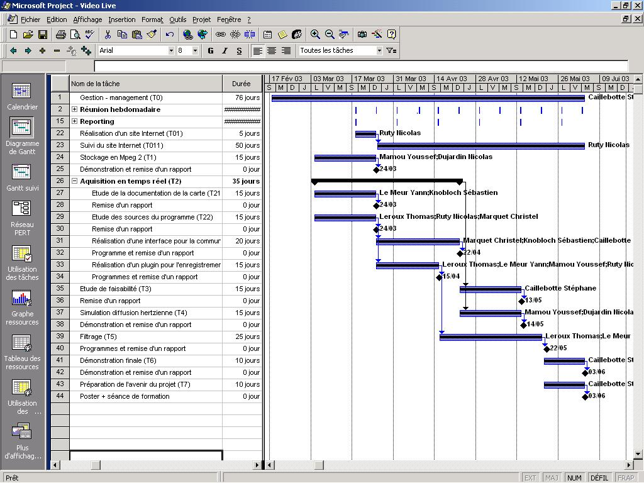
VSTS – Tools
MS Project

Slide 62
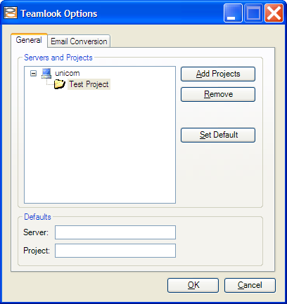
VSTS – Tools
Team Look – one big problem!

Slide 63
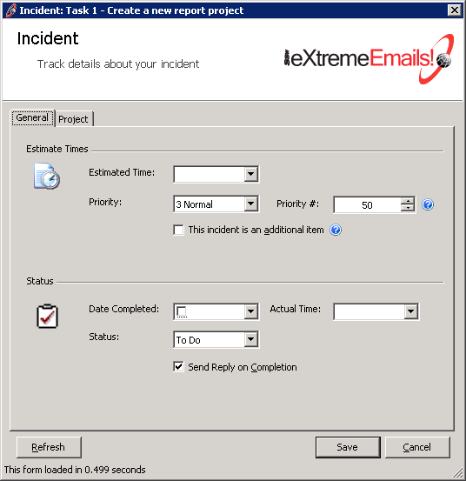
VSTS – Tools
SSW eXtreme Emails!

Slide 64
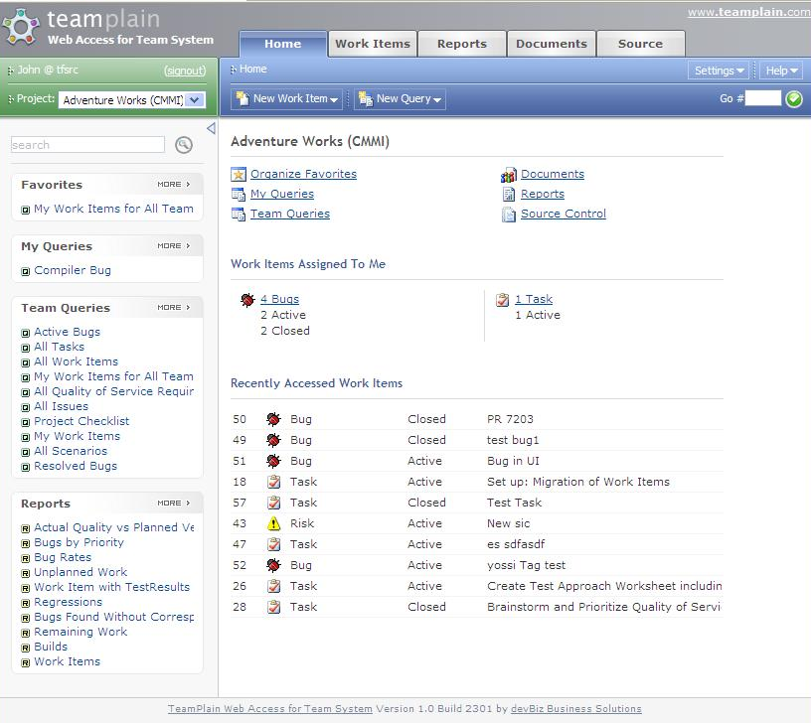
VSTS – Tools
Team Plain

Slide 65
VSTS – Tools - Summary
Web Access - TeamPlain is available ($199 per user)
  http://www.devbiz.com/teamplain/webaccess/
TeamLook - TeamLook is available ($99.95 per user)
  http://www.personifydesign.com/default.aspx?tabid=84
  http://www.personifydesign.com/Default.aspx?tabid=63
eXtreme Email - eXtreme Email is available (US$99 per user)
  http://www.ssw.com.au/ssw/eXtremeEmails/
Notes:
Note adding work items to excel has minor bug when chosing Quality of service item types

Slide 66
VSTS – Tools
Other add-ins can be found at http://blogs.msdn.com/jimlamb/articles/tfsfaq.aspx

Slide 67
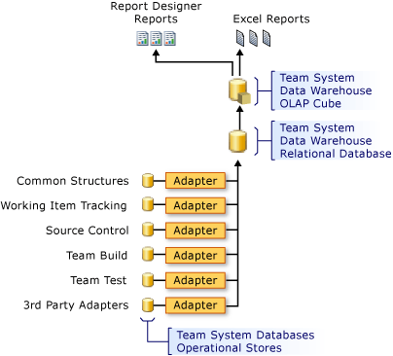
TFS & BI – The core databases

Slide 68
TFS & BI
  The structure of the Team System Cube
    Fact Tables
    Dimension Tables
    Perspectives
      Build Perspective
      Code Churn Perspective
      Code Coverage Perspective
      Current Work Item Perspective
      Work Item Perspective
      Load Test Perspective
      Test Result Perspective
Notes:
http://msdn2.microsoft.com/en-US/library/ms244679(VS.80).aspx

Slide 69
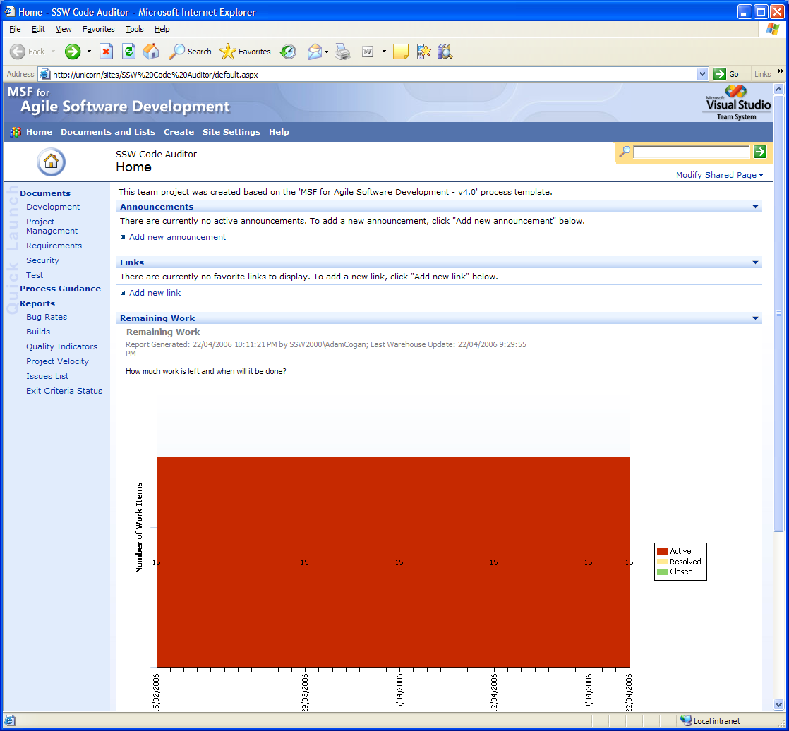
TFS Sharepoint Portal
Can see bugs going down
Can’t create work items
No source browsing
No Search
Limited reports
Useless!
http://unicorn/sites/SSW%20Code%20Auditor/default.aspx

Slide 70
TFS TeamPlain Web Access for Team System
Who for?
Users without Team Explorer (in Visual Studio 2005)
Managers, analysts, tech support, sales, non-developers
Users working on non-Windows computers (as long as they don’t need Source Control)
Missing Diffs in Source Control
No check-in in Source Control
Expensive - $199 per user for the Pro version
http://demo.teamplain.com
http://www.devbiz.com/teamplain/webaccess/default.aspx

Slide 71
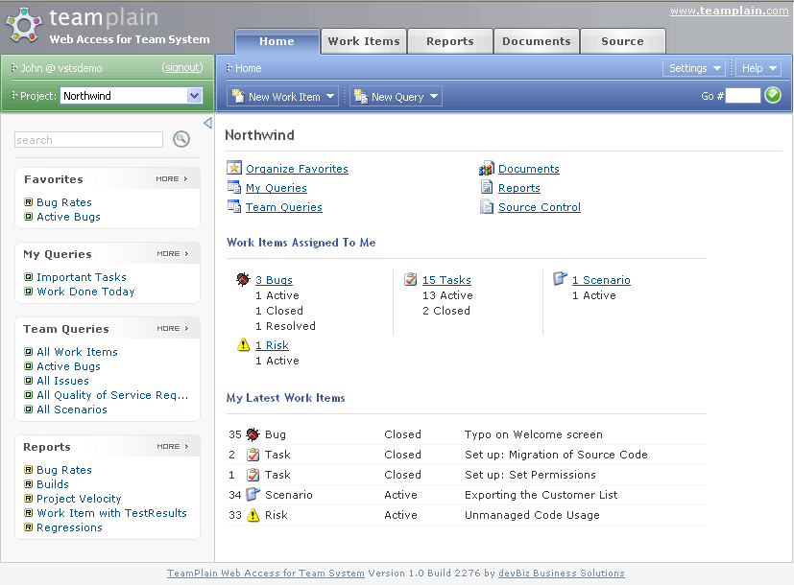
TFS Dashboard

Slide 72
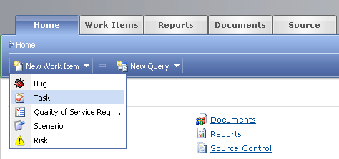
TFS Create New Work Items

Slide 73
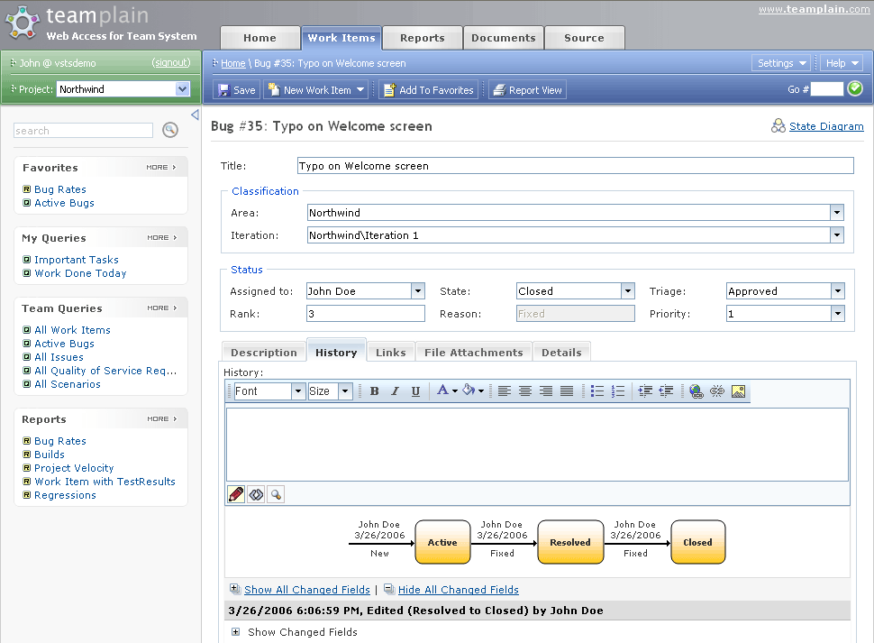
TFS Work Item Editor

Slide 74
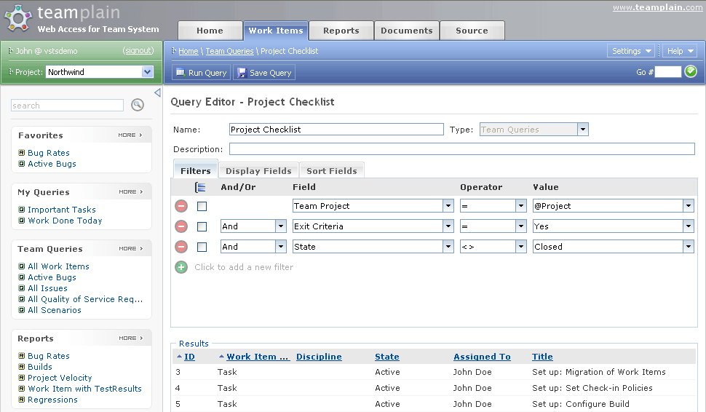
TFS Query Editor

Slide 75
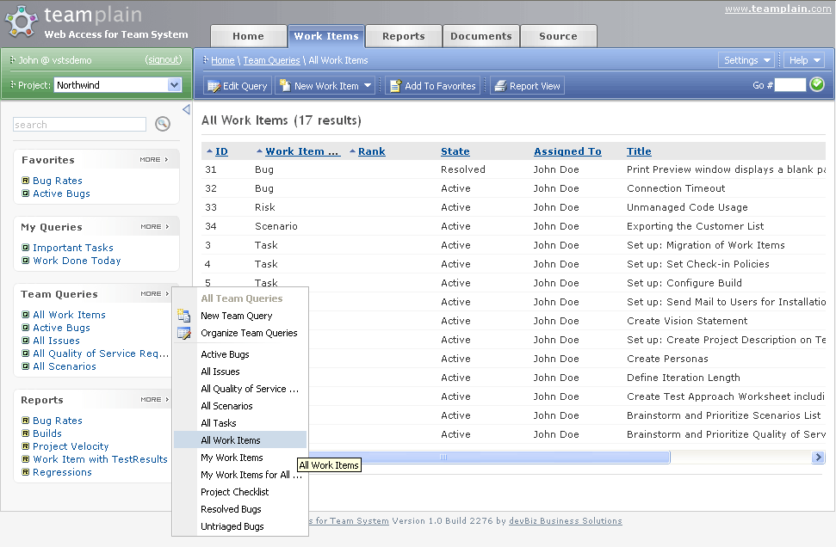
TFS Work Item Query Results

Slide 76
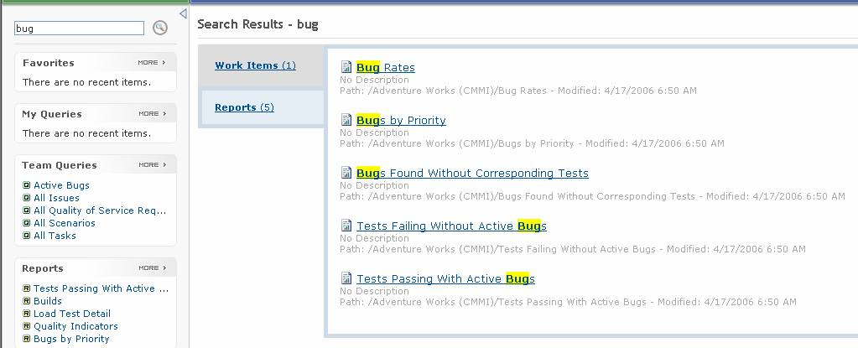
TFS Search Feature

Slide 77
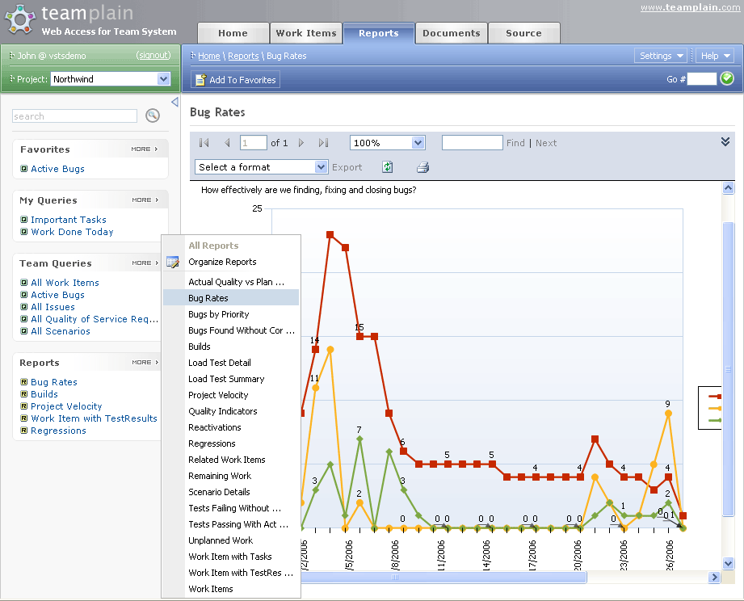
TFS Report Browser

Slide 78
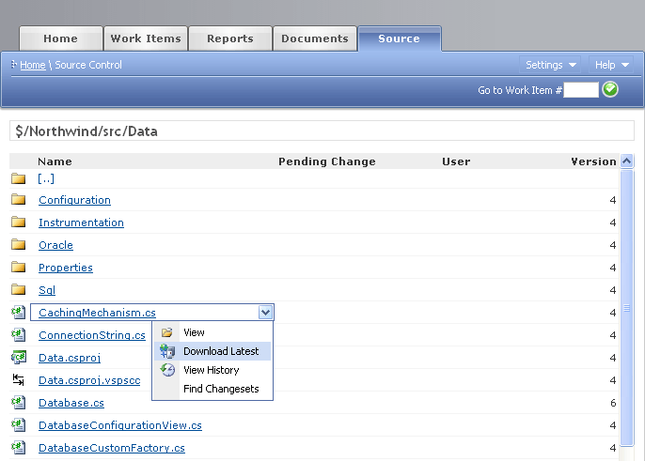
TFS Source Control Browser

Slide 79
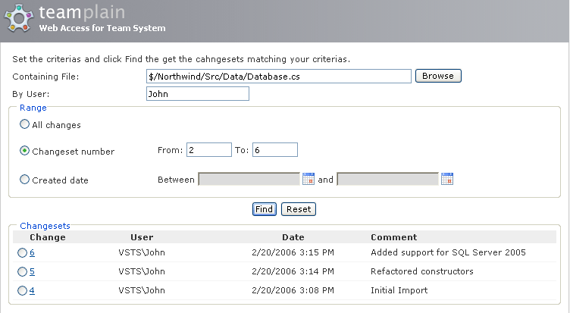
TFS Source Control Changeset Search

Slide 80
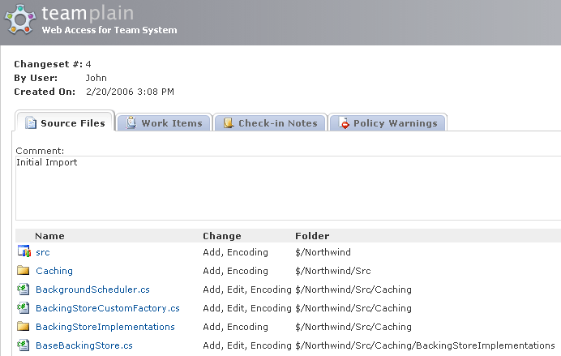
TFS Source Control Changeset Viewer

Slide 81
TFS TeamPlain - Conclusion
It beats the MS SharePoint web portal in every aspect, from performance to UI, from UI to features… the SharePoint web portal looks pretty much useless compare to TeamPlain Web Access.

Slide 82
What’s wrong with VSTS for me?
Unnecessary fields
Data in combos
Getting bugs from Outlook
Responding with history
The Reports

Slide 83
SMS me in next 2 mins
SMS +61 4 1985 1995
What was the best takeaway you got?
3 receive a free SSW mug

Slide 84
Conclusion
Source Control great – miles faster with bulk check outs
Works Items are a good offering for developers
The whole thing brings developers and project managers
Great to see unit tests visible to managers
The SharePoint web portal is pretty much useless

Slide 85
The Future for Microsoft
Work Items

Slide 86
The Future for SSW
Work Items and Emails
  via SSW Extreme Emails
  Linked via WorkItemID
Attaching .diff
Reports on Work Items
Reports on Exchange Server
Working out the important metrics

Slide 87
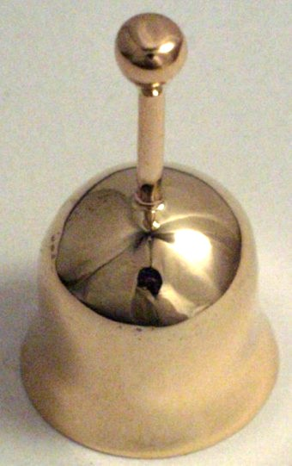

Rules to Successful Projects
Do you use positive reinforcement?

Slide 88
Wish List
HTML in Description
Alerts should include the history (like an email)
Customize the Work Item UI in VS.NET
A full OWA like Portal
www.ssw.com.au/SSW/Standards/BetterSoftwareSuggestions/TeamFoundationServer.aspx

Slide 89
More Resources
Home page for Visual Studio Extensibility http://msdn.microsoft.com/vstudio/extend/customize/
The Visual Studio SDK (includes Team System SDK) is available at
https://affiliate.vsipmembers.com/affiliate/downloadFiles.aspx (requires registration)

Slide 90
Summary
3rd Party - SSW Extreme Emails
TFS Tour
Customizing Process Templates
Customizing Work Items
Integrating
3rd Party TeamLook
3rd Party TeamPlain Web Access for Team System

Slide 91

2 things
adamcogan@ssw.com.au

Slide 92

Thank You!
.NET is Cool

