Slide 1


Sydney .NET Users Group
Next-generation BI for the Masses
Wednesday 15th July 2003
Matthew Lingard
mlingard@zaptechnology.com

Slide 2











ZAP Technology
Australian-based Business Intelligence Solutions Provider, founded in 1997
BI product development company, with offices in Sydney
and Brisbane, Australia
Microsoft Gold Certified Partner – BI
Member of the XML for Analysis Advisory Council
Some of our customers:

Slide 3
Business Intelligence
Majority of Business Intelligence deployments are reaching only 20% of knowledge workers.
  Why?
    Cost of deployment
    Tools are difficult to deploy and to use
    Tools do not suit wider audience
    Proprietary nature of Business Intelligence
olapreport.com: Up to 40% or more of “shelfware”

Slide 4
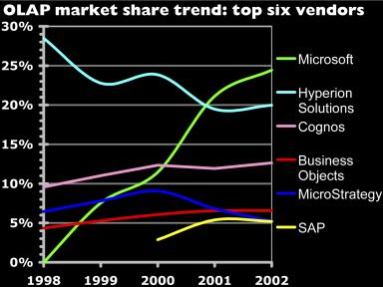
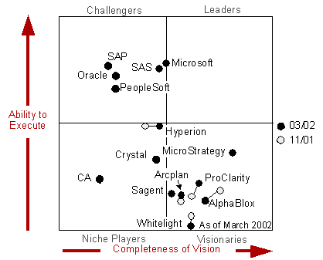
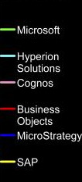
BI Market growth
“Among the more notable changes
in the BI Platform Magic Quadrant
is Microsoft's increasing ability to
execute, with growing adoption of
Analysis Server and related tools”
Howard Dressner - Gartner
“Many Oracle & DB2 sites buy SQL Server purely for Analysis Services, without using the SQL Server RDBMS at all.” www.olapreport.com/Market.htm
March 30, 2003

Slide 5

XML for Analysis – A Business Intelligence Standard
SOAP based XML API designed for:
standardising data access to OLAP and data mining cubes
does not require client-side components
jointly developed by Microsoft and Hyperion
released April 2001, real momentum in 2002
leverages XML, SOAP and HTTP

Slide 6
XMLA – Benefits
What are the benefits of XML for Analysis?
Customers:
will be able to protect server and tools investments.
ensure that new analytical deployments will interoperate
Developers:
will be able to use open access XML-based Web services.
eliminate the need for multiple APIs and query languages.
Independent software vendors:
will be able to reduce complexity and costs for development.
maintenance by writing to a single access interface.

Slide 7
XML for Analysis
1980’s
  SQL ODBC Relational DB’s
  2002
  MDX XMLA OLAP DB’s
  Why is this standard important ?
  The proprietary nature of Business Intelligence systems have made them very expensive.
  XMLA and MDX are the BI standards that will ensure that this changes

Slide 8














Slide 9
XMLA – Vendor Adoption
Microsoft: SQL Server Analysis Services 2000 – NOW
Hyperion: Essbase XTD – NOW
SAP: SAP BW V3.0– Mid-2003
SAS: SAS OLAP – 2003
Applix, Cognos and others to follow
ZAP.BI Suite supports all XMLA cubes

Slide 10
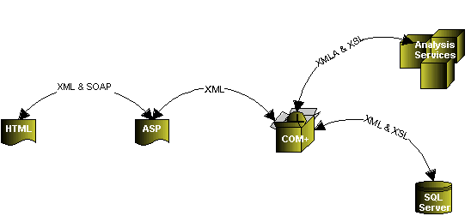
ZAP.BI Suite Application Architecture

Slide 11
ZAP.BI Suite
Business Performance Monitoring
.Net Framework
Web Portal
Reporting
Analysing
Scorecarding
Alerting
Microsoft SQL Server 2000 Analysis Services
Operational Data Stores
ERP
CRM
HR
SCM

Slide 12


What Microsoft says of ZAP.BI Suite

Slide 13
ZAP.BI– Features
 Ad-Hoc Query and Analysis
  Web based drag-and-drop, slice and dice
  Full web analytics and drill trough
  to the relational source
 Managed Reporting
  Save as HTML reports 
  Export to PDF S
    Static PDF (end of month) h
    Updateable PDF a
    Filterable PDF r
    Drillable PDF e
  Export to Excel

Slide 14

ZAP.BI - Built on .Net & XMLA
Based on Open Web Standards: HTML, XML, XMLA & SOAP
Easy to use drag-and-drop and Managed reporting
Zero footprint on the client and Web-based administration
Browser-based Query, Reporting & Analysis: drill-down, up
& through. Create, access & share interactive analytic views
Can be deployed from a single server for minimal impact on resources - Works over a 56k modem dial-up connection
Wide area deployment, including externally
Access based upon security access profiles
For advanced & inexperienced users

Slide 15
