Slide 1
Extreme Programming
Adam Cogan
Database Architect
ssw.com.au

Slide 2
About Adam
Chief Architect for www.ssw.com.au - experience with:
  internal corporate development and
  generic off-the-shelf databases
  Clients: Enterasys Networks, Cisco, Microsoft…
Run Teams of Developers
President .NET User Group, Sydney
Speaker for Microsoft Roadshows, Dev Conn, VSLive
Microsoft Regional Director, Australia
Email: AdamCogan@ssw.com.au

Slide 3



Slide 4


From
To

Slide 5
There Are Different Ways
The Waterfall Approach
  Determine requirements
  Set schedule
  Testing
  Develop in one big step
Agile approaches
  Extreme Programming (XP)
  RUP

Slide 6
Agenda
The Main Problem
The Solution
Implementing XP

Slide 7
Session Prerequisites (Current Problems)
Give estimates to customers
Over promise
Surf the net too much
Don’t give the customer value
Too slow
Under deliver
Over charge

Slide 8
The Main Problem
…is Risk. Examples being:
Schedule Slip – the day comes 6 months to go
Project Cancelled – numerous slips mean nothing in production (bugger it)
System goes sour – some years later
Defect Rate – so high it isn’t used
Business Misunderstood
Business Changes
False Feature Rich
Staff Turnover

Slide 9



Waterfall vs XP

Slide 10
Enter XP…
Extreme Programming (XP) is a software development discipline
Address Risk
Very Productive
Produces High Quality Software
Lot of Fun to Execute
Like driving your car…

Slide 11
Basic Practices of XP…
Planning – writing all the cards
Short Releases
Metaphor
Simple Design
Testing
Refactoring
Pair Programming
Collective Ownership
Continuous Integration
40 Hour Week
On-site Customer
Coding Standards

Slide 12
XP Addresses Risk
Let look at the same examples…

Slide 13
XP Addresses Risk
Schedule Slip – the day comes with 6 months to go
  2. Short Releases
  1. Planning – writing all the cards
It’s the big day –January 1st!

Slide 14
XP Addresses Risk
Project Cancelled – numerous slips mean nothing in production
2. Short Releases
11. On-site Customer
Nearly there.. 1 month to go
Going well… 2 weeks to go

Slide 15
XP Addresses Risk
System goes sour – some years later
4. Simple Design
5. Testing
6. Refactoring
12. Coding Standards
I asked for 1 fix and now there are 3 new problems!
1 week for a simple change… you can’t be serious!

Slide 16
XP Addresses Risk
Defect Rate – so high it isn’t used
5. Testing
9. Continuous Integration
This system is a failure – there are too many bugs!

Slide 17
XP Addresses Risk
Business Misunderstood
3. Metaphor
11. On-site customer
I asked for a “clam steamer” – this is no “clam steamer”!

Slide 18
XP Addresses Risk
Business Changes
1. Planning
2. Short releases
We’re going to give you Sally now because we need John…

Slide 19
XP Addresses Risk
False Feature Rich
1. Planning
2. Short releases
Why do we have nice rich textboxes here, but we can’t print an invoice?

Slide 20
XP Addresses Risk
Staff Turnover
7. Pair Programming
8. Collective Ownership
10. 40 Hour Week
Greg’s leaving… There’s no way this project will be finished on time now

Slide 21
An Entrepreneur’s Experiences with XP
✗ Planning – writing cards *
✓ Short Releases
✗ Metaphor
✓ Simple Design
✓ Testing – using nUnit *
Refactoring
✗ Pair Programming
Collective Ownership
Continuous Integration
✗ 40 Hour Week
✗ On-site Customer
Coding Standards
* Let’s see 3 XP essentials…

Slide 22
Tool 1: Short Releases
Let’s see how a release is put together…
XP Style
  XP Cards
  Becomes a Pile
SSW Style
  Using Emails
  SSW eXtreme Emails!

Slide 23
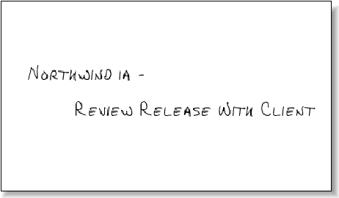
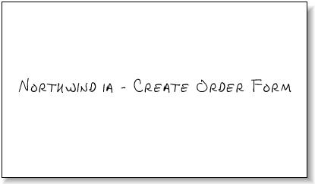
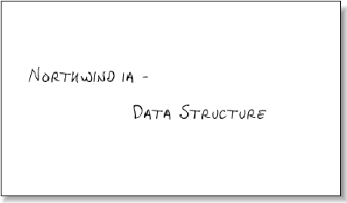
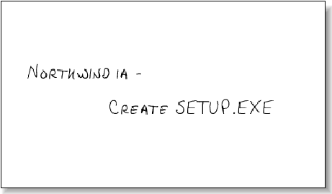
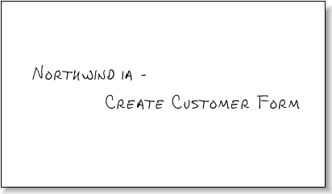

Development Process (Using XP Cards)

Slide 24
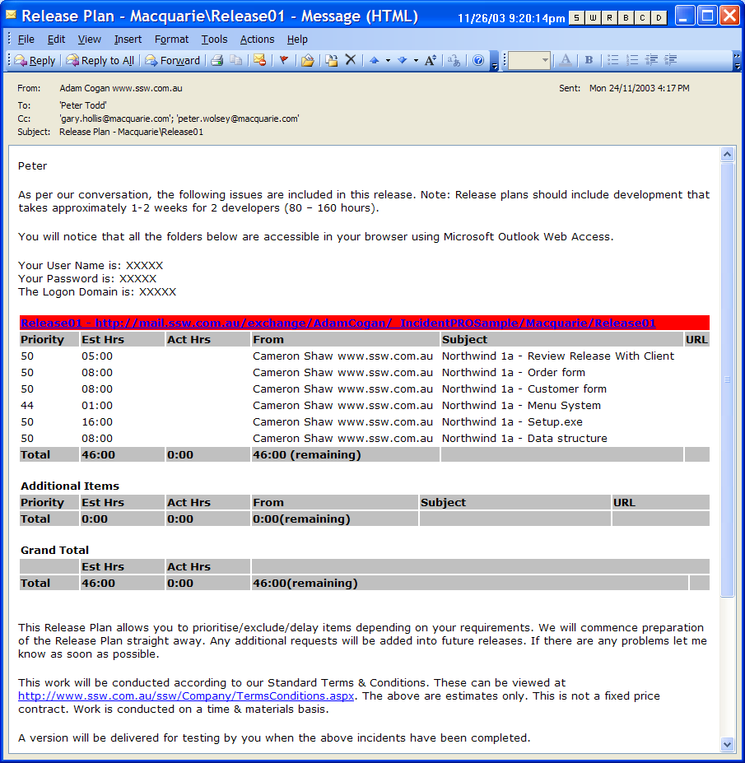
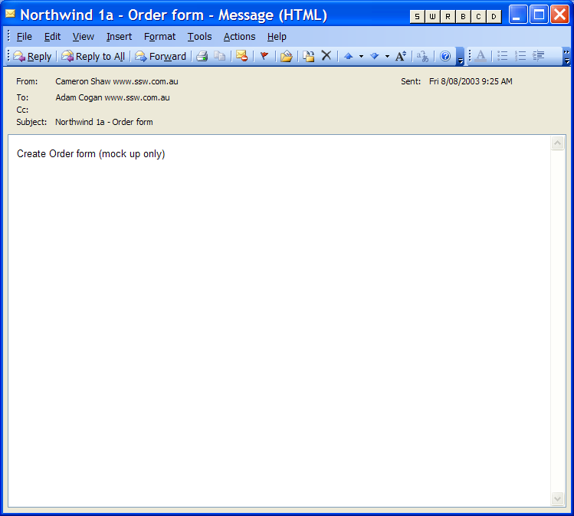
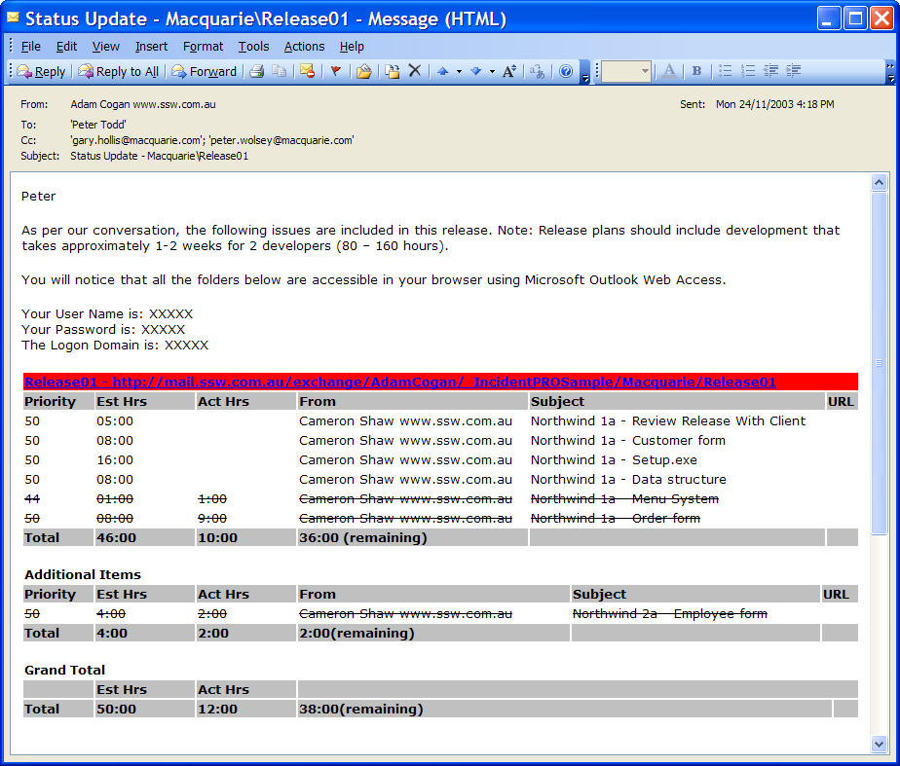
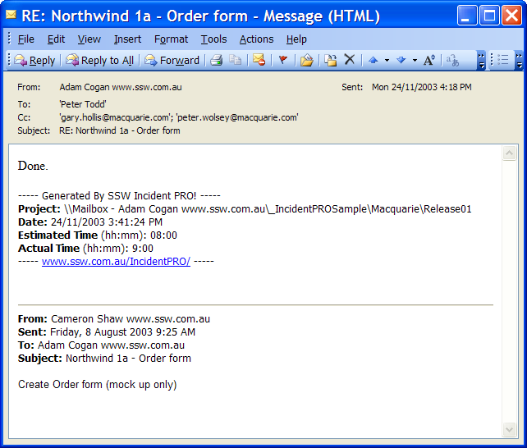
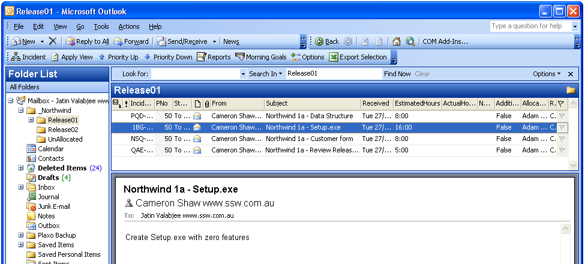
The Development Process (Using SSW eXtreme Emails!)
We need a status update!

Slide 25
Tool 2: Microsoft Word
Your specification should include:
Your UI
Database design
Business rules (aka Unit Tests)

Slide 26
Tool 3: Testing
Unit Testing in .NET
Divide projects into
  UI
  Business
  Unit Tests

Slide 27
Unit Testing Tools
Unit Testing in .NET
NUnit http://nunit.sourceforge.net
HarnessIt www.unitedbinary.com/HarnessIt.aspx
Ladybug www.sethlivingston.com/ladybug
Note: We are only talking about Object Testing aka Middle-Tier

Slide 28
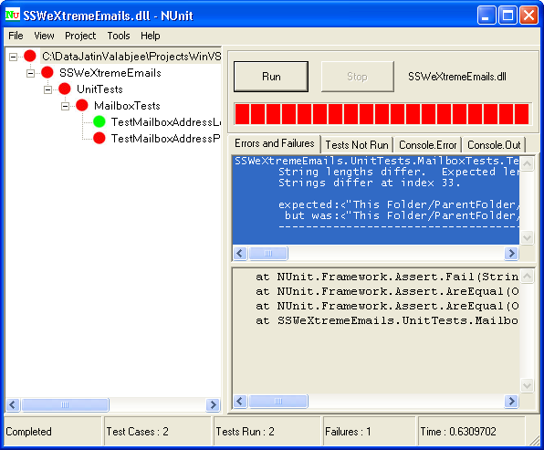
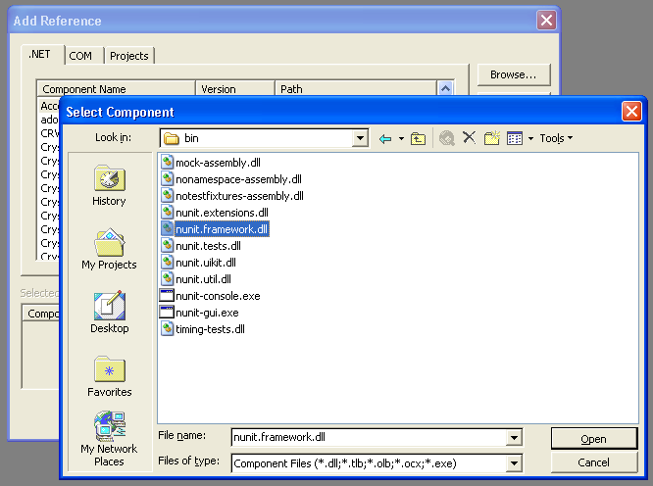
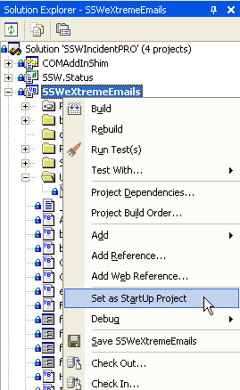
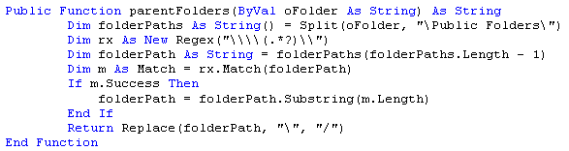
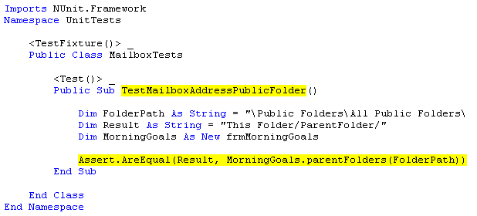
The Coding and Testing Process (Using NUnit)
Write Code
Write Tests
References
Set Start Project
Run

Slide 29
For More Information…
Microsoft Access: Upgrading and Migrating to SQL Server and .NET - Course Resources
www.ssw.com.au/ssw/Events/2004AccessToSQLServerAndNET/Resources.aspx
www.xprogramming.com
www.refactoring.com
“Extreme Programming Explained” by Kent Beck
NUnit www.nunit.org
SSW eXtreme Emails! www.ssw.com.au/extremeemails

Slide 30
Summary
The Basic Problem
The Solution
Implementing XP
  How to make a release plan
  How to capture business rules
  How translate to business tier
  How you make your test case
  How to setup NUnit in .NET
Try it….

Slide 31

2 things
AdamCogan@ssw.com.au

Slide 32

Thank You!

Slide 33


