Slide 1
Session 2
Access to SQL Server 2000
Adam Cogan
Database Architect
ssw.com.au

Slide 2
About Adam
Chief Architect for www.ssw.com.au - experience with:
  internal corporate development and
  generic off-the-shelf databases
  Clients: Enterasys Networks, Cisco, Microsoft…
Run Teams of Developers
President .NET User Group, Sydney
Speaker for Microsoft Roadshows, Dev Conn, VSLive
Microsoft Regional Director, Australia
Email: AdamCogan@ssw.com.au

Slide 3
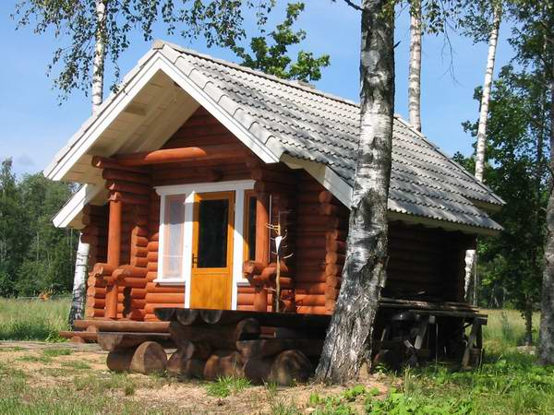
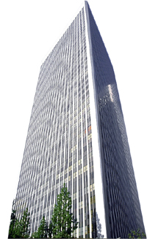
From
To

Slide 4
Overview
1
2
3
4
✓
Access 97
to
Access 2003
Access
to
SQL Server
Access
to
Reporting
Services
Access
to
Windows
Forms .NET

Slide 5
Agenda
Current Problems
What’s New and Different in SQL Server
  Architecture
  Scalability & Performance
  Working with Data
Lab: Migrating from Access to SQL Server

Slide 6
Assumptions
Data is currently in MDB (Access 2000/2002/2003)
SQL Server 2000 installed
Familiar with VBA / DAO
Familiar with Access features
  Indexes
  Relationships
  Referential integrity
  etc.

Slide 7
Session Prerequisites (Current Problems)
“We keep getting corrupt data”
“We need to handle more database users”
“I don’t want the system to go down when we are doing backups”
“Is our database secure? I’m worried people could copy the MDB and take it home”
“The database crashed and we are missing some records”

Slide 8
Enter SQL Server…
Transaction-based (1,5)
Can split database across multiple processors and hard drives (2)
Number of concurrent users limited only by system memory (2)
Live backups (3)
Jobs for automated backups (3)
No file access required to read data (4)

Slide 9

SQL Server Tools
New Tool Set
SQL Server Enterprise Manager
SQL Server Query Analyzer
Visual Studio .NET
Data Transformation Services (DTS)
SQL Server Profiler

Slide 10
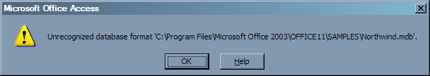
Differences in Architecture
Advantage – Less Chance of Data Corruption
In Access
Database is opened directly
Unexpected system shutdown can corrupt data

Slide 11
Differences in Architecture
Advantage – Less Chance of Data Corruption
SQL Server
Runs as a service
Requests are managed separately
Transactions not processed in case of system failure
Integrity is maintained

Slide 12
Differences in Architecture
Advantage – Database Log Files Enable Data Recovery
In Access
No logging of transactions
SQL Server
All database transactions can be logged
Can be used to recover data in case of system failure

Slide 13
Differences in Architecture
Difference – Higher Minimum System Requirements
In Access
Pentium 75 MHz
128MB
30 MB space
Windows 98

Slide 14
Differences in Architecture
Difference – Higher Minimum System Requirements
In SQL Server
Pentium 166MHz
128MB RAM
270 MB space
Windows 9x

Slide 15
Differences in Architecture
Difference – Higher System Requirements
In SQL Server – Realistically you need
Pentium III 650MHz
512MB RAM
2 GB space
Windows 2003

Slide 16
Differences in Architecture
Difference – Data Types
All Access data types are handled but converted to equivalent SQL Server types
Access (Jet) | SQL Server
Text | nvarchar
Memo | text
Number | int
Date/Time | datetime
Currency | Money
AutoNumber | int (with identity)
Yes/No | bit
OLE Object | image
Hyperlink | text

Slide 17
Differences in Architecture
New User-Defined Data Types (UDDTs)
In Access
No way to ensure consistency in field lengths
No way to quickly change data types or field lengths for multiple fields

Slide 18
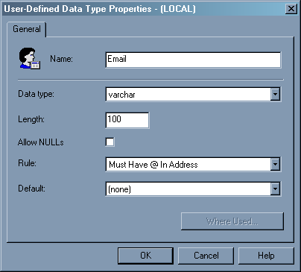
Differences in Architecture
New User-Defined Data Types (UDDTs)
In SQL Server
Specify a custom data type (e.g. Email)
Use in place of varchar(15) etc.
Ensures field data type consistency

Slide 19
Differences in Architecture
Difference – Identity Values Are Generated After an Insert
In Access
AutoNumber generated as you start editing a record
In SQL Server
Identity (AutoNumber) is only generated when record is saved
Can affect functions which examine this value

Slide 20
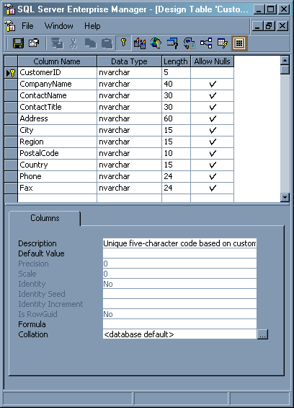
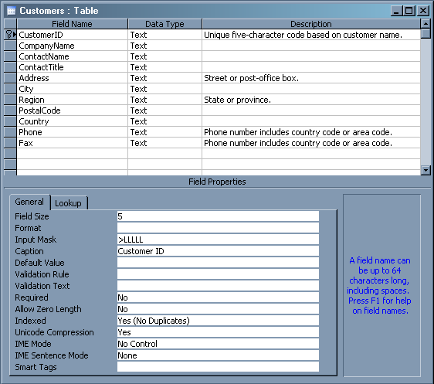


Differences in Architecture
Similarity – Table Design

Slide 21
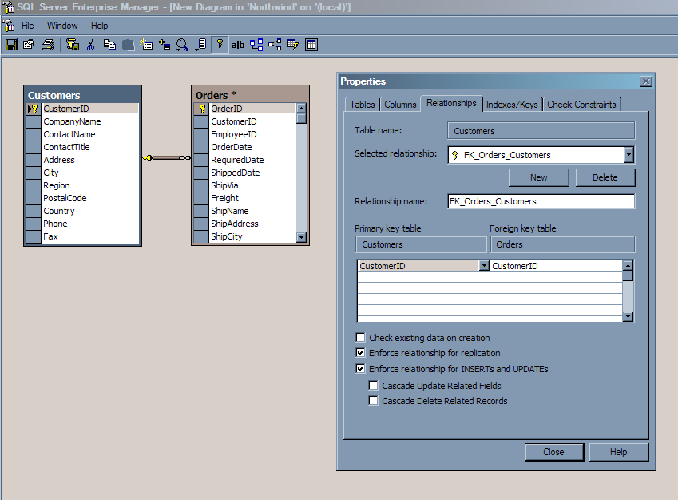
Differences in Architecture
Similarity – Relationships
Created via Enterprise Manager
Notes:
In Access
1. You can cascade update and/or delete update from a table to itself
2. You can cascade update and/or delete update foreign keys in a table where the Required property is set to Yes
3. You can have a relationship between fields that have different field lengths, for example a CustomerID primary key of length 10 linked to a CustomerID foreign key in another table of length 15. This should not be permitted as problems may arise when attempting to enforce referential integrity.

Slide 22
Differences in Architecture
Difference – Data Validation
In Access
Input Mask
Validation Rule
Validation Text
Indexed
Notes:
In Access
1. You can cascade update and/or delete update from a table to itself
2. You can cascade update and/or delete update foreign keys in a table where the Required property is set to Yes
3. You can have a relationship between fields that have different field lengths, for example a CustomerID primary key of length 10 linked to a CustomerID foreign key in another table of length 15. This should not be permitted as problems may arise when attempting to enforce referential integrity.

Slide 23
Differences in Architecture
Difference – Data Validation
In SQL Server
NOT NULL – column cannot contain nulls
CHECK – restrict range of values in column
UNIQUE – ensures unique values (such as ID columns)
PRIMARY KEY
FOREIGN KEY
Notes:
In Access
1. You can cascade update and/or delete update from a table to itself
2. You can cascade update and/or delete update foreign keys in a table where the Required property is set to Yes
3. You can have a relationship between fields that have different field lengths, for example a CustomerID primary key of length 10 linked to a CustomerID foreign key in another table of length 15. This should not be permitted as problems may arise when attempting to enforce referential integrity.

Slide 24
Differences in Architecture
Difference – Data Validation
In SQL Server
Can specify CASCADE for a delete or update operation
Cannot cascade update/delete from a table to itself
Cannot relate fields with different lengths
Notes:
In Access
1. You can cascade update and/or delete update from a table to itself
2. You can cascade update and/or delete update foreign keys in a table where the Required property is set to Yes
3. You can have a relationship between fields that have different field lengths, for example a CustomerID primary key of length 10 linked to a CustomerID foreign key in another table of length 15. This should not be permitted as problems may arise when attempting to enforce referential integrity.

Slide 25
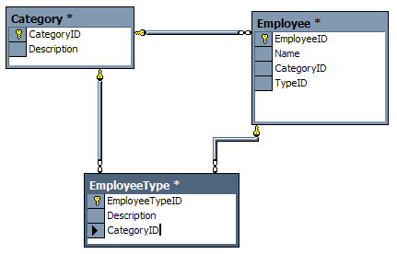
Differences in Architecture
Disadvantage – Cascading Update Circular References are Not Supported
Notes:
In Access
1. You can cascade update and/or delete update from a table to itself
2. You can cascade update and/or delete update foreign keys in a table where the Required property is set to Yes
3. You can have a relationship between fields that have different field lengths, for example a CustomerID primary key of length 10 linked to a CustomerID foreign key in another table of length 15. This should not be permitted as problems may arise when attempting to enforce referential integrity.

Slide 26
Differences in Architecture
Disadvantage – Cascading Update Circular References are Not Supported
Unable to create relationship 'FK_EmployeeType_Employee'.
ODBC error: [Microsoft][ODBC SQL Server Driver][SQL Server]Introducing FOREIGN KEY constraint 'FK_EmployeeType_Employee' on table 'EmployeeType' may cause cycles or multiple cascade paths. Specify ON DELETE NO ACTION or ON UPDATE NO ACTION, or modify other FOREIGN KEY constraints.
[Microsoft][ODBC SQL Server Driver][SQL Server]Could not create constraint. See previous errors.
Notes:
In Access
1. You can cascade update and/or delete update from a table to itself
2. You can cascade update and/or delete update foreign keys in a table where the Required property is set to Yes
3. You can have a relationship between fields that have different field lengths, for example a CustomerID primary key of length 10 linked to a CustomerID foreign key in another table of length 15. This should not be permitted as problems may arise when attempting to enforce referential integrity.

Slide 27
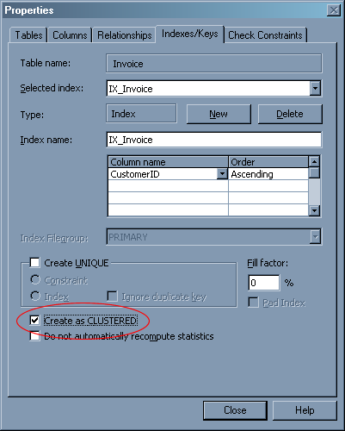
Differences in Architecture
Improvements to Indexing (1 of 2)
Clustered Indexes for fast searches

Slide 28
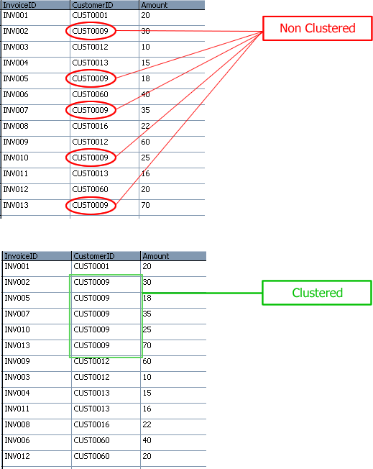
Differences in Architecture
Improvements to Indexing (2 of 2)
Clustered Indexes for fast searches

Slide 29
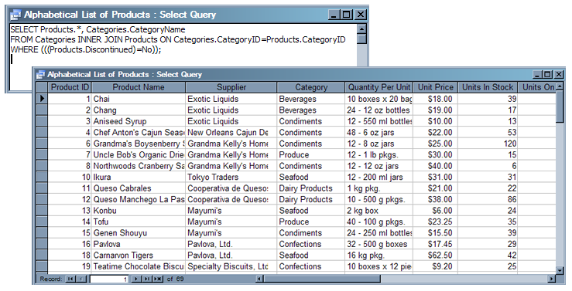
Differences in Architecture
Similarity – Access Queries / SQL Views (1 of 2)
Access Queries

Slide 30
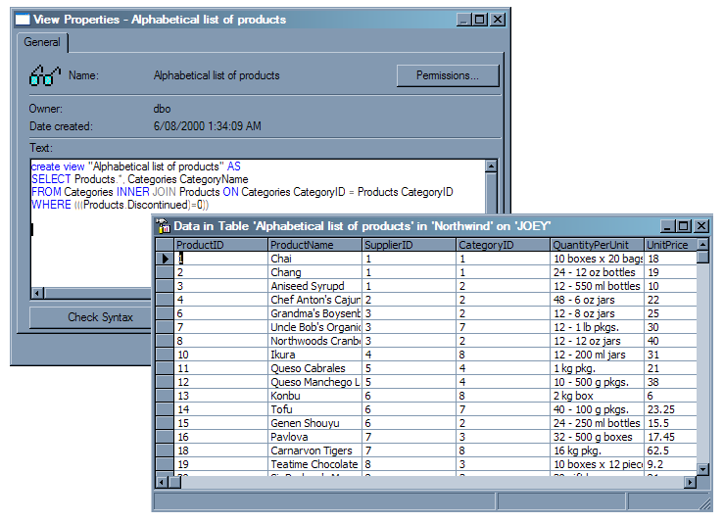
Differences in Architecture
Similarity – Access Queries / SQL Views (2 of 2)
SQL Server Views

Slide 31
Differences in Architecture
Similarity – Access Queries / SQL Stored Procedures (1 of 3)
Access queries
  Accept parameters
  Sorted (ORDER BY)
  Nesting
  Updateability
Notes:
Example here?

Slide 32
Differences in Architecture
Similarity – Access Queries / SQL Stored Procedures (2 of 3)
Extensions to SQL-92
  Conditional logic (if…then…else)
  More flexible sub-queries
  Stored procedures

Slide 33
Differences in Architecture
Similarity – Access Queries / SQL Stored Procedures (3 of 3)
SQL Server stored procedures
  Run in a compiled state
  Execution plan
  Perform conditional logic and return values
CREATE PROCEDURE procCustomersLocal_Select
@IsLocal bit
AS
IF (@IsLocal = 1) --True - only US customers
SELECT * FROM Customers WHERE Country = 'USA'
ELSE
SELECT * FROM Customers WHERE Country <> 'USA'
GO

Slide 34
Differences In Working With Data
New – Temporary Tables
Destroyed at end of current session
Usage is same as tables
Two types
  Local – visible in current session
    Prefix with hash: #WestCoastCustomers
  Global – visible to all sessions
    Prefix with double hash: ##WestCoastCustomers

Slide 35
Differences In Working With Data
New – Table Variables
Query a temporary set of joined data
Stored in memory like other variables
Very fast
Use instead of local temp tables – faster

Slide 36
Differences in Architecture
New Feature – Access Queries / SQL User-Defined Functions
Replaces VBA Functions
3 Types of UDFs
Scalar UDFs
Inline UDFs
Multistatement UDFs

Slide 37
Differences in Architecture
New Feature – Access Queries / SQL User-Defined Functions
Scalar UDFs return a single value
CREATE FUNCTION [dbo].[CalculateTax]
(@Value money, -- The value to have tax added
@Country varchar(255)) -- The current country
RETURNS money -- The tax-inclusive price will be returned
AS
BEGIN
DECLARE @TaxIncPrice money
IF @Country = 'Australia' -- If the country is Australia, add GST
SET @TaxIncPrice = @Value * 1.1
ELSE BEGIN -- Otherwise just return the original value
SET @TaxIncPrice = @Value
END
RETURN @TaxIncPrice
END

Slide 38
Differences in Architecture
New Feature – Access Queries / SQL User-Defined Functions
Inline UDFs return a table from a SELECT statement
Use in place of views when you need parameters (can’t update)
CREATE FUNCTION CustomerNamesInRegion
(@RegionParameter nvarchar(30))
RETURNS table -- This function returns a table
AS
RETURN
(SELECT CustomerID, CompanyName
FROM Customers
WHERE Region = @RegionParameter)
GO

Slide 39
Differences in Architecture
New Feature – Access Queries / SQL User-Defined Functions
Multistatement UDFs also return a table
Can also return a filtered or joined set of data
Much faster than temporary tables – stored in memory
CREATE FUNCTION LargeOrderShippers ( @FreightParm money )
RETURNS @OrderShipperTab TABLE
(
ShipperID int,
ShipperName nvarchar(80),
OrderID int,
ShippedDate datetime,
Freight money
)
AS
BEGIN
INSERT @OrderShipperTab
SELECT S.ShipperID, S.CompanyName,
O.OrderID, O.ShippedDate, O.Freight
FROM Shippers AS S INNER JOIN Orders AS O
ON S.ShipperID = O.ShipVia
WHERE O.Freight > @FreightParm
RETURN
END

Slide 40
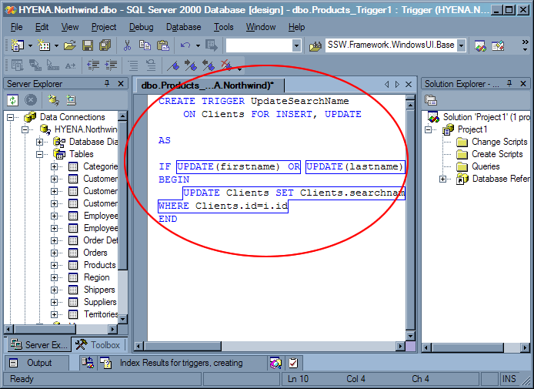
Differences in Architecture
New – Triggers on Tables and Views
Fire when a change is made to data

Slide 41
Differences in Scalability & Performance
More Users, Larger Database
In Access
Limited to ~20 concurrent users
2GB plus linked tables – can slow performance
In SQL Server
Users limited only by available memory
Over 1 Million TB of storage
Self-repairing and self-compacting

Slide 42
Differences in Scalability & Performance
Differences in Querying Data (inc T-SQL)
Change RecordSource:
SELECT * FROM Customers
To:
SELECT * FROM Customers WHERE CustomerID = ‘BOLID’

Slide 43
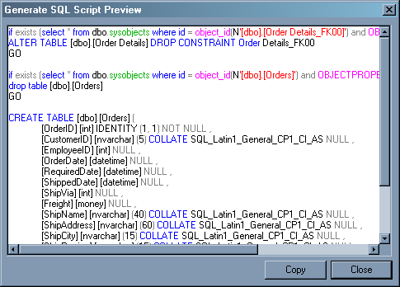
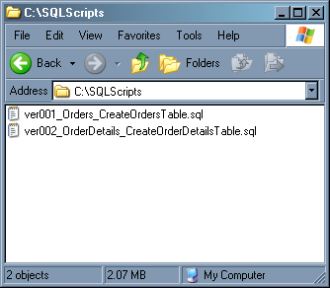

Differences In Working With Data
Advantage – Ability to Script Objects
Automatically generate scripts
Recreate your database anywhere
Generate in order of dependency

Slide 44
Differences In Working With Data
Advantage – Recovering from System Failure
In Access
Attempt to recover data using compact & repair then re-import
Restore from recent backup (lost records)
Run Jet Compact utility (JETCOMP.EXE)
Send database to data recovery consultants
All these ways are costly and risky…

Slide 45
Differences In Working With Data
Advantage – Recovering from System Failure
In SQL Server
3 recovery models
  Simple
  Full
  Bulk-logged
Complete control over transaction logging

Slide 46
Differences In Working With Data
Advantage – Backups Can Be Done While the Database is Running
In Access you have to log off all users first
SQL Server allows live and automated backups using schedules
Notes:
Go to demo and lab now

Slide 47
Other Issues
Windows XP Service Pack 2
  Remote TCP Connections – Add to Trusted Zone
  Only an issue with incoming connections, not outgoing

Slide 48
Summary
Current Problems
  Too Many Database Users
  Corruption
  Security
  Backup and Recovery
What’s New in SQL Server
Other Issues
Lab: Migrating from Access to SQL Server
Notes:
SQL Auditor Demo

Slide 49
For More Information…
www.ssw.com.au/ssw/Events/2004AccessToSQLServerAndNET/Resources.aspx
Lumigent LogExplorer
www.lumigent.com
Notes:
Do the migration demo now. The next slides are for directly after

Slide 50

2 things
AdamCogan@ssw.com.au

Slide 51
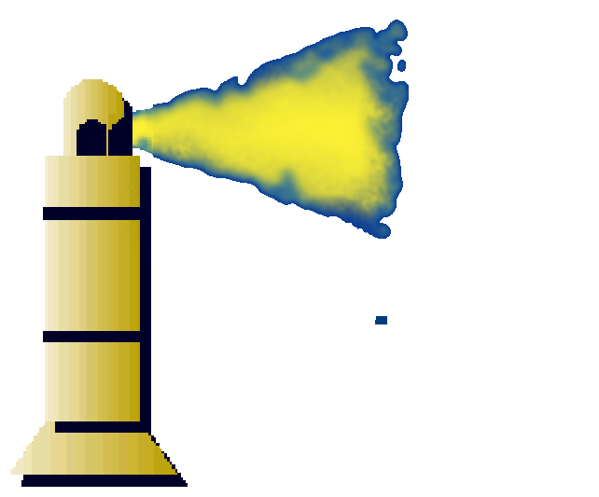
Thank You!

Slide 52


