Slide 1
Microsoft SQL Reporting Services
Adam Cogan
Microsoft Regional Director
SSW Chief Architect

Slide 2
About Adam
Chief Architect for www.ssw.com.au - experience with:
  internal corporate development and
  generic off-the-shelf databases
  Clients: Integral Energy, Microsoft, Cisco, Media Monitors
President .NET User Group, Sydney
Speaker for Microsoft Roadshows, DevCon, VSLive, ODDC
Microsoft Regional Director, Australia …

Slide 3


Slide 4
Introduction
Part of SQL 2000

Slide 5

Angelo Voulgaris
The first person to pay me to write reports…

Slide 6
History
1991-3 – .XLS and .DOC
1992 - Access 1.0
1994 – VB 3 with Crystal Built-In
1995-99
  VB 4, 5, 6 (VB Report Designer)
  A lot continuing with Crystal
1998 – Web
  .ASP
  .DOC, .XLS, .PDF
2001 – Visual Studio .NET with Crystal

Slide 7
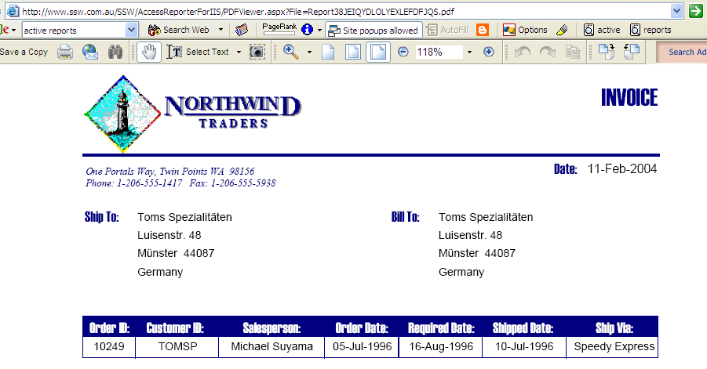
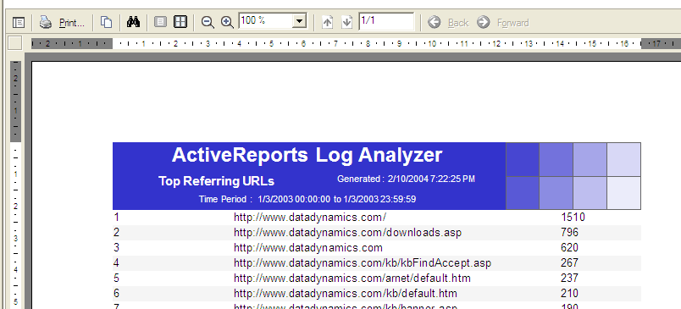
2002+
Crystal
  5 Concurrent Users
3rd Parties
  2001 – SSW Access Reporter
  2002 – Active Reports
  The problem

Slide 8
2004 – SQL Reporting Services
Samples
  Open .SLN
  View AdventureWorks2000
  View http://localhost/Reports
No more Banded Reports
Toolbox
.RDL
  Data, Layout, Preview
SQL Database ‘ReportServer’

Slide 9
Report Lifecycle
Authoring
  .RDL (auto-generated by interface in VS.NET)
  XML
Deployment
  Calls web service on the report server
  Stores .RDL data in database “ReportServer”
  It is then a publicly available “Managed Report” awaiting further security and perhaps scheduling
Delivery
  Access via URL’s
  Numerous rendering formats (MHTML, PDF, Excel, etc.)
  Either push or pull

Slide 10
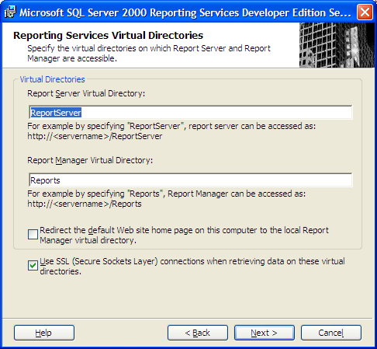
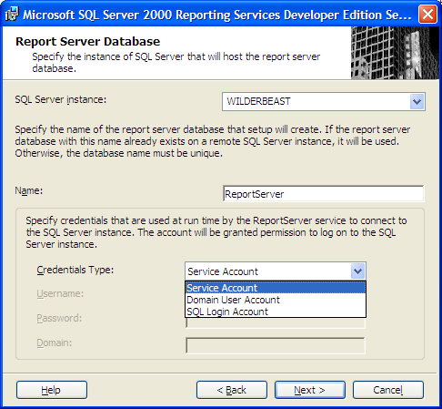
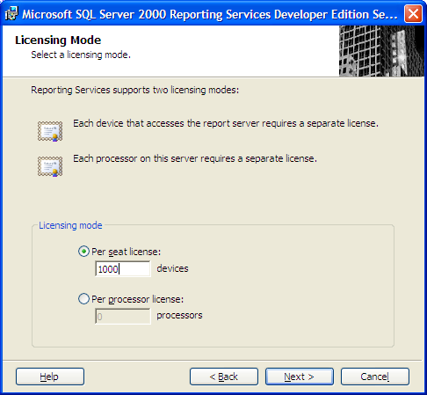

Installing Reporting Services
IIS
(Must have ‘Default Web Site’)
Database
(Must be ‘SQL Server 2000’)
Why do we
need a
database?

Slide 11
#1 Building a report
Building Report ‘Sales’

Slide 12
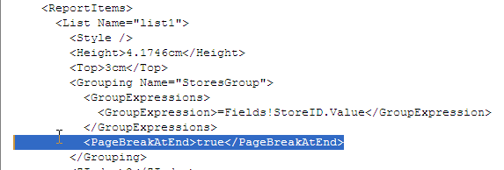
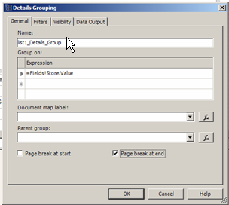

Pagination within a list control
The Beta

Slide 13
What did we see?
You saw
  Table Control
  Matrix Control
  Chart Control
You didn’t see
  Subreports
  Code
Example
  SmartSalary.com.au

Slide 14
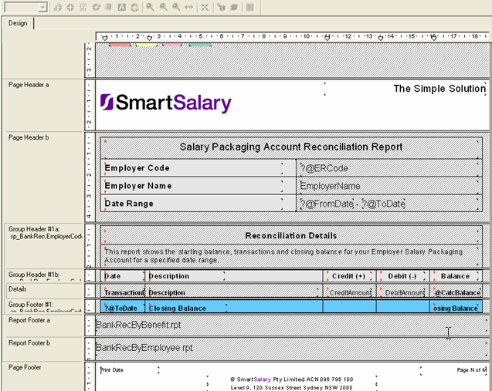
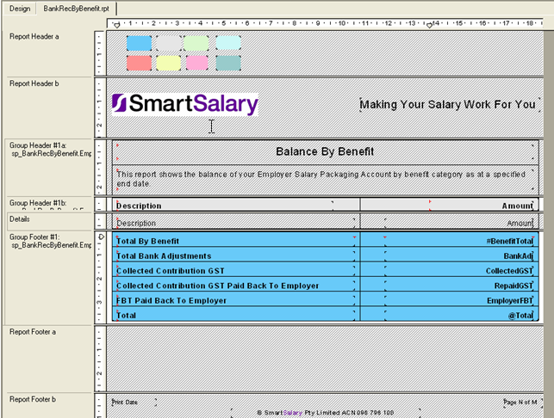
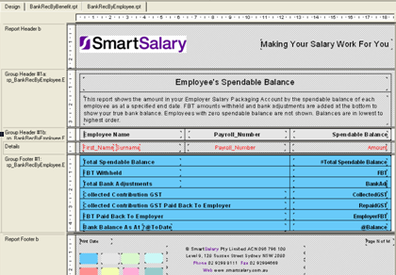
SmartSalary.com.au
– from .rpt files

Slide 15
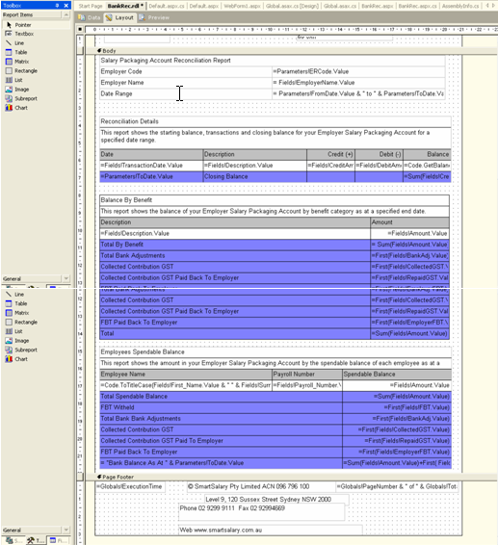
SmartSalary – to an .rdl file
3 datasets – from 3 stored procs
3 table controls
Heaps of Conditional formatting
  Tables (certain category made invisible)
  Controls (red for -) **
2 custom calculation fields
Pagination (each table on new page)
Header and Footer
Added a link in the Windows form
4 hours

Slide 16
And there is more?
Draw data from anything
  .NET managed data provider, OLE DB provider, or ODBC data source
  MSSQL 7.0+, Oracle, Access
  OLAP, Active Directory
Integrated security
Server based reports – a single repository of reports and single management point

Slide 17
Extensibility
You can use <Expressions…> everywhere
  Use custom code and .dll’s to add additional control functionality (useful when the DBA doesn’t like you)
Custom controls – but the output will need to conform to the RDL XML schema
Additional rendering components (.SNP)
Additional Data processing extensions (pass .XML)
Additional delivery methods (SMS)

Slide 18
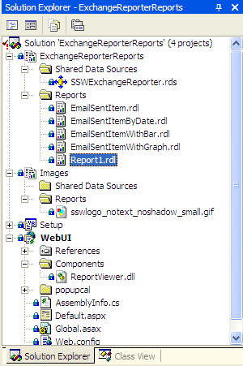
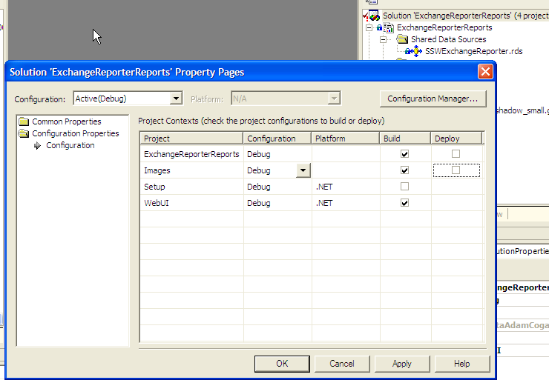
yyTip: Don’t go bonkers
Deploying is the slowest part

Slide 19
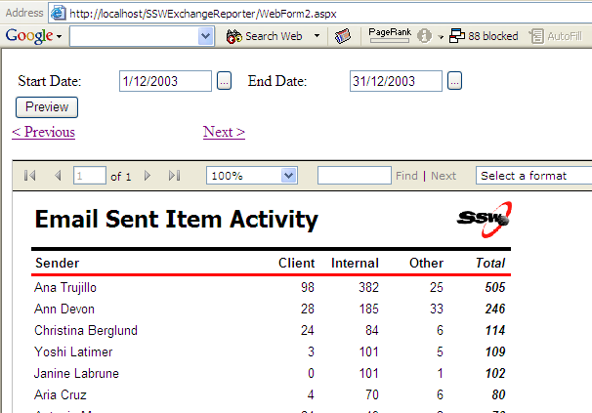
yy#2 Improving Parameters,
Branding, QueryStrings
New web form
Add ReportViewer.dll**
Add ctlReport**
Add the Date Controls (copy)
Add Code
  Page_Load, lnkPrevious, lnkNext
  Submit**
Add Javascript reference in HTML

Slide 20
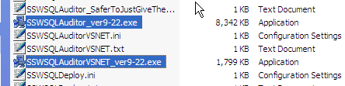
Rich Clients
Crystal (SSW SQL Auditor)
XML / XSL (SSW Code Auditor)
Reporting Services (SSW Exchange Reporter) – Different Deployment Approach

Slide 21
Angelo
Access 1.0
Access 2.0
Access 2000 ADP with MSDE
.NET Windows Forms
  Sales by Category Subreport.rdl
  Note: Can Grow
Deployment

Slide 22
Summary
Strengths
Viewing, Interactivity, Emailing
Multiple Data sources for a single report
Web management and access – globally accessible within the corporation
Niggling Injuries
Parser for the <Expressions…>
Printing – can’t dynamically set ‘Margins’, ‘PageSize’
No control over parameters other than defaults
  No calendar for Date controls
QueryStrings
  http://wilderbeast/Reportserver?%2fSampleReports%2fSales+Order+Detail&rs:Command=Render&SalesOrderNumber=SO8437
Charting – need to be able to resize elements within the chart eg. chart or legend (more like Excel)

Slide 23
Collateral
Reporting Services
  SQL Server
  IIS
  Visual Studio 2003
  15 year old
Wastage
  http://www.microsoft.com/sql/reporting/howtobuy/retailfulfillment.asp $5.00 US
  OR
  www.microsoft.com/australia/sql Free

Slide 24

Resources
MSDN – Download
Whitepaper
  www.ssw.com.au/ssw/standards/DeveloperSQLReportingServices
Book
  www.mannpublishing.com/
  The Rational Guide To:
  SQL Server Reporting Services
  by Anthony Mann
.Net User Groups
  Monthly Meetings
  www.ssw.com.au/NetUG

Slide 25

2 things….
AdamCogan@ssw.com.au
Feedback….

Slide 26

Thank You!

