Slide 1
Session 3
Access to Reporting Services
Adam Cogan
Database Architect
ssw.com.au

Slide 2
About Adam
Chief Architect for www.ssw.com.au - experience with:
  internal corporate development and
  generic off-the-shelf databases
  Clients: Enterasys Networks, Cisco, Microsoft…
Run Teams of Developers
President .NET User Group, Sydney
Speaker for Microsoft Roadshows, Dev Conn, VSLive
Microsoft Regional Director, Australia
Email: AdamCogan@ssw.com.au

Slide 3


From
To

Slide 4
Overview
1
2
3
4
✓
✓
Access 97
to
Access 2003
Access
to
SQL Server
Access
to
Reporting
Services
Access
to
Windows
Forms .NET

Slide 5
Agenda
Current Problems
What’s New in Reporting Services
Lab: Migrating from Access to Reporting Services

Slide 6
Assumptions
Reports in Access
Access 2003
Reporting Services installed
Visual Studio .NET 2003

Slide 7
Session Prerequisites (Current Problems)
“We need our reports to be available on our web site”
“We need easy deployment of new reports”
“I want our sales team to receive monthly status reports via email”
“I want more flexibility in our report designs”

Slide 8
Enter Reporting Services…
Reports are Web-based (1,2)
Non-banded Reports – Flexible Design (4)
Subscriptions to Reports (3)

Slide 9
What’s New and Different in
Reporting Services?
Getting Access reports on the web
There is a solution
Uses the Export formats of an Access report
  e.g. SSW Access Reporter
Online Demo:
www.ssw.com.au/SSW/AccessReporterForIIS/AccessReporterDemo.aspx
What is the problem? …

Slide 10

What’s New and Different in
Reporting Services?
Advantage – Your Reports Anywhere, Anytime
No need for any client software (Snapshot Viewer, Office)
Web-based
Server-driven

Slide 11
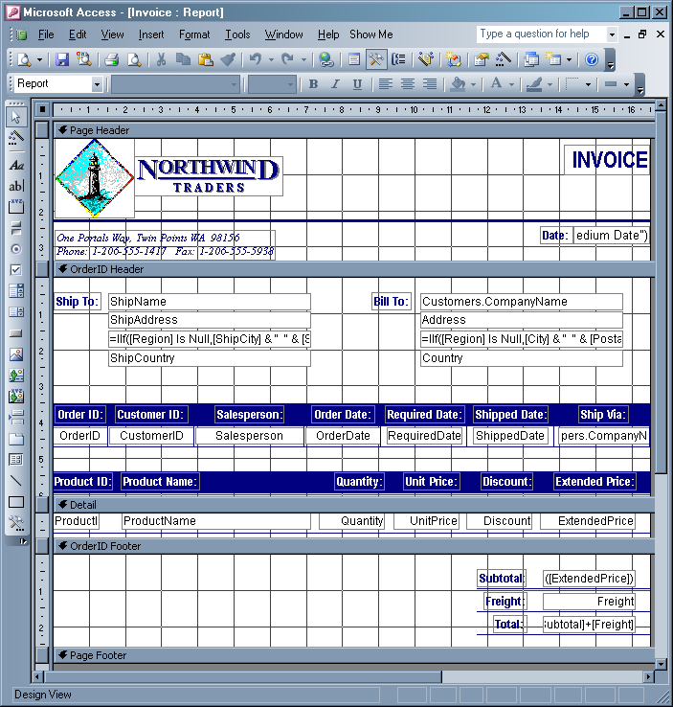

What’s New and Different in
Reporting Services?
Advantage – A Shallow Learning Curve for Access Developers (1 of 2)

Slide 12
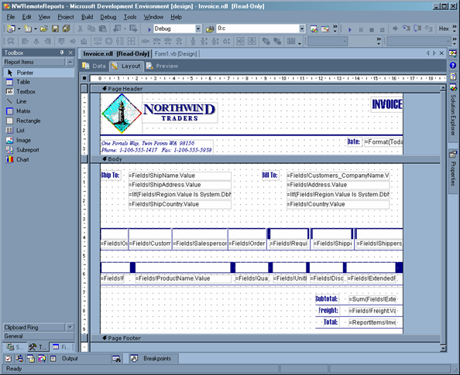

What’s New and Different in
Reporting Services?
Advantage – A Shallow Learning Curve for Access Developers (2 of 2)

Slide 13
What’s New and Different in
Reporting Services?
Advantage – Export Reports to More Formats
In Access
• Microsoft Word (.DOC)
• Microsoft Excel (.XLS)
• Access Snapshot (.SNP)
In Reporting Services
• CSV
• TIFF (Image)
• Acrobat (PDF)
• Web archive
• HTML with Office Web Components
• Excel
• XML file with Report Data

Slide 14
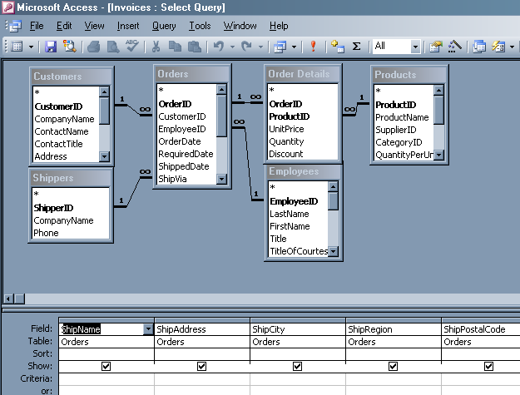
What’s New and Different in
Reporting Services?
Similarity – Designing and Specifying Data for Reports (1 of 2)

Slide 15
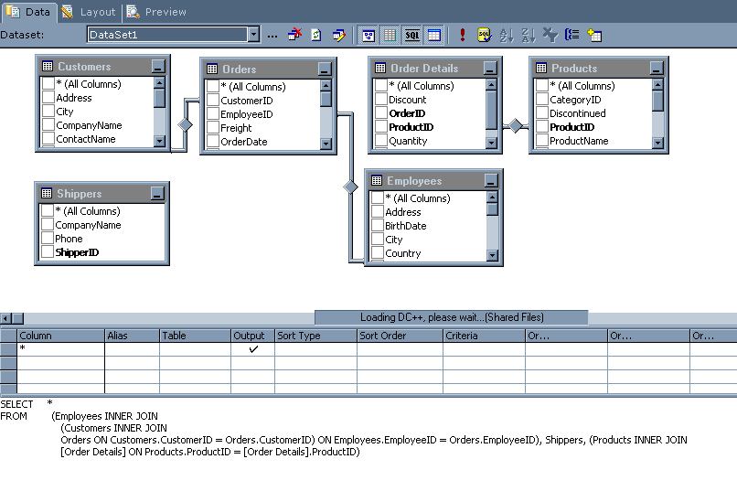
What’s New and Different in
Reporting Services?
Similarity – Designing and Specifying Data for Reports (2 of 2)

Slide 16
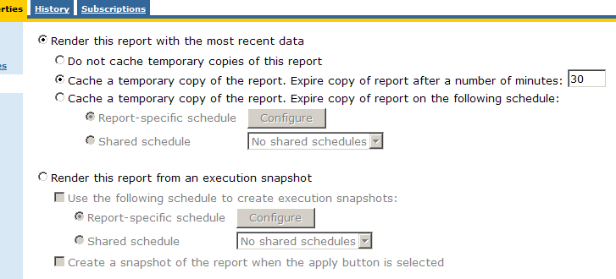
What’s New and Different in
Reporting Services?
Advantage – Scalability
Cached Reports

Slide 17
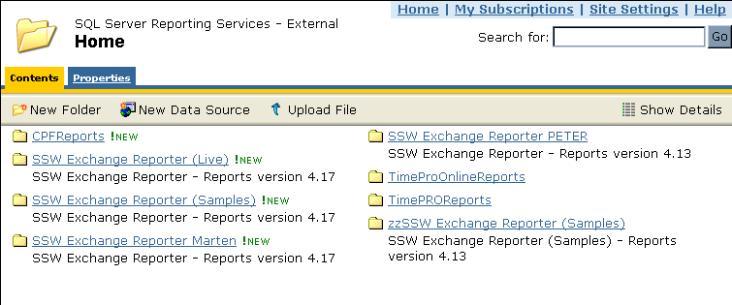
What’s New and Different in
Reporting Services?
Advantage – Consolidate and Control Your Reporting Investment
Deployment of Reports To Clients No Longer Required
Manage Reports from a Central Interface

Slide 18
What’s New and Different in
Reporting Services?
Advantage – Integrates with .NET
In Access
Had to use type libraries and marshalling to call .NET assemblies
In .NET
Use expressions in report to call assemblies
  e.g. performing live currency conversion on report figures
Deploy .NET assemblies by copying them with the reports
No downtime to upgrade assembly versions

Slide 19
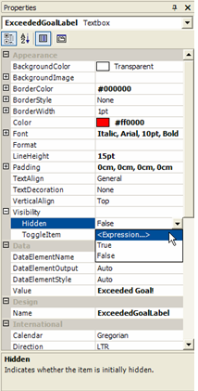
What’s New and Different in
Reporting Services?
Difference – Expressions Are Used Instead of Access Code-behind
Expressions replace VBA
Available for most properties on controls
Note: Any business logic should be in middle tier

Slide 20
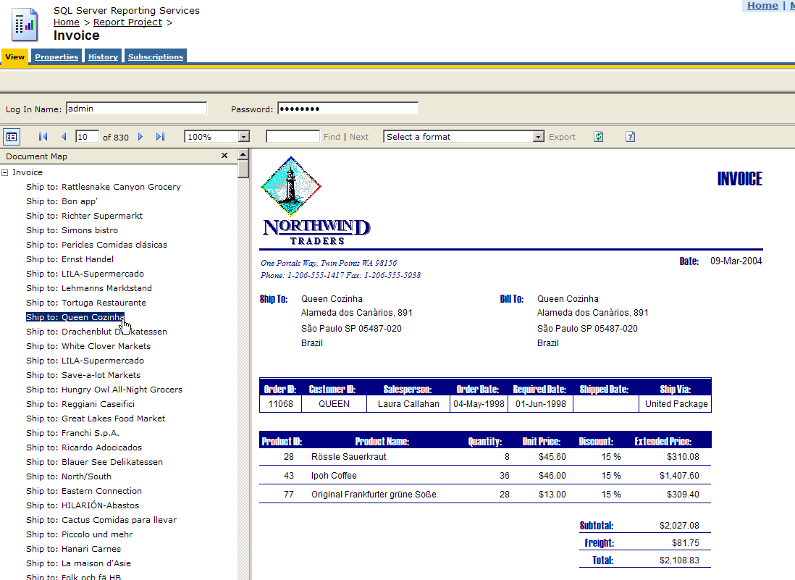
What’s New and Different in
Reporting Services?
Advantage – Report Interactivity (1 of 3)
Automatically generated document maps

Slide 21
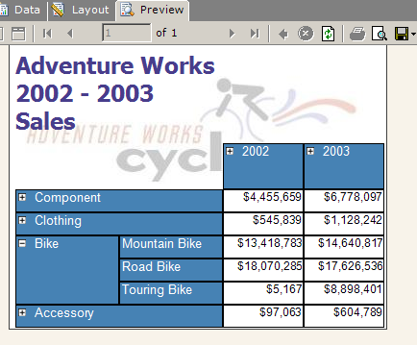
What’s New and Different in
Reporting Services?
Advantage – Report Interactivity (2 of 3)
Drill-down to sub-data

Slide 22
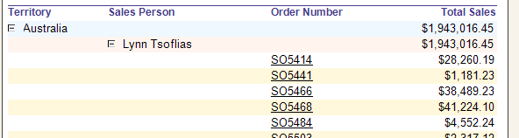
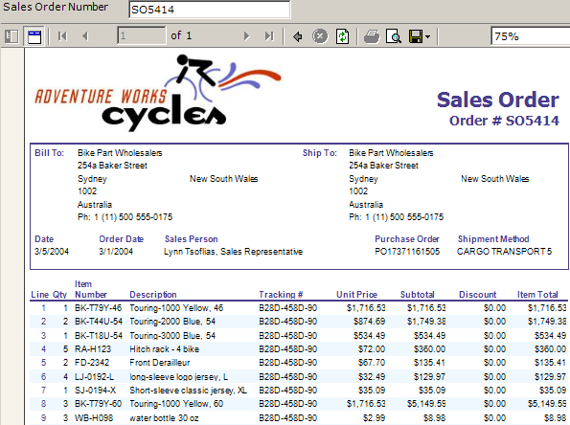
What’s New and Different in
Reporting Services?
Advantage – Report Interactivity (3 of 3)
Drill-through to other reports

Slide 23
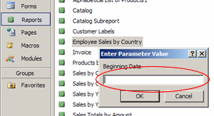
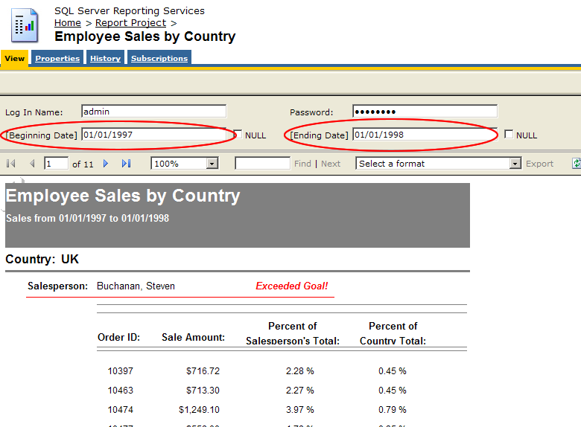
What’s New and Different in
Reporting Services?
Similarity – Parameters

Slide 24
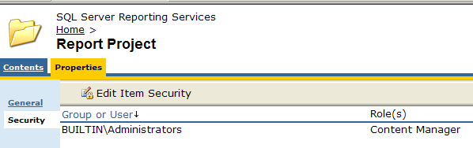
What’s New and Different in
Reporting Services?
Advantage – Integrated Security
No need to setup separate users and groups
Integrates with Active Directory
Role-based

Slide 25
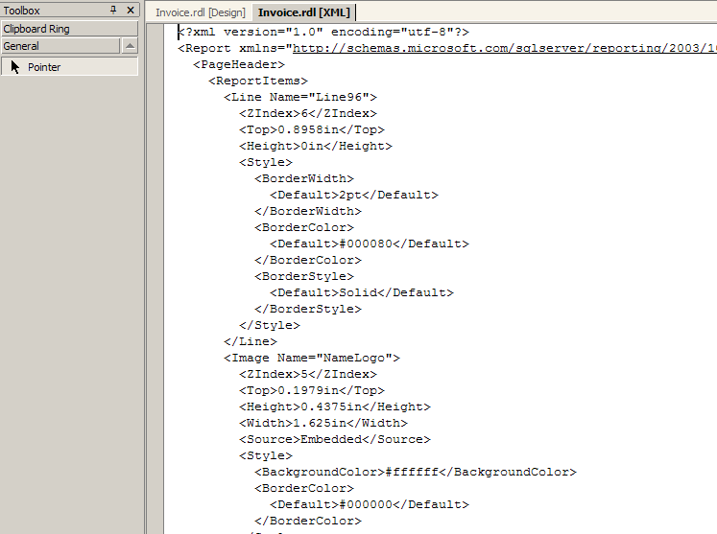
What’s New and Different in
Reporting Services?
Advantage – Extensible Open Architecture
Reports stored as XML – less chance of corruption

Slide 26
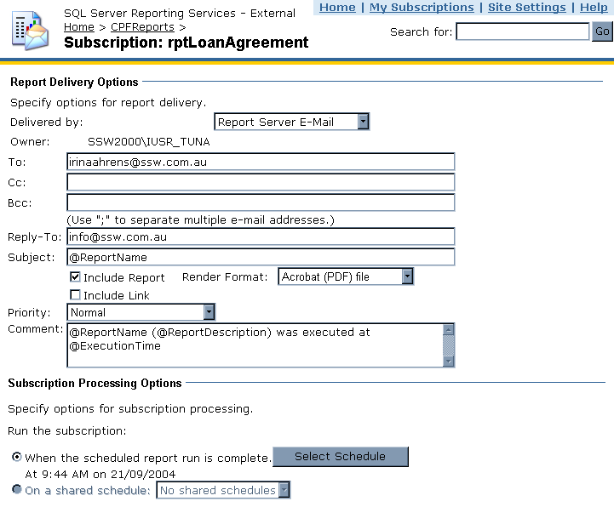
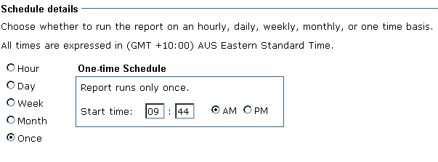
What’s New and Different in
Reporting Services?
Advantage – Scheduling of Reports

Slide 27
What’s New and Different in
Reporting Services?
Advantage – Multiple Data Sources in a Single Report (1 of 2)
In Access
Can only specify one record source for a report
Use subreports for multiple record sources – very inefficient
In Reporting Services
Define a data source for each control (table, matrix, list etc.)
Unlimited number of data sources on a single report
Subreports are supported

Slide 28
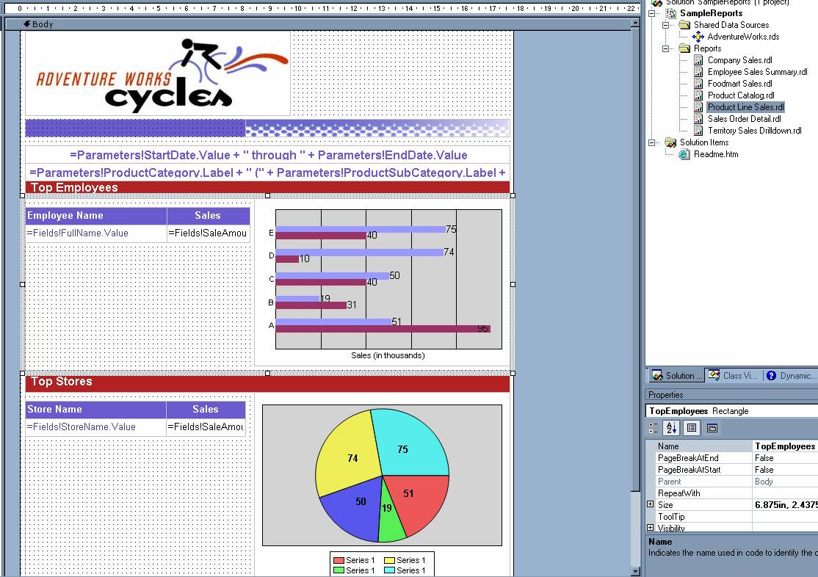
What’s New and Different in
Reporting Services?
Advantage – Multiple Data Sources in a Single Report (2 of 2)

Slide 29
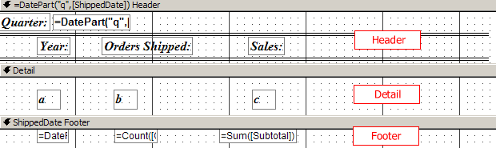
What’s New and Different in
Reporting Services?
Advantage – Design Flexibility: No More Banded Reports (1 of 2)

Slide 30
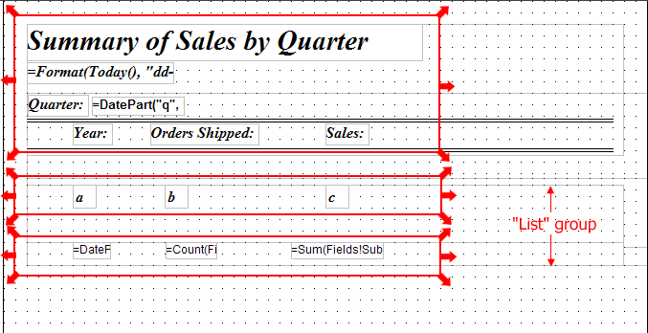
What’s New and Different in
Reporting Services?
Advantage – Design Flexibility: No More Banded Reports (2 of 2)
Group headers, detail and footers can be placed anywhere

Slide 31
What’s New and Different in
Reporting Services?
Advantage – Extensible to Other Devices
In Access you need the Snapshot Viewer or Office
Reporting Services reports are web based
Can view on any device
  Pocket PC
  Smartphone
  Windows Forms
  ASP .NET Pages
  Legacy Devices

Slide 32
What’s New and Different in
Reporting Services?
Similarity – Control Toolbox
Most controls are supported
  Textbox
  Label
  Image
  Chart
Some interactive controls not supported
  Checkbox
  Listbox
  Option button
  Toggle button
  Tab control

Slide 33
What’s New and Different in
Reporting Services?
Difference – Deploying Reports
In Access you copy the MDB containing the reports
In Reporting Services you deploy the project and resources to a target web server
  Any .NET assemblies must be manually copied across

Slide 34
What’s New and Different in
Reporting Services?
Conversion
Use the Access to Reporting Services conversion wizard (included with Reporting Services)
But you will have issues
  Will go through these in the lab

Slide 35
Summary
Current Problems
  Reports are limited to access clients
  Limitations in report design
  New reports require re-deployment to all users
  Can't email reports
  Can’t schedule reports
What’s New in Reporting Services
Lab: Migrating to Reporting Services

Slide 36
For More Information…
www.ssw.com.au/ssw/Events/2004AccessToSQLServerAndNET/Resources.aspx
www.microsoft.com/sql/reporting

Slide 37

2 things
AdamCogan@ssw.com.au

Slide 38

Thank You!

Slide 39


