Slide 1

Enterprise Software Development

Slide 2
SSW Template
Version 3.8 Release

Slide 3
Icon Library
These icons are pulled from Font Awesome - http://fontawesome.io - Feel free to use your own.

Slide 4




Other Icons
Here are some little red people and other items

Slide 5

Adding logo watermark
If you want the logo overlap as shown in the template, you’ll need the logo in the bottom right of this slide. Just copy paste it onto relevant slides.

Slide 6
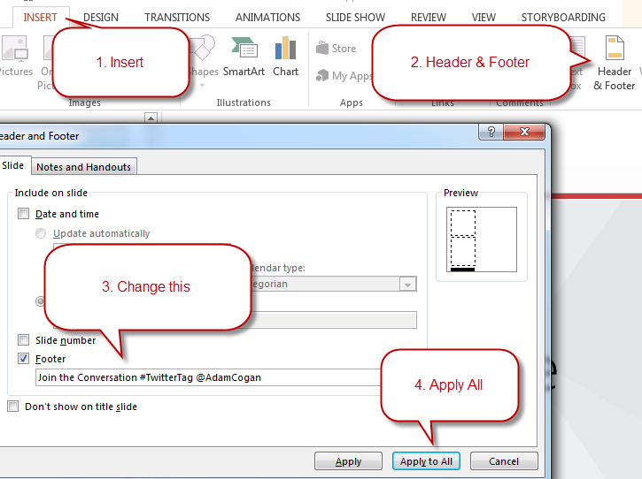
Change the Footer
This layout is made for a screenshot with some descriptive text

Slide 7
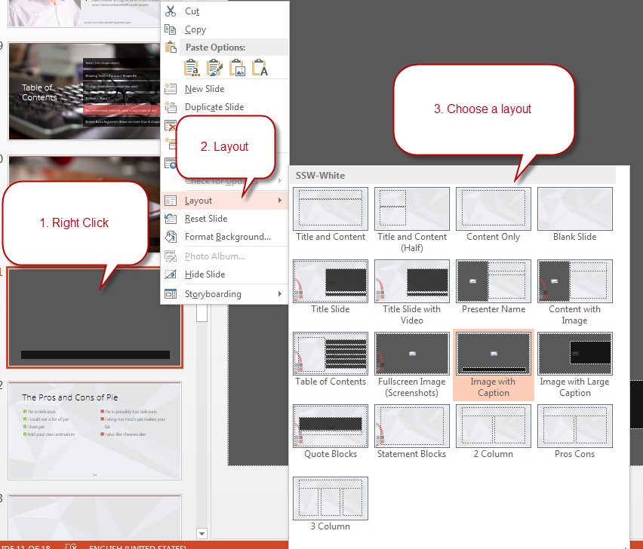
Slide Layouts
Tired of ugly powerpoints? Are you using the template correctly? Do you know you can change the layout of your slides?

Slide 8
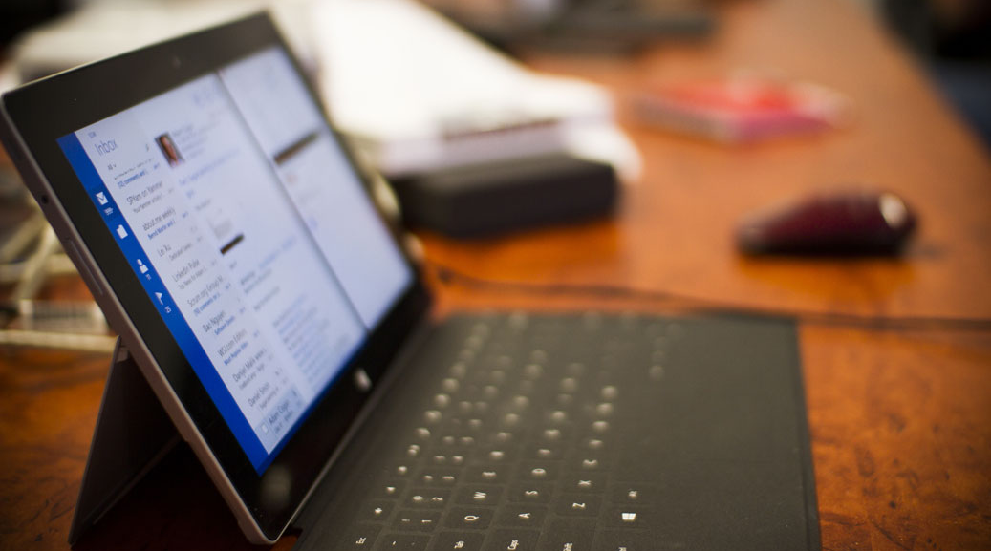
How to use this powerpoint
.NET User Group October 2014

Slide 9

Adam Cogan
The Coganator
#AdamCogan (you can add Facebook etc.)
Crushed a can with his bare fist once
Every year jumps in a pool of ice water because he CAN
Stole a pregnant lady’s chocolate
Look in fileserver for a high res version of your employee photo. \\fileserver\DataSSW\Photos\Employees

Slide 10

Table of Contents
Select this shape object
Drawing Tools > Format > Shape Fill
Change to whatever colour you want
Default is Black
Recommended selected color is any shade of red
Delete Extra Segments (Have no more than 6 chapters)

Slide 11

SSW Stock Photos – \\fileserver\DataSSW\Photos\Powerpoint-StockImages

Slide 12
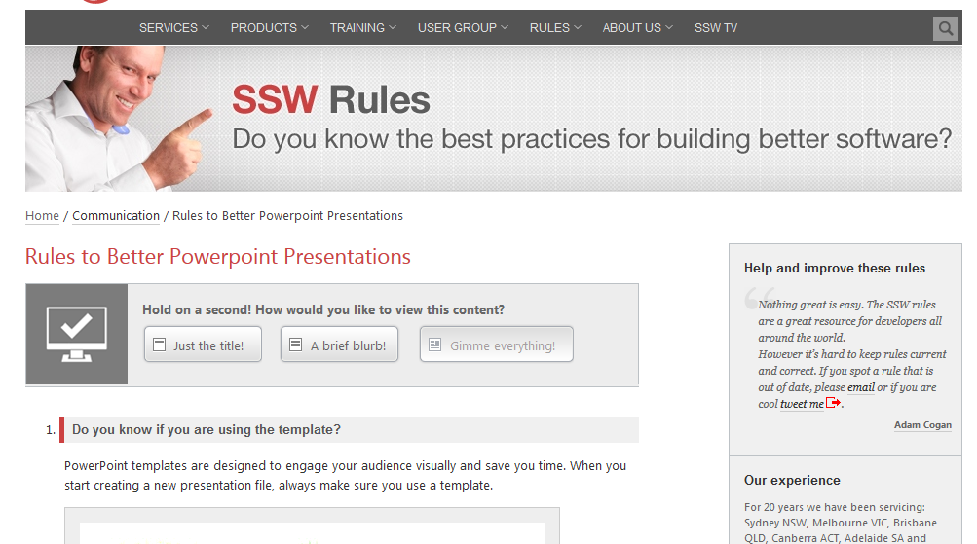
Are you following Rules to Better PPT?

Slide 13

“Coming back to where you started is not the same as never leaving.”
Terry Pratchett, Hat Full of Sky

Slide 14
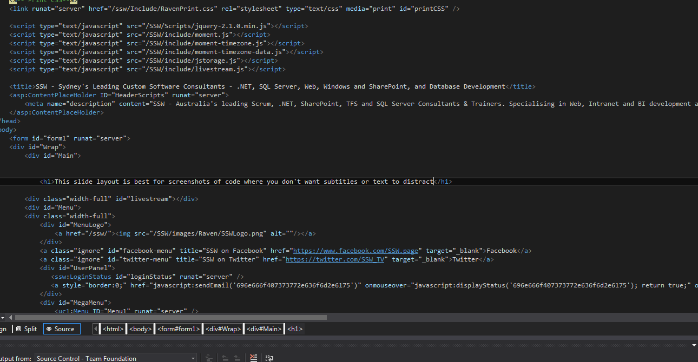

Slide 15
Indenting Text
If you press tab
  While selecting the text
    You can indent it
      Without adding bullet points

Slide 16
The Pros and Cons of Pie
Pie is delicious
I could eat a lot of pie
I love pie
Add your own animation you lazy buggers
Pie is possibly too delicious
Eating too much pie makes you fat
I also like cheesecake

Slide 17
Cake versus Pie
Cake
Sweet
May contain cream
Sometimes contains nuts
Pie
Savoury…. Usually
May contain meat and gravy
Doesn’t usually have nuts

Slide 18
Cake versus Pie versus…
Cake
Sweet
May contain cream
Sometimes contains nuts
Pie
Savoury…. Usually
May contain meat and gravy
Doesn’t usually have nuts
Potato
I love potatoes

Slide 19
This slide has no title, it’s basically made for a huge block of text. You can style this however you want.

Slide 20
This slide has no title, it’s basically made for a huge block of text. You can style this however you want.
With a custom style, the boring slide is now super classy

Slide 21

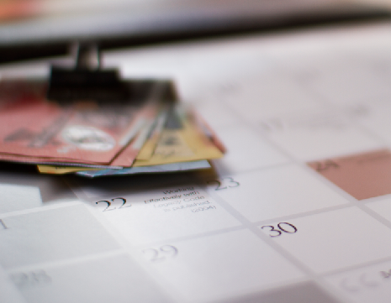
This is a blank slide
Mainly for drawing shapes or small screenshots
You can do anything you want on this slide

Slide 22
Thank you! info@ssw.com.au www.ssw.com.au
Sydney | Melbourne | Brisbane | Adelaide

Slide 23
Find me on Slideshare!
http://www.slideshare.net/SSWconsulting

