Slide 1
Database management systems (it 2040)
Lecture 07 – database Utilities

Slide 2
Lecture content
Transferring data between different sources
Backup and restore of data
Jobs and job schedules
Database maintenance plans

Slide 3
Learning outcomes
At the end of this week, students should be able to
Transfer data between a data source and a database
Create jobs in SQL server
Develop a simple database maintenance plan

Slide 4
Database utilities
Once the database is developed, you may need to perform several tasks on the created tables and stored data.
SQL server provides many types of utilities for performing commonly used tasks.
These include,
Data Transferring
Creating and managing jobs
Backup tools & etc.

Slide 5
data transferring
Some times it is required for transferring data between two sources such as between tables and servers.
SQL server offers a number of options to facilitate the above as follows :
SQL Server Integration Services (SSIS)
Using the SQL Server Import and Export Wizard
Using BCP to Import and Export Data
BULK INSERT
SELECT INTO command

Slide 6
SQL sever import and export wizard
The SQL sever import and export wizard provides a quick way to move data and perform very light transformations of data.
The wizard is available in all editions of SQL Server except the Local Database edition and Express.
Next few slides of the lecture shows how data in an Excel file could be exported to a SQL server table in 5 steps.

Slide 7
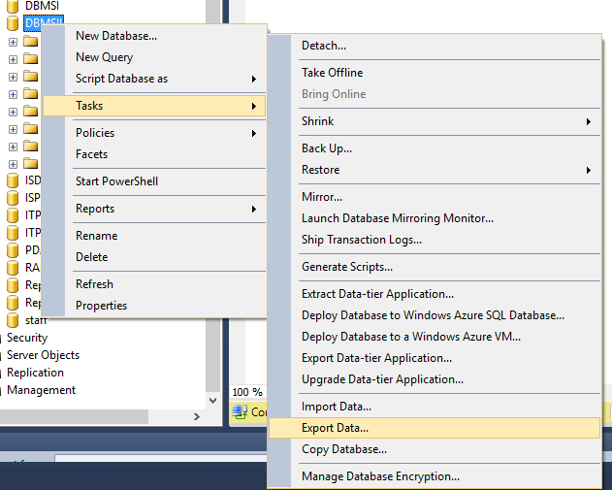
Step 1 – Exporting data from an excel file
Log in to the SQL sever
Right click on a database name and select export data sub menu from the task menu.
Click Next in the welcome screen which appears.

Slide 8
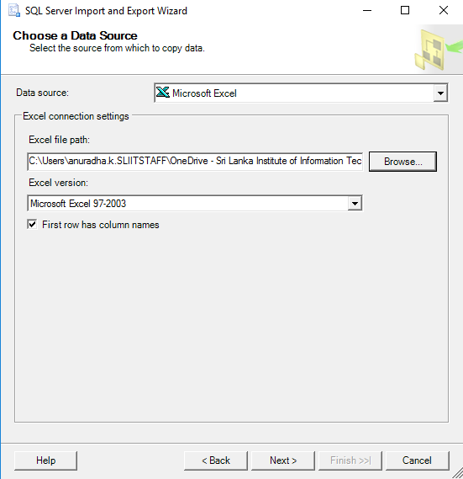
Step 2 – Exporting data from an excel file
On the next screen select the data source.
In this scenario the data source is an excel file.
Browse and select the location of the file.
Tick the check box on the bottom of the screen if the column names are in the first row of the file.
Click Next.

Slide 9
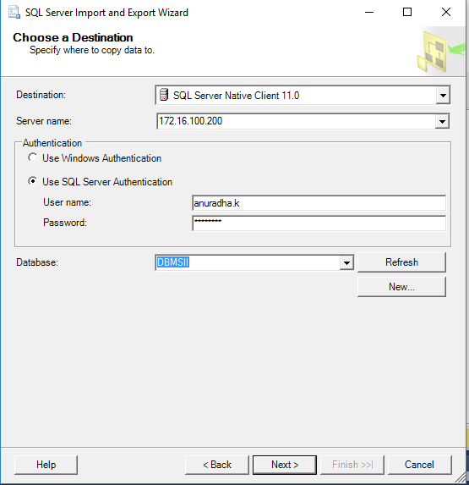
Step 3 – Exporting data from an excel file
Select the destination for the exported data.
In this case the destination is the SQL sever database.
Provide the server name, authentication information and the name of the target database in this screen.
On the next, select whether all data from a file should be copied or specific data should be drawn through querying.
In this case all data from the file should be copied.

Slide 10
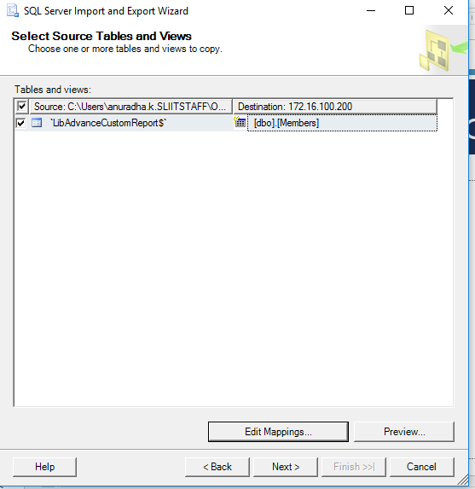
Step 4 – Exporting data from an excel file
In this screen mapping between the source and destination could be done.
Change the destination name (i.e. target table name) if it is required.
Select edit mapping to provide more information on the mapping between the source and the destination
Ex: data types of the source table
Click Next

Slide 11
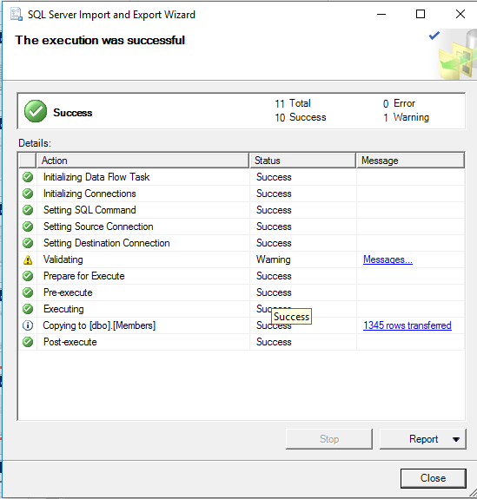
Step 5 – Exporting data from an excel file
Click finish to complete the migration on the next screen.
Outcome of the data migration process would be displayed as shown on the screen.

Slide 12
BCP command
BCP is a powerful command line utility that enables us to transfer large number of records between a SQL instance and a data file using a special file format.
This tool is installed by default with SQL Server.
With BCP the data migrated can be a table or a SQL query result.
Type BCP command on the command line to obtain the options that could be used with the command.

Slide 13
BCP command (Contd.)
Format of the BCP command is as follows
bcp {table|view|"query"} {out|queryout|in|format} {data_file|nul} {[optional_argument]...}
Table|view|query represents the source of the data
out|queryout|in|format determines the command’s mode (direction)
Ex: out option exports data from a table or view into a data file.
Ex: queriyout option exports data retrieved through a query into a data file.
data_file|nul is the full path of the data file or, when a data file should not be specified, the nul value.

Slide 14
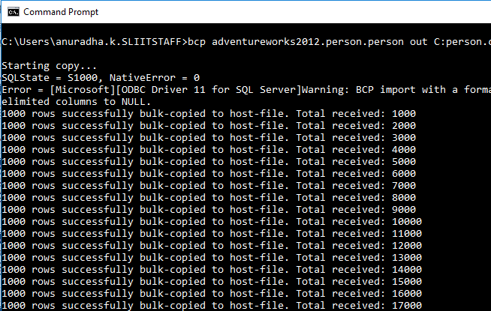
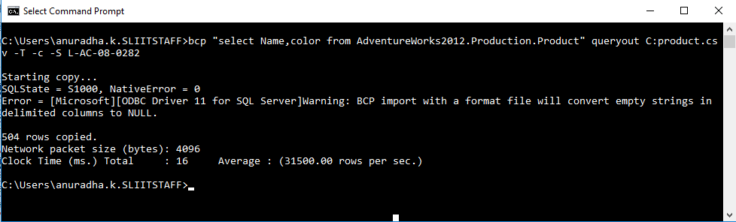
BCP Command – Examples
Copying data from a table to a file
bcp adventureworks2012.person.person out C:person.csv -T -c -S L-AC-08-0282
-c argument is used to perform operations using a character type.
-T is used to connect using a Trusted connection (Windows Authentication).
-S is used to specify the SQL Server name.
Exporting data from a SQL Server Query to a file.
bcp "select Name,color from AdventureWorks2012.Production.Product" queryout C:product.csv -T -c -S L-AC-08-0282

Slide 15
Bulk insert command
BULK INSERT loads data from a data file into a table.
This functionality is similar to that provided by the in option of the bcp command; however, the data file is read by the SQL Server process.
Example :
BULK INSERT emp2 from "D:\emps.csv"
WITH (
FIELDTERMINATOR = ',',
ROWTERMINATOR = '\n'
)
SELECT * FROM emp2

Slide 16
SELECT INTO COMMAND
SELECT INTO statement copies data from one table to another
Tables can be on the same SQL Server or linked SQL servers or on different types of servers using distributed queries
SELECT INTO operates just like Bulk Insert except it can’t read from an external file
SELECT INTO can also create the destination table automatically before copying the data
Example :
select * into emps from emp2

Slide 17
Securing data with backups
Backing up your SQL Server databases, protects you from potentially catastrophic data loss.
With valid backups of a database, you can recover your data from many failures, such as:
User errors, for example, dropping a table by mistake.
Hardware failures, for example, a damaged disk drive or permanent loss of a server.
Natural disasters.

Slide 18
Backup and Restore of databases
The SQL Server backup and restore component provides an essential safeguard for protecting critical data stored in your SQL Server databases.
To minimize the risk of catastrophic data loss, you need to back up your databases to preserve modifications to your data on a regular basis.
A well-planned backup and restore strategy helps protect databases against data loss caused by a variety of failures.

Slide 19
Types of backups
Full Backups : Full database backup takes a copy of the entire database including the part of the transaction log file.
Differential Backups : Differential database backup includes only extents which were changed since the last full database backup.
Transaction Log Backups :Transaction log backup captures all the transaction log records that have been written after the last full database backup or last transaction log backup.

Slide 20
Demo

Slide 21
JOBs in SQL server
A job is a specified series of operations performed sequentially
Use jobs to define an administrative task that can be run one or more times and monitored for success or failure. A job can run on one local server or on multiple remote servers.
A job can perform a wide range of activities and can run repetitive or schedulable tasks
Automatically notify users of job status

Slide 22
Running jobs in sql server
Jobs can run in several ways:
According to one or more schedules.
In response to one or more alerts.
By executing the sp_start_job stored procedure.
Jobs can be created by users in several roles including sysadmin user role
A created job can be edited by only its owners or members of sysadmin role.

Slide 23
Schedules
A schedule specifies when a job runs. More than one job can run on the same schedule, and more than one schedule can apply to the same job. A schedule can define the following conditions for the time when a job runs:
Whenever SQL Server Agent starts. (SQL server agent is the component of SQL sever responsible for automation)
Whenever CPU utilization of the computer is at a level you have defined as idle.
One time, at a specific date and time.
On a recurring schedule.

Slide 24
Demo

Slide 25
Maintenance Plans
A database maintenance plan is a set of specific, proactive tasks that need to be performed regularly on databases to ensure their adequate performance and availability.
Maintenance Plan Wizard and Designer is to cover those critical database maintenance tasks that, as a bare minimum, should be applied to all databases, to ensure adequate performance and availability.

Slide 26
Core maintenance plan tasks
Backup Databases
Verify the Integrity of Database
Maintain a Database’s Indexes
Remove Older Data from msdb
Remove Old Backups

Slide 27
Demo

Slide 28
Thank you!

