Slide 1
Sales Dashboard Analysis
KPIs, Trends, and Insights using Power BI

Slide 2
Key KPIs
- Total Sales (Card)
- Total Quantity Sold (Card)
- Total Profit (Card)
- Profit Margin % (Donut Chart)
- MoM Sales Growth % (Line Chart)

Slide 3
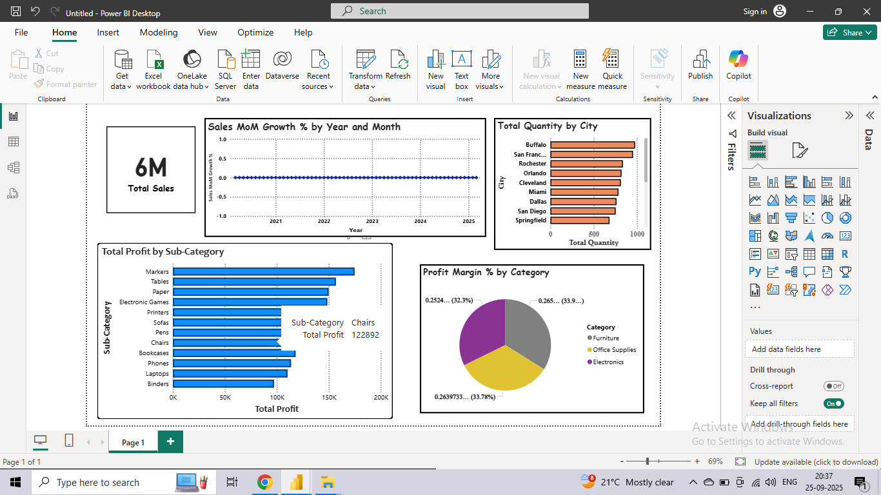
Dashboard View 1

Slide 4
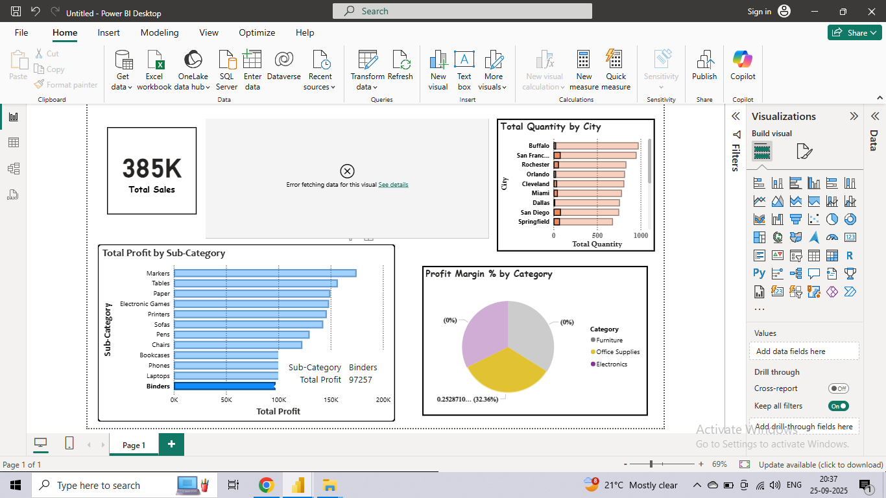
Dashboard View 2

Slide 5
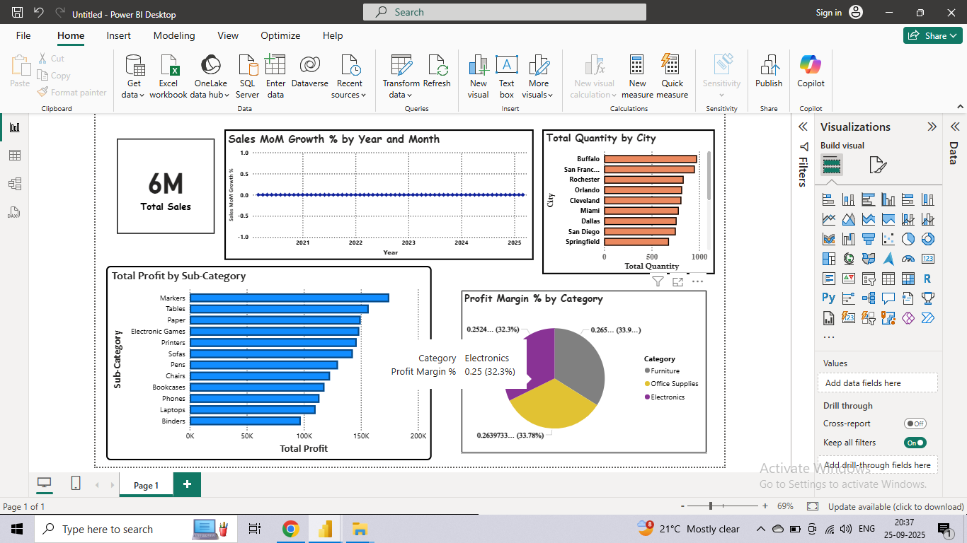
Dashboard View 3

Slide 6
Insights & Observations
- Sales reached over 6M with steady monthly growth
- Cities like Buffalo and San Francisco show high sales volume
- Chairs and Binders are top profit-making Sub-Categories
- Electronics contribute ~32% profit margin
- Need focus on low-margin sub-categories

Slide 7
Thankyou

