Slide 1

Overview
Mitron Bank is a legacy financial institution headquartered in Hyderabad, want to introduce new features into their credit cards line to enhance their product offerings and reach into the financial market.

Slide 2
Objectives
The objective is to analyze this data and provide actionable, data-driven recommendations to guide Mitron Bank in tailoring the new credit cards to customer needs and market trends.

Slide 3
Problem Statement
Demographic classification: Classify the customers based on available demography such as age group, gender, occupation etc. and provide insights based on them.
Avg income utilisation %: Find the average income utilisation % of customers (avg_spends/avg_income). This will be your key metric. The higher the average income utilisation %, the more is their likelihood to use credit cards.
Spending Insights: Where do people spend money the most? Does it have any impact due to occupation, gender, city, age etc.? This can help you to add relevant credit card features for specific target groups.
Key Customer Segments: By doing above, you should be able to identify and profile key customer segments that are likely to be the highest-value users of the new credit cards. This includes understanding their demographics, spending behaviours, and financial preferences.
Credit Card Feature Recommendations: Provide recommendations on what key features should be included in the credit card which will improve the likelihood of credit card usage. This should be backed by the insights from data provided and also some secondary research on the internet for this.

Slide 4
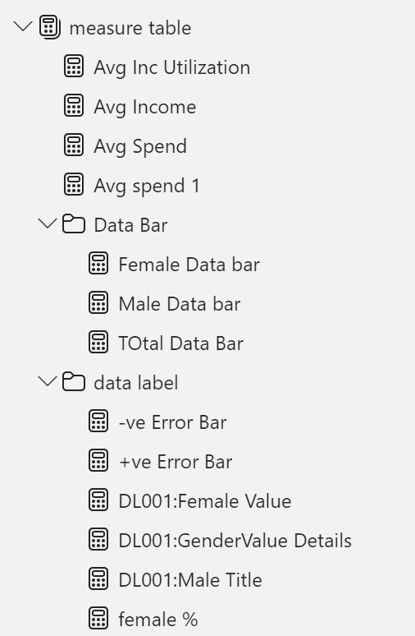
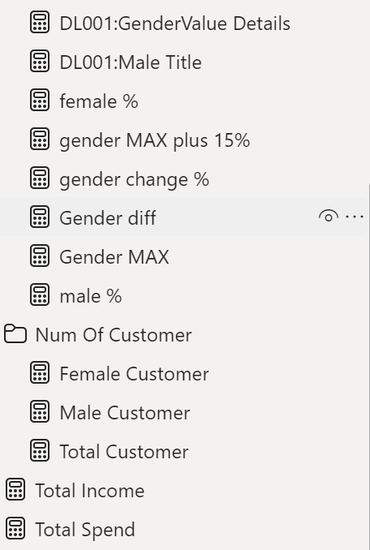
Measure Used

Slide 5
Demographic Analysis Insights
Total Customers: 4000
Gender Distribution: Males (64.93%) Females (35.08%)
Age Group Distribution: Highest in 25-35 (1498)
City-wise Distribution: Mumbai leads with 1078 customers.
Occupation-wise Distribution: Salaried IT Employees highest (1294)
Marital Status Distribution: Married Customers (78.41%)

Slide 6
Spend Analysis Insights
Avg Income Utilization: 42.82% Key Metrics: Total Income: $1240M, Total Spends: $531M
Credit cards dominate spending at $216M with a utilization rate of 17.45%.
Males lead in spending with $357M, and married individuals top spending charts at $429M.
September emerges as the highest spending month at $116M, constituting 21.84% of the total spend.
Males exhibit a higher income utilization rate at 44.39%, compared to females at 39.92%.
Singles show a utilization rate of 43.06%, slightly surpassing married individuals at 42.77%.

Slide 7
Credit Card Recomendation
Enhanced Reward Programs:
★ For High Spenders: Introduce tiered reward systems with higher cashback or reward points for customers with higher spending, targeting males and married individuals.
★ Occupation-Specific Rewards: Tailor rewards for salaried IT employees.
Customizable Credit Limits:
★ Utilization-Based Limits: Offer higher credit limits for customers with higher income utilization rates, such as males and singles.
Seasonal Offers and Promotions:
★ High Spending Months: Launch promotions in September, the highest spending month.
Demographic-Specific Features:
★ Age Group Focus: Develop features appealing to the 25-35 age group, including travel perks, dining discounts, and lifestyle rewards.
★ City-Specific Offers: ★ Mumbai-Specific Benefits: Provide city-specific benefits such as local merchant discounts, travel passes, and exclusive city events access.

Slide 8
Credit Card Recommendation Continued
Convenience and Security:
★ Contactless Payments: Ensure all new credit cards support contactless payments.
★ Enhanced Security: Introduce advanced security features like biometric authentication and real-time fraud alerts.
Financial Management Tools:
★ Spending Insights: Offer tools providing customers with insights into their spending patterns and suggestions on optimizing their credit usage.
★ Budgeting Assistance: Integrate budgeting tools to help customers manage their finances better.
Loyalty Programs:
★ Long-Term Benefits: Establish loyalty programs that reward long-term customers with benefits such as fee waivers, exclusive access to premium services, and higher reward rates.
Educational Content:
★ Financial Literacy: Provide educational content and workshops on financial management, credit usage, and maximizing card benefits.

Slide 9
Thank you
Presented by Sahil Shah The beautiful thing about learning is that no one can take it away from you.

