Slide 1
Analysis of Student’s Scoring Patterns using Process Mining techniques
Team Members
1. VONKAYALA ASHWINI - 1DS19CS192
2. PALLAPOTHU LAKSHMI SHARANYA - 1DS19CS730
3. SRUNGARAPU SAI SRI NANDAN - 1DS19CS172
4. VISHWAKUMAR K HIREHALLI - 1DS19CS191
Under the Guidance of
Dr. Deepak. G
Professor, Dept of Computer Science and Engineering

Slide 2
Introduction
Process mining is a set of techniques that merge data science and process management to aid in the analysis of operational processes using event logs. Process mining aims to convert event data into insights and actions.
Event data is used in process mining techniques to show what people, machines, and organizations are really doing.
Process mining provides novel insights that can be used to identify the executional path that operational processes take and address performance and compliance issues.
Process mining is an essential component of data science, driven by the availability of event data and a desire to improve processes.

Slide 3
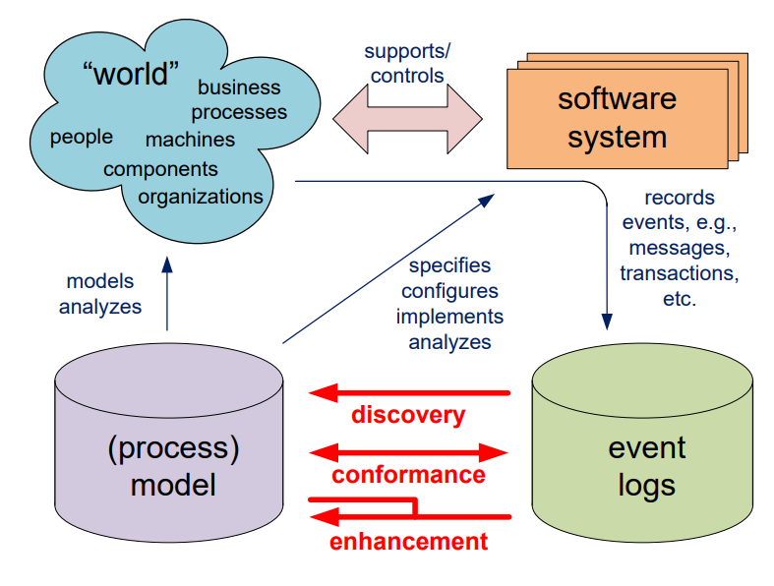
Process mining flowchart

Slide 4
Introduction to The Problem:
In the current education system, there are a lot of activities with an unstructured way of functioning, as a result of which the quality of student learning processes is decreasing.
Proposed Solution
Processing mining is a technique that uses event log data to analyze the functionality of a process. We intend to use this technology to investigate the processes taking place in the educational system in order to identify short comings, bottlenecks, or loops.
The next step is to build a model to generate a much more efficient method for implementing these processes in the system.

Slide 5
Contribution of Each project Members
VONKAYALA ASHWINI - 1DS19CS192 | PALLAPOTHU LAKSHMI SHARANYA - 1DS19CS730
Preprocessing of the data. | Celonis integration
SRUNGARAPU SAI SRI NANDAN - 1DS19CS172 | VISHWAKUMAR K HIREHALLI - 1DS19CS191
Fitness checking | Model extraction

Slide 6
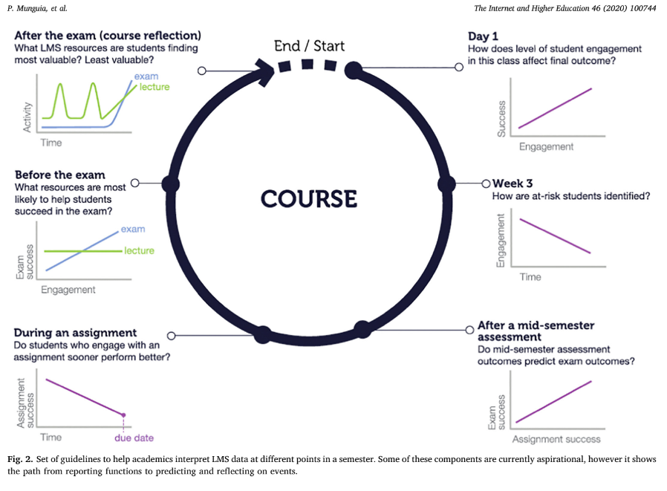
Life cycle

Slide 7
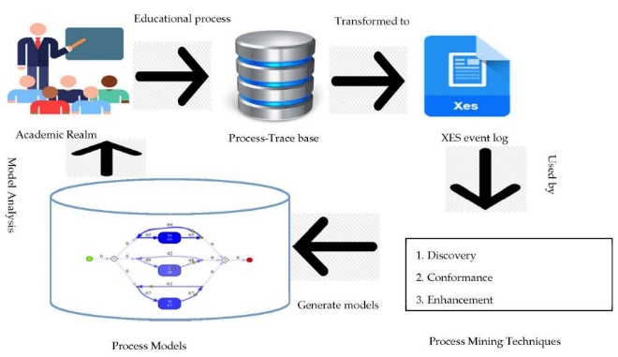
SYSTEM DIAGRAM / ARCHITECTURE:

Slide 8
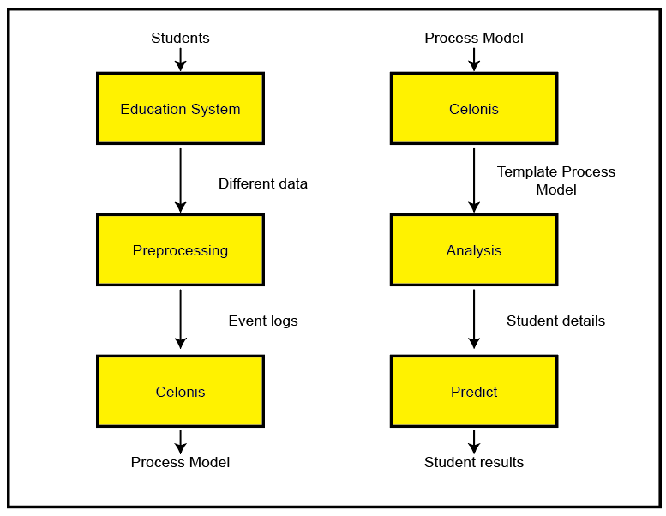
Modules

Slide 9
Modules Descriptions
Educational System: The educational system is the primary source of data for the process mining system. It could be a learning management system, an online course platform, or any other digital tool used for educational purposes. The educational system generates a large amount of raw data that needs to be processed and analyzed to gain insights into how students learn and interact with the system.
Preprocessing: The preprocessing module is responsible for cleaning and preparing the raw data obtained from the educational system for further analysis. This module typically involves data cleaning, data transformation, and data integration to ensure the data is suitable for process mining. Data cleaning involves removing errors, duplicates, or incomplete data. Data transformation involves converting data from one format to another, while data integration involves combining data from different sources to create a unified dataset.

Slide 10
Modules Descriptions
Celonis: Celonis is a popular process mining software that can be used to analyze and visualize complex data. In the educational process mining system, Celonis is used to discover, monitor, and improve educational processes by identifying patterns and bottlenecks in the data. Celonis provides a graphical interface that allows users to visualize and explore the data, and it supports a wide range of process mining techniques such as process discovery, conformance checking, and performance analysis.
Analysis: The analysis module uses various statistical and machine learning techniques to identify patterns and trends in the data. This module typically involves applying descriptive and exploratory data analysis techniques to understand the data, followed by more advanced techniques such as clustering, classification, and regression analysis to build predictive models. The analysis module can help identify factors that affect student performance, such as learning style, engagement, and motivation.

Slide 11
Modules Descriptions
Predict: The predict module is used to forecast future events based on the analysis of historical data. This module typically involves building predictive models using machine learning algorithms to identify patterns and trends in the data. Predictive models can be used to forecast student performance, identify at-risk students, and recommend interventions to improve learning outcomes. The predict module can also be used to optimize educational processes by identifying areas for improvement and predicting the impact of proposed changes.

Slide 12
Algorithm
Data Collection: The first step in the educational process mining process is to collect data from the educational system. This data can include student interactions with the system, performance on assessments, and other relevant data.
Data Cleaning and Preprocessing: The next step is to clean and preprocess the data to ensure that it is suitable for analysis. This may involve removing duplicates, filling in missing values, and converting the data to a standardized format.
Process Mining: The processed data is then analyzed using process mining techniques. This involves using software tools like Celonis to discover, monitor, and improve educational processes.

Slide 13
Algorithm
Descriptive Analysis: Descriptive analysis techniques are used to summarize and visualize the data. This helps identify patterns and trends in the data and gain a better understanding of how students interact with the educational system.
Predictive Modeling: Predictive modeling techniques are then used to build models that can forecast future events based on historical data. These models can be used to predict student performance, identify at-risk students, and recommend interventions to improve learning outcomes.
Evaluation: The predictive models are evaluated using various performance metrics to determine their effectiveness. This involves comparing the predicted outcomes to actual outcomes and assessing the accuracy of the model.

Slide 14
Algorithm
Intervention and Improvement: The final step involves using the insights gained from the analysis to identify areas for improvement and implement interventions to improve learning outcomes. This may involve modifying educational processes, providing targeted support to at-risk students, or introducing new teaching methods to enhance student engagement and learning.

Slide 15
Algorithm – Alpha miner
Define all events
Define all possible start events
Define all possible end events
Calculate possible sets A and B, all events in A should be casually related to events in B
Drop non maximum sets
Create places for all derived sets and add start + end state
Draw the connections

Slide 16
Algorithm
L1 = [< A,B,C,D >,< A,C,B,D >,< A,E,D >]

Slide 17
Algorithm
L1 = [< A,B,C,D >,< A,C,B,D >,< A,E,D >]

Slide 18
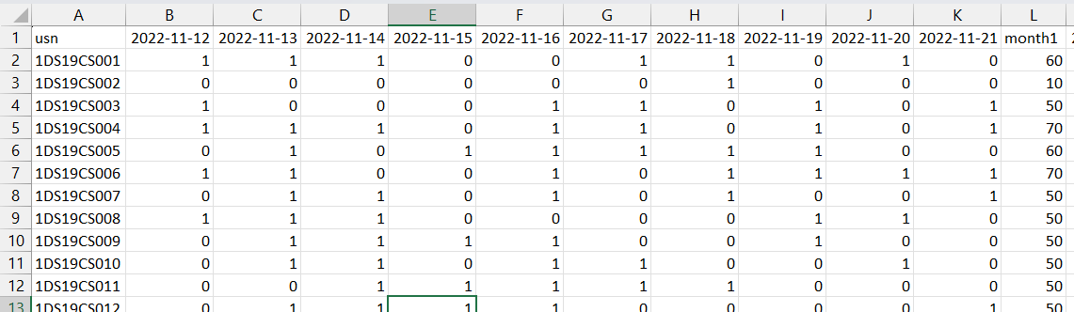
Input
Attendance

Slide 19
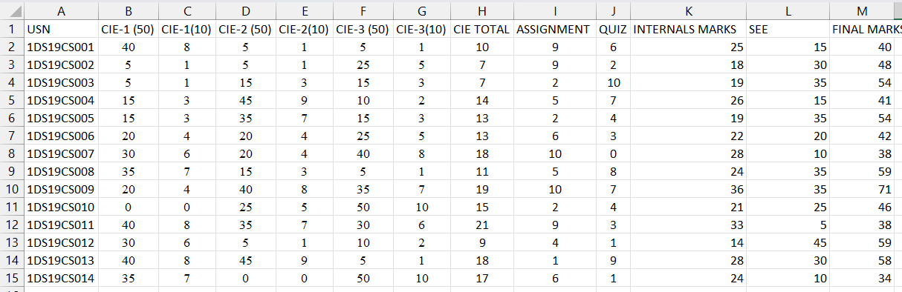
Input
Marks

Slide 20
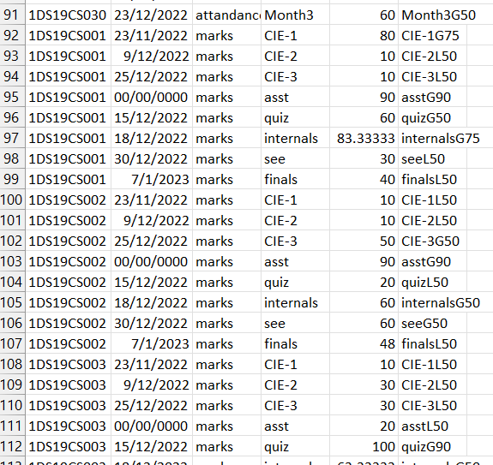
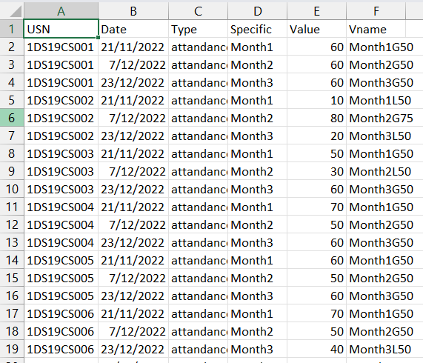
Preprocessing
Event logs

Slide 21
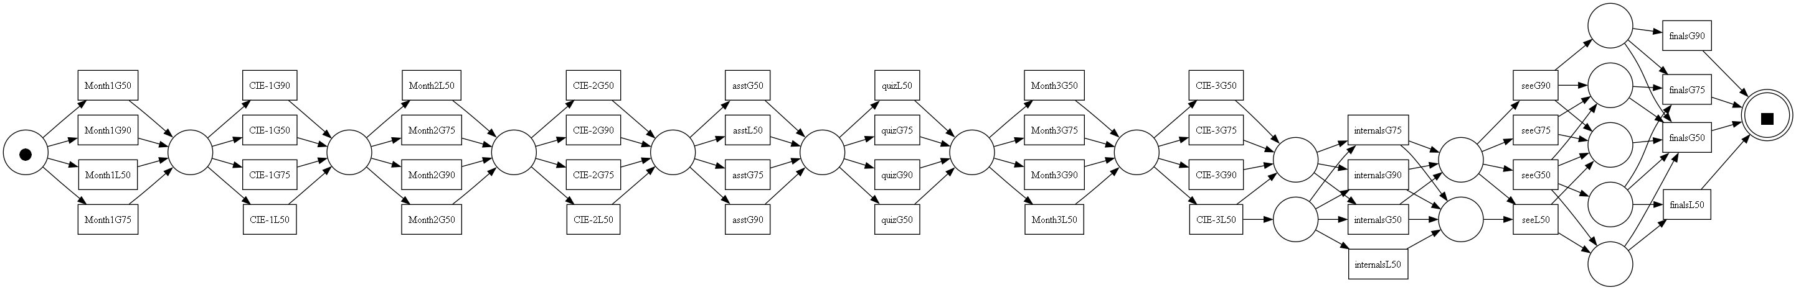
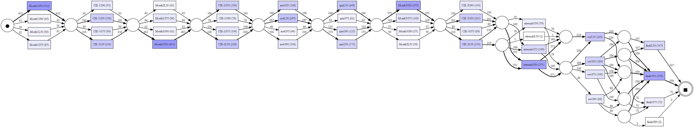
Output

Slide 22
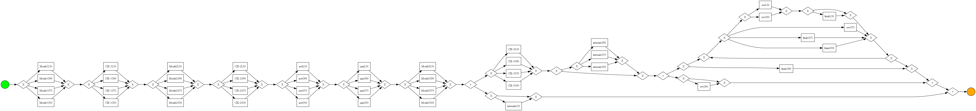
Output

Slide 23
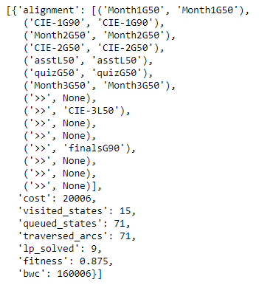
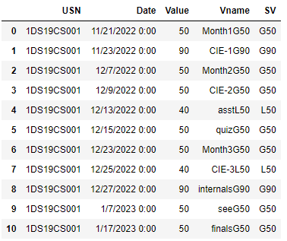
Output

Slide 24
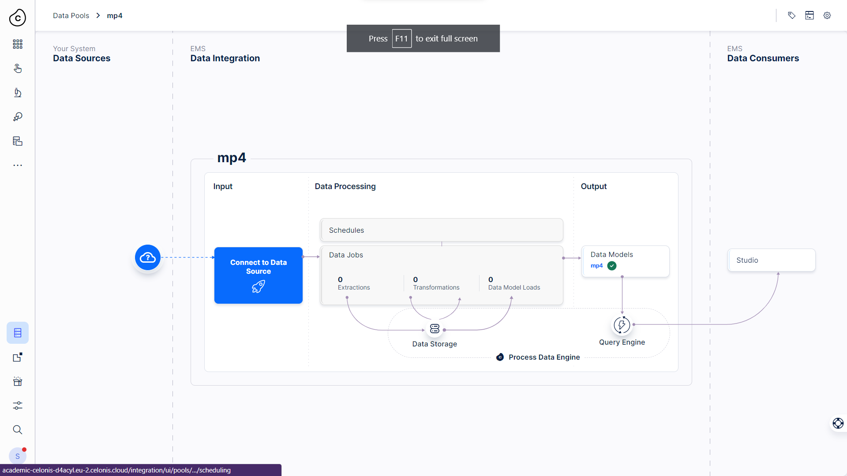
PROJECT TOOL SNAPSHOT:

Slide 25
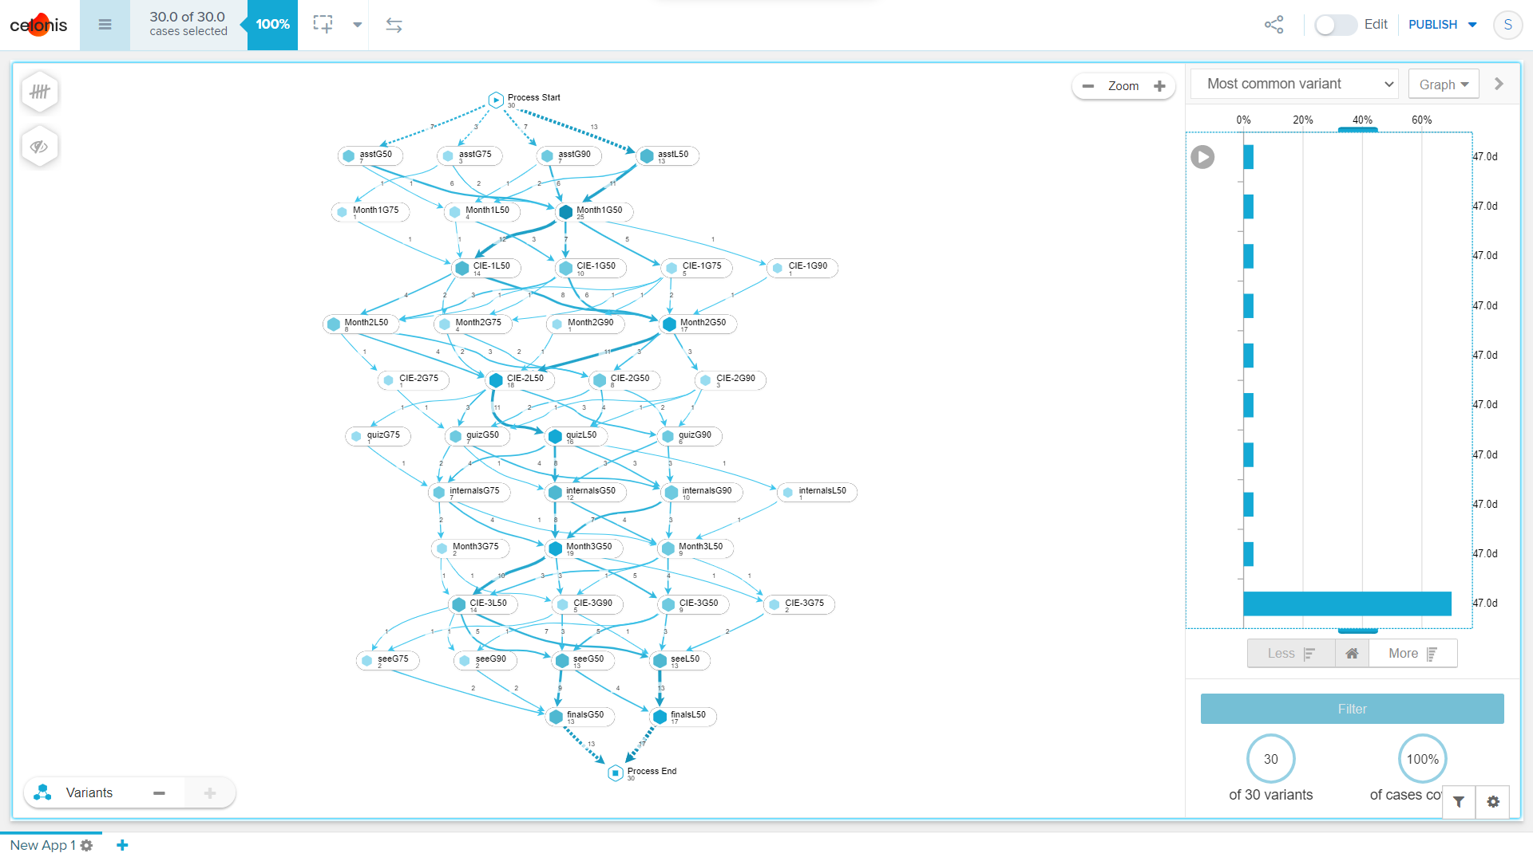
PROJECT TOOL SNAPSHOT:

Slide 26
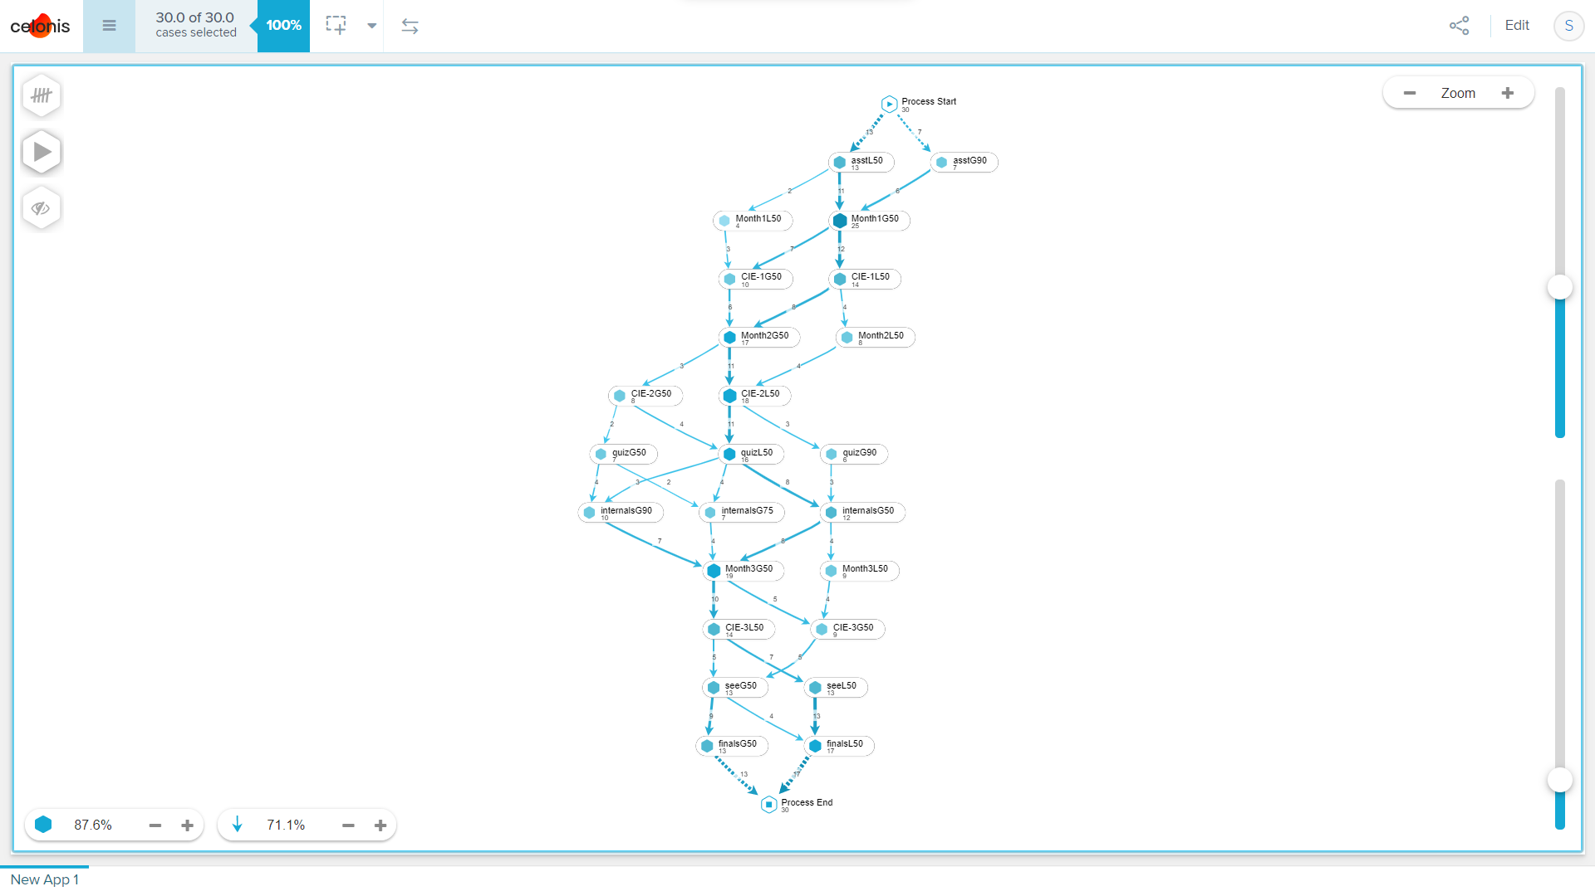
PROJECT TOOL SNAPSHOT:

Slide 27
Thank You
Vonkayala Ashwini-1DS19CS192
Pallapothu Lakshmi Sharanya-1DS19CS730
Srungarapu Sai Sri Nandan-1DS91CS172
Vishwakumar K Hirehalli-1DS19CS191

