Slide 1

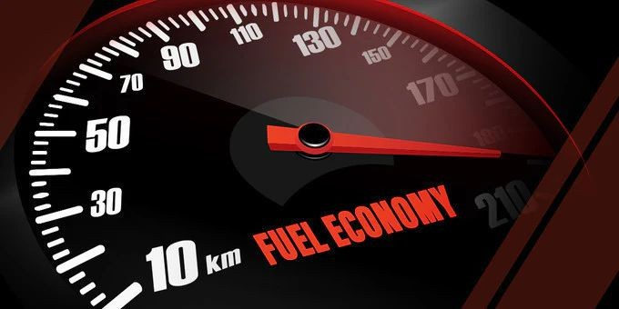
Predicting Fuel Effciency using Machine Learning
Presented By : AIT 582 DL1- Team 2
Siddharth Sajjansingh Sandu
Dhruval Dharmesh Bhau
Sai Saketh Cholleti Saesha Baniya
Pragya Dhungana Arika Bhattarai
Rahul Guttapally

Slide 2

Agenda
Introduction Significance
Research Questions
Overview of Dataset Visualization Methodology
Models
Challenges and Overall Contribution Future Scope
References

Slide 3
Introduction
Fuel efficiency is a critical aspect of modern transportation and energy consumption. Predicting fuel efficiency is a key area of interest in the automotive industry and beyond.
In this presentation, we will explore into the methods and technologies used to predict fuel efficiency, including data analytics, machine learning algorithms, and models. We will discuss how these predictive tools can help manufacturers, policymakers, and consumers optimize fuel consumption, reduce costs, and minimize environmental impact.

Slide 4
Dhruval Dharmesh Bhau
M.S in Data Analytics engineering.

Slide 5
Significance
Cost savings: Vehicles with higher fuel efficiency require less fuel to operate, resulting in lower fuel costs for consumers and businesses.
Environmental impact: Improved fuel efficiency leads to reduced greenhouse gas emissions and air pollution, contributing to a cleaner and healthier environment.
Regulatory compliance: Many countries have fuel efficiency standards and emissions regulations that automakers must meet, driving innovation in fuel-efficient technologies.
Consumer demand: With rising fuel prices and growing environmental awareness, consumers are increasingly prioritizing fuel efficiency when choosing vehicles.

Slide 6
Research Questions
What vehicle characteristics are most indicative of fuel efficiency?
Engine displacement, number of cylinders, and vehicle weight significantly influence fuel efficiency. Higher values in these attributes typically decrease MPG.
Can a model be developed to predict a vehicle's miles per gallon (MPG) accurately using these characteristics?
Yes, a predictive model using machine learning techniques like linear regression and random forests can accurately estimate a vehicle's MPG based on its characteristics, with the random forest model showing the highest accuracy.

Slide 7
Pragya Dhungana
M.S in Data Analytics engineering.

Slide 8
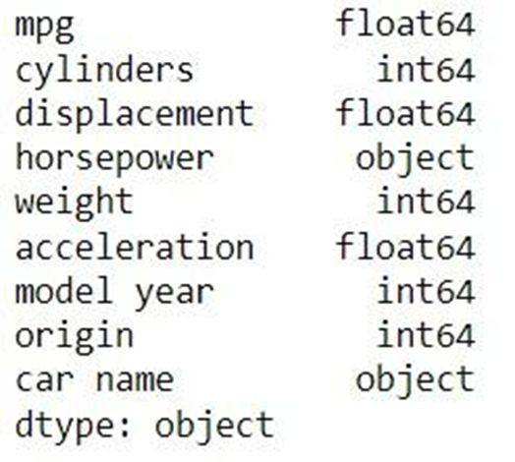
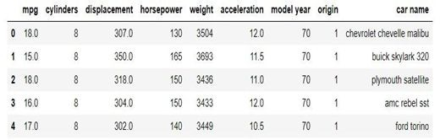
Overview of Dataset
Dataset covers a wide range of vehicle attributes organized by model and specifies each car by its unique features. It includes 399 rows and 9 columns.

Slide 9
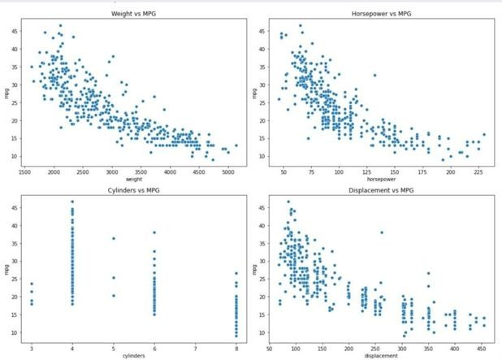
Visualization
Weight vs MPG: There's a clear negative trend, indicating that heavier cars tend to have lower MPG.
Horsepower vs MPG: Similarly, cars with more horsepower generally show lower MPG, indicating a trade-off between power and fuel efficiency.
Cylinders vs MPG: Vehicles with more cylinders tend to have lower MPG, likely due to larger, less efficient engines.
Displacement vs MPG: A similar negative trend is observed, where higher engine displacement is associated with lower MPG.

Slide 10
Rahul Guttatally
M.S in Data Analytics engineering.

Slide 11
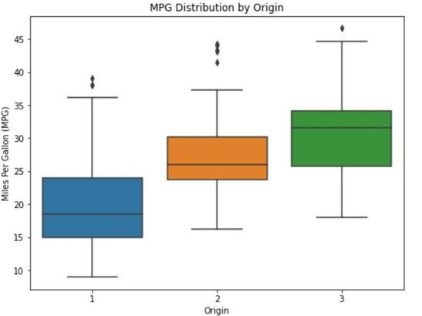
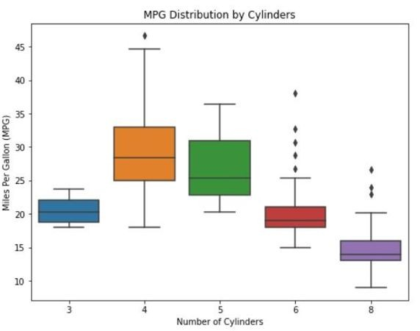
Visualization
MPG Distribution by Origin: The boxplot by origin shows differences in MPG based on the origin of the vehicle. This could reflect variations in automotive engineering priorities and regulations across different regions.
MPG Distribution by Cylinders: The boxplot reveals how MPG varies with the number of cylinders. It's evident that vehicles with fewer cylinders tend to have higher MPG, reflecting a trend towards better fuel efficiency in engines with fewer cylinders.

Slide 12
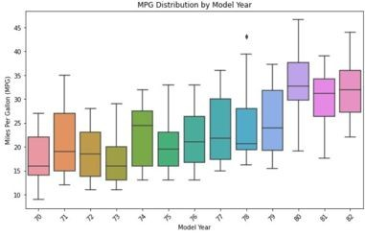
Visualization
MPG Distribution by Model Year:
This visualization shows the progression of fuel efficiency over model years. There's a noticeable trend towards higher MPG in newer models, indicating improvements in fuel efficiency over time.

Slide 13
Saketh Cholleti
M.S in Data Analytics engineering.

Slide 14
Methodology
We have utilizes various evaluation methods to evaluate the performance of different models, these techniques will cover both conventional statistical measures and machine learning-specific metrics. Evaluation methods are:
Mean Absolute Error (MAE)
Root Mean Squared Error(RMSE)
Coefficient of Determination (R² )

Slide 15
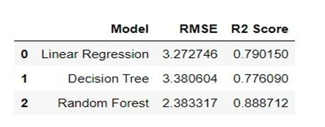
Models
The evaluation of the three models on the test set yielded the following results:

Slide 16
Siddharth Sajjansingh Sandu
M.S in Data Analytics engineering.

Slide 17
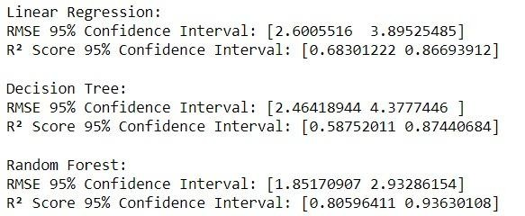
Models
This output provides the 95% confidence intervals for the RMSE and R² Score metrics obtained through bootstrapping for each regression model.

Slide 18
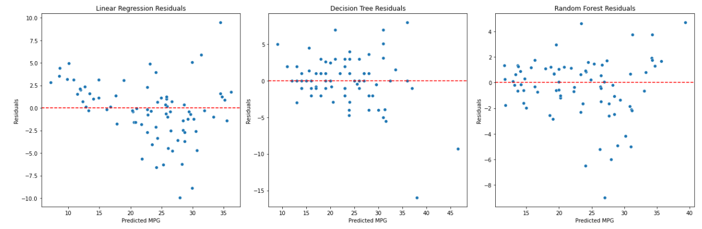
Models
Linear Regression: Random residuals with some consistent prediction errors.
Decision Tree: Higher residual variability, indicating sensitivity to specific data points.
Random Forest: Residuals tightly clustered around zero, showing high accuracy without systematic errors.

Slide 19
Saesha baniya
M.S in Data Analytics engineering.

Slide 20
Challenges &Overall Contribution
Challenges
This Auto mpg dataset primarily includes conventional vehicles, limiting insights into electric and hybrid models.
This analysis requires deep understanding and expertise to identify and engineer relevant features for accurate predictions.
For this Dataset it is difficulty in capturing non-linear relationships between vehicle attributes and fuel efficiency.
Overall Contribution
Highlights the development of a predictive model that can estimate MPG from vehicle attributes, showcasing the practical application of machine learning in automotive design.

Slide 21
Future Scope
Expansion of Feature Set: Include additional features like aerodynamics and hybrid powertrain details to improve model accuracy.
Broader Data Set: Use a more diverse dataset, including electric and hybrid vehicles, to widen applicability.
Real-Time Data Application: Implement models in vehicles to provide real-time feedback on fuel efficiency.
Integration with Advanced Technologies: Merge with autonomous driving systems to optimize safety and fuel usage.
Policy and Economic Impact Analysis: Explore the broader economic and policy implications of adopting fuel-efficient vehicles on a large scale.

Slide 22
References
[1] Davis, Maggie. “Study: Fuel Efficiency Has Improved 35.4% | LendingTree.” Lending Tree, 7 August 2023, https://www.lendingtree.com/auto/fuel-efficiency-study/
. (Accessed 25 February 2024).
[2] Hastie, T., Tibshirani, R., & Friedman, J. The Elements of Statistical Learning: Data Mining, Inference, and Prediction (2nd ed.). Springer Series in Statistics. Available at: https://hastie.su.domains/Papers/ESLII.pdf. (Accessed: 02 February 2024).
[3] Katreddi, S. (2023). Development of Machine Learning based approach to predict fuel edict fuel consumption and maintenance cost of Heavy- Duty Vehicles using diesel and alternative fuels. The Research Repository at WVU. Available at:
https://www.researchgate.net/publication/333367045_A_ Machine_Lea rning_Model_for_Average_Fu el_Consumption_in_Heavy_Vehicles (Accessed: 25
February 2024).
[4] Utah Department of Transportation Research & Innovation Division. (2021) Utilizing machine learning to cross-check traffic data and Understand Urban Mobility. Available at: https://rosap.ntl.bts.gov/view/dot/56869/dot_56 869_DS1.pdf (Accessed: 02 February 2024).
[5] Venkataraman, R. (2020) Predicting vehicle fuel efficiency. Medium. Available at: https://towardsdatascience.com/predicting-vehicl e-fuel- efficiency-c6065479a72f (Accessed: 01 February 2024).
[6] Xie, X., Sun, B., Li, X., Olsson, T., Maleki, N. and Ahlgren, F. (2023) Fuel consumption prediction models based on machine learning and Mathematical Methods. MDPI. Available at: https://www.mdpi.com/2077-1312/11/4/738 (Accessed: 01 February 2024).

Slide 23
Thank You

