Slide 1
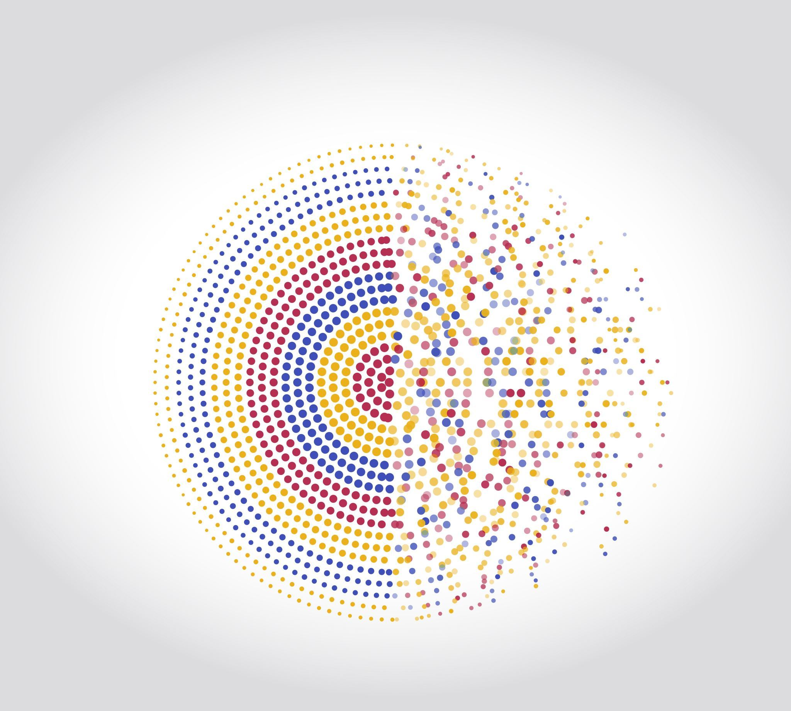
IT Solutions & Technology Domains
IV-CSE

Slide 2

What is IT?

Slide 3
IT Categorization
Service
Product

Slide 4

What is a Product?
A product is a tangible or intangible item that is created once and sold to many customers with little or no customization.
Examples:
Mobile apps (Instagram, WhatsApp)
Software products (Windows, MS Office)
Physical items (laptops, smartphones)
Key Characteristics:
Same product for all users
Scalable (one product → many customers)
Development cost is mostly upfront
Revenue grows as users increase

Slide 5
What is a Service?
A service is an activity or solution provided to a customer, often customized based on their requirements.
Examples:
Software development services
IT consulting
Cloud deployment support
Maintenance and technical support
Key Characteristics:
Tailored to customer needs
Continuous interaction with clients
Depends heavily on skilled manpower
Revenue is project-based or time-based

Slide 6

Product Category Deep Dive
What are SaaS & PaaS?
SaaS (Software as a Service): Ready-to-use cloud software accessed via the internet. Example: Zoho CRM, Zoho Mail, Zoho People.
PaaS (Platform as a Service): Cloud platforms used to build and deploy applications. Example: Zoho Creator (low-code), Zoho APIs.
Zoho Product Components
Apps / Standard Products: Business tools like CRM, Books, Projects (SaaS)
Java / IoT Platforms: Backend systems for data processing and device integration (PaaS)
LLP (Low-Code Platform): Build apps with minimal coding (PaaS)
HR Products: Employee, payroll, and recruitment systems (SaaS)

Slide 7

Service Category Deep Dive
1. C – Consulting
Advises clients on what to do. Example: Cloud strategy planning. Careers: Consultant, Business Analyst.
2. C + DCA / SAI – Consulting + Development & Integration
Plans and builds complete solutions. Example: Developing & integrating an ERP system. Careers: Software Developer, Full-Stack Engineer.
3. Managed Services
Maintains and supports systems. Example: 24/7 application monitoring. Careers: Support Engineer, Cloud Admin.

Slide 8
Different Types of Domains in IT
1. Web Development
2. Mobile Application Development
3. Cloud Computing
4. Data Science & Analytics
5. Artificial Intelligence & Machine Learning
6. Cybersecurity
7. Internet of Things (IoT)
8. Software Testing & QA
9. Enterprise & Business Applications

Slide 9
1. Web Development
Builds websites and web applications.
Uses HTML, CSS, JavaScript, React, Node.js.
Examples: E-commerce sites, company websites Careers: Frontend, Backend, Full-Stack Developer

Slide 10
2. Mobile Application Development
Develops apps for Android and iOS.
Uses Java, Kotlin, Flutter, React Native.
Examples: Banking apps, food delivery apps Careers: Android / iOS / Flutter Developer

Slide 11
3. Cloud Computing
Manages applications and data on the cloud.
Uses AWS, Azure, Google Cloud.
Examples: Cloud hosting, SaaS platforms Careers: Cloud Engineer, DevOps Engineer

Slide 12
4. Data Science & Analytics
Analyzes data to find insights.
Uses Python, SQL, Power BI, Machine Learning.
Examples: Sales prediction, user behavior analysis Careers: Data Analyst, Data Scientist

Slide 13
5. Artificial Intelligence & Machine Learning
Builds intelligent systems that learn from data.
Uses Python, TensorFlow, NLP, Computer Vision.
Examples: Chatbots, disease detection, recommendation systems Careers: AI/ML Engineer, Research Engineer

Slide 14
6. Cybersecurity
Protects systems from cyber attacks.
01
Uses ethical hacking, network security tools.
02
Examples: Firewall systems, penetration testing Careers: Security Analyst, Ethical Hacker
03

Slide 15
7. Internet of Things (IoT)
Connects devices to the internet.
Uses Arduino, sensors, cloud platforms.
Examples: Smart homes, healthcare monitoring Careers: IoT Engineer, Embedded Developer

Slide 16
8. Software Testing & QA
Ensures software quality and reliability.
Uses manual and automation testing tools.
Examples: Application testing before release Careers: QA Engineer, Automation Tester

Slide 17
9. Enterprise & Business Applications
Software for business operations.
Uses ERP, CRM systems (SAP, Zoho).
Examples: HR, payroll, finance systems Careers: ERP Consultant, Business Analyst

Slide 18

Hierarchy Of Information Technology

Slide 19
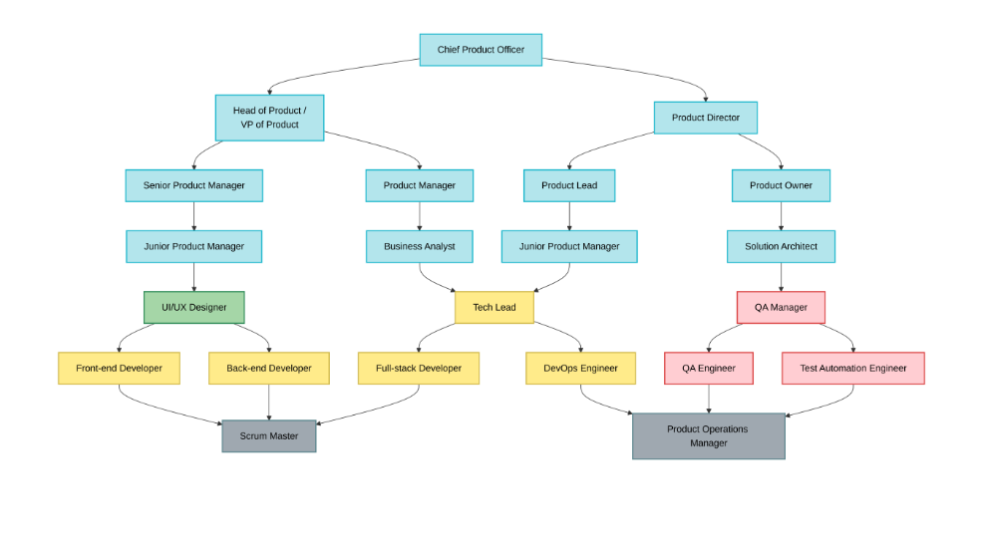

Slide 20

Placement Drive
What is a Placement Drive?
A placement drive is a recruitment process conducted by companies to hire students from colleges or universities.

Slide 21
Common Stages in a Placement Drive
Aptitude Test – Logical, quantitative, verbal skills
Technical Round – Core subjects, coding, problem solving
HR / Managerial Round – Communication, attitude, culture fit

Slide 22
Optional Rounds in Placement Drive
Group Discussion (GD): Tests communication, teamwork, and leadership.
Coding Round / Hackathon: Evaluates real-time problem-solving and coding skills.
Technical Assessment: Deep evaluation of domain knowledge or projects.
Case Study / Presentation: Tests analytical thinking and solution approach.
Managerial Round: Checks decision-making and work ethics.

Slide 23
Why Placement Drives Matter
Provides direct industry entry
Tests real-world skills
Helps students start their professional career

Slide 24
Student Preparation Areas
Aptitude & reasoning
Core technical skills
Programming & projects
Communication & resume

Slide 25

Companies and their Rounds

Slide 26
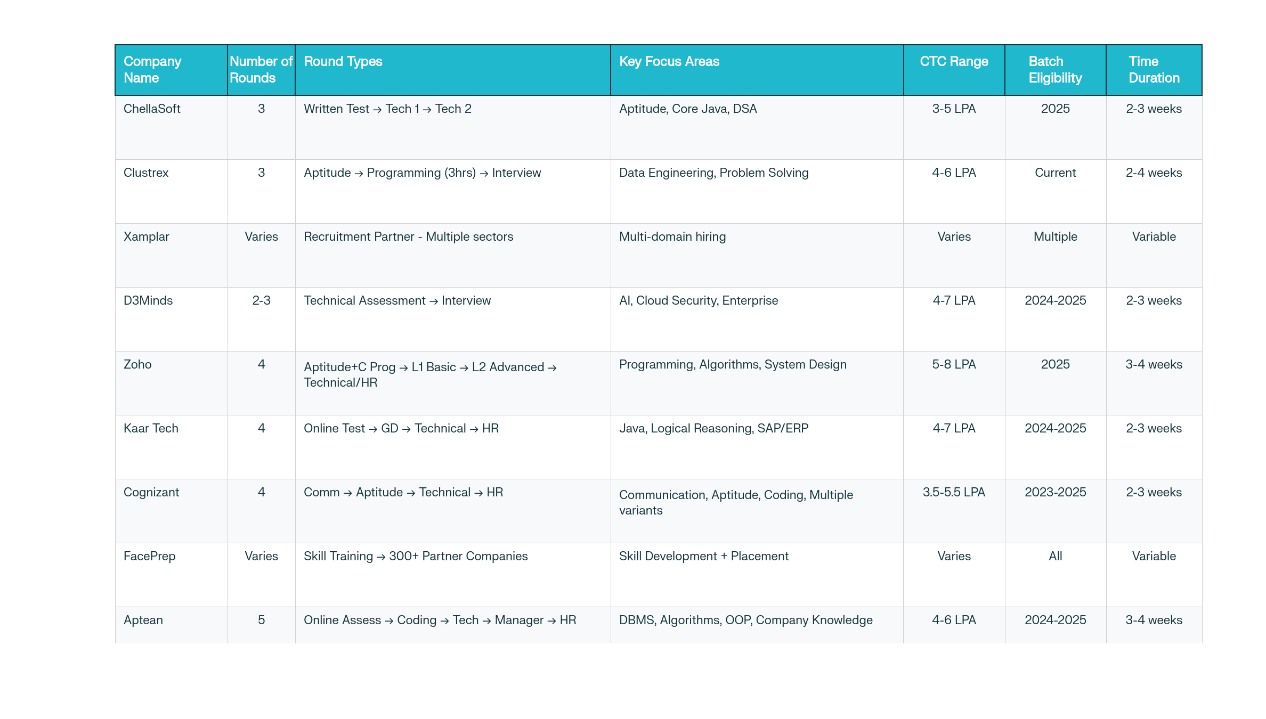

Slide 27
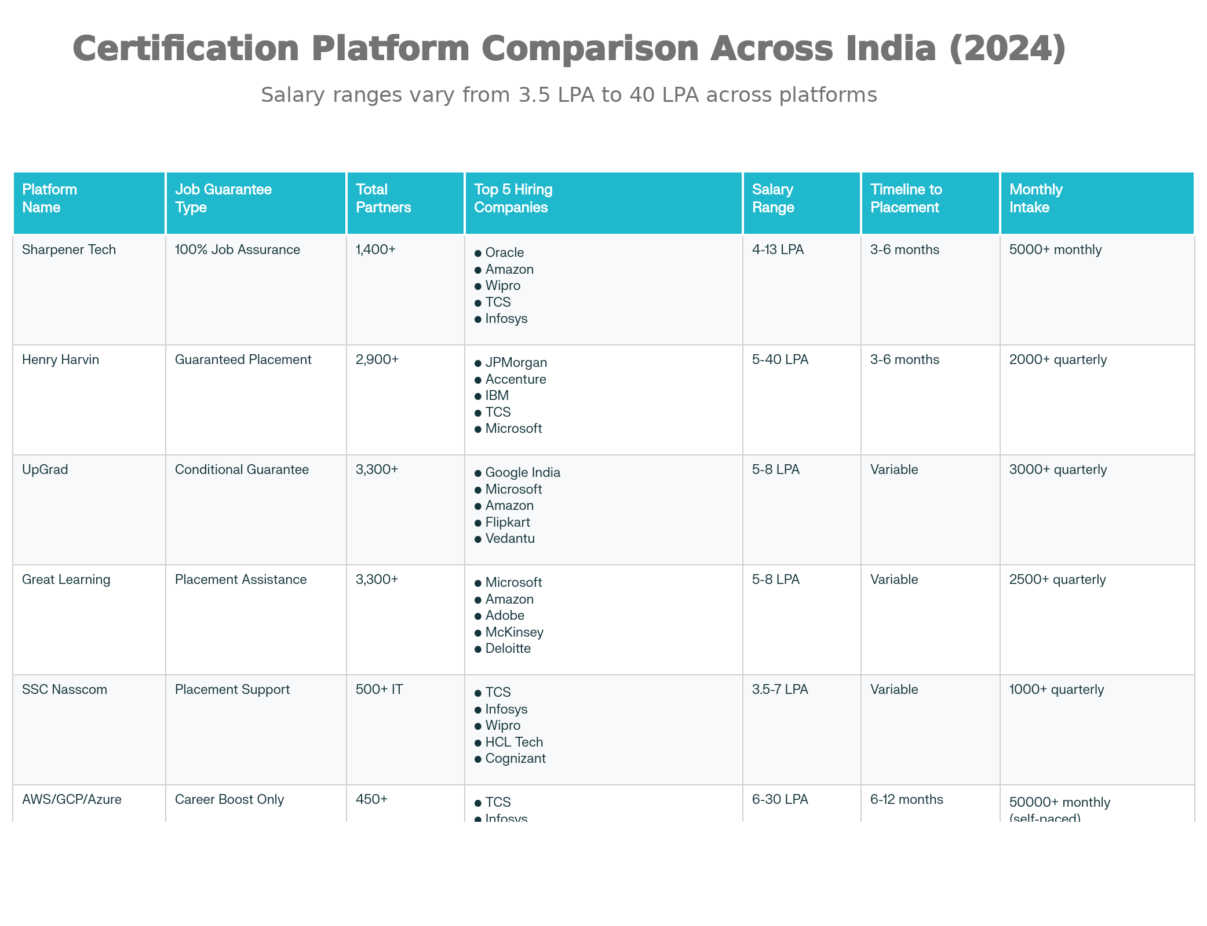

Slide 28
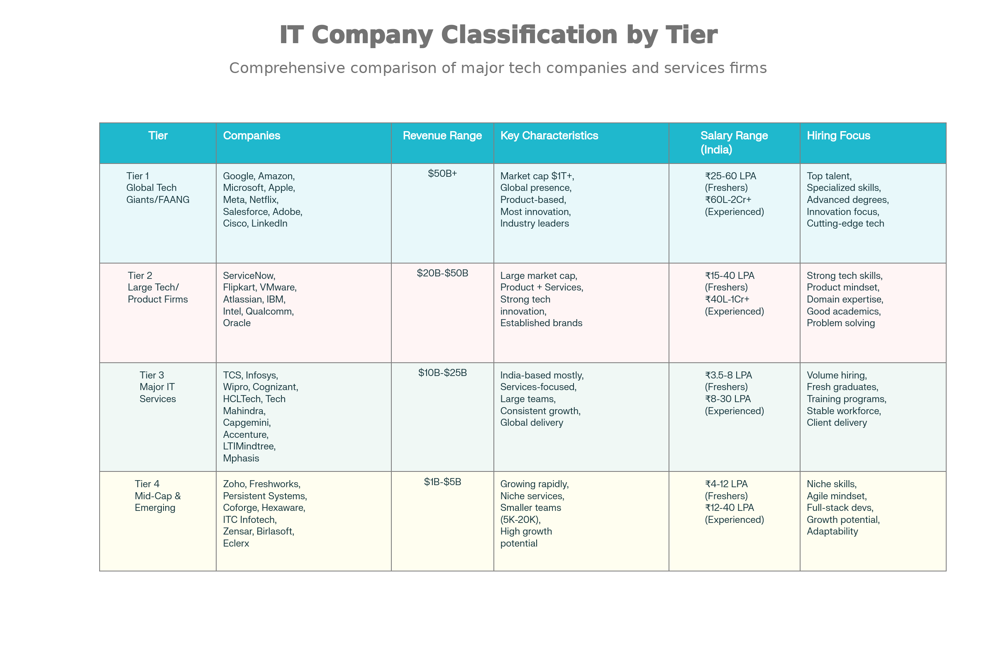

Slide 29
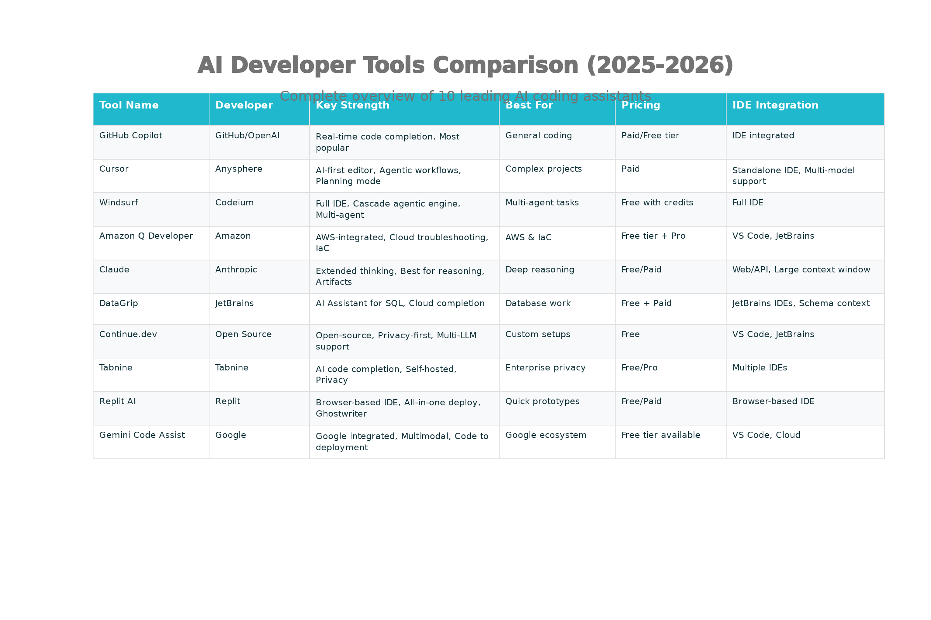

Slide 30

THANKYOU

